Slide 1


CONDUCTING A MORE
EFFICIENT MEETING

Slide 2
MODULE OVERVIEW
You will learn effective meeting preparation
You will be able to write INFORMATION-FULL agendas
You will understand the basics of parliamentary procedures
You will learn to manage meeting time effectively

Slide 3
MEETING PREPARATION
Continuous Cycle
  Preparation
  Conducting a meeting
  Follow-up to meeting

Slide 4
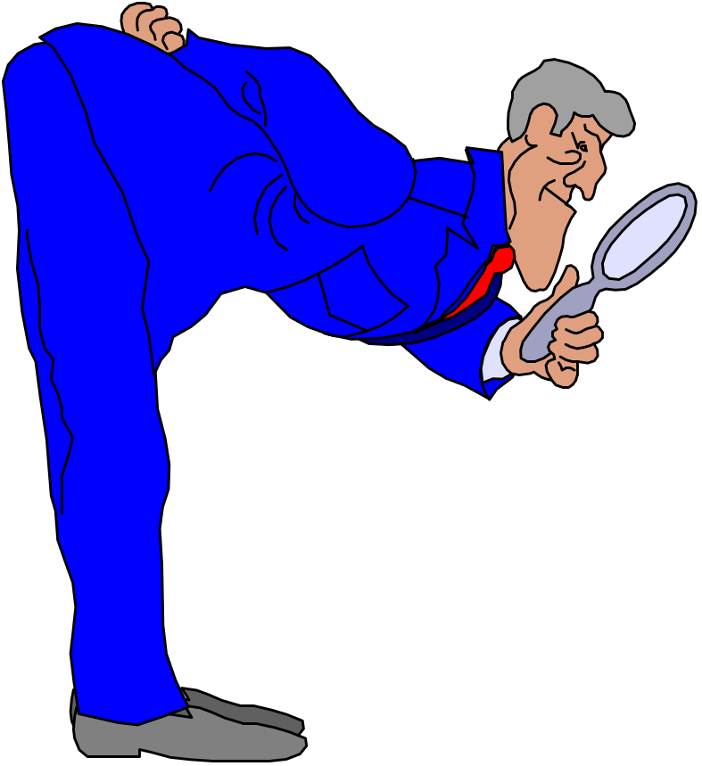
INFORMATION GATHERING
Collect ballot results
Review correspondence
Review minutes and action items from previous meeting
Contact TG chairman
Review jurisdiction list
Contact staff manager
Prepare agenda

Slide 5
WHY IS AN AGENDA IMPORTANT??
Prepares chairman
Prepares attendees
Creates an interest
Clearly defines objectives
Provides a valuable organizational tool

Slide 6

INFORMATION AGENDA INCLUDES:
Meeting date, time, location
General information
Agenda/minutes approvals
Agenda items with background/goals
Old/New Business
Summary/ Assignments

Slide 7
DISTRIBUTION OF AGENDAS
Provide electronic copy to staff manager
    manager will post to members only section of home page
    ensure copies are available at the meeting

Slide 8
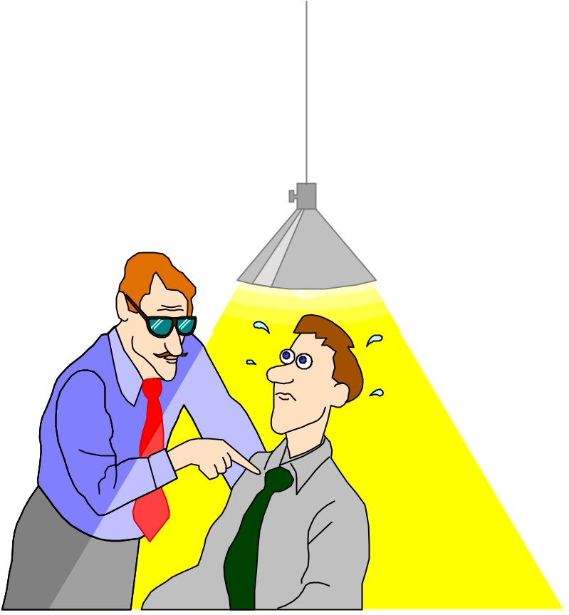
COVERAGE OF MEETING
IF YOU CANNOT ATTEND, FIND A REPLACEMENT
BRIEF YOUR REPLACEMENT ON THE AGENDA

Slide 9
AT THE MEETING
Is the room set properly
Audio visual
Number of seats

Slide 10
CONDUCTING A MEETING
START ON TIME!!
Delegate the task of taking minutes if you haven’t a subcommittee secretary
Review the agenda/obtain agreement on the meetings objectives and goals
Revise agenda if necessary

Slide 11
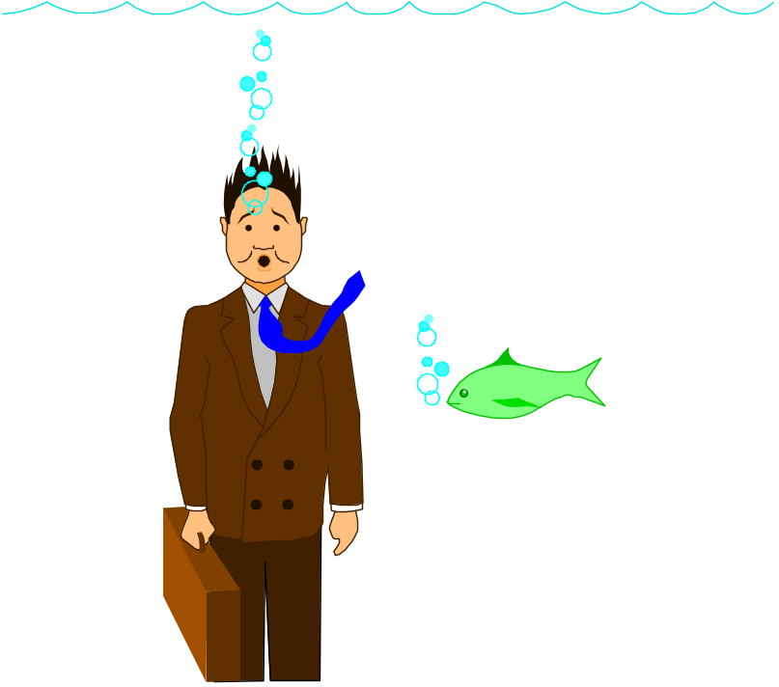
ROLE OF THE CHAIRMAN
Recognize attendees who wish to speak
Remain neutral
Summarize discussion and future action
Maintain order

Slide 12
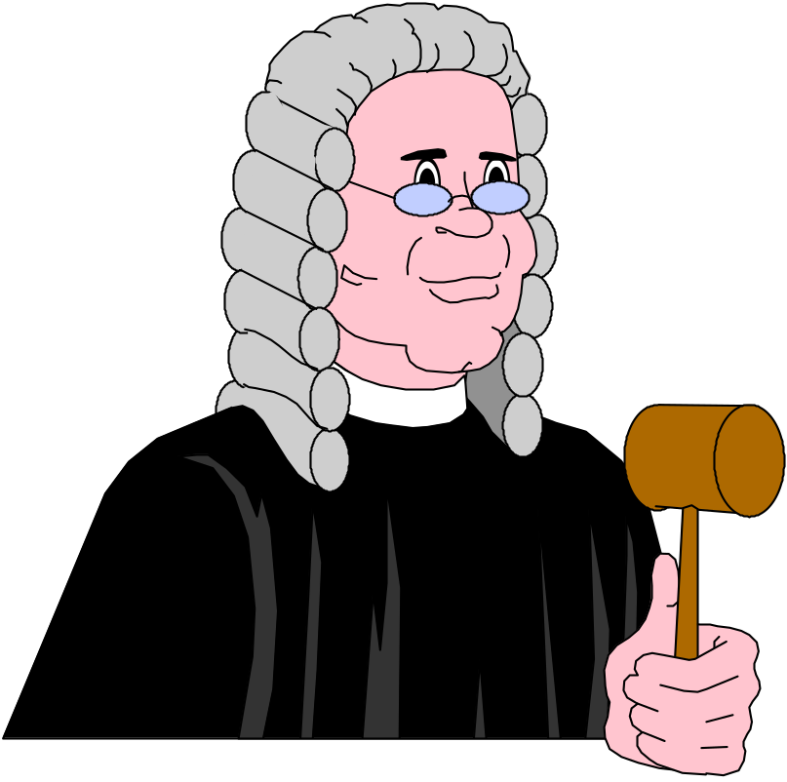
PARLIAMENTARY PROCEDURE
Majority rule must prevail
Rights of members w/minority opinion are protected
Respect for all members assured
Logical order of business provided

Slide 13
Robert’s Rules are used when…
Seeking resolution to a controversial issue (e.g. handling a negative vote)
Requires a formal vote count (e.g. voting on a not persuasive negative)
Business must be conducted in a formal and efficient manner (e.g. main and subcommittee meetings)

Slide 14
Do not use Robert’s Rules when…
The purpose of the meeting is to develop creative solutions or to hold a brainstorming session
The issues being discussed are not contentious (e.g. future meeting locations)

Slide 15
WHY DO WE RUN OUT OF TIME??
Repetition
Wander from the agenda
Lengthy discussion of controversial issues

Slide 16
MEETING TECHNIQUES
Focus attention on the agenda
Set time limits
Identify different opinions
Establish task groups/chairmen as needed

Slide 17

CLOSING A MEETING
State conclusions reached
Summarize assignments
Give staff manager next meeting requirements

Slide 18
AFTER THE MEETING
Prepare minutes as soon as possible after the meeting
    actions and discussions that took place are fresh in the writer’s mind
    committee members may rely on receipt of minutes before they implement promised actions
Send electronic version of minutes to the staff manager

Slide 19
PREPARING MINUTES
Follow the format of the meeting agenda and include:
    the committee number and title, date/location of meeting, and time called to order
    an accurate summary of the decisions and conclusions reached
    the assignments that were made
    the follow-up action required
    time of adjournment and notice of the next meeting date, time and location

