Slide 1
Introduction to Computers

Slide 2
Are Computers Important?
OF COURSE!

Slide 3
So What is a Computer?
A computer is an electronic device, operating under the control of instructions stored in its memory
Collect Data (Input)
Processing
Produces Information (Output)

Slide 4
What is a Computer?
Can be programmed
Carries out a set of arithmetic or logical operators
Typically made up of a processing unit and some form of memory

Slide 5
How Many Computers Did You Use Today?
Classroom computer
Projector has computers in it
Cars have dozens of computers
Elevators
Cash Registers
…

Slide 6
History
1801 - Jacquard Loom
1830 – Charles Babbage
George Stibitz - father of the modern digital computer.
1937, Stibitz invented and built a relay-based calculator using binary circuits
1936, Alan Turing regarded as father of computer science

Slide 7
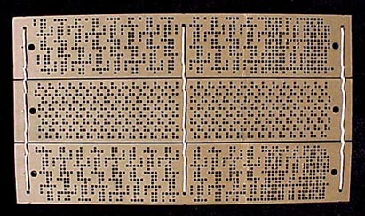
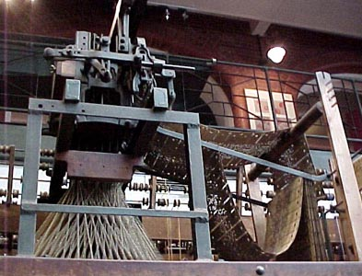
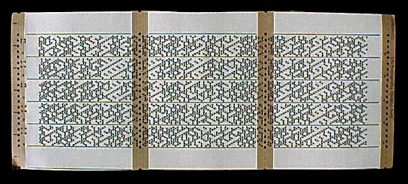
History
1801 - Jacquard Loom

Slide 8
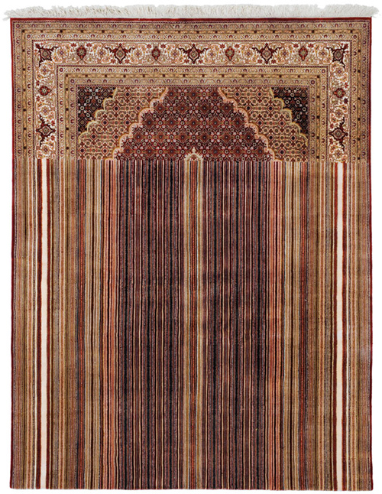
History

Slide 9
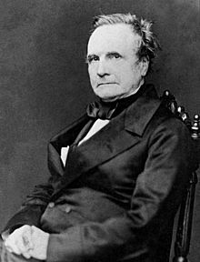
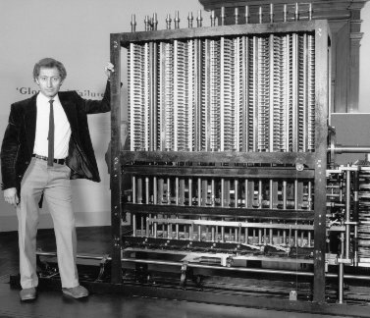
History
1830 - Charles Babbage’s Analytical Machine
Notes:
“While Babbage's machines were mechanical and unwieldy, their basic architecture was similar to a modern computer. The data and program memory were separated, operation was instruction-based, the control unit could make conditional jumps, and the machine had a separate I/O unit.[142]” Wikipedia
Machines not built in his lifetime

Slide 10
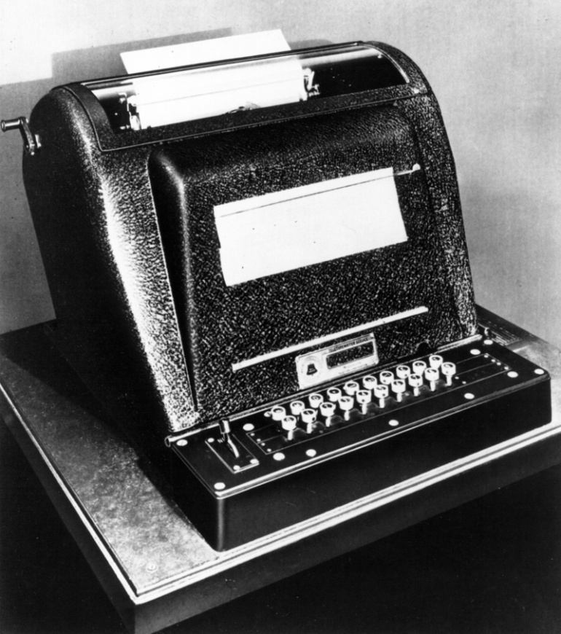
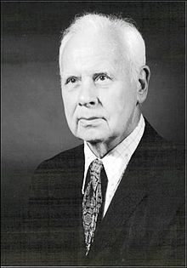
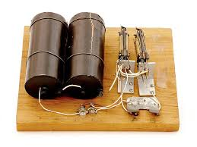
History
1937 – George Stibitz – Father of the Modern Digital Computer
Notes:
"He was a Bell Labs researcher known for his work in the 1930s and 1940s on the realization of Boolean logic digital circuits using electromechanical relays as the switching element." Wikipedia

Slide 11
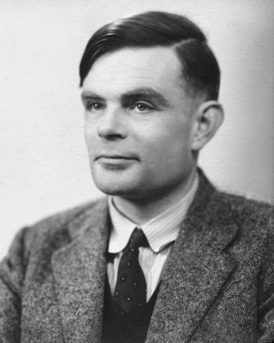
History
Alan Turing – Father of Computer Science
Turing Machine
Notes:
"He was highly influential in the development of computer science, providing a formalisation of the concepts of "algorithm" and "computation" with the Turing machine, which can be considered a model of a general purpose computer.[3][4][5] Turing is widely considered to be the father of theoretical computer science and artificial intelligence.[6]" Wikipedia
"The Imitation Game is a 2014 historical thriller film about British mathematician, logician, cryptanalyst and pioneering computer scientist Alan Turing who was a key figure in cracking Nazi Germany's naval Enigma code which helped the Allies win the Second World War..." Wikipedia

Slide 12
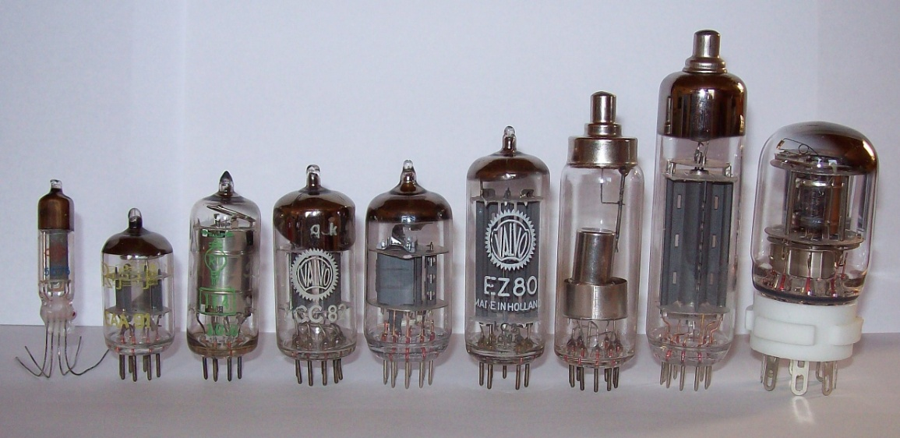
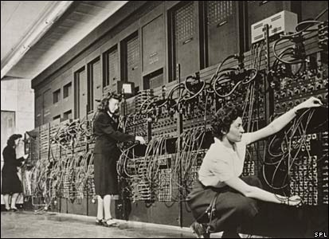
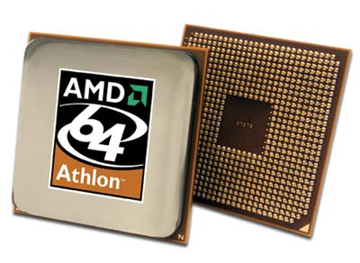
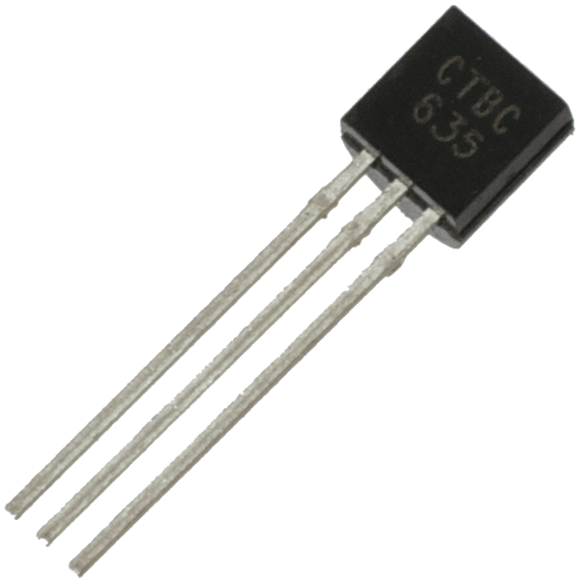
History Continued
Punch Cards
Vacuum Tubes
Transistors
Integrated Circuit Microprocessor

Slide 13
The Components of a Computer
Input – Allows users to enter data or instructions into a computer
Output – Hardware that conveys information
System Unit – Case that contains the electronic components
Storage Device – Device that holds data, information, and instructions
Communication Device – Enables a computer to send and receive data, instructions, and information to and from one or more computers or mobile devices

Slide 14
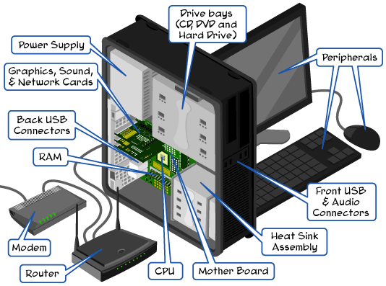
Components of a Computer

Slide 15
Hardware and Software
Hardware: electric, electronic, and mechanical components
Software: also called a program, tells the computer what tasks to perform and how to perform them

Slide 16
Types of Computers
Personal Computers
Mobile Computers and Mobile Devices
Game Consoles
Servers
Mainframes
Supercomputers
Embedded Computers

Slide 17
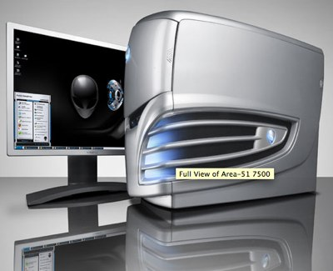
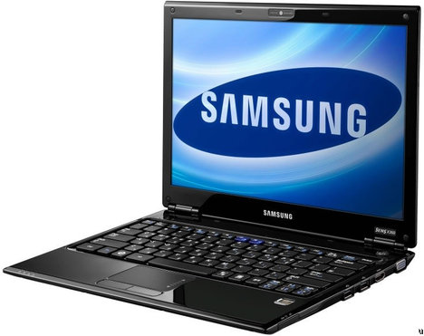
Personal Computer

Slide 18
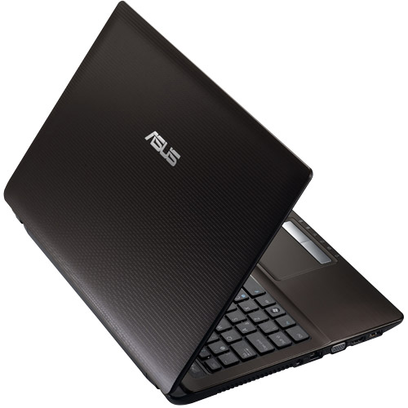
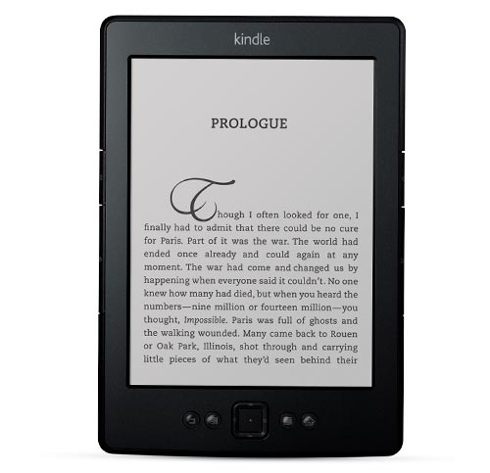
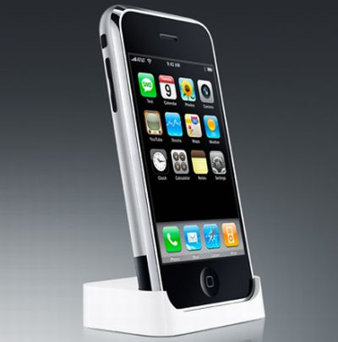
Mobile Computers and Mobile Devices

Slide 19
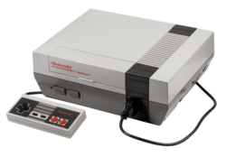
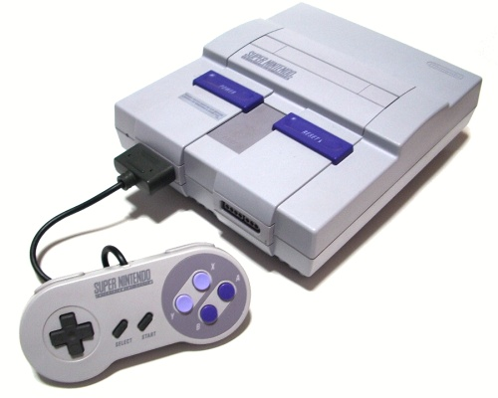
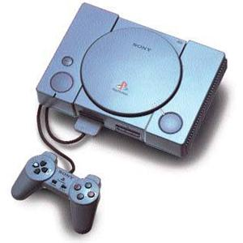
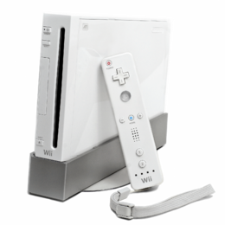
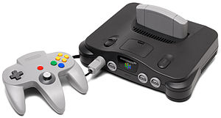
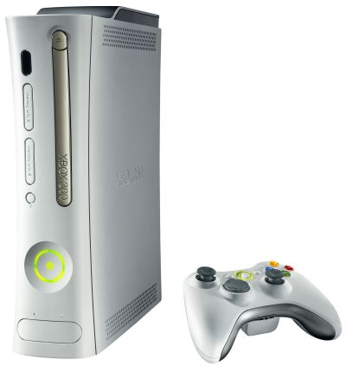
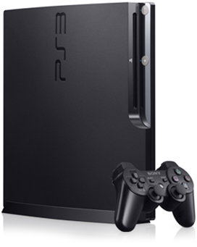
Game Consoles

Slide 20
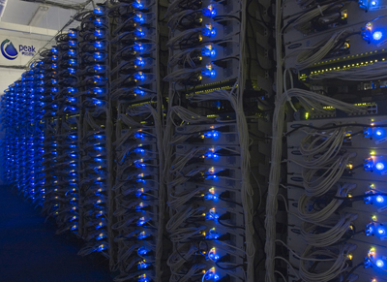
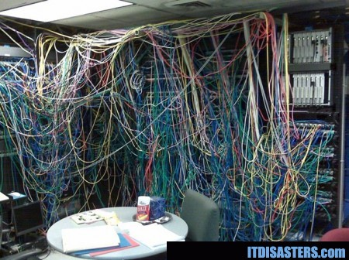
Servers

Slide 21
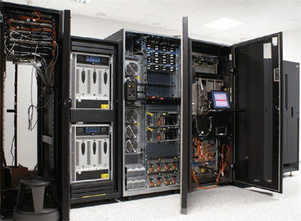
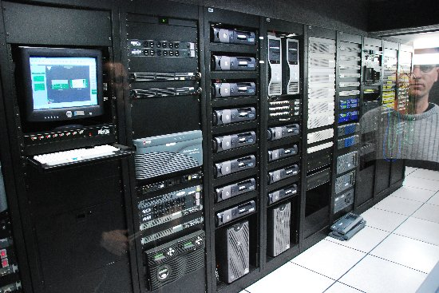
Mainframe

Slide 22
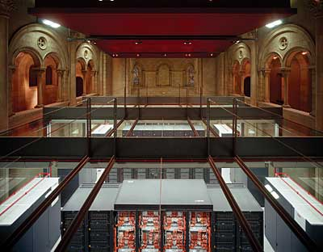
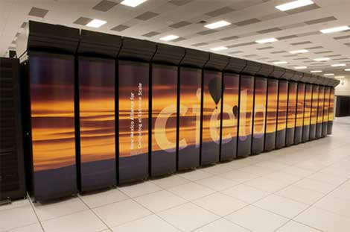
Supercomputers

Slide 23
Embedded Computers
A special purpose computer that functions as a component of a larger product
Calculators
ATM’s
Thermostats
Cameras
Printers
Etc.

Slide 24
Topics We’ll Get To
Internet, World Wide Web
Input Devices
Output Devices
Computer Hardware
Computer Software
Storage
Operating Systems
Special Topics – Piracy, Censorship, Privacy, Viruses, etc.

