Slide 1
Database Concepts
CSCI1150 - Project Update

Slide 2
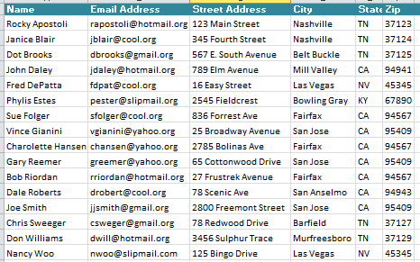
Definitions
Database is a group of related objects
Objects can be Tables, Forms, Queries or Reports
All data reside in Tables
A Row in a Table is a record which is a group of related fields also known as Attributes
A Column in a Table is the intersection of all the same fields in a Table

Slide 3
Definitions
Fields have data types – text, integer, currency, yes/no, date/time, double
Each Database Table has a Primary Key that can uniquely identify each of the Records in the Table
Tables within a Database should be logically related
The Relationship is via a Key pair
In the referencing table it is termed the Foreign Key
In the referenced table is a Primary Key

Slide 4
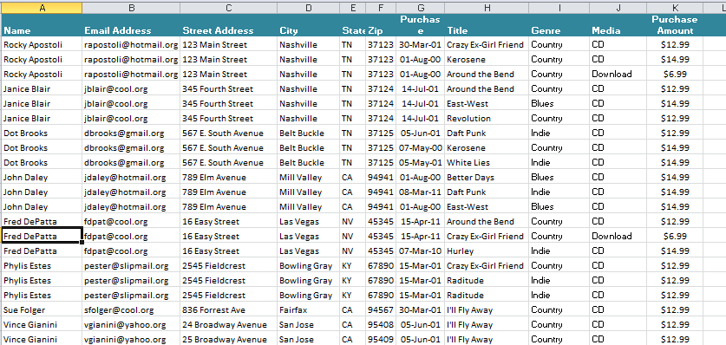
Spreadsheet Data Representation
Rows = Records
Columns = Fields
Limitations?

Slide 5
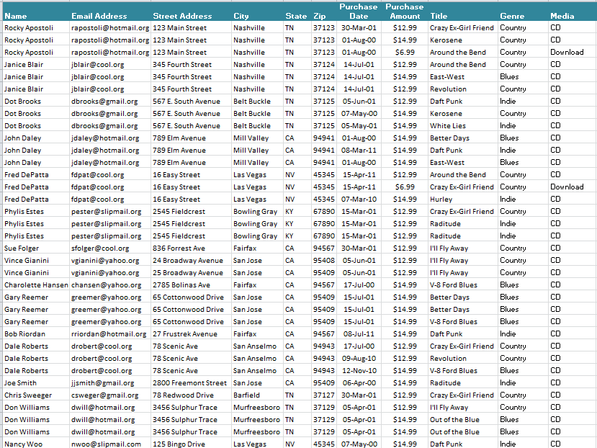
Looking at the Data
What are the major Entities (Nouns) represented in this data?

Slide 6
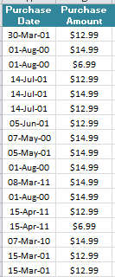
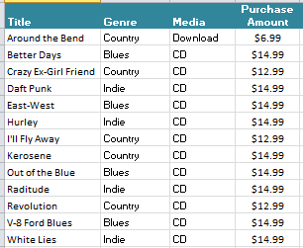
Entities
CUSTOMERS
PURCHASE ITEMS
RECORDINGS

Slide 7
Entity Relationships
CUSTOMERS
PURCHASE ITEMS
1 to 1
RECORDINGS
RELATIONSHIPS
1 to many
1 to 1
1 to many

Slide 8
Keys
Primary Key
Must be unique
Existing or new field if needed
Single or concatenated fields
Foreign Key
Used to link/related Tables
CUSTOMERS
PURCHASE ITEMS
RECORDINGS
Ideas for these tables?

Slide 9
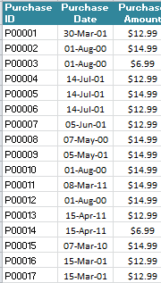
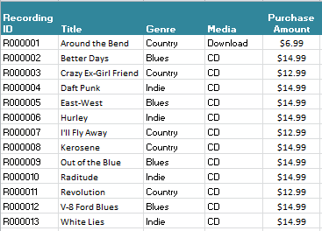
Primary Keys
CUSTOMERS
PURCHASE ITEMS
Why not Recording Title?
RECORDINGS

Slide 10

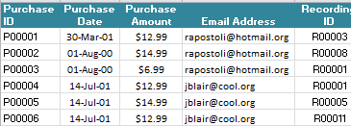
Foreign Keys
CUSTOMERS
PURCHASE ITEMS
RECORDINGS

Slide 11
Basic DB Design – Keys and Relationships
Table Name = Customers
Primary Key = Email Address
1 to 1
1 to many
Table Name = Purchase Items
Primary Key = Purchase ID
Foreign Key = Customer: Email Address
Foreign = Recordings: Record ID
1 to 1
Table Name = Recordings
Primary Key = Recording ID
1 to many

Slide 12
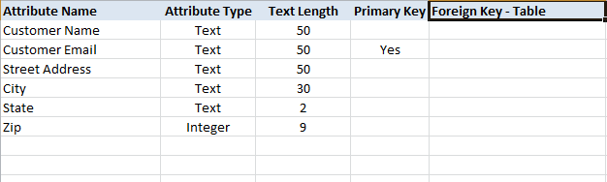
Table Attributes
Example for Customer Table

