Slide 1
Cascading Style Sheets

Slide 2
Cascading Style Sheets (CSS) Introduction
CSS Objectives
Provide more control over web site content presentation and formatting
Facilitate cross web page consistency
Reduce the amount of coding within a web page to accomplish the desired results
CSS style sheets can be embedded in web page source files or as separate documents
If embedded the CSS definition would be done above the <body> tag
They can facilitate consistent formatting throughout a web site
The CSS statements differ from HTML statements
CSS Properties perform roughly the same function as some HTML tag attributes
There are more many more Properties
A set of Properties can be applied against more than one element in a single CSS statement
CSS is obsoleting HTML in web page source coding (deprecating)
An excellent source for CSS properties is:
http://www.w3schools.com/cssref/default.asp

Slide 3
CSS Basic Examples

Slide 4


Cascading Style Sheets (CSS) Introduction
Font Property Example – Change the default format for h1 header element
Without CSS
<html>
<head>
<title> CSS Rules</title>
</head>
<body>
<h1> Nice Header?</h1>
</body>
</html>
With CSS
<html>
<head>
<title> CSS Rules</title>
</head>
<style type=text/css>
h1 {
color: white;
background-color: blue;
font-size: 120%;
}
</style>
<body>
<h1> Nice Header?</h1>
</body>
</html>

Slide 5
Properties Apply Against Content Type
Examples of the Content Types
Border
Background
Font
List
Marquee
Padding
Table

Slide 6
Font Properties
Font Properties include:
font | Sets all the font properties in one declaration
font-family | Specifies the font family for text (e.g. comic-sans)
font-size | Specifies the font size of text (e.g. %, pixels, named (e.g. small))
font-style | Specifies the font style for text
font-variant | Specifies whether or not a text should be displayed in a small-caps font
font-weight | Specifies the weight of a font (e.g. lighter, bold, bolder)

Slide 7
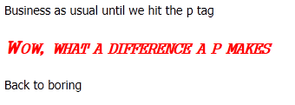
Font Property Example
<html>
<head>
<title> your name </title>
</head>
<style type=text/css>
P {
font-family: gungsuh;
font-style: italic;
font-variant: small-caps;
font-weight: bold;
font-size: 150%;
color: red;
}
</style>
<body>
Business as usual until we hit the p-tag
<p>Wow, what a difference a p-tag makes </p>
Back to boring
</body>
</html>

Slide 8
Font Properties
Font Properties include:
color | Sets the color of text
direction | Specifies the text direction/writing direction
letter-spacing | Increases or decreases the space between characters in a text
line-height | Sets the line height
text-align | Specifies the horizontal alignment of text
text-decoration | Specifies the decoration added to text
text-indent | Specifies the indentation of the first line in a text-block
text-transform | Controls the capitalization of text
vertical-align | Sets the vertical alignment of an element
white-space | Specifies how white-space inside an element is handled
word-spacing | Increases or decreases the space between words in a text

Slide 9
Table Properties
Table Properties include:
border-collapse | Specifies whether or not table borders should be collapsed
border-spacing | Specifies the distance between the borders of adjacent cells
caption-side | Specifies the placement of a table caption
empty-cells | Specifies whether or not to display borders and background on empty cells in a table

Slide 10


Table Example
CSS
<html>
<head>
<title> huh </title>
</head>
<style type=text/css>
table { border-collapse: collapse; }
table, td, th { border:1px solid blue;}
th { background-color: blue; color: white; }
td { padding: 10px 20px 10px 20px;}
</style>
<body>
<table>
<tr>
<th>Name</th>
<th>Address</th>
</tr>
<tr>
<td>Lightning T. Mascot</td>
<td>E.Main St, M'boro TN</td>
</tr>
</body>
</html>
Without CSS
<html>
<head>
<title>Huh</title>
</head>
<body>
<table border="2px">
<tr>
<th>Name</th>
<th>Address</th>
</tr>
<tr>
<td>Lightning T. Mascot</td>
<td>E.Main St, M'boro TN</td>
</tr>
</body>
</html>

Slide 11
Next Step for CSS Knowledge

Slide 12

Classes
Classes provide a shorthand method of formatting
They are defined in the style section (internal or external)
When defining names they are prefaced by a period symbol
When applied the period is not added to the name
Definition
<style>
.blueit {
color: blue;
font-size: 150%;
font-style: italic;
font-weight: bold;
font-variant: small-caps;
}
</style>
Use in Body
<p> Hello </p>
<p class = “blueit”> I’m so blue </p>

Slide 13

Span Element
Span allows for limiting the scope of a format change
Best applied for non-trivial changes
Span can be used with or without a Class
Class allows for multiple Span selections
<html>
<title> huh </title>
<style type=text/css>
span {
color: blue; font-size: 150%;
font-style: italic; font-weight: bold;
font-variant: small-caps;
}
</style>
<body>
<table>
<p> I'm <span>so </span> blue</p>
</body>
</html>
<html>
<title> huh </title>
<style type=text/css>
.blueit {color: blue;}
.redit {color: red;}
</style>
<body>
<p> I'm <span class=redit> so </span> <span class=blueit> blue </span> </p>
</body>
</html>

Slide 14
Div Element
Div element enables different formatting of logical sections of a page , e.g:
Banners
Navigation tabs
Page footer
Special formatting such as indenting content
Div elements can be nested
The Div element is an XHMTL construct that works within the CSS environment
Multiple Div elements can be defined within a page or style sheet, distinguished via unique names
Div element names must contain “#” (hash) sign, e.g.:
col#tabs
#floatleft

Slide 15
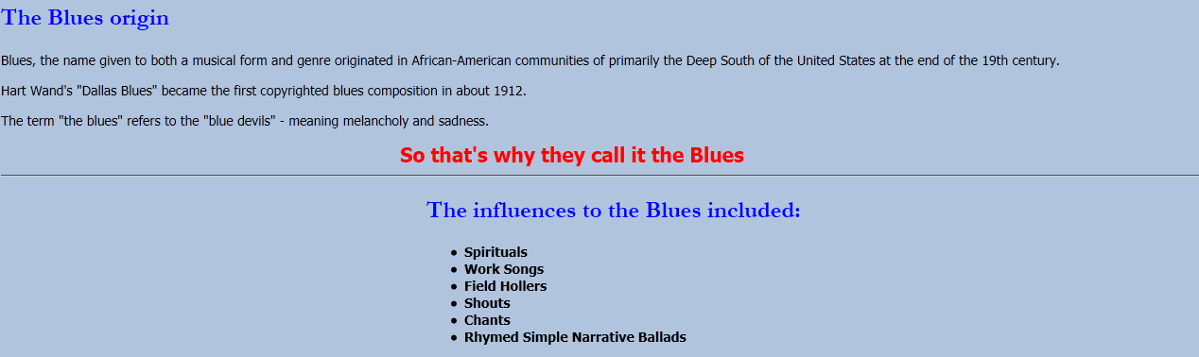
Div Element Example
Use in Body
<div id=offset450>
<h2>The influences to the Blues included
</h2>
<ul>
<li>Spirituals</li>
<li>Work Songs</li>
<li>Field Hollers</li>
<li>Shouts</li>
<li>Chants</li>
<li>Rhymed Simple Narrative Ballads</li>
</ul>
Definition
<style>
#offset500 {
position: relative;
left: 500;
}
</style>
Results

