Slide 1
Web Site Development Overview

Slide 2
Introduction
The basic components of a web site are:
Content – information displayed or accepted from users
Static – content that doesn’t change for different user interactions
Dynamic – content that varies based on the user, user input, etc.
Instructions
Formatting – how the content is to be displayed
Navigation – path between web pages
Other Actions – Pop-up windows, field input and validation
Building a web site consists of creating the Content and Instructions

Slide 3
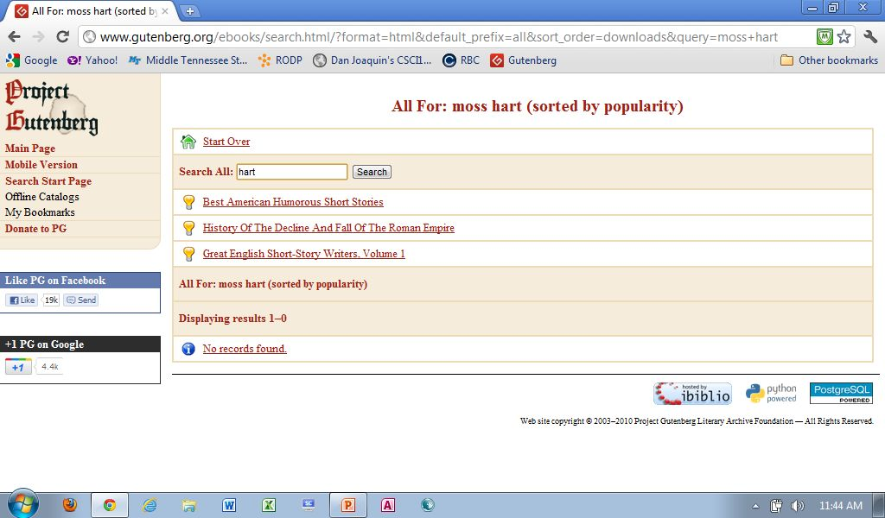
Web Page Example
URL with path to specific page
Input, Javascript
Static
Content
Dynamic
Content

Slide 4
Key Technologies

Slide 5
Hypertext
Text that using links enables non-sequential access within and between documents and web sites
Origin
1945 - Vannar Bush - a system for linking microfilm machines
1965 - Ted Nelson - coined the terms hypertext and hypermedia
1977 - First hypermedia use was a tour of Aspen
1983 – Hypermedia development tool for Apple II
1987 – Apple release Hypercards for the Macintosh

Slide 6
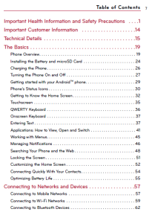
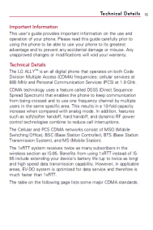

Links Can Be Followed Ad Hoc
Web Site A
Within a page
Between pages
Between web sites
Web Site B

Slide 7
Markup Language
Programming Language - set of rules that direct the actions of a computer
Markup Language - programming language for formatting “documents” where a document can be any stored file, not just text
Formatting is defined in the document with a series of tags
1960s – IBM defined:
Standardized General Markup Language (SGML)
Formatting of documents to be printed
Many of the earliest tags still in use in Markup Languages today

Slide 8
Hypertext Markup Language (HTML)
The combination of Hypertext and Markup Languages
Origination credited to physicist Tim Berners-Lee
Working at CERN (European Organization for Nuclear Research)
Looking for method for scientists to share information between networked computers
First used in December 1990
Using document elements (tags) to link (jump to) related documents within and between computers
Language that can be used to develop a web site

Slide 9
Browser
Program that interprets and acts on the contents of documents encoded with HTML or other language with a similar intent
1992 University of Kansas
Lynx browser
Used for student campus information – text only
1993 University of Illinois
First browser to support both text and graphics information
Mosaic browser whose co-author was Marc Andreesen
1995 Netscape IPO
Founding members were Jim Clark and Marc Andreesen
Primary products the Netscape browser and web server (based on Mosaic)
1995 Internet Explorer 1.0
Initial browser from Microsoft who licensed the software from Spyglass
1996 Internet Explorer 3.0
Equivalent Netscape functionality bundled with Windows 95

Slide 10

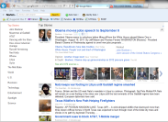
Browser and Web Server
Web Server
Computer that holds Web Pages and processes Browser requests
Web Browser
Program that requests and interprets web pages encoded with HTML, etc.
Web Pages
Web site content

Slide 11
HTML
HTML- instructions embedded in a document (web page) that informs a browser how to treat the documents contents
The instructions are expressed as tags with attributes further defining the tag’s actions
HTML tags are:
Delimited by greater and less than symbols < and >
e.g. <b> indicates the text that follows is to be bolded
May require an opening and closing tags </tag> to stop the action
e.g. <b>This text will be in bold</b>
Attributes further qualify tags
<font color=“blue”, size=“5”>
This tag indicates the format of the text that follows
The color of the text will be blue and size 5 (where 3 is the default size)

Slide 12
HTML Tag Rules
When using HTML tags
Whitespace (blanks, new lines) are generally ignored
Attribute values are enclosed in single or double quotes
Beware: HTML does no checking for syntax errors – it interprets what it can and ignores the rest. You will need to be the error checker for yourself.

Slide 13
HTML Example - Code
<html>
<head>
<title>CSCI1150</title>
</head>
<body bgcolor="lightgreen">
<h1>CSCI1150 Introduction to Computers</h1>
<font color="darkgreen"><h2>Objective</h2></font>
Acquaint student with basic principles and
technologies of computer systems.
<font color="darkgreen"><h2>Methods</h2></font>
This course uses a combination of:
<ul>
<li>Lectures and Guided Tours</li>
<li>Labs and Other Assignments</li>
<li>Exams</li>
</ul>
</body>
</html>
Notes:
webDevelopment/example.html

Slide 14
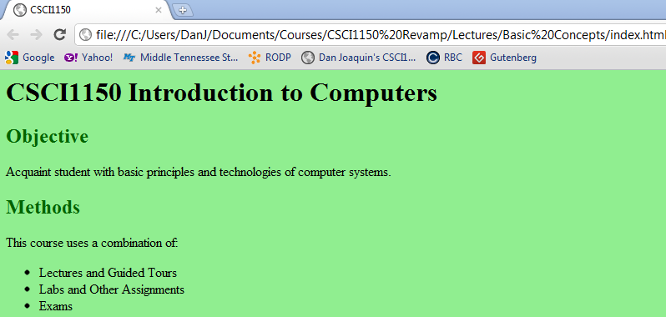
HTML Example – Results

Slide 15
Cascading Style Sheets - CSS
A Style Language, like HTML, that describes the appearance of documents
Provides the same types of formatting capabilities as HTML, and much more
CSS:
Allows for better separation of document content and formatting information
Can be stored separately from the document’s contents
Can specify different formatting information for different presentation modes (e.g. viewing versus printing)
Allows content developers to focus on content
Facilitate sharing of formatting instructions across documents
For the most part, CSS is replacing the use of HTML for formatting content

Slide 16
JavaScript
Provides interactive features to browsers
Forms controls such as field validation
Mouse-rollover that causes a field displayed to change
Popping a new window
JavaScript programs run in the browser (on your Mac/PC)
Supported by “all” browsers
Disadvantages
Users can disable
Common carrier for malware

Slide 17

Planning for a Web Site
What Do You Think Makes a Good Web Site?

Slide 18
Planning for a Web Site
Some considerations:
Be clear on the audience, purpose and requirements
Plan your sites look and feel
Be consistent
Be clear
Use of fonts, color, graphics, sounds and video
Set and test page loading speed for acceptability
Plan the structure and hierarchy of your pages
Within a page
Between pages
Plan your navigation
Within a page
Between pages
Between your site and other sites
Create a mockup and check with users

Slide 19
Process for Developing a Web Site
Planning and design
Create the web pages using an editor or other authoring tool
Test the web pages
Publish the web pages by uploading the pages to the web server(s)

Slide 20
Basic Approach to Writing a Program
Document the problem to be solved
Sketch out how to solve the problem – Algorithm
Functions and flow
Web page and report design
Write the code with tool of choice
Hint: Do it incrementally
Thoroughly test
Test each function
Test the system end to end
If appropriate stress test
In Testing the goal is to break code rather than a user finding the errors

