Slide 1
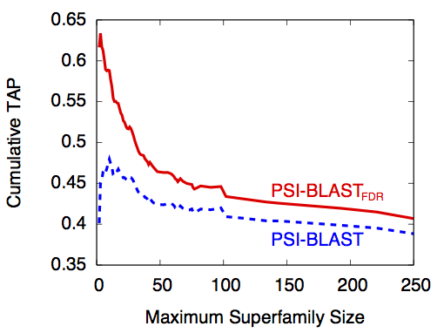
False Discovery Rates for
Iterative Database Searching
Alex C. Williams, Anthony G. Davis, Hyrum Carroll, PhD
Middle Tennessee State University, Department of Computer Science
Introduction
Methods
Conclusions
In Bioinformatics, the reliability of a similarity score between a genetic query sequence and a database sequence is represented by an Expectation value, or E-value. Modern homology search algorithms such as BLAST or HMMER, scrutinize the retrieval list with a uniform E-value threshold in order to determine truly significant results.
In iterative searching situations, this can be especially problematic because the likelihood of a truly insignificant result being reported as significant (false positive) increases with the number of performed hits.
While many different aspects of homology search algorithms have been rigorously studied, the inlcusion threshold has not received the same attention. In order to improve search sensitivity, we propose the use of the false discovery rate (FDR) as a method for controlling threshold criterion.
Development of PSI-BLAST_{FDR}
PSI-BLAST_{FDR} extends the PSI-BLAST algorithm by replacing the uniform E-value threshold criterion with a false discovery rate controlled threshold. It is based on version 2.2.27 of NCBI’s PSI-BLAST.
Controlling the False Discovery Rate
Several FDR methods exist and are widely used in many other fields. An exemplary FDR control method is the Benjamini-Hochberg method. This method calculates the threshold value for each sequence retrieved and considers the first k ranked sequences as significant that satisfy the following criterion: P_{k} ≤ kα/m, where P_{k} is the P-value of the k^{th} sequence and m is the size of the database searched. Because PSI-BLAST utilizes E-values, and given that E-value = P-value * m, we implemented the Benjamini-Hochberg method as: E_{k} ≤ kα with E_{k} being the E-value of the k^{th} sequence.
Using accepted evaluation procedures, PSI-BLAST_{FDR} had a TAP value 4.90% higher than PSI-BLAST on the ASTRAL40 test datasets. This difference is significant given the extremely wide use that PSI-BLAST enjoys. Furthermore, PSI-BLAST_{FDR} is particularly appropriate for queries with small superfamily sizes as evidenced by it obtaining a TAP value 20.9% higher than PSI-BLAST. For queries in larger superfamilies, if the goal is to assign function to a query, then adequately identifying the superfamily is sufficient. For example, retrieving 50% of a large superfamily clearly indicates which superfamily the query belongs. This objective is not currently captured in retrieval evaluation metrics and may make evaluation values misleading for large superfamilies.
While we only addressed PSI-BLAST in this study, additional database search algorithms that use uniform thresholds, such as Jackhmmer (hmmer.janelia.org), could also benefit from the implementation of a FDR controlled threshold. Furthermore, employing more advanced false discovery rate methods, such as the Q-value method could also yield improvements.
Fig 1. The BLAST algorithm: Flowchart
Fig 2. The PSI-BLAST algorithm: Flowchart
Determining Retrieval Efficacy
We leveraged the query sequences in the ASTRAL40 database. ASTRAL40 is a subset of the Structural Classification of Proteins (SCOP) 1.75A database with sequences having less than 40% sequence identity to each other. We only considered the 10,323 queries that have at least one other superfamily member in the database. We sorted the queries by their names and assigned the 5,162 odd sequences to a training set and the 5,161 even sequences to a test set.
Results
Objectives
References
In this study, we utilize the TAP method as the evaluation criterion for retrieval efficacy. We evaluated four different FDR methods with five values of α on a subset of 103 random queries from the training database. Of these methods, PSI-BLAST_{FDR} with the Benjamini-Hochberg method received the best TAP value. On the full training database, we only evaluated α values for the Benjamini-Hochberg FDR method. Of these parameters, PSI-BLAST_{FDR} with α=0.05 received the best TAP of 0.423 while PSI-BLAST received 0.403. Consequently, we adopted this method and α level as the defaults for PSI-BLAST_{FDR}.
The purpose of this study was to effectively reduce the number irrelevant sequences yielded from the iterative search and retrieval process. Controlling the number of irrelevant sequences will yield more accurate results as to which sequences are truly homogenous to one another.
Altschul, S., Gertz, E., Agarwala, R., Scha ̈ffer, A., and Yu, Y. (2009). PSI-BLAST pseudocounts and the minimum description length principle. Nucleic Acids Research, 37(3), 815–824.
Altschul, S. F., Madden, T. L., Scha ̈ffer, A. A., Zhang, J., Zhang, Z., Miller, W., and Lipman, D. J. (1997). Gapped BLAST and PSI- BLAST: a new generation of protein database search programs. Nucleic Acids Research, 25(17), 3389–3402.
Benjamini, Y. and Hochberg, Y. (1995). Controlling the False Discovery Rate: a Practical and Powerful Approach to Multiple Testing. Journal of the Royal Statistical Society, Series B, 57, 289–300.
Carroll, H. D., Kann, M. G., Sheetlin, S. L., and Spouge, J. L. (2010). Threshold Average Precision (TAP-k): A Measure of Retrieval Efficacy Designed for Bioinformatics. Bioinformatics, 26(14), 1708–1713.
Chandonia, J., Hon, G., Walker, N., Lo Conte, L., Koehl, P., Levitt, M., and Brenner, S. (2004). The ASTRAL Compendium in 2004. Nucleic Acids Research, 32(Database Issue), D189–D192.
Gonzalez, M. and Pearson, W. (2010). Homologous over-extension: a challenge for iterative similarity searches. Nucleic acids research, 38(7), 2177–2189.
Fig 3. Cumulative PSI-BLAST_{FDR} TAP and PSI-BLAST TAP versus aggregate superfamily size for the test datasets in ASTRAL40.
Notes:
Specifically, there have been studies linking breast volume asymmetry to several breast cancer risk factors as well as suggesting that breast size asymmetry is larger in women diagnosed with breast cancer.

