Slide 1

ChronOS
An Educational Operating System written in Rust
Betty Liu year 3 project
> ChronOS_
Notes:
备注！

Slide 2
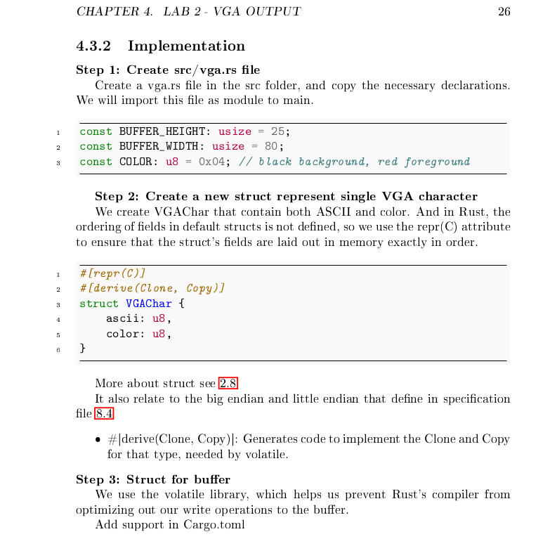
Overview
Teaching Operating System
OS concept
CS241 & CS257
And Rust!
Two parts
Lab sheet
Codes
> ChronOS_

Slide 3
Background Material
Why difference?
Previous projects
> ChronOS_

Slide 4
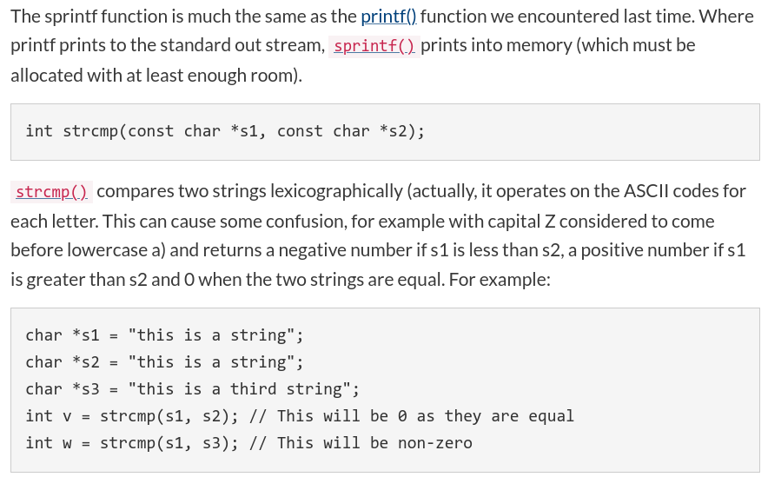
Current CS241 Labs
Primarily teach the C programming language
Not building a standalone OS kernel
Lacks depth in OS concepts
> ChronOS_

Slide 5
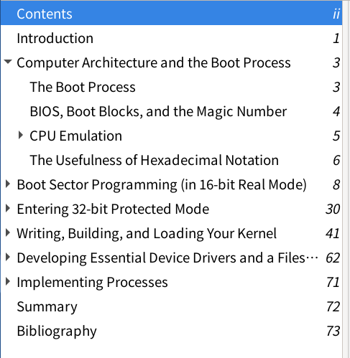
Birmingham OS Guide
Writing from scratch in C and some assembly
Lots of detail about low-level implementation
Uses too much assembly language
> ChronOS_

Slide 6
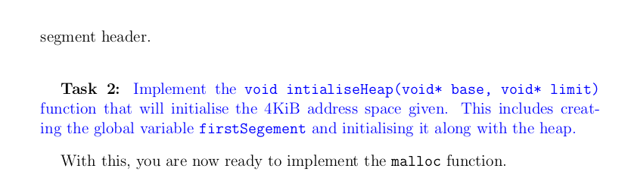
PunchOS
Warwick previous third year project done by Nicholas Walker
Implement function on skeleton
Also provide labs & codes and test
Using C
> ChronOS_

Slide 7
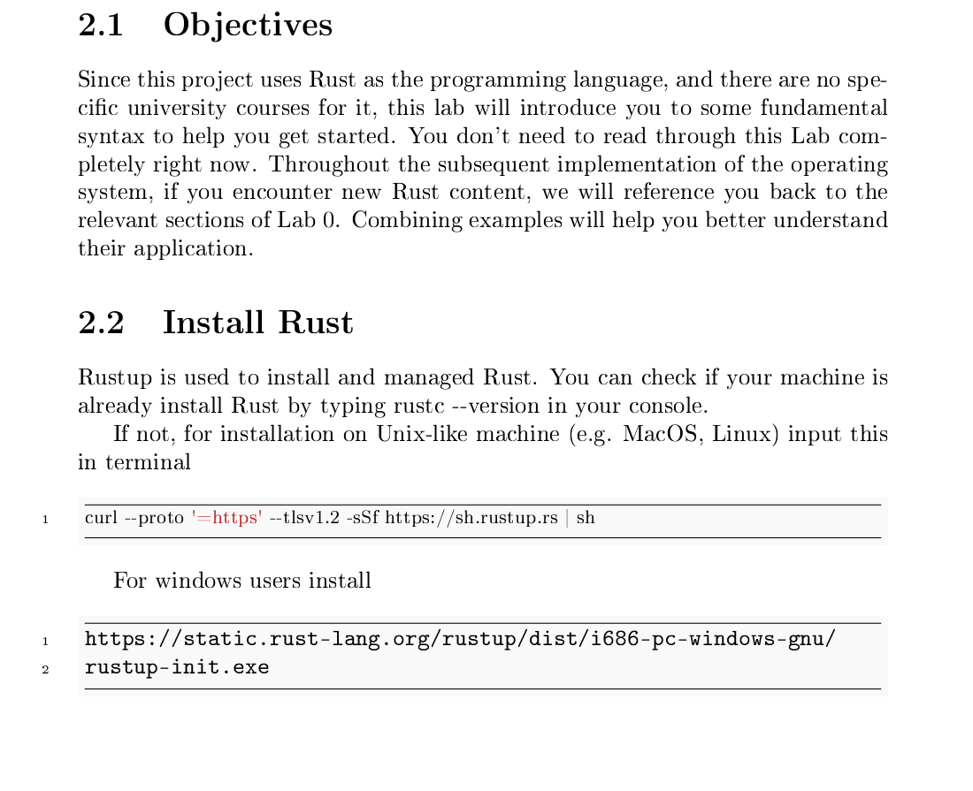
ChronOS
Using Rust instead of C, learning a new language
Avoiding assembly
Beginner friendly
Your OWN OS!
“Very beginner-friendly, with plenty of links back to previous concepts, and well-laid-out. ”
“The structure is good, concise, and easy to understand, even though I've never touched Rust in my life.”
> ChronOS_

Slide 8
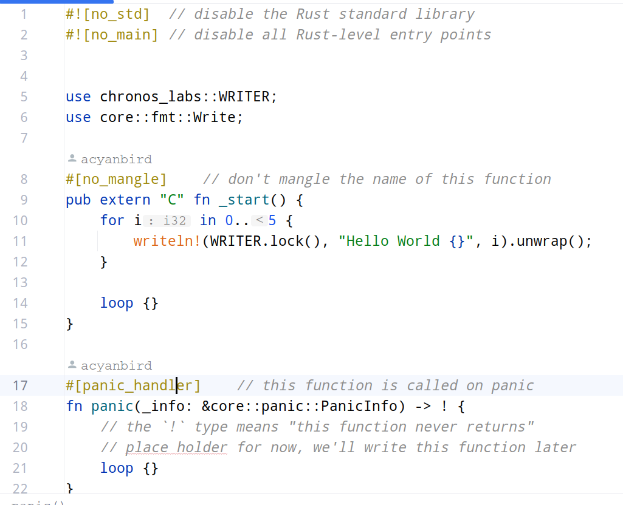
Tools used
IDE RustRover
Test and highlight
Git & GitHub
Keep branches and backup
> ChronOS_

Slide 9
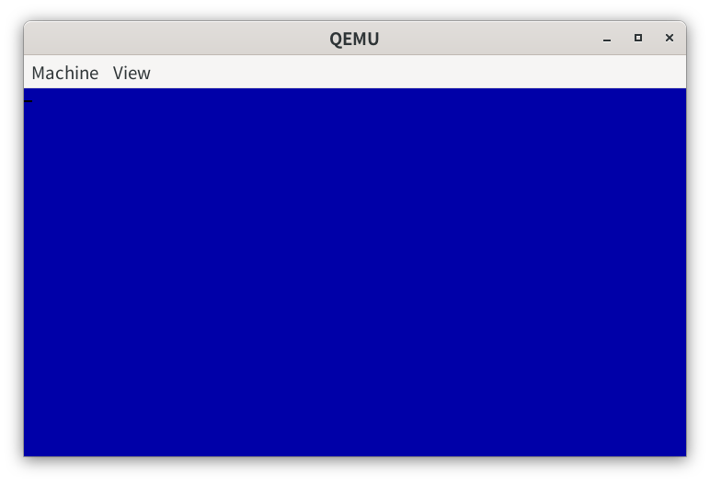
QEMU
Virtual machine monitor and emulator
OS testing that run simple kernel
> ChronOS_

Slide 10
Technical challenge
New language
Few support, base on C most
Gap between course and reality
Develop without standard library
Explain to beginner
> ChronOS_

Slide 11
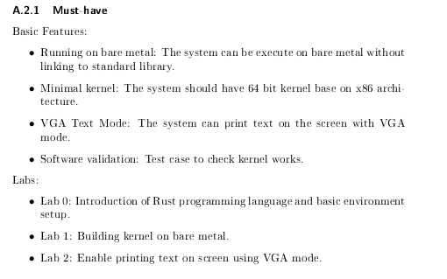
Overview of design
Lab sheets:
Lab 0: Rust learning
Lab 1 - Lab 4: Function implement
Codes:
Branches available for each tasks
Test cases
Cross over!
> ChronOS_

Slide 12
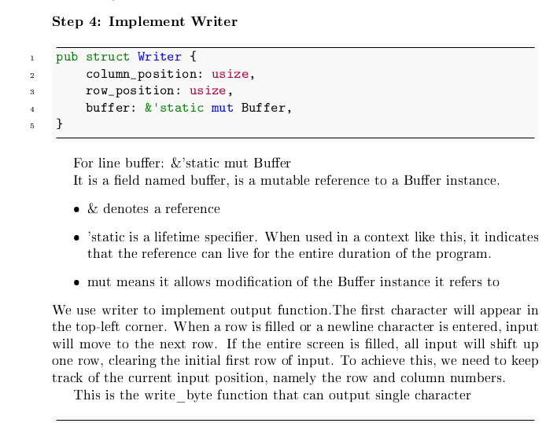
Lab sheet
Explain every steps in detailed
Rust introduction with every new things
Extra knowledge
“Good structure, concise easy to understand even though I've never touched Rust in my life”
“Provides step by step process with additional material and guides”
“Nice use of code snippets / color coding”
> ChronOS_

Slide 13
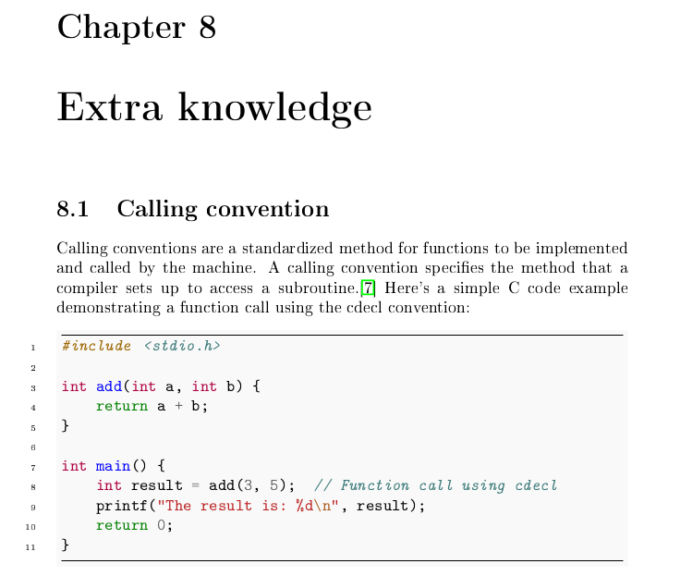
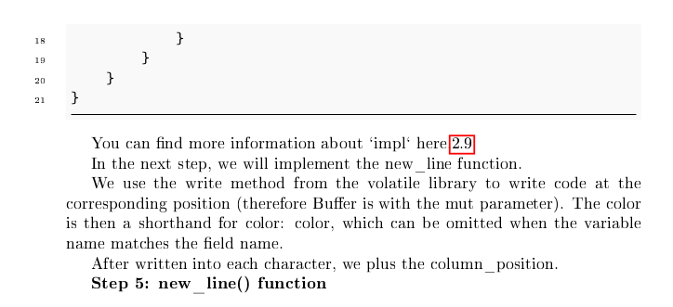
> ChronOS_

Slide 14
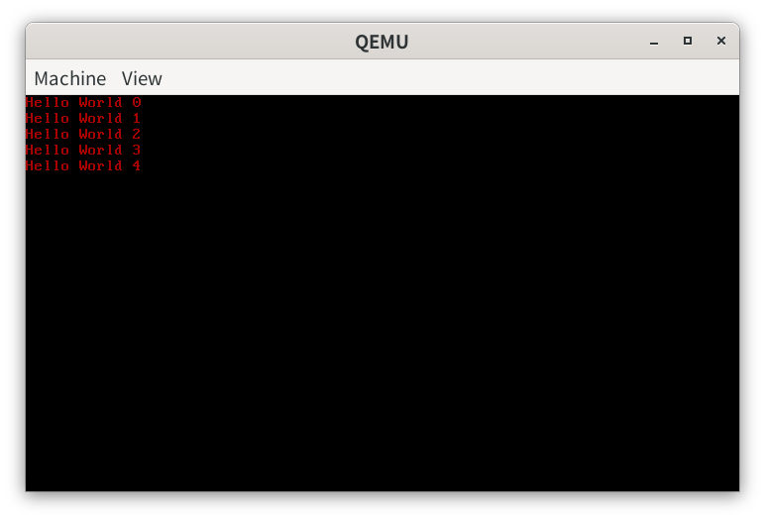
Codes
Codes available for each tasks
Can directly work base on previous task
Have a look of result
> ChronOS_

Slide 15
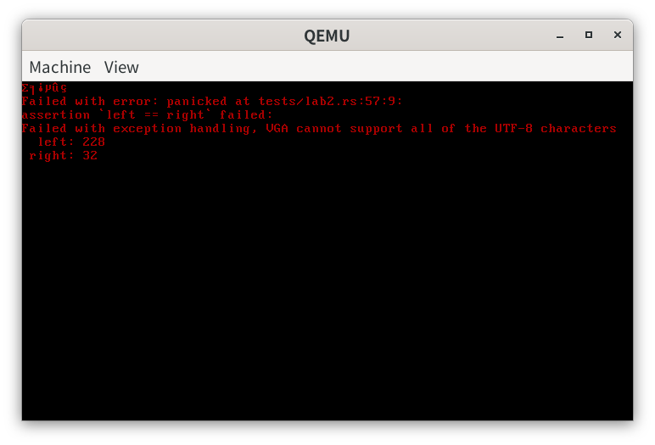
Codes - Testcase
“I really like the use of error messages for your projects”
> ChronOS_

Slide 16
Project Management
Incremental software development
Supervisor meeting every 2 weeks
Unforeseen problems:
Project progress fell short of expectations due to external factors
Underestimated workload from other courses and experienced failure in one
> ChronOS_

Slide 17
Future work
Keybroad input
Multi process
Video tutorial
> ChronOS_

Slide 18
DEMO
Setup from scratch - Set up environment & Go ahead for simple task
Live demo show result, and testing. Success or fail
> ChronOS_

Slide 19

> Thank you! Questions time_

