Slide 1
Tech Journal Club xCELLigence® Real-Time Cell Analyzers
04/01/20
Gabby Cole

Slide 2
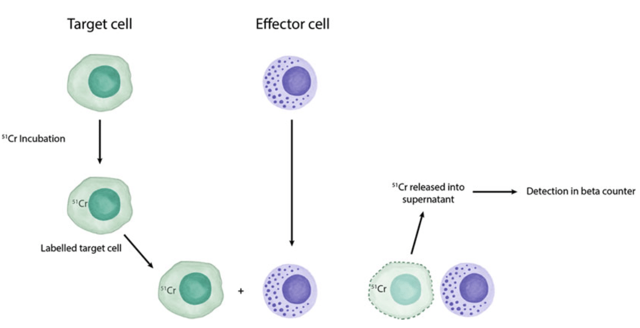
Issues with Golden standard: Chromium 51(Cr) release assay
Cytotoxicity of effectors against tumor cells
Suffers from problems with sensitivity
Unable to run flow on the cells or use the supernatant for cytokine analysis

Slide 3
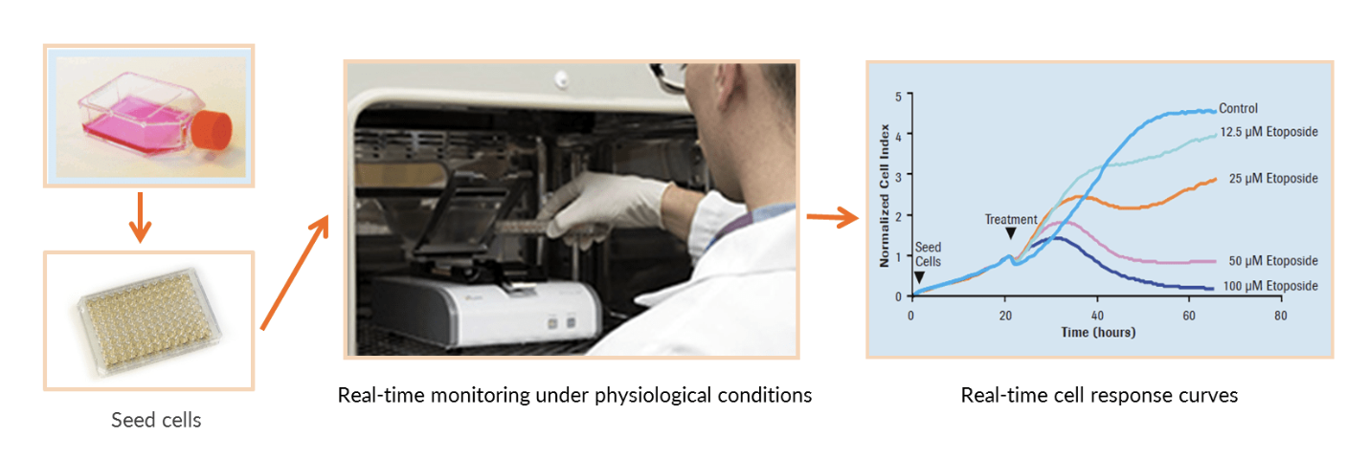
Monitored with the real-time cell analysis (RTCA; xCELLigence ACEA Biosciences
Simple Workflow and sensitivity of evaluating low E:T
Real-Time Quantitative monitoring of both minutes and days
Automatic Data Plotting by RTCA software enables facile data display and objective analysis

Slide 4
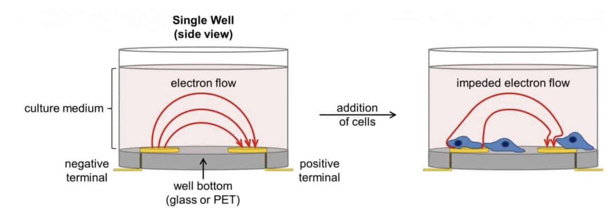
Unit of a cellular impedance assay is a set of gold microelectrodes
Presence of cells at the electrode-solution interface impedes electron flow
Extremely sensitive readout of cell number, cell size/morphology, and cell-substrate attachment quality

Slide 5
Suspension Tumor Line Tethering Approaches
Cancer Type | Validated Cell Line | Selective Tethering Mechanism | Verified Target Expression by Flow Cytometry
Acute Lymphoblastic Leukemia (ALL) | NALM6 | CD9 | CD3-, CD9+, CD19+, CD20-, CD22+, CD38+, CD138+, CD269+, HLA-DR+
 | RS4;11 | CD9 | CD3- , CD9+, CD14+, CD19+, CD20-, CD22+, CD38+, CD138+, CD269+, CD123+(low)
Chronic Myelogenous Leukemia (CML) | K562 | CD29 or CD71 | CD3-, CD14-, CD15+, CD19-, CD29+, CD33+, CD71+, CD235a+
Non-Hodgkin Lymphoma (NHL) | Daudi | CD40 or CD19 | CD3-, CD19+, CD20+, CD40+
 | Raji | CD40 or CD19 | CD3-, CD19+, CD20+, CD40+
 | Ramos | CD40 or CD19 | CD3-, CD19+, CD20+, CD40+
Multiple Myeloma (MM) | RPMI 8226 | CD9 | CD3-, CD9+, CD19-, CD38+, CD138+, CD269+, HLA-DR+
 | MM1R | CD9 and CD71 | CD3-, CD9+, CD19-, CD38+, CD71+, CD138+, CD269+, HLA-DR+
Acute Myeloid Leukemia (AML) | HEL 92.1.7 | CD29 | CD13+, CD29+, CD33+, CD15+, CD123+
Chronic Lymphocytic Leukemia (CLL) | MEC2 | CD40 | CD3-, CD13+, CD19+, CD20+, CD40+, CD138+

Slide 6
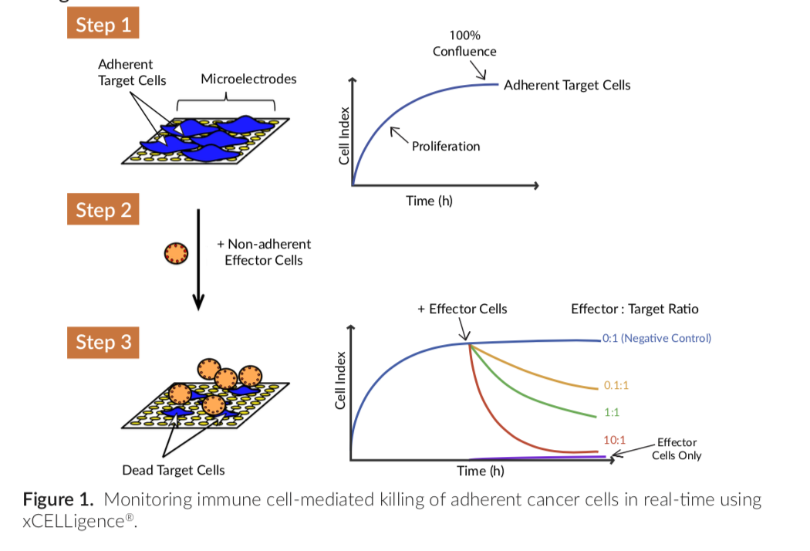
Non-adherent Cancer Cell Killing
Day 1:
Coat with diluted Tethering Reagent
Take background measurement with culture medium
Add tumor cells and let settle (30 minutes)
Load and start data acquisition to monitor target cell attachment and proliferation.
Day 2:
Pause data acquisition and add effector cells
Start data acquisition to monitor effector cell-mediated killing of immobilized target cells.
Cell Index (CI)
CI = (impedance at time point n – impedance in the absence of cells)
/nominal impedance value

Slide 7
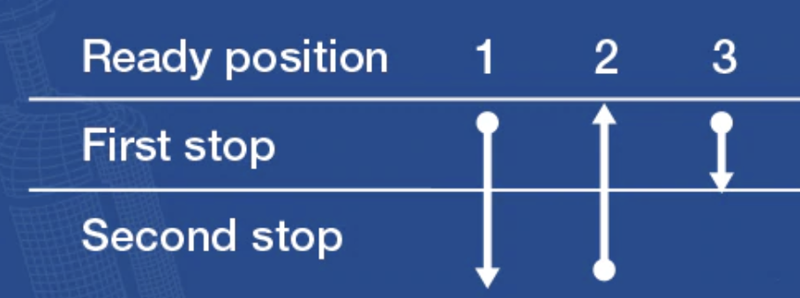
Tendency to foam: Use the reverse pipetting technique
Do not go all the way down to the second stop in Step 1
Press the operating button slightly past the first stop then take up the volume and release to the first stop

Slide 8
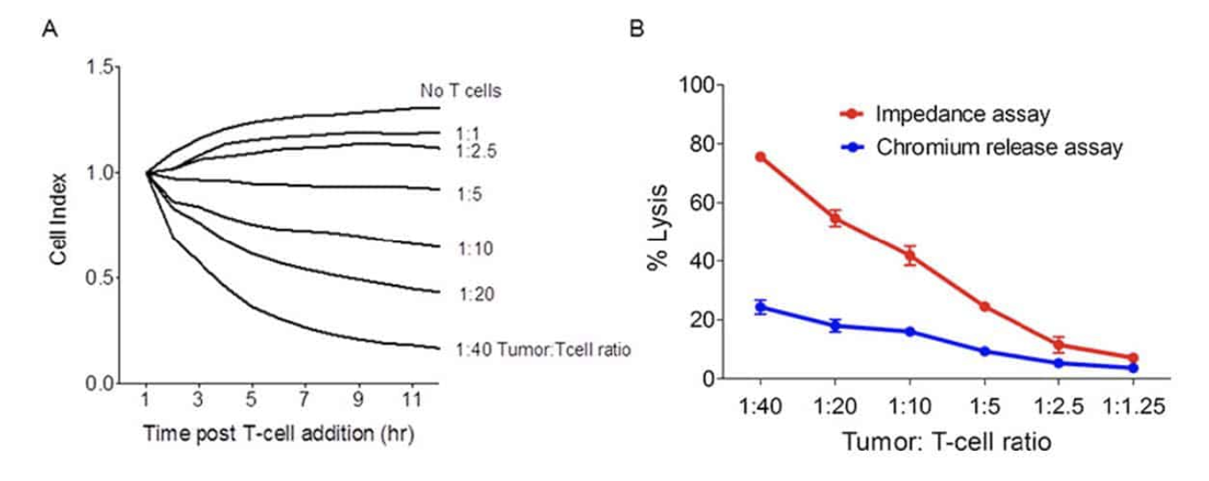
Application Highlight: Detecting Cytolytic Activity of
CD8+ T Cells
Side by side comparison with the ⁵¹Cr release assay vs xCELLigence RTCA assay
Shows sensitivity and dynamic range
Figure adapted from J Vis Exp. 2012 Aug 8;(66):e3683.

Slide 9
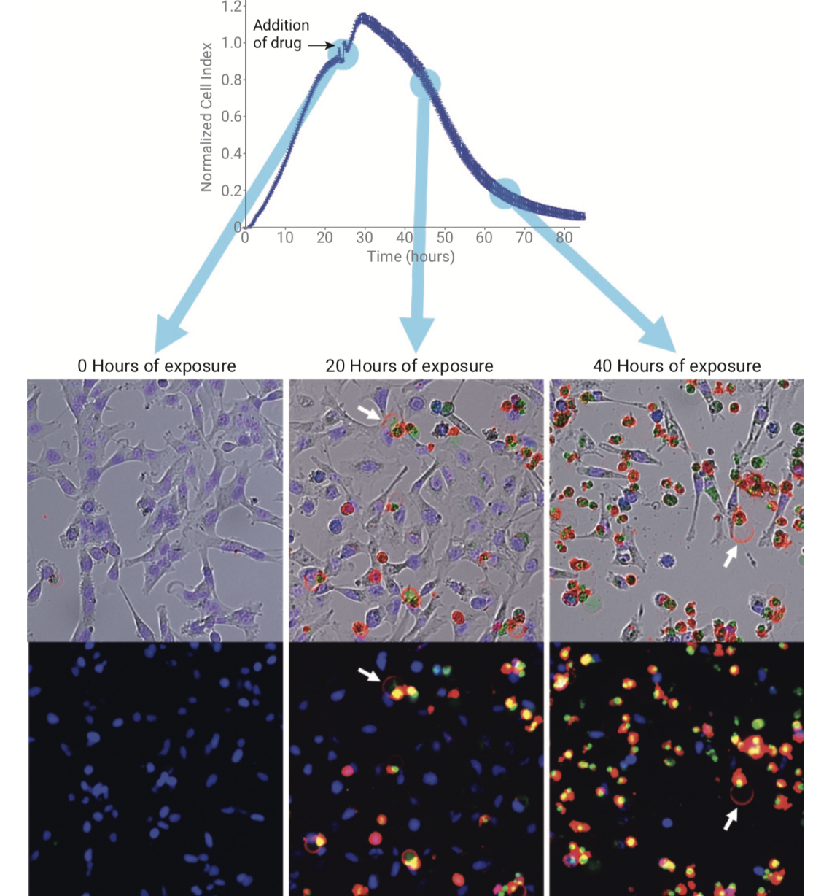
Live Cell Imaging with xCELLigence Biosensor
Simultaneously tracking five different perspectives
Impedance
Blue nuclei labeled tumor cell counts
Induction of apoptosis tracked by percent cellular confluence
Caspase 3 activation
Phosphatidylserine translocation
Red fluorescence: Annexin V
Green fluorescence: Activated Caspase 3
Blue fluorescence: Nuclear-localized BFB

Slide 10
Questions?

