Slide 1
Preparing custom TCR libraries using the 10x Genomics platform
Megan Maerz

Slide 2
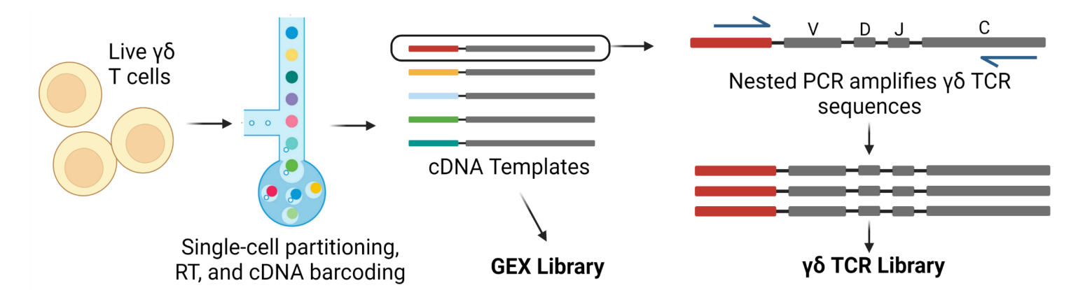
TCR Targeted Enrichment
Primers that are complementary to the TCR constant regions and to Read 1 are used to amplify TCR-encoding transcripts in nested PCRs.
10x only sells a kit for human or mouse αβ TCRs → Custom primers required for other library preps (γδ, NHP).
Custom primers for amplifying human γδ TCRs have been published (PMID #31011186 and #33674358).

Slide 3
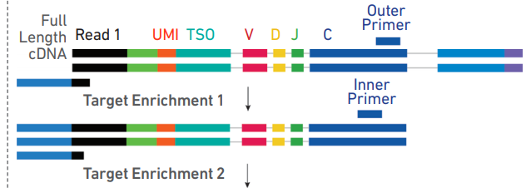
Primer Design
Gel bead primers
Original transcript
Added during cDNA Amp.
Six unique primers are needed:
10x_outer_F (Forward)
Constant_A/D_Outer_R1
Constant_B/G_Outer_R2
Illumina_P5 (Forward)
Constant_A/D_Inner_R1
Constant_B/G_Inner_R2
P5
Adaptor
TCR transcripts are amplified in two nested PCRs.
First PCR: Forward primer adds P5 adaptor (binds to Illumina flow cell), reverse primers bind to outer TCR constant regions.
Second PCR: Forward primer binds to P5 adaptor, reverse primers bind to inner TCR constant regions.

Slide 4
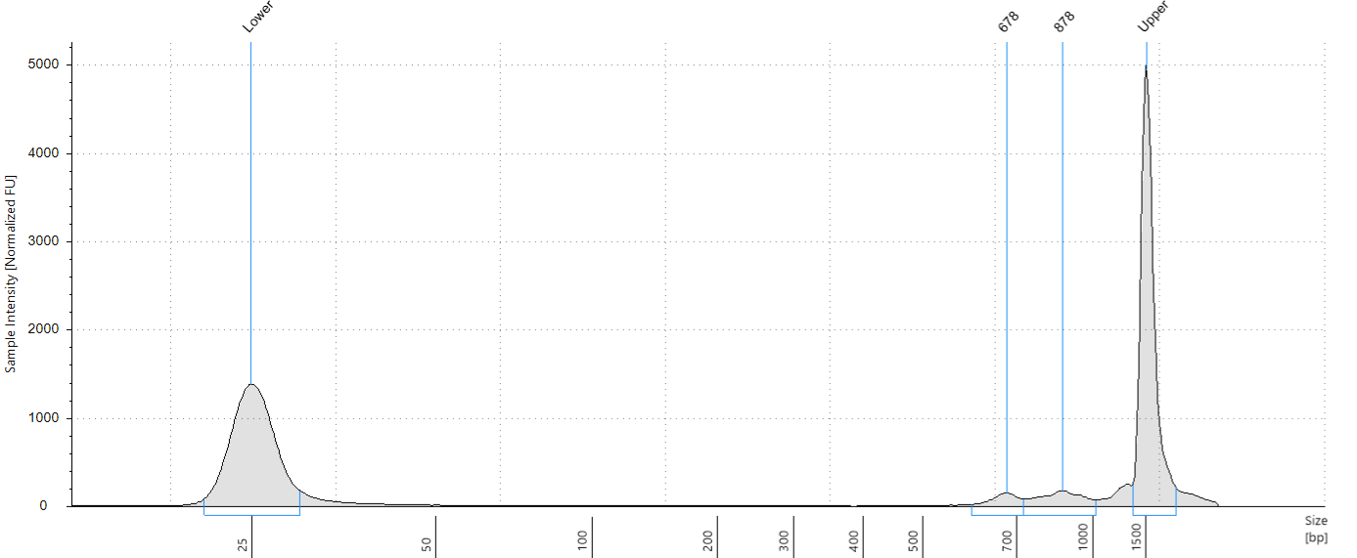
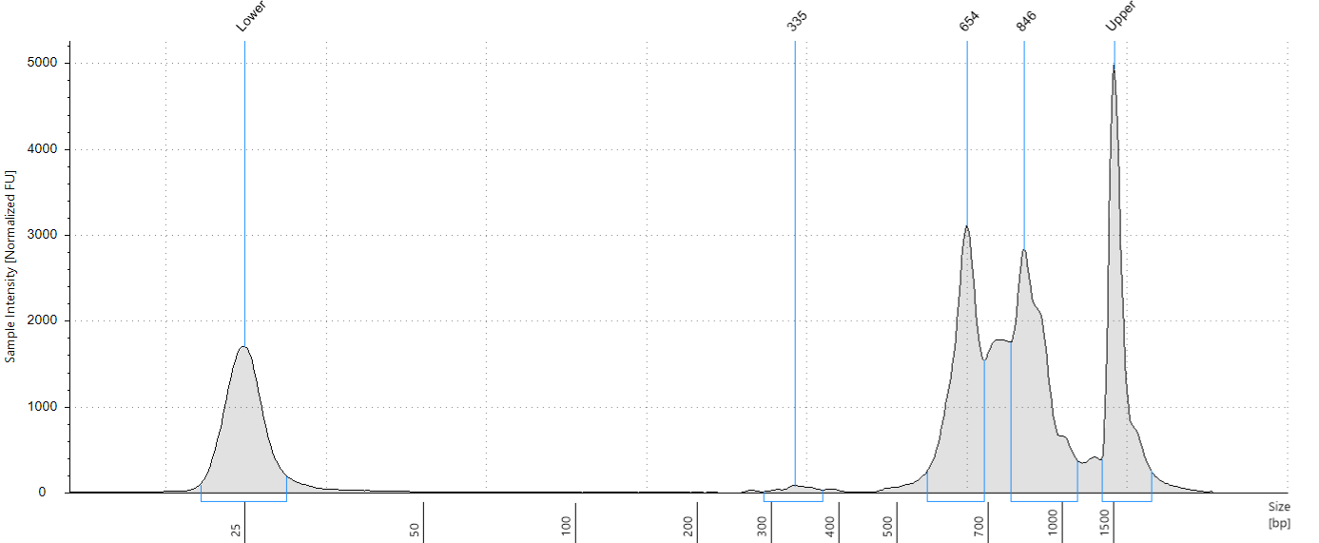
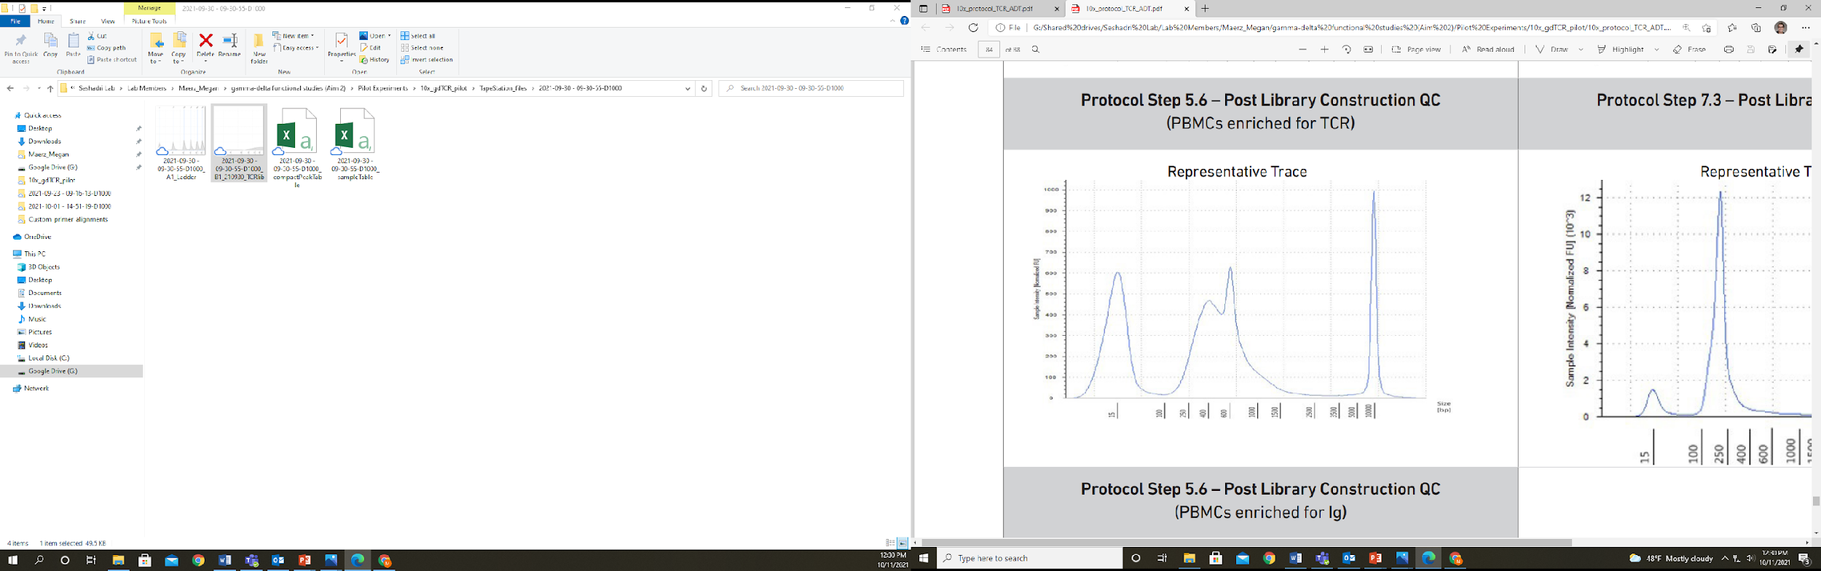
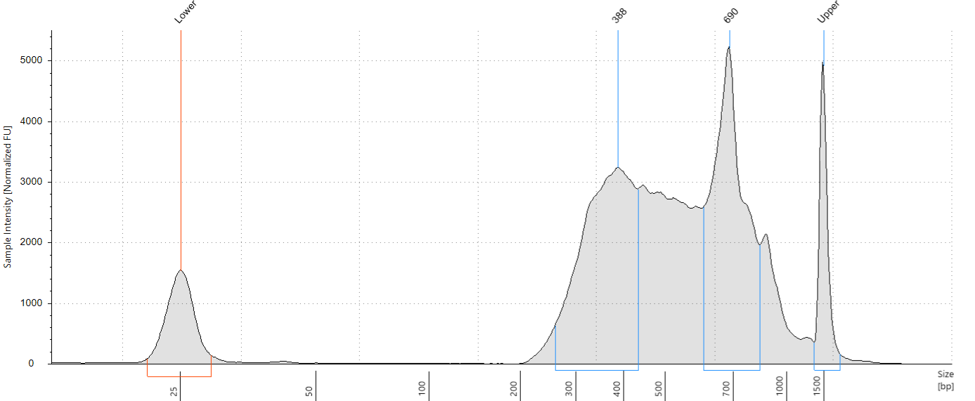
PCR Optimization
TapeStation Trace
PCR not optimized
TapeStation Trace
Optimized
Final TCR library
TapeStation Trace
Optimized
Custom primers may not amplify well without additional optimization.
We’ve found success in focusing on the annealing temperatures.

Slide 5
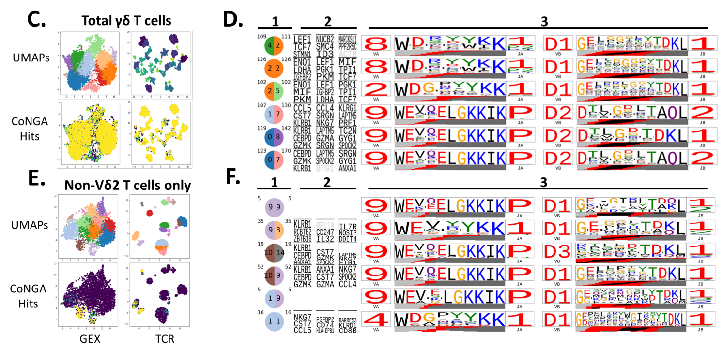
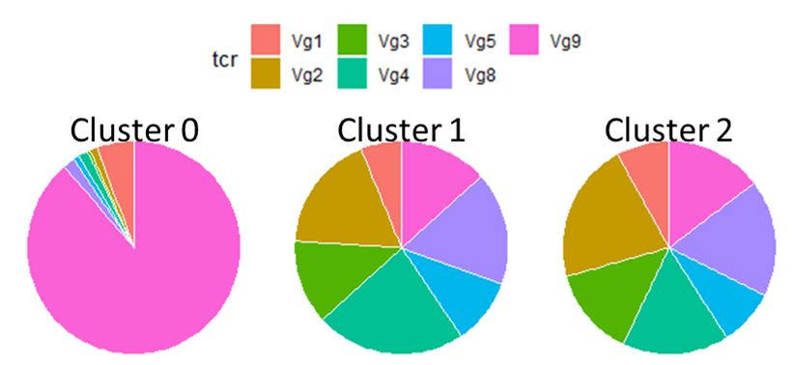
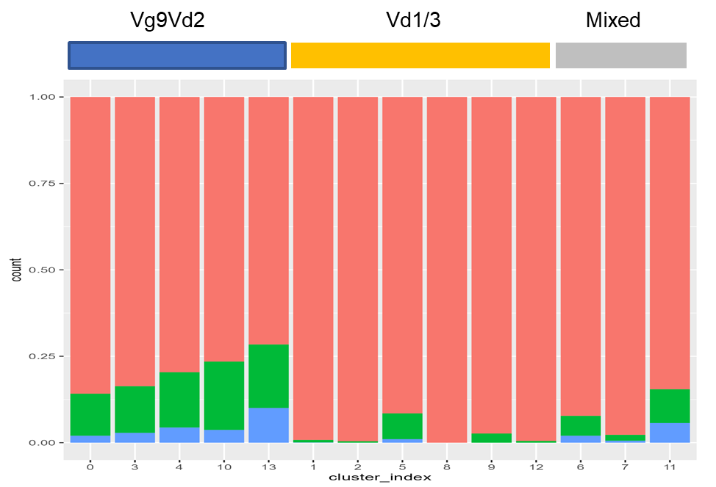
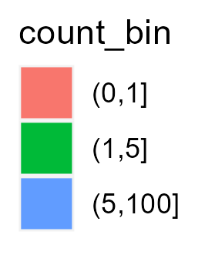
TCR Analysis
With some adjustments to the cellranger VDJ pipeline, the resulting data can be analyzed like any other TCR dataset (if the tool is compatible with your TCR/species of interest!).
Gene usage
CDR3 matches
Clonality
TCR clustering

