Slide 1
TCR reconstruction from Adaptive Sequencing
Prepared by: Michelle Brault

Slide 2
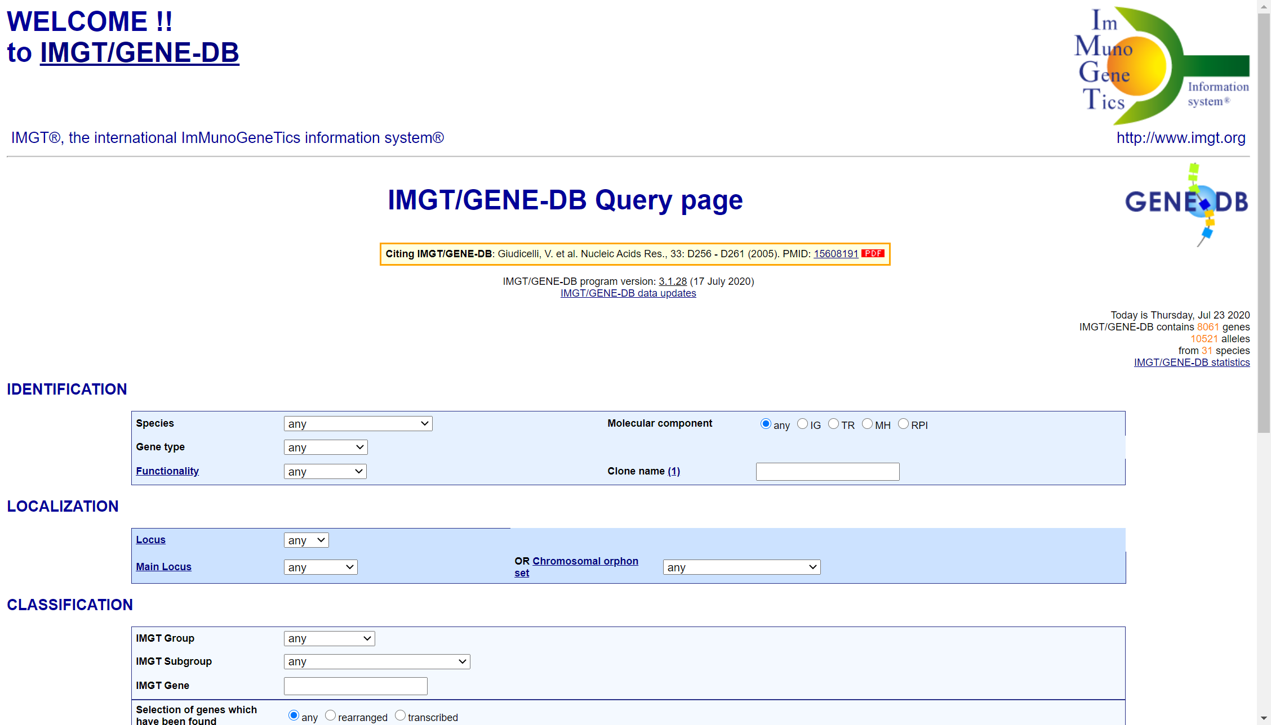
Step 1: Go to IMGT Gene (http://www.imgt.org/genedb/)
The page should look like this!

Slide 3
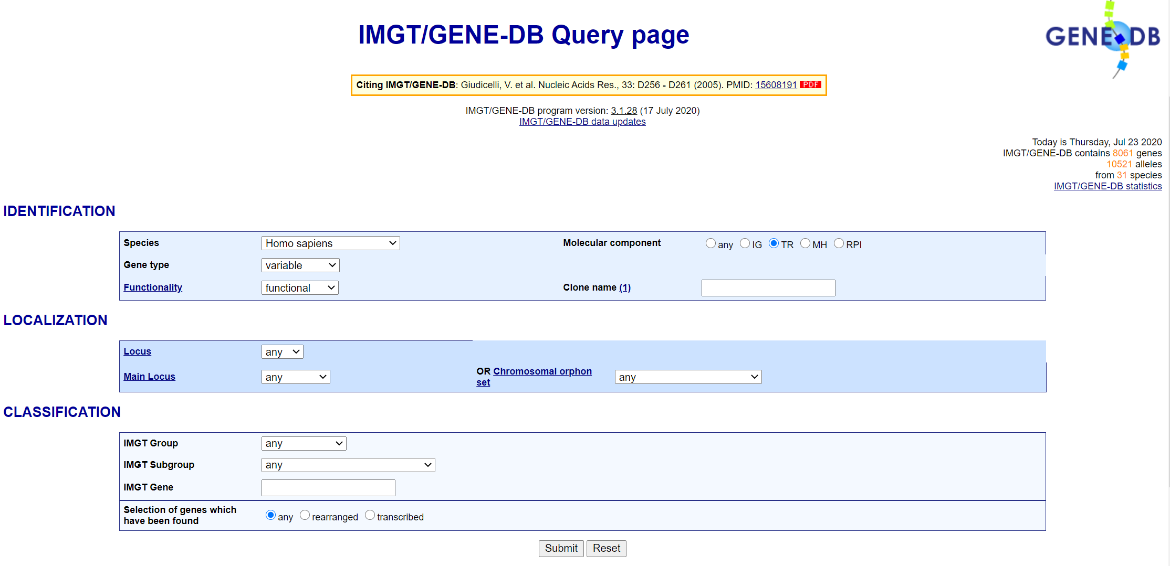
Step 2: Put in the correct identifiers
For gene type, it will be “Variable” for V regions and “Joining” for J regions. We will start with V regions.
You can attempt to search for your specific gene, like “TRAV13-01” but often the gene name will be slightly off and give you no results. I recommend leaving it blank.

Slide 4
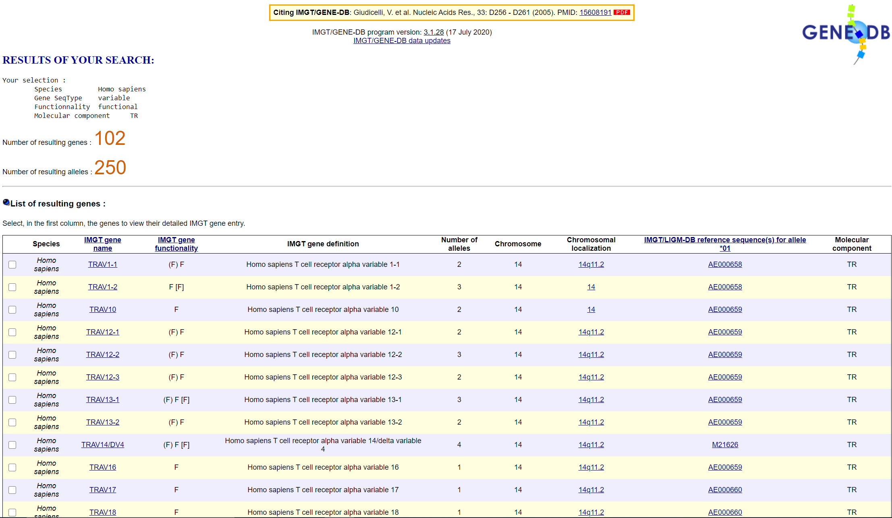
Step 3: Find your V regions
You will get a list of all variable regions for both alpha and beta chains. Find your V regions for each chain but BE SURE NOT TO MIX THEM UP!!
TRAV is an alpha V region.
TRBV is a beta V region.
Click the box of the regions you’d like to get a sequence for.
Note: Some genes have a dashed number, and some do not (e.g. TRAV1-1 vs TRAV10). Adaptive might give you a dashed number, but if that’s not available on the list, click the undashed one that corresponds to it (e.g. if you want TRAV10-1, click TRAV10)

Slide 5
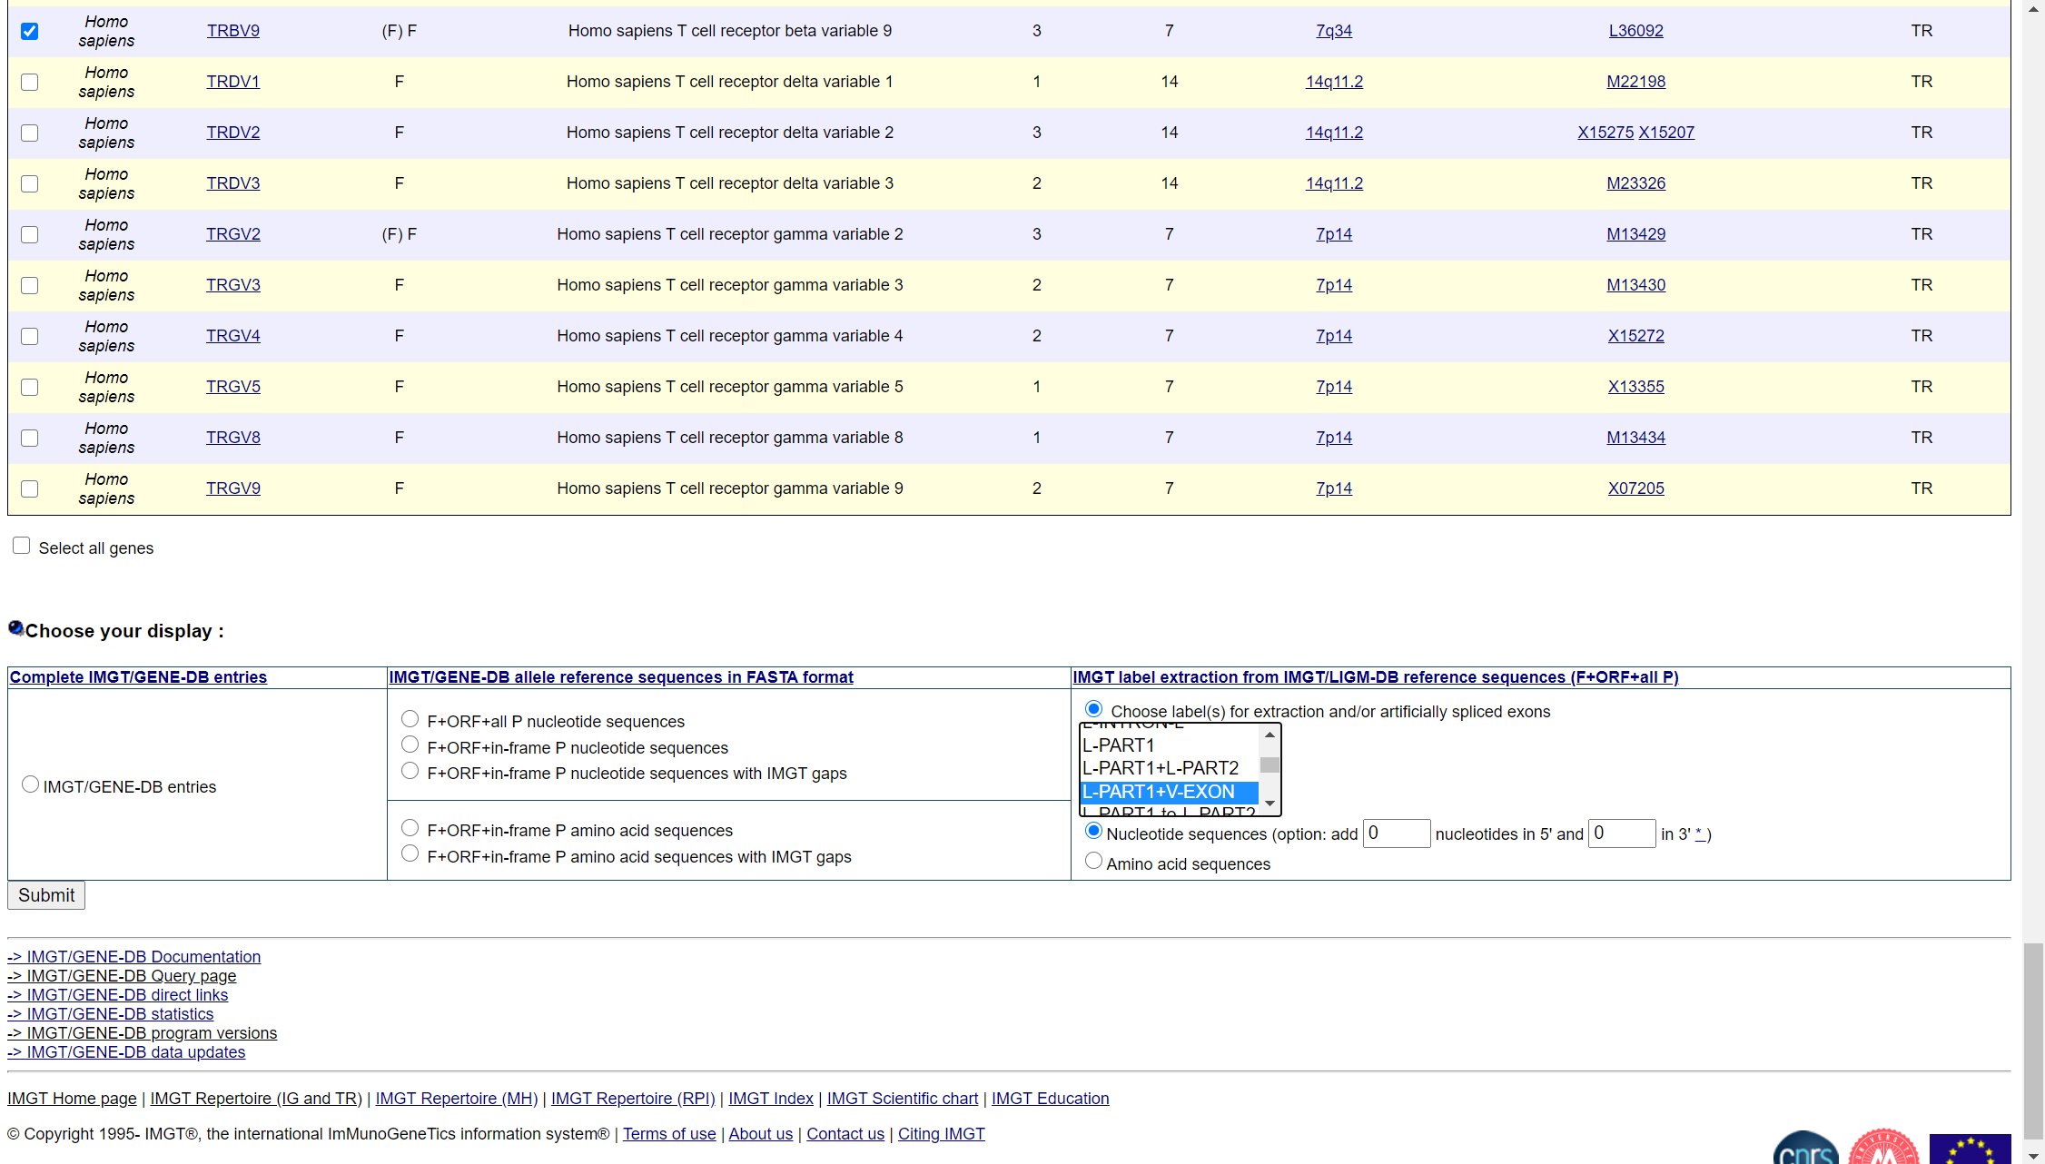
Step 4: Put in sequence parameters at bottom of page
After you’ve selected the regions you want, scroll all the way to the bottom. It should look like the image to the right.
Under right hand column, select to choose label(s), and use the box to scroll for L-PART1+V-EXON. This gives you the exon sequence. You do NOT want introns.
Click submit.

Slide 6
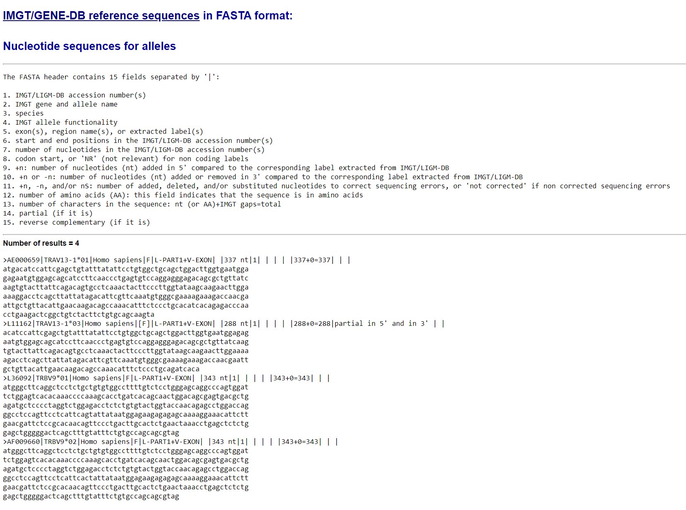
Step 5: Copy your sequences to an excel sheet
You will get a list of results. Find the sequences that correspond to your identified region from Adaptive.
Example:
I was given TRAV13-1 and TRBV09*01 from Adaptive.
There are two results for TRAV13-1 (red circles), 13-1*01 and 13-1*03, but the *03 version does not seem to be complete (288nt vs 337nt, lacks atg at start). I will copy TRAV13-1*01.
There are two results for TRBV09 (blue circles), TRVB09*01 and TRVB09*02, but I want *01, so I will copy that.
Tip: If you copy the sequences right into excel, they will copy into multiple lines, which can cause problems with alignment later. I use http://removelinebreaks.net/ to remove the whitespace in the sequence so it copies into excel in one continuous sequence.

Slide 7
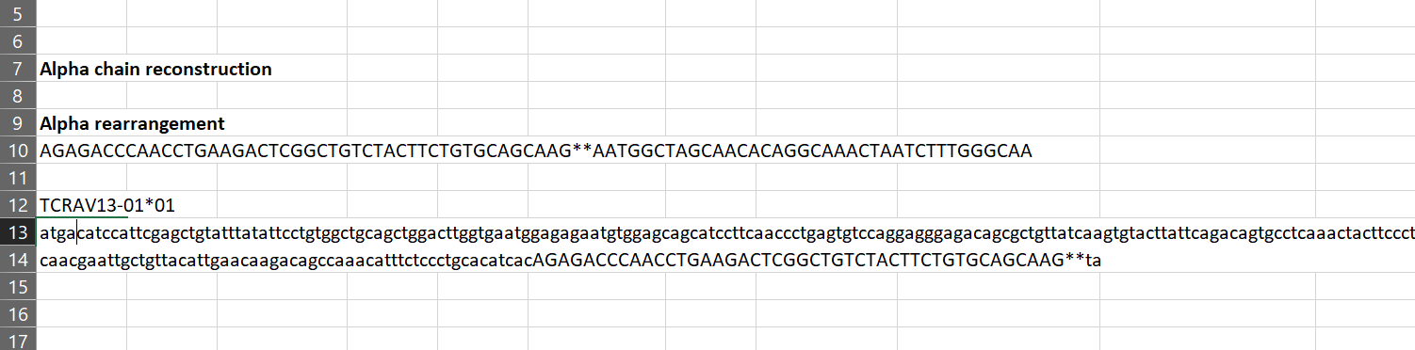
Step 6: Mark where your V region stops in reference sequence
You will need the alpha and beta rearrangement sequence from Adaptive (indicated with red arrow). It helps if you copy it with the color formatting for alignment but it’s not necessary.
Copy your V regions from Step 5 into excel.
Using the FIRST 10ish bp of the rearrangement sequence, use “Find” (Ctrl+F) to match that sequence in your reference sequence. Moving 5’ to 3’, find the first base pair that is different between the two and mark breakpoint in both sequences. I’ve marked that point with ** and blue arrows. Notice how the sequence is the same before the ** and different after, which represents the rearrangement breakpoint. It also helps to use lowercase/capital letters or colors to help you see overlaps.
Note: If you have the Adaptive color coding, that will show you where breakpoints are.

Slide 8
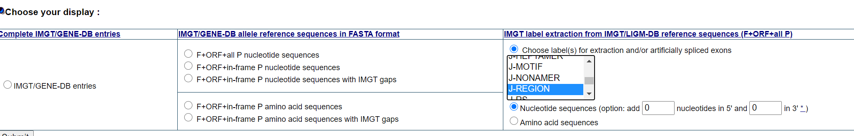
Step 7: Repeat steps 1-5 for J regions
For Step 2: Make sure to select “joining” in the “Gene type” dropdown box instead of “variable”
For Step 4: Make sure to select “J-REGION” from box instead of “L-PART1+V-EXON”

Slide 9
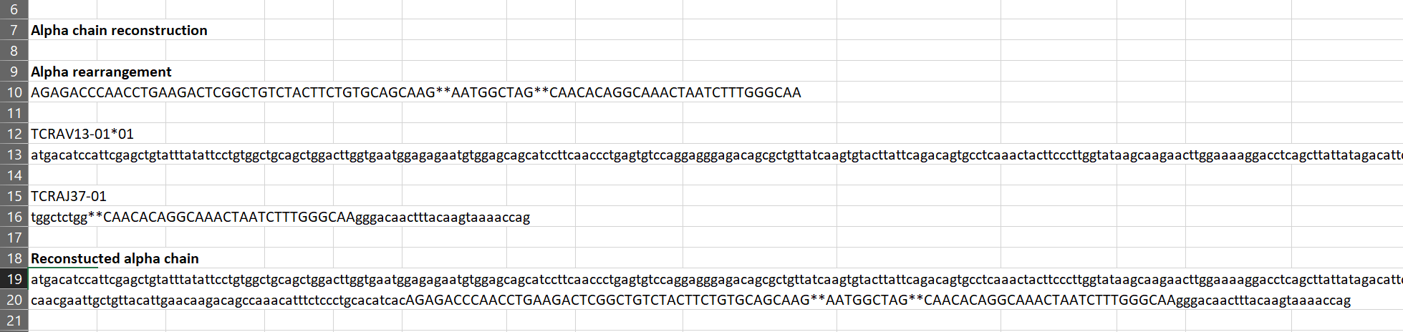
Step 8: Mark where your J region starts in reference sequence
You will need the alpha and beta rearrangement sequence from Adaptive (indicated with red arrow). It helps if you copy it with the color formatting for alignment but it’s not necessary.
Copy your J regions into excel.
Using the LAST 10ish bp of the rearrangement sequence, use “Find” (Ctrl+F) to match that sequence in your reference sequence. Working 3’ to 5’ (backwards), find the first base pair that is different between the two and mark breakpoint in both sequences. I’ve marked that point with ** and blue arrows. The sequence in between your markers (red circle) is the unique rearrangement associated with your TCR. THIS SUPERCEDES THE REFERENCE SEQUENCES!!!!
Note: If you have the Adaptive color coding, that will show you where breakpoints are.

Slide 10
Step 9: Reconstruct entire alpha/beta chain from references
Copy the reference sequence for your V region from the 5’ end UP TO THE MARKER (**). Paste into new cell.
Copy the sequence in between the markers in your alpha rearrangement sequence from Adaptive. Paste onto the end of the pasted sequence from part a. (red circle)
Copy the reference sequence of your J region STARTING AT THE MARKER all the way to the 3’ end. Paste onto the end of the pasted sequence from part b.
You now have your reconstructed alpha or beta chain. Notice that the rearrangement sequence from Adaptive lies in the middle of your chain – blue arrows at start and end for reference.

