Slide 1
Experimental Histopathology Shared Resources
Basic Tissue Freezing Workshop
Presenter Elizabeth Benitez, M.Ed., Research Histotechnician III

Slide 2
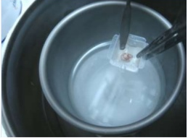
Why Isopentane Freezing?
The quicker you freeze samples the better the results.
  Less ice crystals = better morphology
  Samples freeze in about 10-12
  seconds.
  Isopentane freezing produces better morphology for muscle and tissues with a lot of fat.

Slide 3
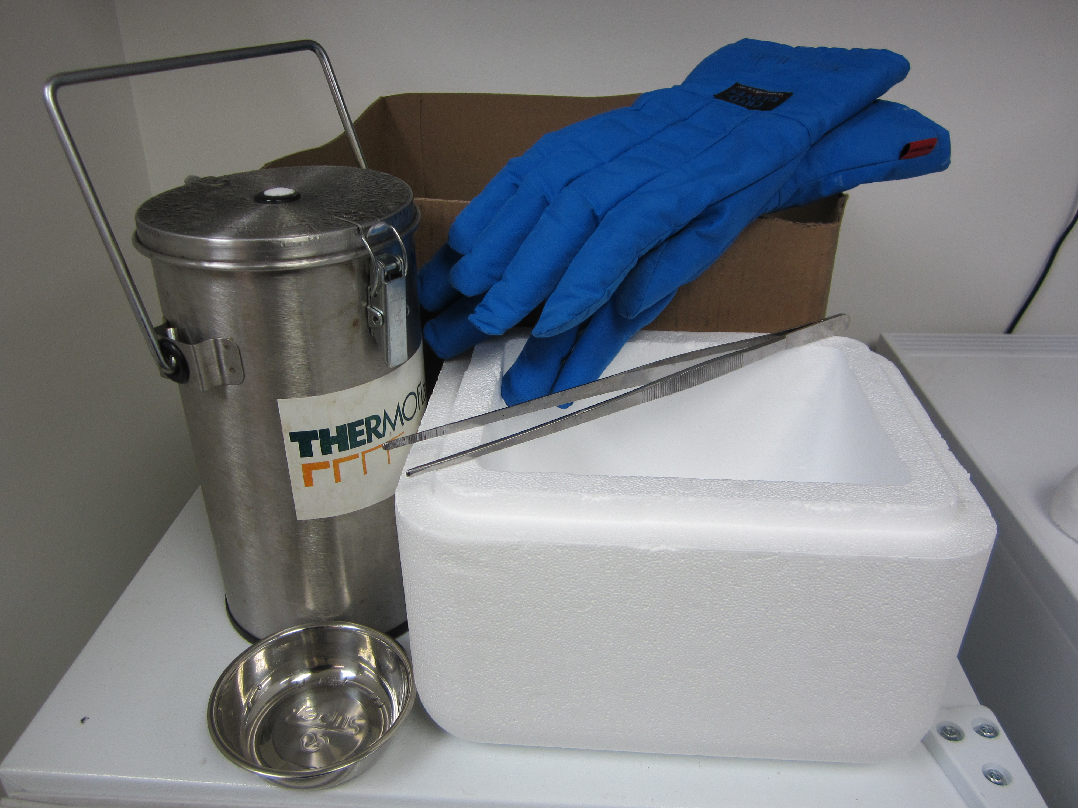
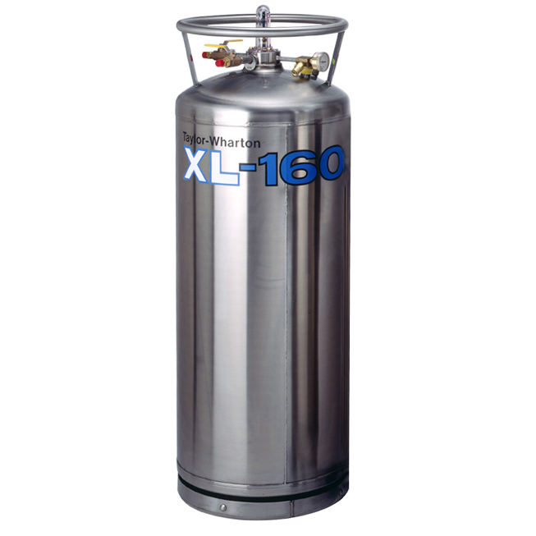
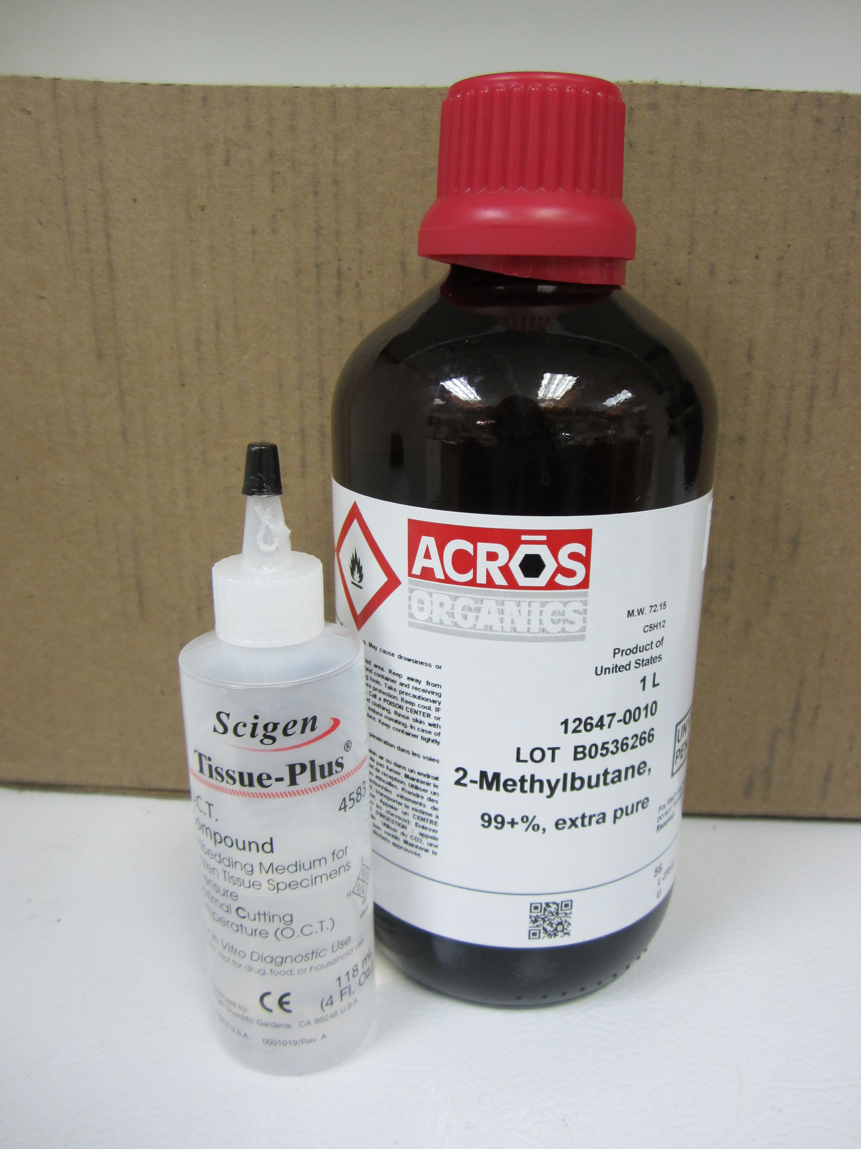
Materials
Safety Gear
Materials
Solutions & misc.
Gloves Cryo Gloves Safety gear for handling Liquid nitrogen | Intermediate Cryomold Mold (15mm x 15 mm x 5 mm) Thermo flasks Forceps Styrofoam container Aluminum foil Box for -70 freezer storage | Tissue Tek OCT Isopentane/2-methylbutane (1liter) Liquid Nitrogen (900ml) Dry Ice or easy access to -70 freezer

Slide 4
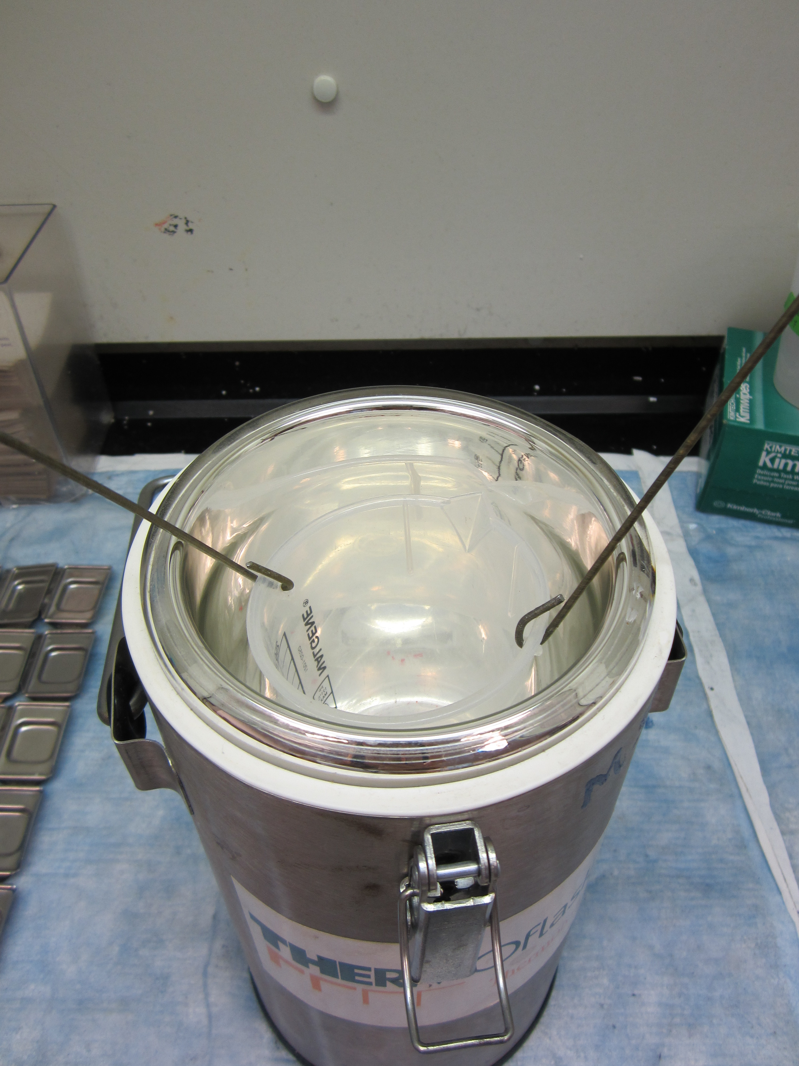
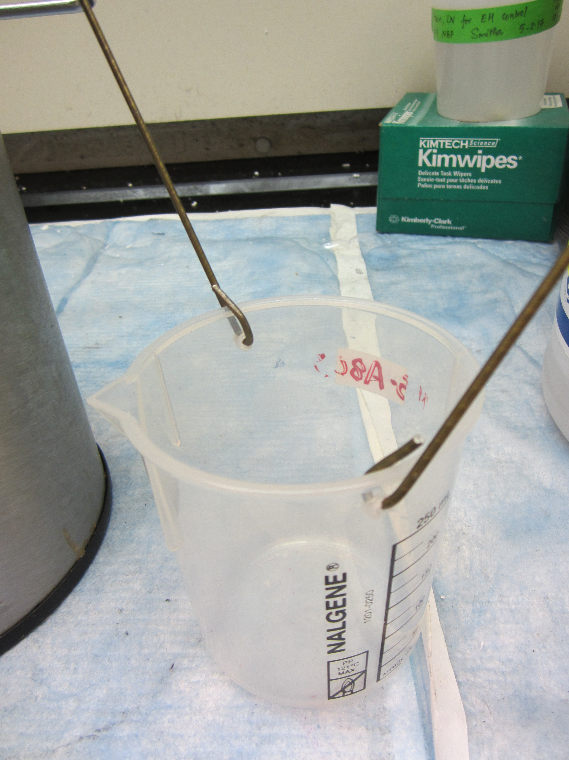
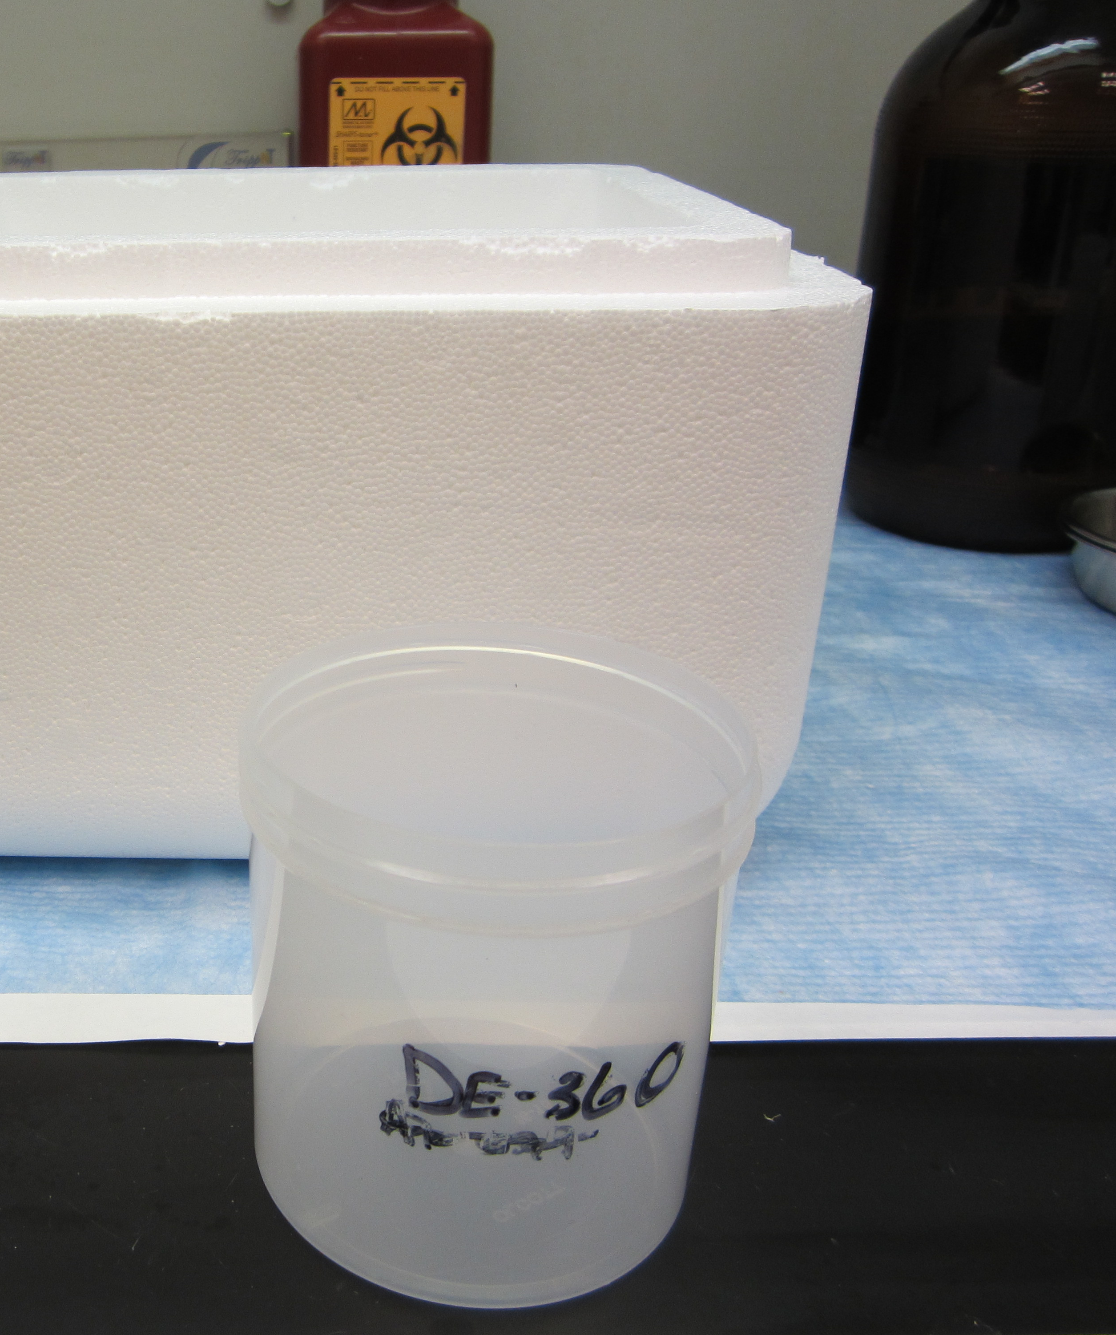
Setting up for freezing
Flask method: Open a hole on either side of the plastic 500 ml beaker and run a metal wire through on either side. Make sure that the beaker fits inside and can hang off of the top of the Thermo Flask.
Styrofoam box method: Just use a regular 500 ml polypropylene container and Styrofoam box with a lid.

Slide 5
Setting up for freezing
Bend edge of cryomolds upward for better handling of mold while freezing.
Label Cryomolds with a sharpie pen
Styrofoam box with dry ice and lid (for when you are done embedding the tissue).
Liquid nitrogen (500 ml – 1 liter)
Aluminum foil (to wrap up embedded tissue)
Have all materials ready for embedding
Use proper safety materials and precautions while freezing.

Slide 6
Setting up solution for Thermo flask
Fill 500 ml container/beaker with approximately 300 ml of isoptentane/2-Methlybutane
Lower 500 ml container/beaker with isopentane/2-methylbutane into a thermoflask with 500 ml of Liquid nitrogen
Allow beaker to sit in liquid nitrogen until you see edges of the beaker turning white (cold) approximately 10 minutes
isopentane should look like a slurry before use (approximately 5-10 minutes depending on amount of isopentane)

Slide 7
Setting up solution for dry ice method
Fill bottom of Styrofoam box with about 1 inch of liquid nitrogen
Fill a 500 ml container/beaker with approximately 300 ml of Isoptentane/2-Methlybutane.
Slowly lower container into liquid nitrogen. Ensure that the container does not spill into the liquid nitrogen.
Allow beaker to sit in liquid nitrogen until you see edges of the beaker turning white (cold) approximately 10 minutes
Isopentane should look like a slurry before use (approximately 5-10 minutes depending on amount of isopentane)

Slide 8
Prepping the tissue
Cut down tissue samples:
<3 mm in thickness
<10 mm in length
Keep fresh tissue on a moist gauze with saline to avoid drying artifact.
Right before embedding, dry the tissue on a paper towel or dry cloth to avoid ice crystals before freezing.

Slide 9
Embedding
Put a small amount of OCT in the labeled cryomold before placing the tissue inside. Avoid or pop any air bubbles that emerge.
Place the tissue in the center of the mold and carefully surround the tissue with OCT. Use a circular motion.
Fill the mold entirely making sure that the tissue is submerged in OCT.
Use forceps to keep tissue flat or area of interest downward.

Slide 10
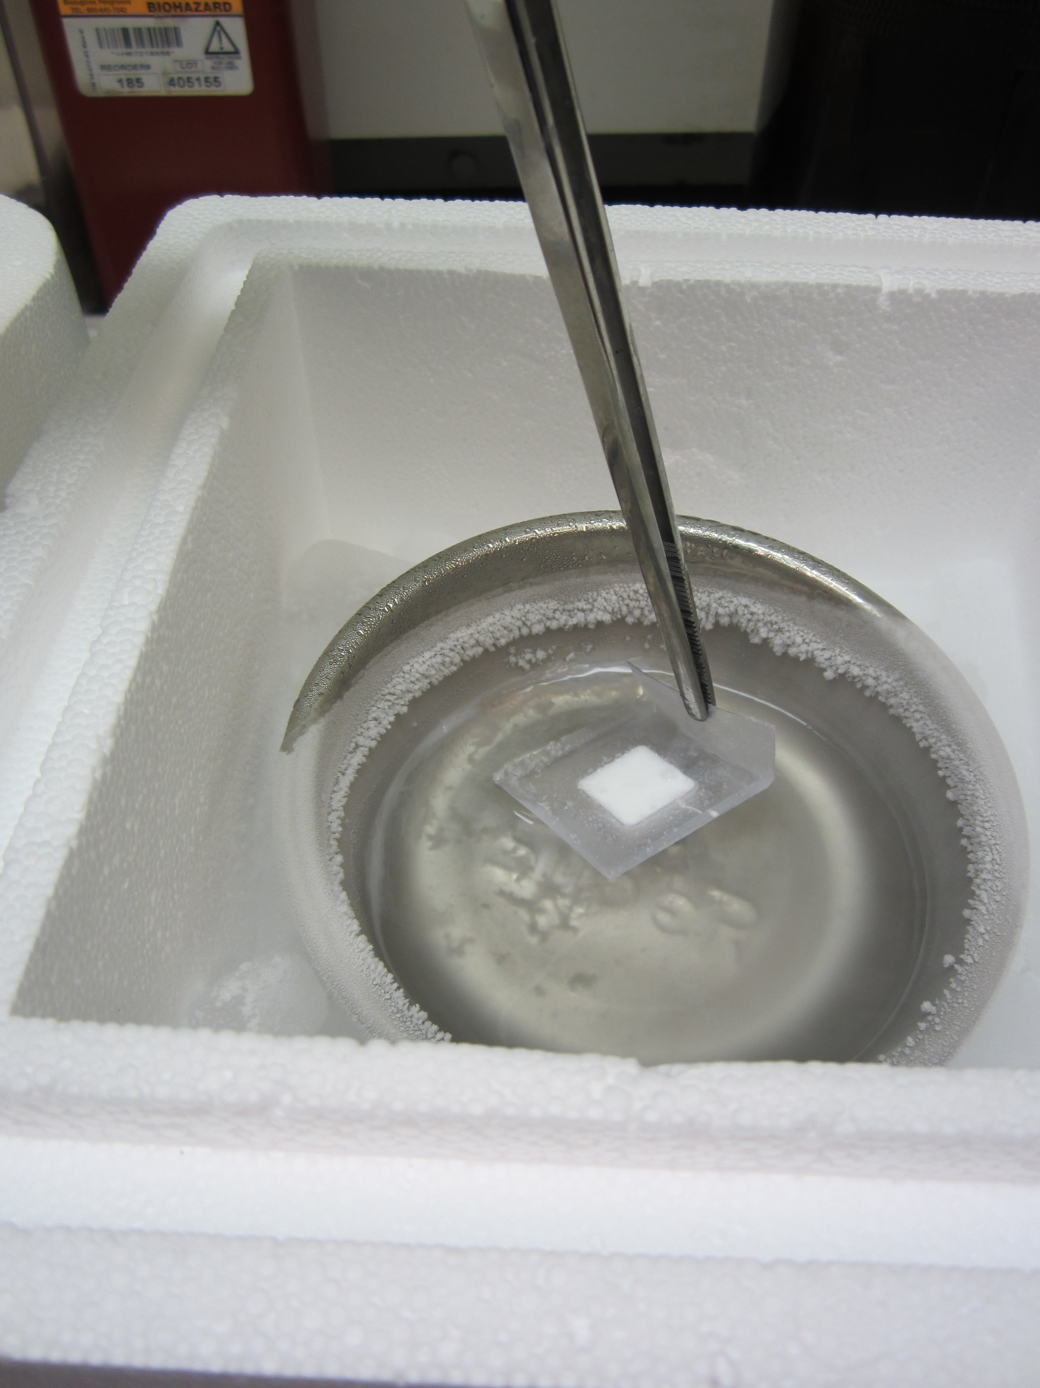
Isopentane Freezing
Slowly lower the mold into the isopentane with forceps using the bent edge of the cryomold. *keeping the mold as flat as possible
Use a circular or back and forth motion to ensure complete freezing of the sample/OCT
Typical freezing will take 10-12 seconds however, samples can stay longer in the isopentane.

Slide 11
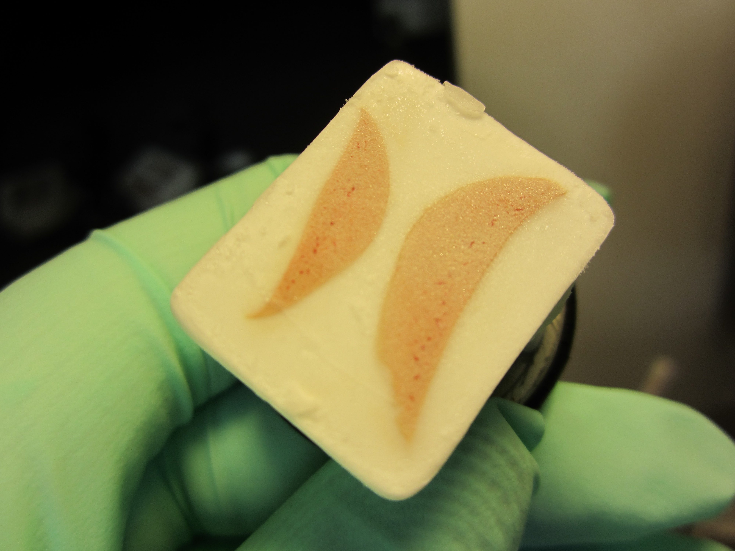
After freezing
After the samples have been in the isopentane a minimum of 10-12 seconds, remove samples using forceps and shake off excess liquid isopentane.
Use gloves and wrap samples in aluminum foil for storing. If necessary, keep samples on dry ice before relocating samples into a -70 freezer.
For long term frozen sample storage use a cardboard box
Tissue can be submitted to Experimental Histopathology for frozen cutting

Slide 12
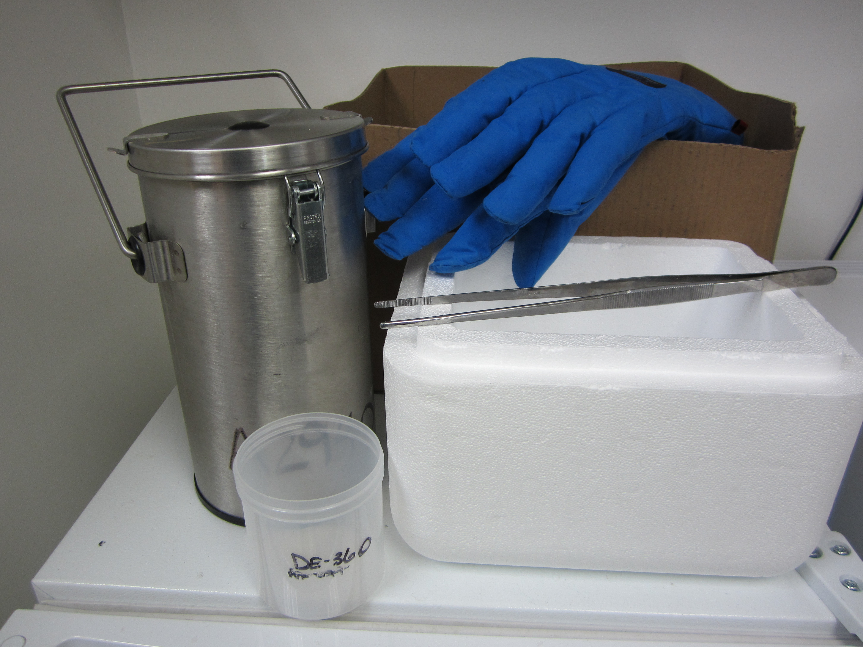
Ordering information
Cryomold Mold (4566 Cryomold® Intermediate 15 x 15 x 5 mm, 100/pcs)
4 Fl oz.Tissue-Plus OCT (Sciegen, 4583)
Thermo Scientific Thermo Flask 2L (Thermo Fisher Scientific 2123)
Tempshield Cryo Gloves (Fisher Scientific S98416B or S98416C)
Isopentane/2-Methylbutane (Fisher Scientific AC126470010, 1 liter)

Slide 13
THANK YOU!
Questions?
Savanh Chanthaphavong, Director of Experimental Histopathology rchantha@fredhutch.org
Elizabeth Benitez, Research Histotechnician III
ebenitez@fredhutch.org

