Slide 1
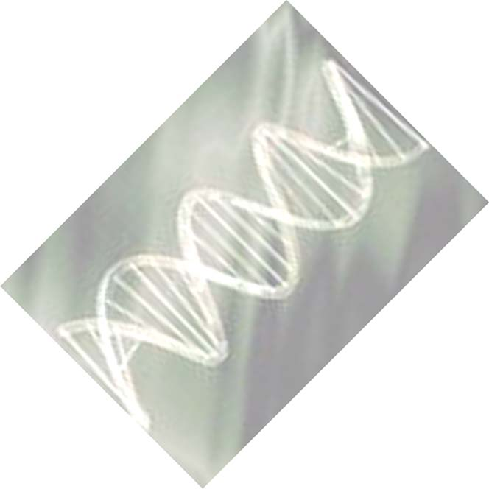
Polymerase
Chain
Reaction
PCR

Slide 2
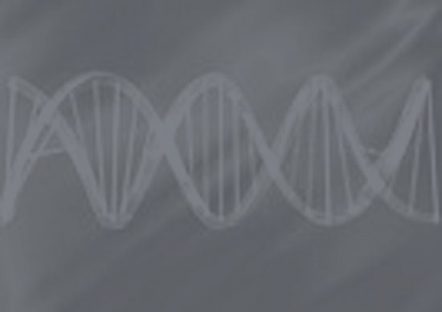
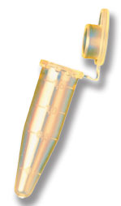
What is PCR?
An in vitro process that detects, identifies, and copies (amplifies) a specific piece of DNA in a biological sample.
Discovered by Dr. Kary Mullis in 1983.
A technique that has revolutionized modern molecular biology.

Slide 3

"Beginning with a single molecule of genetic material DNA, PCR can generate 100 billion similar molecules in an afternoon. The reaction is easy to execute. It requires no more than a test tube, a few simple reagents and a source of heat. The DNA sample can be pure, or it can be a minute part of an extremely complex mixture of biological materials. The DNA may come from a hospital tissue specimen, from a single human hair, from a drop of dried blood at the scene of a crime, from the tissues of a mummified brain or from a 40,000-year-old wooly mammoth frozen in a glacier.“
-Kary Mullis, Scientific American

Slide 4
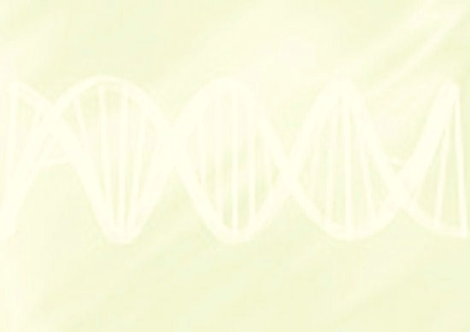
PCR Requires the following:
  Template DNA to be amplified
  Pair of DNA primers
  Thermostable DNA polymerase
  dNTPs
  Buffer to maintain pH and to provide Magnesium Ions
  Thermal cycler

Slide 5
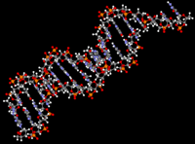
Reaction Components
www.accelrys.com
  1. Template DNA
    A sequence of DNA that is to be copied. Also called target DNA.
    Can amplify (copy) a piece of DNA ~50 to ~4000 base pairs long (maybe more, depending on ingredients).
    DNA must be isolated from an organism before it can be copied (remember Cell lysis, Protein denaturation, DNA precipitation)

Slide 6
Reaction Components
  2. A Pair of DNA primers
  In the cell (in vivo), primers are short RNA strands that serve as a starting point for DNA replication
  In a PCR reaction (in vitro), Primers are short synthetic strands of single stranded DNA that exactly match the beginning and the end of the DNA fragment to be amplified.
5’
3’
Reverse Primer
Genomic DNA
3’
5’
5’
3’
Forward Primer
3’
5’
Target DNA length

Slide 7
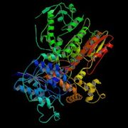
Reaction Components
  3. DNA polymerase
    Polymerase builds a new DNA strand in the 5’ to 3’ direction.
    The newly-polymerized molecule is complementary to the template strand and identical to the template's partner strand.
DNA polymerase

Slide 8
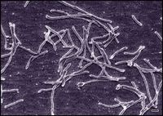
  DNA polymerase must be Thermostable (Heat–stable) because of high temperatures used in PCR
  Called Taq polymerase because it is isolated from the bacteria Thermus aquaticus (they live in hot springs)
Brock & Freeze, 1969

Slide 9
Reaction Components
  4. dNTPs
  dNTPs (deoxynucleosides) are the building blocks in the PCR Reaction.
  They are the monomers that DNA polymerase uses to form DNA…..the A’s, T’s, C’s and G’s that will build the new strand of DNA.
G
G
T
G
C
T
G
A
C
T
T
A
A
C
A
C
G
G
G
T
A
T
C
A
A
C
G
C

Slide 10
Reaction Components
  5. Buffer
  To work properly, Taq needs mg⁺⁺
  The concentration of magnesium ions needs to be optimized with each target and primer combination.
  Too little magnesium could equal little or no PCR product, too much could mean unwanted product….a fine line.
  Buffer also maintains pH

Slide 11
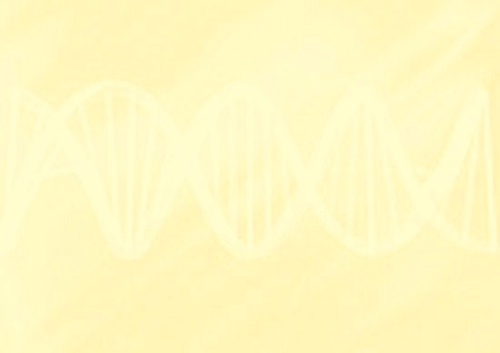
How Does PCR Work?
A Three-Step Process
Each step happens at a different temperature
  Step 1: Denaturation
  Step 2: Annealing
  Step 3: Extension
1 cycle

Slide 12
How Does PCR Work?
Step 1: Denaturation
Heat over 90ºC breaks the hydrogen bonds of DNA and separates double-stranded molecule into two single strands
Double Stranded DNA target
Denatured single strand
Denatured single strand

Slide 13
How Does PCR Work?
Step 2: Annealing - Primer Binding to Target also called Hybridization
Temperature is reduced ≈ 50-65ºC
(Annealing temperature depends on primer length and G-C content. )
Template Strand #1
5’
3’
3’
5”
Forward Primer
Reverse Primer
5’
3’
3’
5’
Template Strand #2

Slide 14
How Does PCR Work?
Step 3: Extension
Temperature is increased≈ 72ºC
(taq’s ideal temperature)
Template Strand #1
5’
3’
3’
5’
Taq
Taq
5’
3’
Template Strand #2

Slide 15
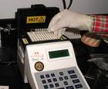
Equipment
  Thermal cycler
  Is needed for PCR
  Thermal cyclers have metal heat blocks with holes where PCR reaction tubes can be inserted. The thermalcycler then raises and lowers the temperature of the block at each step (denaturation ~95 ͦC, annealing ~55 ͦC and extension 72 ͦC)

Slide 16
PCR a CHAIN reaction
At the end of the first PCR cycle, there are now two new DNA strands identical to the original target
Multiple Cycles (30-40)
Exponential Growth
  # of Copies =2^{n}
  (Where ^{n} is the number of cycles)

Slide 17
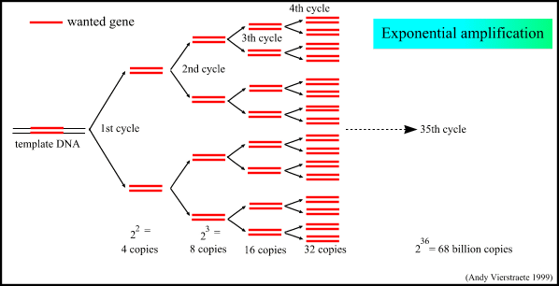
Exponential Amplification of the Target DNA Sequence

Slide 18
BEWARE !
Other DNA can contaminate the PCR reaction
Sources:
The person who is setting up the reaction
The tubes
The enzymes, buffers or water used in the reaction
VALIDATION
Do a negative control (no DNA) to validate that the PCR product is amplified from the intended DNA, not some other source of DNA.
A positive control using DNA with good primers validates that the reaction conditions and thermal cycler work properly.

Slide 19
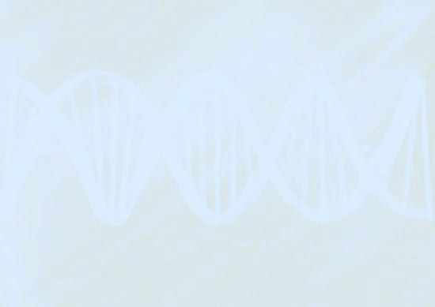
PCR: Analysis
At the end of a PCR reaction, there is a A LOT more of your target DNA than before the reaction started…billions of copies!
Now the sample is large enough to be seen on a gel and analyzed.

Slide 20
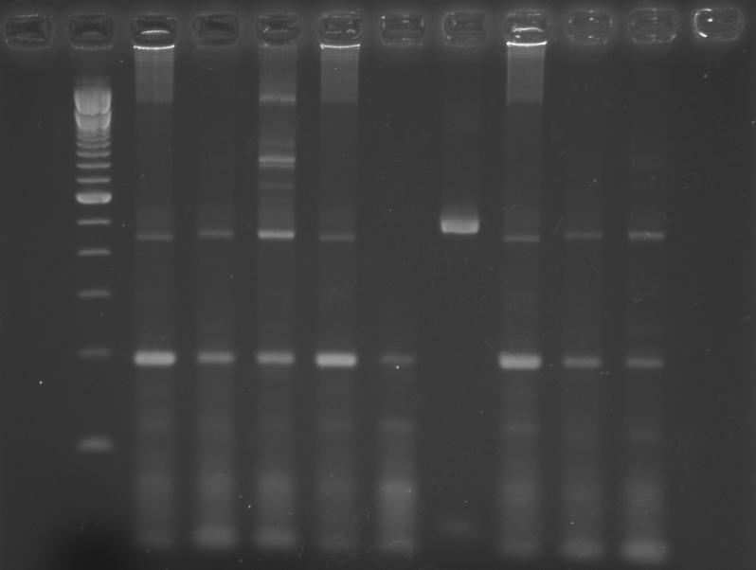
Analysis of PCR Results
Gel Electrophoresis
A DNA Ladder of known size is run along with the samples. This allows analysis of the size of the piece of DNA amplifed by PCR.
200 bp
100 bp
PCR Target Band

Slide 21
PCR Product –
An End and a Means
An end PCR can be the final step in analyzing or answering a question. An example is food samples. PCR can identify a piece of DNA that indicates genetic modification, or contamination by bacteria.
A means PCR can amplify a gene for further study, or for cloning.

Slide 22
PCR
A powerful, versatile tool
There are many uses for PCR in a endless array of scientific fields:
      DNA sequencing
      DNA profiling (fingerprinting)
      Making recombinant DNA for GMOs
      Detecting foreign organisms in food
        Salmonella, E. coli
      Detecting the cause of an infection or disease
        Lyme Disease, Strep throat, STDs, etc., etc.
Agriculture Molecular biology
Archaeology Botany
Medicine Cell biology
Forensics

