Slide 2
Study Concept
Pegylated Urate Oxidase to Reduce Graft vs. Host Disease (GVHD) Following Myeloablative HLA-matched Allogeneic Stem Cell Transplantation (ASCT)

Slide 3
Outline
Brief primer on transplant and GVHD
Phase I Clinical Data
Animal / Mechanistic Data
Study Concept

Slide 4
Outline
Brief primer on transplant and GVHD
Phase I Clinical Data
Animal / Mechanistic Data
Study Concept

Slide 5
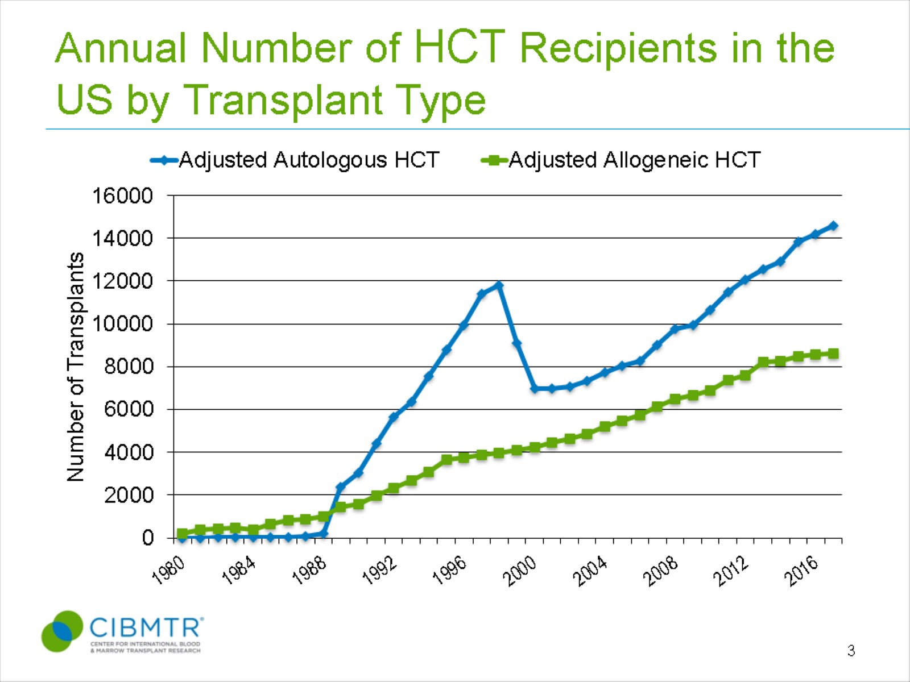
Annual Number of HCT Recipients in the US by Transplant Type
Notes:
Slide 3: The estimated annual numbers of transplant recipients in the U.S. were compiled according to the number of first transplants registered with the CIBMTR. Estimates of how closely the numbers reported are representative of actual transplant activity vary according to the type of transplant and number of centers reporting data per year. Prior to 2007, all transplants, except unrelated donor allogeneic transplants facilitated by the NMDP, were reported voluntarily. It was estimated that the CIBMTR captured 90% of all unrelated donor transplants performed in the US, 60-90% of related donor allogeneic transplants and 65 to 75% of autologous transplants. These estimates were extrapolated from other databases that capture transplant center activity, accreditation or hospital discharges. After 2007, the Stem Cell Transplant Outcomes Database (SCTOD) was initiated which changed reporting requirements and data capture to an electronic format. The SCTOD requires that all allogeneic transplants performed in the US be registered with CIBMTR. The numbers of allogeneic transplants from the US in the CIBMTR are representative of the total US transplant activity. Data reporting of autologous transplants remains voluntary and the numbers in the CIBMTR database are estimated to be 80% in 2016.
The estimated annual number of allogeneic transplants recipients surpasses 8,000 a year in the US in 2013 with 8631 transplants estimated in 2017, up from 8556 in 2016. The number of autologous transplants recipients in the US continues to increase, most prominently since 2010, mainly from transplants performed for plasma cell and lymphoproliferative disorders extending to older patients.

Slide 6
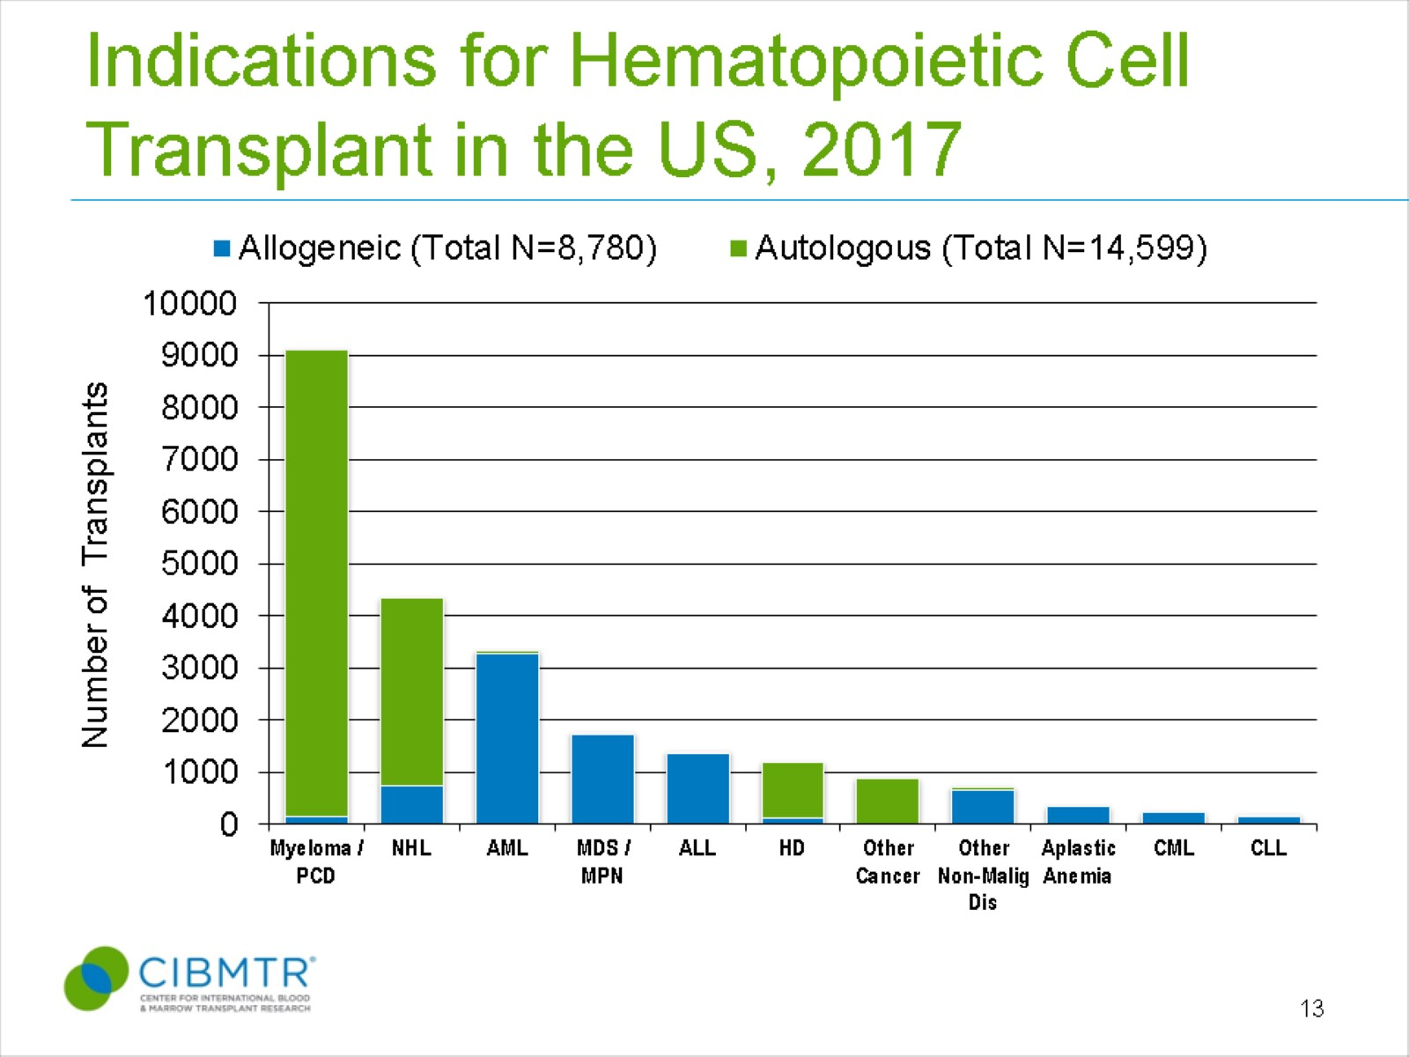
Indications for Hematopoietic Cell Transplant in the US, 2017
Notes:
Slide 13: The most common indications for HCT in the US in 2017 were multiple myeloma and lymphomas (NHL and HD) accounting for 63% of all HCTs. Acute leukemias (AML, ALL) and MDS (combined with MPNs) are the most common indications for allogeneic transplants accounting for 72% of allogeneic HCTs. MDS/MPN transplants have increased after the availability of Centers for Medicare and Medicaid Services (CMS)-approved Coverage with Evidence Development studies allowing allogeneic HCT in Medicare-insured patients for MDS (since 2010) and will continue to increase with the approval for myelofibrosis in 2017.

Slide 7
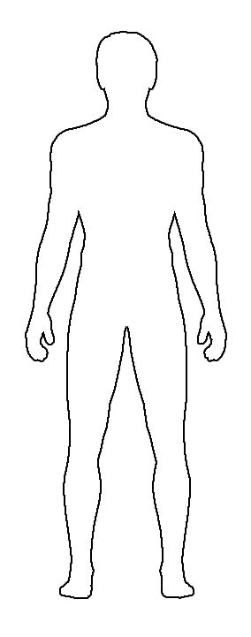

ASCT and Graft vs. Host Disease
Donor
Recipient
SCT
+/- acute GVHD
Conditioning
Engraftment
*ASCT used to treat a variety of malignant and benign hematologic conditions
*GVHD: donor immune system attacks genetically disparate recipient
*Acute GVHD vs. Chronic GVHD
*20-60%: risk of acute GVHD grade 2+ (depending on type of transplant)
*40-50%: response rate to first-line treatment with high-dose steroids

Slide 8
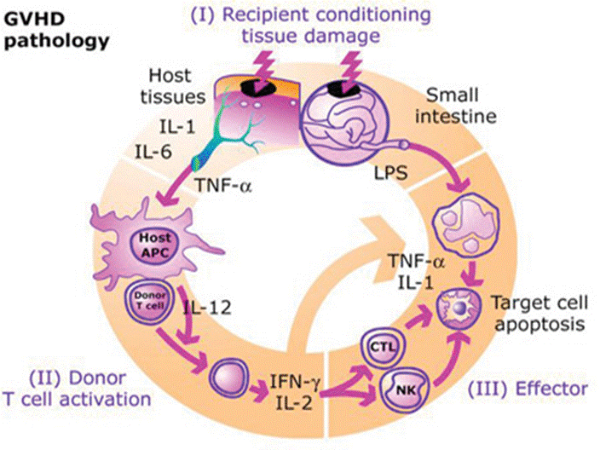
Pathogenesis of Acute GVHD
Notes:
The initiation and maintenance of acute graft-versus-host disease (GVHD) has been conceptualized into distinct phases with positive feedback loops that perpetuate the process.
The first phase is generally considered to be activation of antigen presenting cells (APCs). In many models, the conditioning phase damages host tissue which respond by secretion of proinflammatory cytokines such as TNF-alpha, IL-1, and other “danger signals”. These changes increase expression of costimulatory molecules on APCs, MHC antigens, and chemokine gradients that alert the residual host and donor immune cells. Note that damage to the GI tract is also particularly important as it allows for systemic translocation of immunostimulatory microbial products such as LPS that also activate APCs.
Antigen presentation causes activation of alloreactive donor T-cells that recognized mismatched minor and major histocompatibility complexes constitutes the second phase. Once donor T-cells are activated, the final effector phase occurs, resulting in destruction of the target tissue. The resulting tissue damage, if not treated, will further amplify the process to more severe stages of GVHD pathology, which are extremely difficult to control (Blazar).

Slide 9
Outline
Brief primer on transplant and GVHD
Phase I Clinical Data
Animal / Mechanistic Data
Study Concept

Slide 10

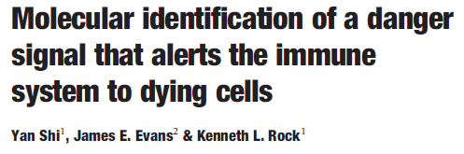
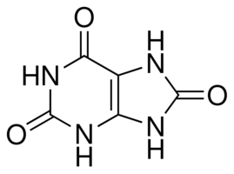
Identification of Uric Acid as Endogenous Adjuvant
CTL priming in mice reduced by 90% in those treated with allopurinol and uricase [1].
Addition of uric acid in vitro stimulated bone-marrow derived DCs to express CD86 (B7-2) and CD80 (B7-1), the effect of which was stronger than LPS [1].
Tumor implants in mice undergoing immune rejection harbored increase uric acid levels, and suppression of uric acid by allopurinol or uricase inhibited tumor immune rejection [2].
Depletion of uric acid reduces the proliferation of autoreactive T-cells in a transgenic diabetes model [3].
Uric Acid
[1] Shi Y, et al. Nature. 2003;425:516-521.
[2] Hu DE, et al. Cancer Res. 2004;64:5059-5062.
[3] Shi Y, et al. J Immunol. 2006;176:3905-3908.
Notes:
A very interesting observation was made over the past decade that shed light on what constitutes the initial “danger signal” that activates the APCs (Show study title). It had been well known that dying cells in the absence of microbial factors release “danger signals” that stimulate APCs to mature, similar to pathogen activated microbial products. Co-injection of dying cells with an antigen into animals is known to have an adjuvant effect, stimulating T-cell responses to the antigen. However, only until recently had it been shown that uric acid is one of primary mediators of this danger signal. Shi et al. purified this endogenous adjuvant activity from the cytosol of damaged cells and showed it to be uric acid, an end product of purine catabolism. Several important findings were made following this observation:
Cytotoxic T-lymphocyte priming in mice is reduced by 90% in those treated with allopurinol and uricase.
Addition of uric acid in vitro stimulated bone marrow derived DCs to express CD86 and CD80, the effect of which was shown to be stronger than LPS.
In a later study, it was shown that tumor implants in mice undergoing immune rejection harbored increase uric acid levels, and that suppression of uric acid by allopurinol or uricase inhibited tumor immune rejection.
Another study demonstrated that depletion of uric acid reduced proliferation of autoreactive T-cells in a transgenic diabetes model where beta-cells in the islets of Langerhans expressed a specific self-antigen.
Combined with our current understanding of acute GVHD, this new insight into a central mechanism behind cell-death mediated inflammation and activation of APCs led us to hypothesize whether depletion of uric acid could inhibit to some degree the onset of acute GVHD.

Slide 11
Phase I Study Design
Hypothesis:
Suppression of uric acid at time of transplantation may modulate the immune activation of host APCs and alter the incidence of acute GVHD.
Uricase given d-7 to d-2
Donor
Recipient
SCT
+/- acute GVHD
Conditioning
Engraftment

Slide 12
Phase I Study Design
Inclusion Criteria:
Indication for conventional myeloablative allogeneic SCT
18< Age <65
GCSF-mobilized PSCs
HLA 6 of 6 antigen matched (A, B, DR) related or unrelated donors
Rasburicase Group
Matched Controls
21 patients
21 patients
IV Rasburicase 0.20 mg/kg (d-7 to -2)
Allopurinol per protocol 300mg QD (d-7 to d-1)
Exclusion Criteria:
Active HIV infection
Uncontrolled DM2
Active CHF
Active angina pectoris
O2 dependent COPD
Failure to give full informed consent
Standard GVHD prophylaxis
MRD: Cyclosporine or tacrolimus + MTX
MUD: Tacrolimus and MTX + Thymoglobulin
1 case of hemolytic anemia (G6PD)
20 patients
Primary outcome: incidence of acute aGVHD grade 2+
Secondary outcome: PFS, OS, MRD/MUD comparison

Slide 13
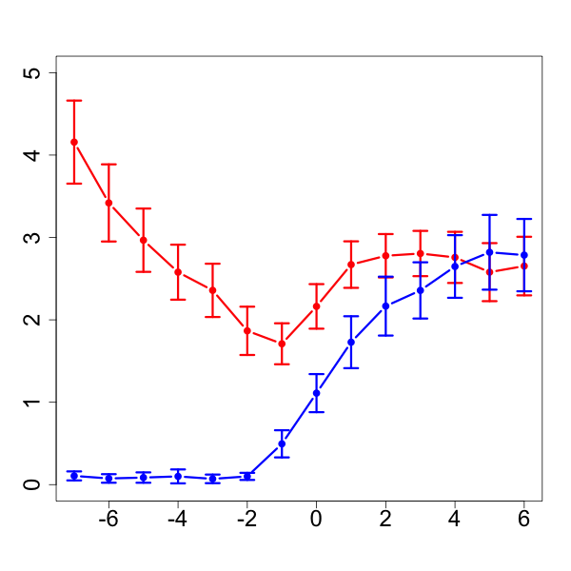
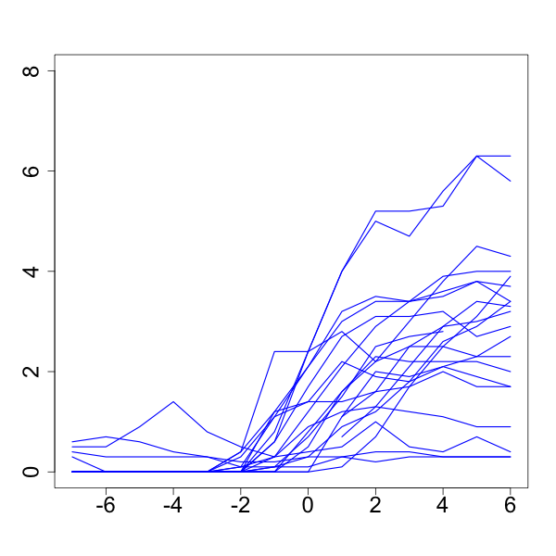
Phase I Study Results
Rasburicase Group
Control
Serum Uric Acid (mg/dL)
Rasburicase
Transplant Day
p<0.0001
Transplant Day

Slide 14
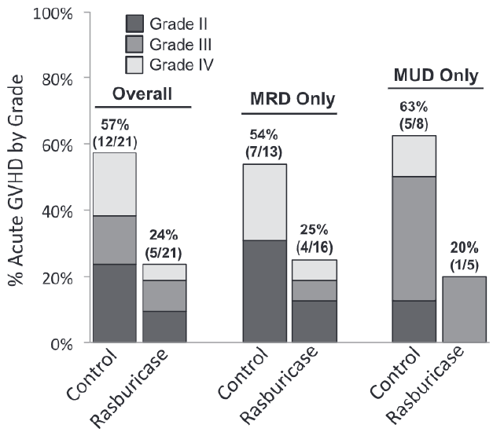
Phase I Study Results

Slide 15
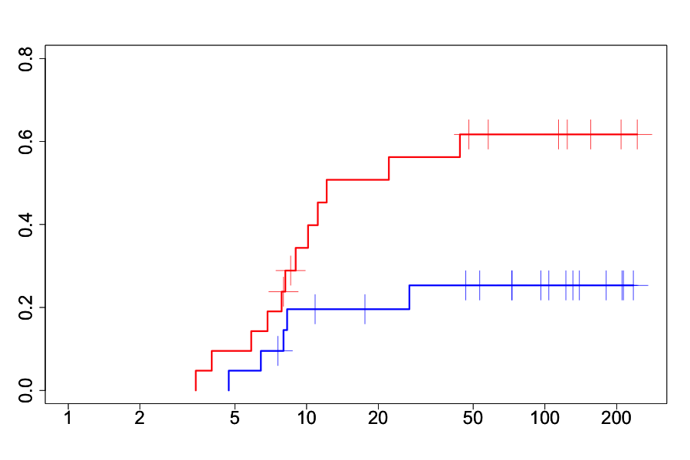
Cumulative proportion of Acute GVHD Grade II-IV
Control
Intention-to-treat
Rasburicase
p=0.036
Post-transplant Time (weeks)

Slide 16
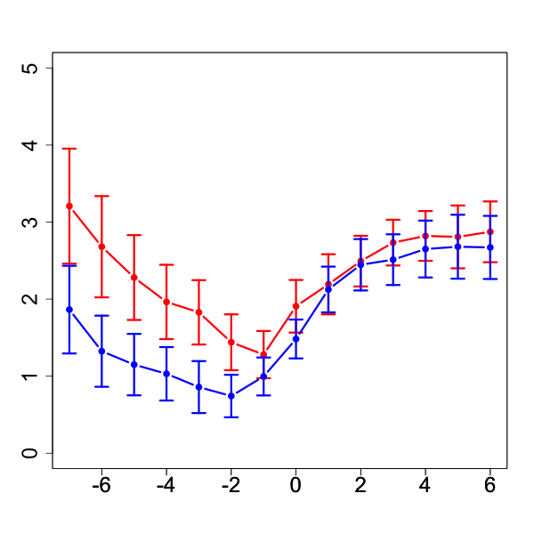
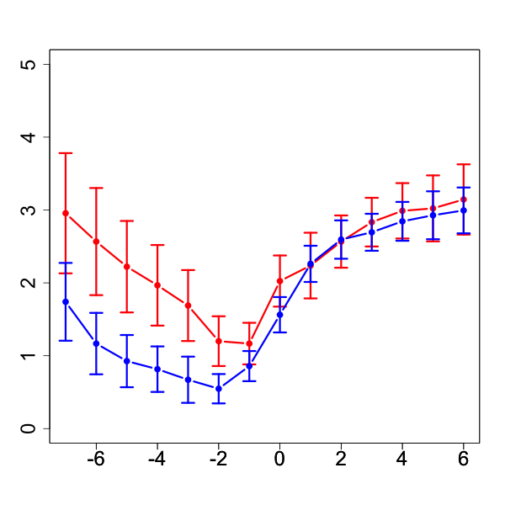
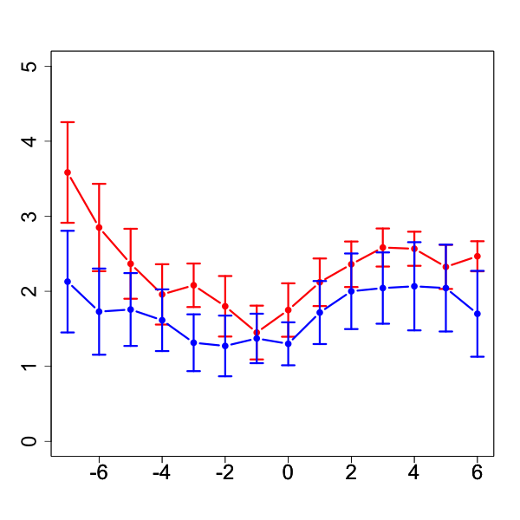
Serum Uric Acid Levels
All Transplants
MRD Only
MUD Only
aGVHD2+
No aGVHD2+
All Patients
Serum Uric Acid (mg/dL)
Transplant Day

Slide 17
Outline
Brief primer on transplant and GVHD
Phase I Clinical Data
Animal / Mechanistic Data
Study Concept

Slide 18
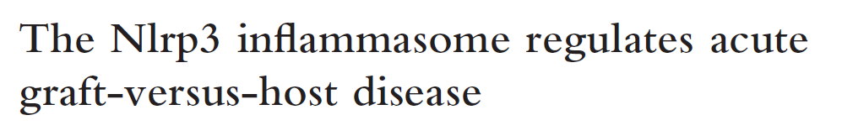
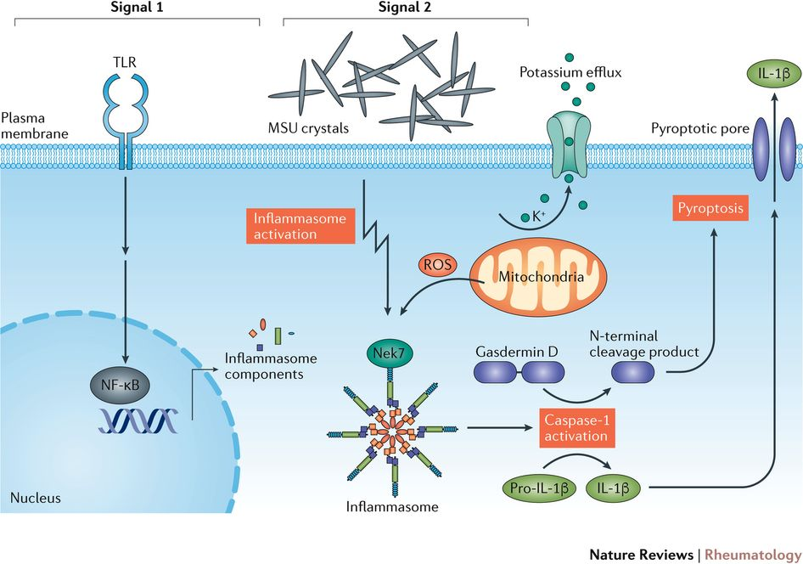

Slide 19
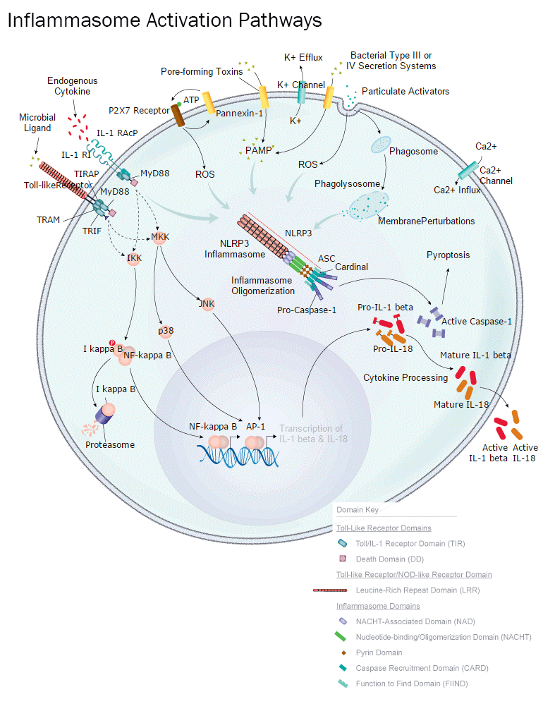
IL-1β
IL-18
https://www.rndsystems.com/pathways/inflammasome-activation-pathways

Slide 20


Reduction of GVHD in Mouse Models
B6
BALB.c
TBI
?GVHD
Transplant
D-1 uricase
D5 uricase

Slide 21
Reduction of GVHD in Mouse Models
B6
BALB.c
TBI

Slide 22
Outline
Brief primer on transplant and GVHD
Phase I Clinical Data
Animal / Mechanistic Data
Study Concept

Slide 23
Pegylated Uricase
Favorable pharmacokinetics for reducing uric acid for the duration of conditioning with a single administration
Safety profile has been established for patients with chronic gout
  We would not require repeated administration

Slide 24
Study Concept
Pegylated uricase (d-7)
Donor
Recipient
SCT
Primary and secondary outcome measures (e.g. incidence, timing, severity of acute GVHD)
Myeloablative Conditioning
Engraftment
1) Phenotypic analysis of host APC and various T-cell subsets from PBMCs.
2) Serum cytokine analysis
3) Serum uric acid levels
4) Pre-transplant and at intervals up to day 100

Slide 27

Headline, Gradient and Watermark slide
Text in Navy, Regular
Switch color and bold for emphasis

Slide 28
A Patient’s Perspective of the Transplant Process at FHCRC
Arrival Conference
Consultation
Data Review
Day 0
Day 100
1-3 months
1-3 weeks
~1 week
~2-3 weeks
Donor Search
Conditioning
Engraftment
LTFU Clinic
Inpatient BMT (UW)
Outpatient BMT (SCCA)
Notes:
The Nobel Prize in Physiology or Medicine 1990 was awarded jointly to Joseph E. Murray and E. Donnall Thomas "for their discoveries concerning organ and cell transplantation in the treatment of human disease.“
Joseph Murry – first kidney transplant in 1954

Slide 29
Annual Number of HCT Recipients in the US by Transplant Type
Notes:
Slide 3: The estimated annual numbers of transplant recipients in the U.S. were compiled according to the number of first transplants registered with the CIBMTR. Estimates of how closely the numbers reported are representative of actual transplant activity vary according to the type of transplant and number of centers reporting data per year. Prior to 2007, all transplants, except unrelated donor allogeneic transplants facilitated by the NMDP, were reported voluntarily. It was estimated that the CIBMTR captured 90% of all unrelated donor transplants performed in the US, 60-90% of related donor allogeneic transplants and 65 to 75% of autologous transplants. These estimates were extrapolated from other databases that capture transplant center activity, accreditation or hospital discharges. After 2007, the Stem Cell Transplant Outcomes Database (SCTOD) was initiated which changed reporting requirements and data capture to an electronic format. The SCTOD requires that all allogeneic transplants performed in the US be registered with CIBMTR. The numbers of allogeneic transplants from the US in the CIBMTR are representative of the total US transplant activity. Data reporting of autologous transplants remains voluntary and the numbers in the CIBMTR database are estimated to be 80% in 2016.
The estimated annual number of allogeneic transplants recipients surpasses 8,000 a year in the US in 2013 with 8631 transplants estimated in 2017, up from 8556 in 2016. The number of autologous transplants recipients in the US continues to increase, most prominently since 2010, mainly from transplants performed for plasma cell and lymphoproliferative disorders extending to older patients.

Slide 30
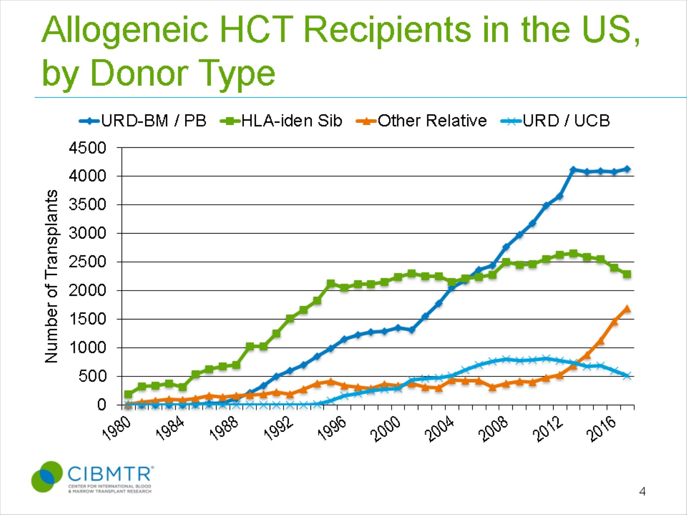
Allogeneic HCT Recipients in the US, by Donor Type
Notes:
Slide 4: Upon further stratifying the number of allogeneic transplants recipients in the US by donor type, recipients of unrelated donor transplants represent the largest group. The number of unrelated donor (URD) transplants has surpassed the number of allogeneic transplants from related donors after 2006 and the gap between these two types of approaches peaked in 2012. After 2012, the numbers of URD and HLA-identical siblings transplants has shown a downward trend in absolute numbers. Transplants performed with alternative donors is increasing. From 2003 to 2011, there were a steady increase in the numbers of transplants using umbilical cord blood as a result of several published studies demonstrating its benefit in both children and adults. From 2012 onward, there was an increase in the numbers of transplants from ‘Other Relatives’, likely due to the use of haploidentical donors with post-transplant cyclophosphamide strategy. In 2014, the numbers of transplants using ‘Other Relatives’ surpassed the total numbers of umbilical cord transplant performed in the US, accounting for 11% of all allogeneic transplants performed in the US. In 2017, this is the only group of donor type that is increasing with all other donor types showing decline or stability in use.

Slide 31
Indications for Hematopoietic Cell Transplant in the US, 2017
Notes:
Slide 13: The most common indications for HCT in the US in 2017 were multiple myeloma and lymphomas (NHL and HD) accounting for 63% of all HCTs. Acute leukemias (AML, ALL) and MDS (combined with MPNs) are the most common indications for allogeneic transplants accounting for 72% of allogeneic HCTs. MDS/MPN transplants have increased after the availability of Centers for Medicare and Medicaid Services (CMS)-approved Coverage with Evidence Development studies allowing allogeneic HCT in Medicare-insured patients for MDS (since 2010) and will continue to increase with the approval for myelofibrosis in 2017.

Slide 32
Results – Baseline Characteristics
 | Rasburicase (N=21) | Control (N=21)
Age (M, range) | 42.9 (20-59) | 45 (21-55)
Male (n, %) | 14 (67%) | 9 (43%)
Disease (n, %)
Acute Myelogenous Leukemia | 14 (67%) | 13 (62%)
Acute Lymphoblastic Leukemia | 5 (24%) | 4 (19%)
Myelodysplastic Syndrome | - | 1 (5%)
Non-Hodgkin Lymphoma | - | 2 (10%)
Myeloproliferative Disease | 2 (10%) | -
Chronic Myelogenous Leukemia | - | 1 (5%)

Slide 33
Results – Baseline Characteristics
Transplant Characteristics (n, %)
Engraftment Time (M, range) | 15 (13-28) | 15 (14-29)
First Transplant | 21 (100%) | 19 (90%)
Matched Related Donor | 16 (76%) | 13 (62%)
Cyclosporin + Methotrexate | 14 (86%) | 11 (85%)
Tacrolimus + Methotrexate | 2 (14%) | 2 (15%)
Matched Unrelated Donor | 5 (24%) | 8 (38%)
Tacrolimus + Methotrexate + ATG | 4 (80%) | 8 (80%)
Tacrolimus + Methotrexate | 1 (20%) | 2 (20%)
Disease Status at Time of Transplant (n, %)
Complete Remission | 20 (95%) | 21 (100%)
Conditioning Protocol (n, %)
Busulfan + Cyclophosphamide/Fludarabine* | 14 (67%) | 16 (76%)
TBI + Cyclophosphamide | 7 (33%) | 5 (24%)
Notes:
Add conditioning regimens.

Slide 34
Safety
Notes:
The most common type of adverse events was mucositis, nausea, diarrhea, and vomiting, which were no different compared to control. The only grade III or IV adverse event attributable to rasburicase was 1 case of intravascular hemolysis in G6PD patient. One case of thrombocytopenia thought secondary to antibiotics (grade III), and one case of tongue swelling that resolved with no interference in oral intake (grade II).

Slide 35
Incidence of chronic GVHD
Control
Rasburicase
No cGVHD
4 (19%)
Mild cGVHD
7 (33%)
9 (43%)
Moderate-severe cGVHD
9 (43%)
8 (38%)
5 (24%)
Notes:
- No difference in incidence of cGVHD
- No difference in severity of cGVHD but trend towards milder disease in rasburicase group.

Slide 36
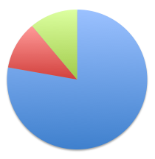
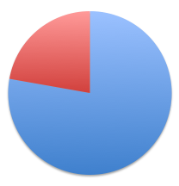
Causes of Mortality
Causes of mortality
9 deaths in control group
9 deaths in rasburicase group
1
2
Relapsed disease
1
Primary infection
Sequelae of GVHD
7
7
Notes:
Of note, our study was not powered to detect differences in overall survival
9 deaths in control group
7 cases of relapsed disease
1 case of infection associated with increased immunosuppresion from aGVHD at day 177
1 case of respiratory failure from fibrotic lung disease / pneumonia at day 60.
9 deaths in rasburicase group
7 cases of relapsed disease
1 case of H1N1 flu at day 510
1 case of metapneumovirus pneumonia at day 55

Slide 37
Section transition slide

Slide 39


Thank you or Transition Slide

