Slide 1
NIOS II Emulator Increment 1 Retrospective
Team 12
Team Members
Jake Ediger
Alex Michael
Alex Czarnick
Avinash Nooka

Slide 2
Overview
Project Description
Functional Requirements
Nonfunctional Requirements
Use Cases (or Scenarios)

Slide 3
Project Overview
The NIOS II Emulator’s primary purpose is to replicate the behavior of Altera’s NIOS II architecture, commonly found in FPGAs.
Creating an emulation of the chip and creating an environment for development brings life back to an aging system. Our system is designed to be a one and done solution for testing assembly code for the NIOS II processor without needing a separate board or micro controller.
When completed, the emulator will not only mimic the NIOS II exactly but will make coding and debugging in assembly more user friendly.

Slide 4
Objectives and Success Criteria
The system will emulate a 32 bit NIOS II processor capable of running all instructions of the actual NIOS II can.
Design of a 64 kilobyte memory block that is addressable on 16 bits.
Displaying 32 registers along with special registers.
Design of a processor that exists in three states; running, paused, and not ready.
Design of a GUI that provides an intuitive user interaction.

Slide 5
Proposed System Overview
The system will be able to emulate the NIOS II processor by running inputed assembly code and showing register values, and current processor state. It will be based on the functional and nonfunctional requirements.
This proposed system entails the following features:
input consisting of a text file containing NIOS II assembly code that is fed in and parsed
a simulated little endian memory holding the same values as real memory would in an FPGA
a GUI (Graphical User Interface) that displays information about the current process
a debugging aid that will inform the user with information on errors or potential problems

Slide 6
Overview
Project Description
Functional Requirements
Nonfunctional Requirements
Use Cases (or Scenarios)

Slide 7
Functional Requirements
F1: Read in a text document of assembly instructions and labels by parsing each line and executing them correctly by identifying which instructions, registers, and labels are being used.
F2: Simulate a 32 bit, little endian processor environment with 16 bit memory addresses and 32 general purpose registers. Although these addresses will be simulated, they will behave the same as an actual NIOS II processor.
F3: Display current processor state as; “RUNNING,” “PAUSED,” and “NOT READY.” This will be done through the GUI.

Slide 8
Functional Requirements
F4: Represent a 64 kilobyte byte-addressable block of memory for specific data accessibility. Like F2, this memory will be simulated but behave identically to the NIOS II memory.
F5: Display Program Counter value and contents of the 32 general purpose registers and special registers. These values will be shown in the GUI.
F6: Run, Pause, and Reset buttons for controlling the program with the ability to step through and debug assembly code for fixing bugs or examining segments of code. These buttons will be usable through the GUI.

Slide 9
Functional Requirements
F7: User can add, update or delete in memory through the GUI.
F8:The user will have the ability to specify up to 16 memory locations to the monitor. For each user specified memory location, the program should display the four contiguous bytes starting at that memory location in hexadecimal.
F9: A functional and intuitive GUI that will fulfill the previous functional requirements, as well as being intuitive to somebody familiar with the NIOS II architecture.

Slide 10
Overview
Project Description
Functional Requirements
Nonfunctional Requirements
Use Cases (or Scenarios)

Slide 11
Nonfunctional Requirements
N1: Performance
The system should provide an execution time that is indistinguishable from the actual NIOS II chip
The system should show data to the GUI in real-time
N2: Usability
The input file format will be clearly described to avoid pre-runtime errors
The GUI should be intuitive to use for anybody with experience in NIOS II
Errors that occur will be clearly described to the user to aid debugging

Slide 12
Nonfunctional Requirements (cont.)
N3: Stability and Reliability
The system should be able to handle basic errors while providing information on bugs
N4: Platform Compatibility
The system will be able to run on multiple operating systems, provided the correct software is installed beforehand
The system will provide an almost identical look across all compatible operating systems

Slide 13
Overview
Project Description
Functional Requirements
Nonfunctional Requirements
Use Cases (or Scenarios)

Slide 14
Scenarios
Runtime Steps | User’s Experience
Text file with assembly code of length ‘N’ is fed into the system. The text file is parsed into assembly code. The assembly code is ran through the system. The system sends real time values to the GUI. The system finishes running the assembly code and displays the end values of registers with a completion message | User will start program with their desired file. System will display “Parsing” message until parsing is done. While system runs through assembly code, user will be able to see current values. After code is finished, system will display completion message and the last known values

Slide 15
Use Case:
Entry Condition: | Processor is NOT READY
Flow: | User inputs text file Text file is parsed and checked for code errors
Exit Condition: | Processor is PAUSED

Slide 16
Use Case:
Entry Condition: | Processor is PAUSED
Flow: | User presses run
Exit Condition: | Processor is RUNNING

Slide 17
Use Case:
Entry Condition: | Processor is RUNNING
Flow: | System executes BREAK DISPLAY registers OR User presses pause DISPLAY registers
Exit Condition: | Processor is PAUSED

Slide 18
Entry Condition: | Processor is RUNNING
Flow: | System executes code DISPLAY registers
Exit Condition: | Processor is RUNNING

Slide 19
Summary
Project Description
Functional Requirements
Nonfunctional Requirements
Use Cases (or Scenarios)

Slide 20
Increment 2 - Project Overview
Use Case Model
-Use Case actions that the NIOS 2 emulator will perform in collaboration with the user of the system.
Domain Model
Object Model
- An overview of our running system using classes and objects.
Dynamic Model
- Represents the interaction, workflow, and different states of the components in the NIOS 2 system emulator.

Slide 21
Use Case Diagrams
These diagrams will be representing the main functionalities of our program.

Slide 22
Use Case Diagram

Slide 23
Domain Model
Formal representation of our classes, roles, datatypes, users, rules, and logic.

Slide 24
Object Model

Slide 25
Dynamic Model
Our Domain model’s behavior using UML sequence diagrams.
The sequence diagrams will go into more detail of hour our system will behave for each case in our Use Case Model

Slide 26
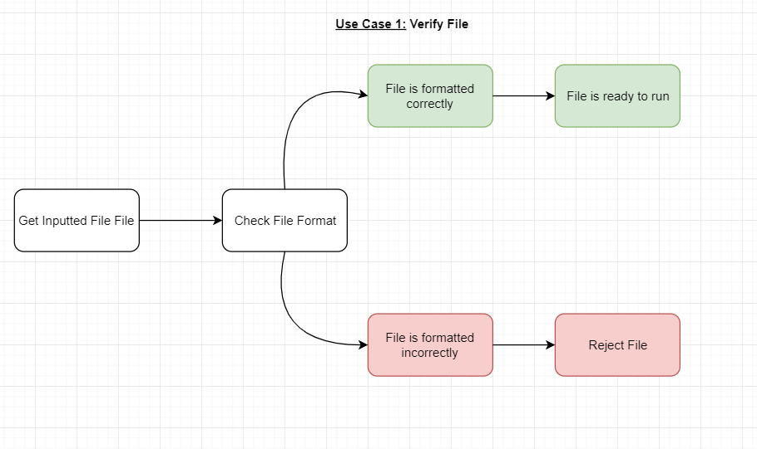

Slide 27
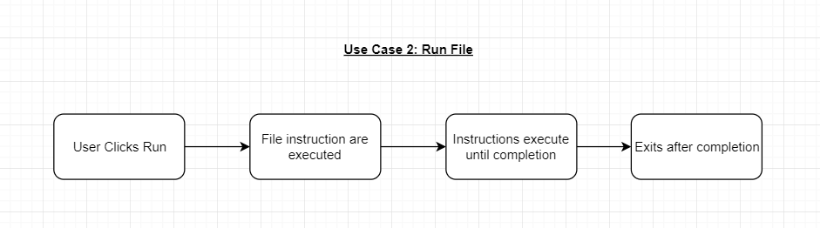

Slide 28
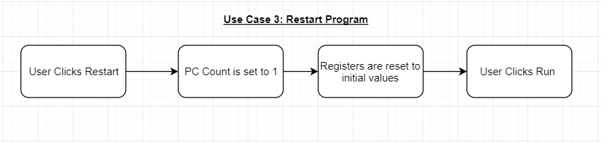

Slide 29
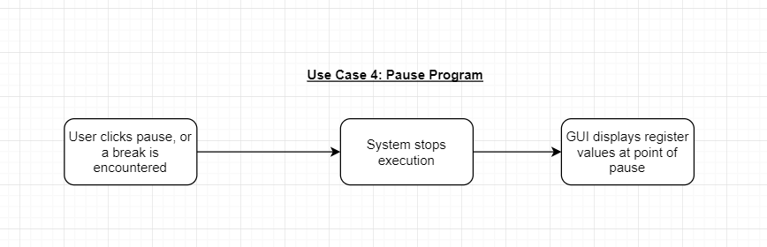

Slide 30
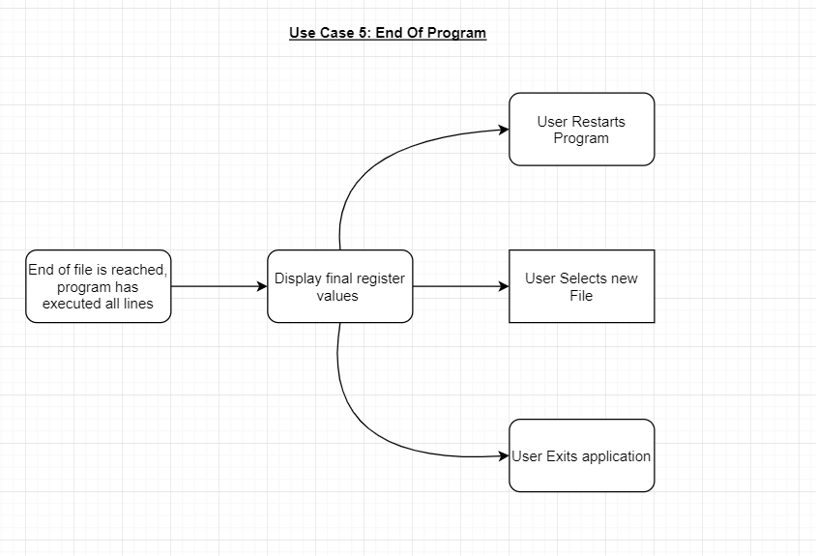

Slide 31
