Slide 1
CS4710: Artificial Intelligence Course Introduction
What is this course about? How much homework is there? How hard will I have to work? Will I pass if I am drunk while doing the homework? Other important questions!

Slide 2
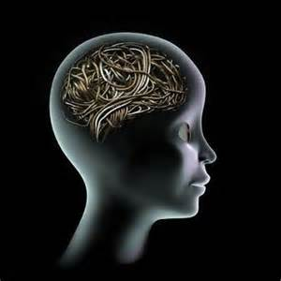
Course Info:
MTWRF @ 10:30-12:45
With breaks…of course!
Instructor:
Dr. Mark Floryan
Office: Rice 203
TAs:
Yuchi Tian (yt8mn@virginia.edu)

Slide 3
Pre-requisites
Absolutely Required:
CS2150 (Prog. and Data Rep.)
CS2102 (Discrete Math)
Helpful, but not (technically) required:
CS4102 (Algorithms)
Probability
We’ll review some of this when necessary
Statistics
Not much, but a little stat is helpful

Slide 4
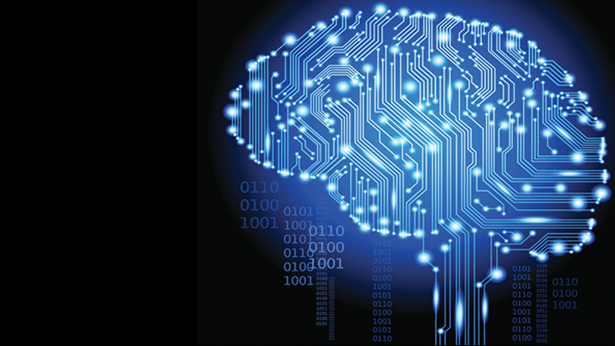
I Expect You to Know
Graphs
Comfortable implementing a graph
Adj. List or Adj. Matrix
If you aren’t comfortable with graphs, review them NOW!
At some point, we will do a VERY short review of this
Basic Discrete Math Material
Propositional Logic
Basic logic and inference

Slide 5
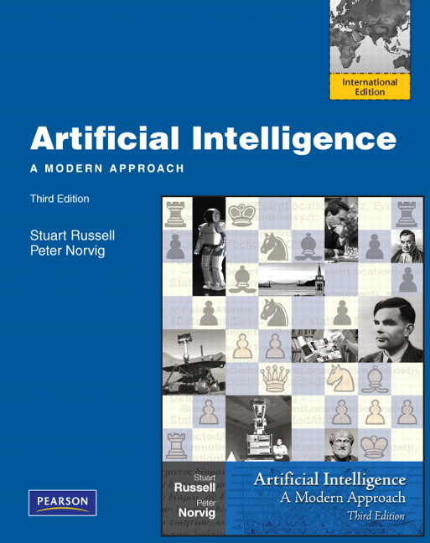
Textbook (Required)
Artificial Intelligence: A Modern Approach
Third Edition
Stuart Russel & Peter Norvig
ISBN: 978-0136042594
We will be following the book loosely
So you can probably survive without it, but I recommend having it.

Slide 6
Topics (As of right now)
Introduction to AI
Knowledge Representation
Expert Systems
Search
Reasoning Under Uncertainty
Multi-Agent Systems
Machine Learning
Course is meant to be an overview of AI, so won’t go completely into any one topic.
* Might add some natural language processing, computer vision, etc. if time allows.

Slide 7

Midterms
Three midterms and one final:
We will have a test every Friday
First one is just an essay
Other ones are traditional technical exams
Exams designed to take ~1.5 hours at most

Slide 8

Homework: The Meat of the Course
5 of these (small chance we remove or add one, but most likely 5)
50% of your grade
Programming problems
Problems will be well-defined, but many solutions possible
For each you will:
Turn in your code
Usually some kind of write-up regarding your solution

Slide 9
Homework: The Meat of the Course
Recommendations:
Start Early!! These HWs generally are not of the “just implement something” form.
You will need to:
Implement an algorithm
Test it, see where it does well and fails
Tweak it and see how performance changes
Test on MANY different types of inputs
Analyze the differences
Write an analytical paper about it

Slide 10
Homework Groups
You may work in groups of 2 on the homework. NO MORE!
Only one submission necessary, but must let us know who your partner was.
Can have different partners on different assignments if you want.
Collaboration outside of your group, in any way, is an honor violation unless otherwise stated.

Slide 11
Homeworks:
HW 1: Automatic Theorem Prover
HW 2: Pathfinding (with a probabilistic twist!)
HW 3: Ticket To Ride AI
HW 4: Negotiation
HW 5: Machine Learning

Slide 12
Homework: Late Policy
You may use up to two late days throughout the semester
This means you cannot complain about various things that happen to you
Interviews
Emergencies
Etc.
…this is what the late days are for
Of course, happy to discuss truly extraordinary circumstances

Slide 13

Grading
25% Midterms
20% Final Exam
50% Homeworks
5% Attendance / Participation
Keeping it simple

Slide 14
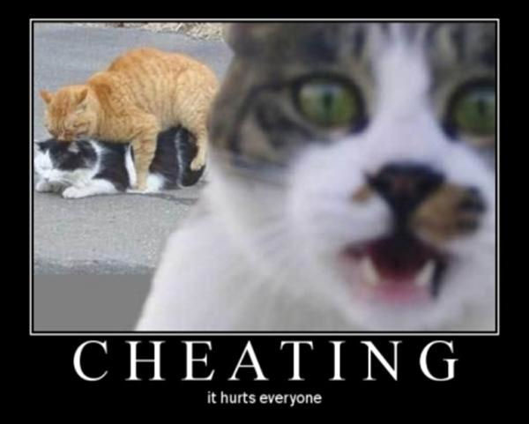
Cheating
Let’s define cheating:
Looking at someone else’s code (online or elsewhere)
Someone outside your group writing your code
Not cheating:
Discussing the HW at a high level
Looking at pseudo-code or instructional videos online (as long as there is no code)

Slide 15
Ok…I think that is all
You have an assigned reading tonight:
“Computer Science as Empirical Inquiry: Symbols and Search”
-Allen Newell and Herbert Simon
This is due tomorrow. You must have read this, I will check somehow…hmmmmmm.

