Slide 1
CS4710: Artificial Intelligence Intro to AI
What are some typical AI problems? How do we approach them? What are the different sub-fields of AI? Is true AI really achievable?

Slide 2
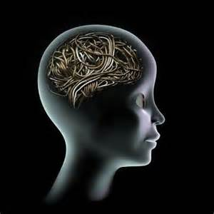
Topics
What is AI?
Summary of typical AI problems
Planning
Vision
Learning
Etc.
Knowledge Representation Overview
Is AI achievable?

Slide 3
What is AI?

Slide 4
Artificial Intelligence:
What do you all think it is?

Slide 5
Artificial Intelligence:
…is the intelligence exhibited by machines or software. It is an academic field of study which studies the goal of creating intelligence. Major AI researchers and textbooks define this field as "the study and design of intelligent agents", where an intelligent agent is a system that perceives its environment and takes actions that maximize its chances of success.

Slide 6
Typical AI Problems

Slide 7

A Simple Task
Imagine you simply need to go shopping.
What are some of the complex things you have to accomplish?
This is the part where we congratulate ourselves for simple tasks and realize how AMAZING humans are

Slide 8
A Simple Task
Planning:
Formulating a sequence of actions
What directions to use, order of shops to visit
Vision
Making sense of the world we see
Recognizing faces, etc.
Robotics
Acting in the world and perceiving our environment directly
Natural Language
Speaking and understanding others
Learning
Adapting from our experiences

Slide 9

Planning
Discovering a set of actions to take.
Think of a robot that isn’t moving yet, but is standing around planning out what it will do.
This is very common if agent has a lot of information about it’s environment.
E.g., If I now all the information about roads, intersections, etc. I can write a GPS system that finds paths for me.
But what if I don’t have that information?
What if that information is uncertain?

Slide 10
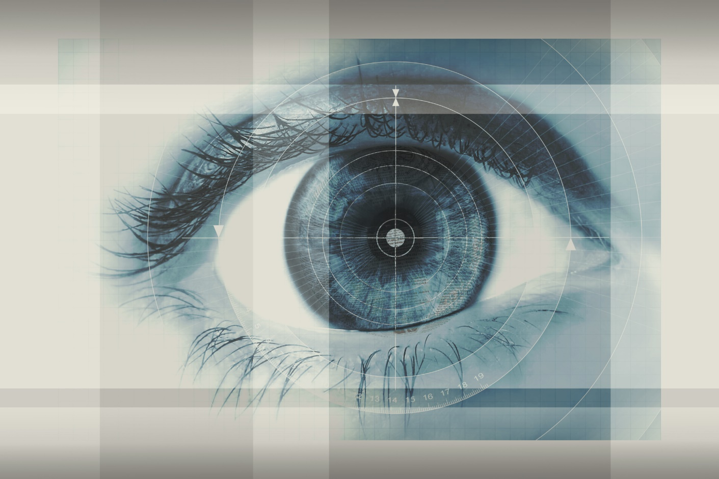
Vision
Making sense of the world around us that we see.
Can’t plan a path if I have no information, might have to look around.
Problems in this area:
Recognizing objects in a scene
Scene reconstruction
Motion Analysis
Some other vision systems that you might use include…?

Slide 11
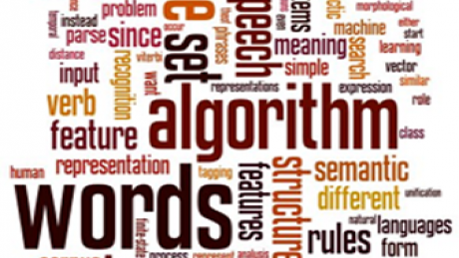
Natural Language
Let’s think for a second about how AMAZING natural language is.
We are able to:
Listen to sounds, understand words, interpret meaning.
Create and construct new sentences on the fly.
I’m doing this right now.
This is literally incredible!
Other NLP systems we use?

Slide 12
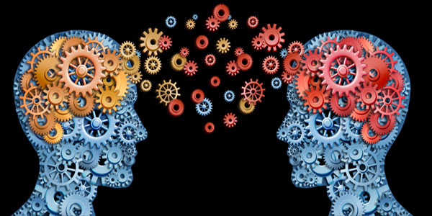
Learning
What are some different ways in which we learn?
What are some ways in which computers learn?
What are some systems we use today that learn?

Slide 13
Defining Intelligence
What are some of the running themes we are seeing so far?

Slide 14

Some tasks require experts
Medical Diagnosis
Equipment Repair
Computer Configuration
Financial Planning
We can develop systems that do these things to!

Slide 15
Expert Systems
Expert Systems attempt to simulate how an expert human goes about accomplishing a task.
Why might development of these systems be difficult / different from other systems?

Slide 16
Knowledge Representation

Slide 17
Overview
Most “intelligence” requires a lot of information.
Need to represent this information somehow.
Several different general approaches
Required reading on Collab for this. Due next time!!

Slide 18
Formal Systems
Use axioms and formal logic
Logical statements evaluated to determine the systems output
Usually perceives the world directly to evaluate truth value of certain inputs
What are some uses of this type of system?

Slide 19
Ontologies
Structuring knowledge in graph form
Usually consists of nodes, interconnections, etc.
Many variations

Slide 20
Statistical Methods
Some AI systems use statistics to make “educated guesses” about what action to take.
EXAMPLE:
Learning systems can be shown pictures of 1000 faces and build a statistical model of how people look.
The system will then be able to probabilistically guess when it sees a face (or even detect who the person is)
Some uses of this?

Slide 21
Is True AI Achievable?
Some thought experiments on whether AI is even possible. The Turing Test and other philosophical things.

Slide 22
Is “true” AI Possible?
Guess we have to define “true”
Let’s start with a preliminary definition:
An AI is intelligent if it acts like a human
Is this good enough?

Slide 23
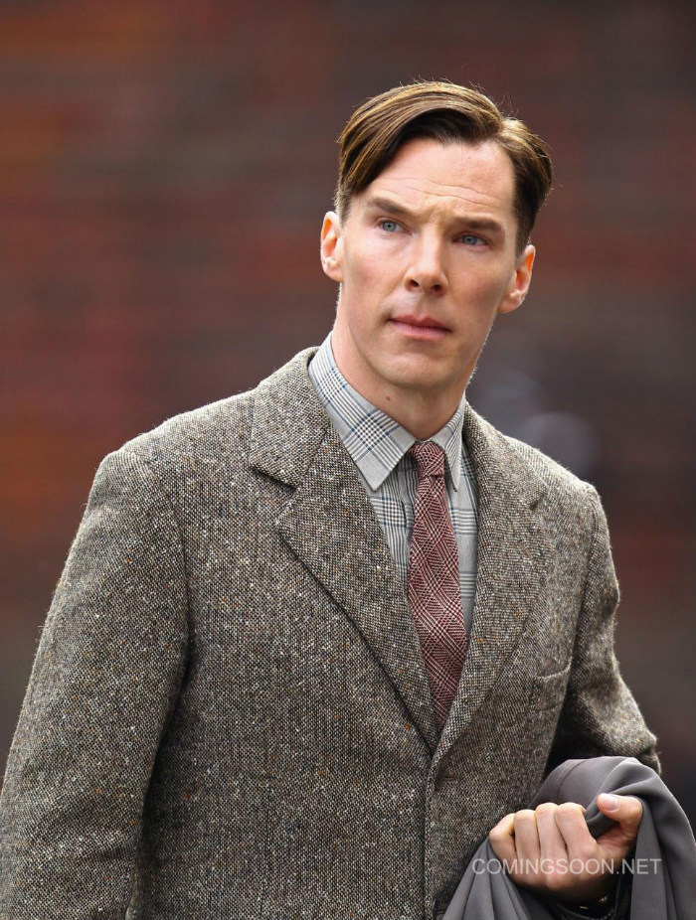
The Turing Test
Introduced by Alan Turing in 1950
He called it “The Imitation Game”
WOAH! Like the movie!
Simple Test
Examiner chats with an agent on a computer (via chat console)
Examiner must determine if the agent is a computer or a real human
The machine passes the test if it convinces examiner that it is a human

Slide 24
The Turing Test
Corollary:
If a system acts as intelligently as a human being, then it is as intelligent as a human being
Do you agree?

Slide 25
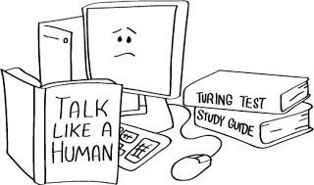
Determinism
Is the human mind deterministic?
If so, then it seems we should be able to simulate it
This starts to make us, as human beings, feel a bit insignificant

Slide 26
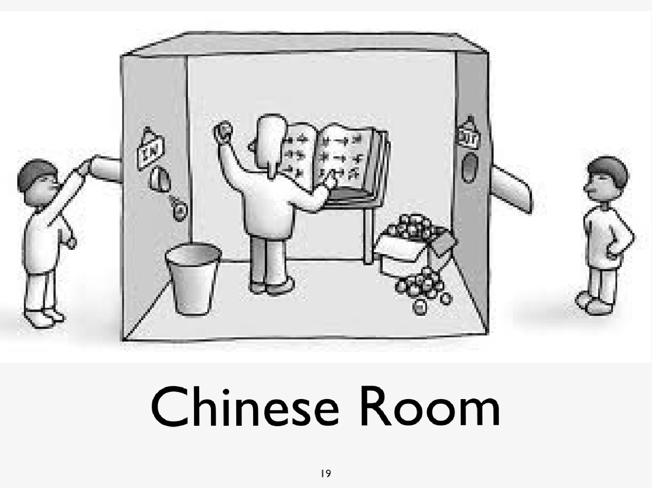
The Chinese Room Argument
Introduced by John Searle
Meant as a rebuttal to the Turing Test and to claims that intelligence is deterministic
Formally, Searle was refuting this claim:
"The appropriately programmed computer with the right inputs and outputs would thereby have a mind in exactly the same sense human beings have minds."

Slide 27
The Chinese Room Argument
Imagine you are in a room
You have a book which:
Given series of Chinese symbols (which you can’t read)
Maps to a new set of symbols
There is a hole on each end

Slide 28
The Chinese Room Argument
What are the results of this experiment?
What are the implications?
Is the Turing Test a valid test for intelligence?
What would be a better test for intelligence?

Slide 29
Emotions
Can a system, then, feel emotions such as love?
The determinist would still say yes…why?

Slide 30
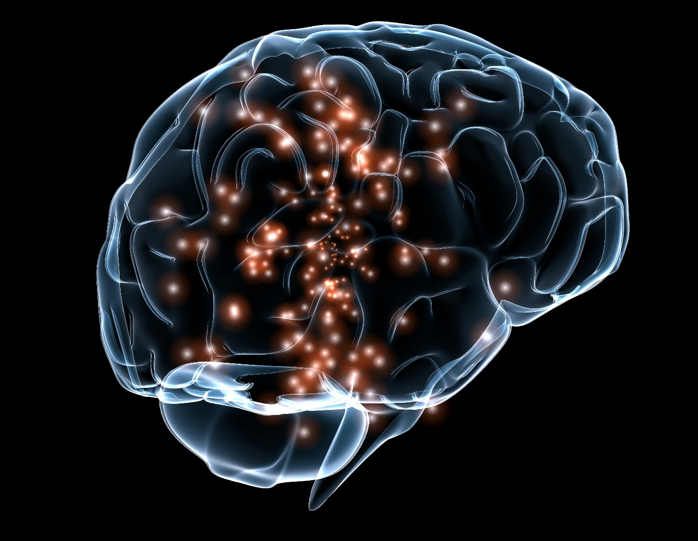
China Brain
Another thought experiment
Lawrence Davis (1974)
Ned Block (1978)
Assume our brain is intelligent (seems fine)
Now assume someone is tasked with hitting a button to manually fire one neuron (because that neuron is otherwise broken)
Take this to the extreme (all neurons)
Are you still a human being? Intelligent?

Slide 31
Summary
The core philosophical question is whether intelligence is purely deterministic (and thus programmable)…
…Or if humans have something innately human that cannot be represented (consciousness, a soul, etc.)

Slide 32
Conclusion

Slide 33
AI in Practice
Isn’t really mystifying
We don’t have the “secret” to human intelligence, and certainly haven’t shown we can program it.
However! We can use techniques to simulate human intelligence in various ways.
No technique currently exists that gives a system a sense of “consciousness”
A very philosophical concept as we’ve seen

Slide 34
AI in Practice
So…AI is building systems that
Perceive their environment directly
Represent knowledge in a useful way
Execute algorithms
Produce an action (output) in the physical world (speech, robotics, etc)
Which means much of AI is about how to represent knowledge (2150 is useful here) and how to construct algorithms that do something useful (“intelligent”)

