Slide 1
CS4710: Artificial Intelligence Expert Systems
Some processes can only be reasonably done by experts. How do we model this knowledge and build such systems?

Slide 2

Topics
What is an Expert System / Brief History
Example: Rule-Based Expert Systems
Concrete Example: CLIPS
Software Engineering Process for Expert Systems

Slide 3
WHAT IS AN EXPERT SYSTEM?
An expert system is a computer program that contains some of the subject-specific knowledge of one or more human experts.
Notes:
An expert system contains knowledge about a particular field to assist human experts or provide information to people who do not have access to an expert in the particular field.

Slide 4
Expert System Problem Categories
Interpretation: Forming high level conclusions from raw data
Example: People who go to UVa tend to get good jobs
Prediction: Projecting probable consequences of situations
Example: “If patient has grave’s disease they will get hyperthyroidism”
Diagnosis: Determining cause of malfunctions in complex situations based on symptoms
Example: “Given blood test results and other symptoms it is likely you have diabetes”
Design: Finding a configuration of system components that meets a set of goals
Example: Smart home. Need certain appliances but want to keep energy usage low.
Notes:
An expert system contains knowledge about a particular field to assist human experts or provide information to people who do not have access to an expert in the particular field.

Slide 5
Expert System Problem Categories
Planning: Devising a set of steps to reach a set of goals (generated on the fly)
Example: “Here are a set of steps that will fix your computer”
Monitoring: Comparing observed behavior to expected behavior
Example: “Warning: oxygen levels coming out of engine are too low, throw check engine error”
Instruction: Assisting in the education process in technical domains
Example: “In order to learn guitar, the optimal next exercise is to practice your scales”
Control: Governing the behavior of a complex environment
Example: Establishing actions of a robotic arm that does something
Notes:
An expert system contains knowledge about a particular field to assist human experts or provide information to people who do not have access to an expert in the particular field.

Slide 6
Expert Systems: Brief History

Slide 7
Early 70s
Goal of AI scientists → develop computer programs that could in some sense think .
In 60s→ general purpose programs were developed for solving the classes of problems but this strategy produced no breakthroughs.
In 1970→ it was realized that The problem-solving power of program comes from the knowledge it possesses.
Notes:
The phase of the computer revolution, from which expert systems developed, actually started in the early seventies. While computer hardware specialists were developing microchip technology, software specialists (the people who design and build the programs to control the computers), were laying the groundwork for a breakthrough in the software area in the field of computer science known as artificial intelligence-AI.
The goal of AI scientists had always been to develop computer programs that could in some sense think, that is, solve problems in way that would be considered intelligent if done by human.
In the sixties AI, scientists tried to simulate the complicated process of thinking by finding general methods for solving broad classes of problems; they used these methods in general-purpose programs. However despite some interesting progress, this strategy produced no breakthroughs. Developing general-purpose programs was too difficult and ultimately futile. The more classes of problems a single program could handle, the more poorly it seemed to do on any individual problem. It was therefore decided that if it was too difficult to make an entire program general purpose, they would concentrate instead on developing general methods or techniques to use in more specialised programs.
It wasn’t until the late 1970s that AI scientists began to realise something quite important: The problem-solving power of program comes from the knowledge it possesses, not just from the formalisms and inference schemes it employs.

Slide 8

To make a program intelligent, provide it with lots of high-quality, specific knowledge about some problem area.
Notes:
This conceptual breakthrough can be quite simply stated: -
To make a program intelligent, provide it with lots of high-quality, specific knowledge about some problem area.
This realization led to the development of special-purpose computer programs, systems that were expert in some narrow problem area.
These programs are called expert systems, and thus a new field began.

Slide 9
Aside: Discrete Math Review

Slide 10

Predicate Logic
Powerful way to represent most facts
Allows for inference
Modus Ponens, etc…
Is relatively flexible, and common in AI systems.

Slide 11
Propositions
A proposition is a variable that represents a statement and has a true/false value
P = “Allison Likes Cakes”
Q = “Allison Eats Cakes”
*P & Q are arbitrary, can use any symbol
P & Q can be either true or false

Slide 12
Basic Connectives
∧
P ∧ Q
Allison likes cakes AND Allison eats cakes
∨
P ∨ Q
Alisson likes or eats cakes
¬
¬P
Allison does not like cakes

Slide 13
Conditionals
→
P → Q
If Allison likes cakes then she eats them
⬄
P ⬄ Q
Allison likes cakes iff she eats them

Slide 14
Functional Propositions
Common for propositions to be functions and have arbitrary parameters.
cake(C) = “C is a cake”
likes(T) = “Allison likes T”
Gives us some more general expressing power

Slide 15
Quantifiers
∀
For all quantifier
∀c (cake(c) → likes(c))
For all cakes, Allison likes them
∃
Exists quantifier
∃c | cake(c)
There exists something that is a cake (Thank God!)

Slide 16
Modus Ponens
P
P → Q
∴ Q
Similarly:
¬Q
P → Q
∴ ¬P

Slide 17
Example: Rule-Based Expert Systems

Slide 18
Rule-Based Architecture
Control Scheme (Interpreter)
Condition-Action Rules
IF alarm_beeps THEN ADD smoky
IF hot AND smoky THEN ADD fire
IF fire THEN ADD switch_on_sprinklers
Database of Facts
alarm_beeps
hot

Slide 19
Acquiring New Facts
By human operator simply telling the system something is true.
Example?
By interacting with the environment directly
Temperature sensor determines whether hot is set to true or false
Others?

Slide 20
Forward Chaining
Until special HALT symbol in DB
Pick a logical rule that can be applied
Add resulting truth statement to DB of facts
Continue until no new knowledge can be created
This continues indefinitely, until a special halt signal is given, or every time a DB fact is updated or changed externally.

Slide 21
Forward Chaining: Simple Example
Control Scheme (Interpreter)
Condition-Action Rules
IF alarm_beeps THEN ADD smoky
IF hot AND smoky THEN ADD fire
IF fire THEN ADD switch_on_sprinklers
Database of Facts
alarm_beeps
hot

Slide 22
Forward Chaining: Simple Example
Control Scheme (Interpreter)
Condition-Action Rules
IF alarm_beeps THEN ADD smoky
IF hot AND smoky THEN ADD fire
IF fire THEN ADD switch_on_sprinklers
Database of Facts
alarm_beeps
hot
smoky

Slide 23
Forward Chaining: Simple Example
Control Scheme (Interpreter)
Condition-Action Rules
IF alarm_beeps THEN ADD smoky
IF hot AND smoky THEN ADD fire
IF fire THEN ADD switch_on_sprinklers
Database of Facts
alarm_beeps
hot
smoky

Slide 24
Forward Chaining: Simple Example
Control Scheme (Interpreter)
Condition-Action Rules
IF alarm_beeps THEN ADD smoky
IF hot AND smoky THEN ADD fire
IF fire THEN ADD switch_on_sprinklers
Database of Facts
alarm_beeps
hot
smoky
fire

Slide 25
Forward Chaining: Simple Example
Control Scheme (Interpreter)
Condition-Action Rules
IF alarm_beeps THEN ADD smoky
IF hot AND smoky THEN ADD fire
IF fire THEN ADD switch_on_sprinklers
Database of Facts
alarm_beeps
hot
smoky
fire

Slide 26
Forward Chaining: Simple Example
Control Scheme (Interpreter)
Condition-Action Rules
IF alarm_beeps THEN ADD smoky
IF hot AND smoky THEN ADD fire
IF fire THEN ADD switch_on_sprinklers
Database of Facts
alarm_beeps
hot
smoky
fire
switch_on_sprinklers

Slide 27
Conflict Resolution
Which rule to apply when many choices available?
What are some ways we could deal with this?
Discuss!
Can you devise a situation when the order of rule application might be important?

Slide 28
Reason Maintenance
What if a fact is removed
E.g., if ‘hot’ is removed from the DB of facts.
This means some other acquired facts may now be invalid?
How would you deal with this?

Slide 29
Reason Maintenance
Control Scheme (Interpreter)
Condition-Action Rules
IF alarm_beeps THEN ADD smoky
IF hot AND smoky THEN ADD fire
IF fire THEN ADD switch_on_sprinklers
Database of Facts
alarm_beeps
hot
smoky
fire
switch_on_sprinklers

Slide 30
Pattern Matching
Can extend this idea to arbitrary parameters.
For example:
IF temperature(R,hot) AND environment(R,smoky)
THEN ADD fire_in(R)

Slide 31
Backward Chaining
Good when we want to query the system and see if something is true.
Suppose I ask the system “is it the case that the room is hot and sprinklers are on”
Backward Chaining
See if proposition(s) already true
If not, find rules that can prove them and try to prove those conditionals are true
e.g., I don’t know if sprinklers are on but I do know that if hot and smoky → sprinklers are on.
So…prove hot and smoky instead

Slide 32
Backward Chaining
QueryForFact(f)
Base Case:
If f in working memory, return true
Else:
Find rules with f as consequence
Recursively call QueryForFact on rule
Return true if QueryForFact returns true
Return false if no rule found and not in working memory

Slide 33
Query(switch_on_sprinklers)
Control Scheme (Interpreter)
Condition-Action Rules
IF alarm_beeps THEN ADD smoky
IF hot AND smoky THEN ADD fire
IF fire THEN ADD switch_on_sprinklers
Database of Facts
alarm_beeps
hot

Slide 34
Return Query(fire)
Control Scheme (Interpreter)
Condition-Action Rules
IF alarm_beeps THEN ADD smoky
IF hot AND smoky THEN ADD fire
IF fire THEN ADD switch_on_sprinklers
Database of Facts
alarm_beeps
hot

Slide 35
Return Query(hot) && Query(smoky)
Control Scheme (Interpreter)
Condition-Action Rules
IF alarm_beeps THEN ADD smoky
IF hot AND smoky THEN ADD fire
IF fire THEN ADD switch_on_sprinklers
Database of Facts
alarm_beeps
hot

Slide 36
Backward Chaining
QueryForFact(f)
Base Case:
If f in working memory, return true
Else:
Find rules with f as consequence
Recursively call QueryForFact on rule
Return true if QueryForFact returns true
Return false if no rule found and not in working memory

Slide 37
CLIPS

Slide 38
CLIPS: Expert System Shell
Rule-based expert systems are often known as production systems (CLIPS actually stands for C Language Integrated Production System).

Slide 39
The CLIPS Programming Tool
History of CLIPS
Influenced by OPS5 and ART
Implemented in C for efficiency and portability
Developed by NASA, distributed & supported by COSMIC
Runs on PC, Mac, also under UNIX and VAX VMS
CLIPS provides mechanisms for expert systems
A top-level interpreter
Production rule interpreter
Object oriented programming language
LISP-like procedural language

Slide 40
Components of CLIPS
Rule-Based Language
Can create a fact list
Can create a rule set
An inference engine matches facts against rules
Object-Oriented Language
Can define classes
Can create different sets of instances
Special forms allow you to interface rules and objects

Slide 41
Defining Facts
Facts can be asserted
CLIPS> (assert (today is sunday))
<Fact-0>
Facts can be listed
CLIPS> (facts)
f-0 (today is sunday)
Facts can be retracted
CLIPS> (retract 0)
CLIPS> (facts)

Slide 42
Managing Facts
Clearing all facts
CLIPS> (clear)
CLIPS> (facts)
Grouping facts - typically in a file (“today.clp”)
(deffacts today ; can be cleared with (undeffacts today)
(today is sunday)
(weather is warm)
)
After loading facts, assert with (reset)

Slide 43
Defining Rules
Rules have the following structure
(defrule rule-name optional-comment
optional-declaration
condition
...
condition
=>
action
...
action
)

Slide 44
An Example CLIPS Rule
(defrule sunday “Things to do on Sunday”
(salience 0) ; salience in the interval [-10000, 10000] //defines priority
(today is Sunday)
(weather is sunny)
=>
(assert (chore wash car))
(assert (chore chop wood))
)
So, if fact list contains conditions, add assertions

Slide 45
Variables & Pattern Matching
Variables make rules more applicable
(defrule pick-a-chore
(today is ?day)
(chore is ?job)
=>
(assert (do ?job on ?day))
)
If conditions are matched, then bindings are used

Slide 46
Defining Functions in CLIPS
Uses a LISP or Scheme-like syntax
(deffunction function-name (arg ... arg)
action ... action)
(deffunction initialize ()
(clear)
(assert (today is sunday)))

Slide 47
Explanation Subsystem Example
This part of system allows us to provide an explanation of the reasoning that led to some conclusion.
Let’s see an example:

Slide 48
Explanation Subsystem Example
System: Is there gas in the fuel tank? User: Yes. System: Is it true that the engine turns over? User: No. System Is it true that the lights come on? User: Why? System: I am trying to prove: problem with battery. It has been established that it is not the case that the engine turns over. Therefore if it is not the case that the lights come on then there is a problem with battery. Is it true that the lights come on? User: No. System: I conclude that there is a problem with the battery. User: How? System: This follows from Rule 2: IF NOT engine_turns_overAND ...

Slide 49
Building Blocks of Expert System

Slide 50
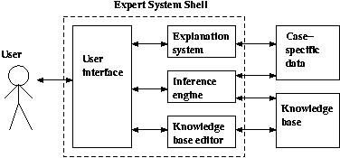
More General ES Architecture

Slide 51
More General ES Architecture
User Interface:
Menus, NLP, or any other interaction to interface with a human user
Explanation Subsystem:
Module that allows the program to explain its reasoning
Inference Engine:
Makes inferences about data given the knowledge base
Knowledge base editor:
Helps an expert or engineer tailor the knowledge base with a user-friendly tool

Slide 52
More General ES Architecture
Knowledge Base:
Knowledge as you know it. Inference Rules defined and general knowledge defined
Case-specific data:
Includes data provided by the user, data specific to one case, or partial conclusions constructed by inference rules.

Slide 53
Choosing A Problem
Creating an expert system can be VERY time consuming and expensive
Need domain experts
Need engineers
Need to build expert shell (like CLIPS) if don’t already have it.
So when is this justified?

Slide 54
Choosing A Problem
Cost-benefit analysis must make sense
The “expert” is not already widely available
Problem using symbolic reasoning
No dexterity or physical skill (but robotics getting better)
Problem is well-structured and requires little common-sense knowledge
Rigorous technical knowledge easier to capture than fluffy common-sense knowledge

Slide 55
Choosing A Problem
Problem doesn’t already have a pure algorithmic solution
Cooperative and articulate experts exist! Need to be able to find these domain experts
Problem of proper size and scope
Why?
Requires expert knowledge, but only takes human an hour or so to finish

Slide 56

Who / What is involved?
?

Slide 57
User Interface
It enables the user to communicate with an expert system (Like CLIPS)
Notes:
Any expert system is useless if the intended user can not communicate with it . The component of an expert system that communicates with the user is known as the user interface.

Slide 58
Knowledge Engineer
A knowledge engineer is a computer scientist who knows how to design and implement programs that incorporate artificial intelligence techniques.
Notes:
A knowledge engineer is an AI specialist, perhaps a computer scientist or programmer who is skilled in the art of developing expert systems.

Slide 59
Domain Expert
A domain expert is an individual who has significant expertise in the domain of the expert system being developed.
Notes:
A domain expert is an individual who has significant expertise in the domain of the expert system being developed. It is not necessary that the domain expert understand the AI or expert systems.

Slide 60
Knowledge Engineering
The art of designing and building the expert systems is known as KNOWLEDGE ENGINEERING knowledge engineers are its practitioners.
Knowledge engineering relies heavily on the study of human experts in order to develop intelligent & skilled programs.

Slide 61
Developing Expert Systems
Determining the characteristics of the problem.
Knowledge engineer and domain expert work together closely to describe the problem.
Notes:
First of all the knowledge engineer and domain expert work together closely to describe the problem that the expert system is intended to solve. The description may be revised several times before both of them are satisfied with it.
It is also important to identify the resources. For e.g. Who is to participate in the development process? Does a single domain expert possess all necessary expertise, or is the domain knowledge distributed over several people in an organization? People are not the only resources that must be identified. It is unusual for all domain knowledge to be embodied in human experts. Therefore another resources for information such as references, books , journals and procedure manuals are usually identified and located.

Slide 62
The engineer then translates the knowledge into a computer-usable language, and designs an inference engine, a reasoning structure, that uses the knowledge appropriately.
He also determines how to integrate the use of uncertain knowledge in the reasoning process, and what kinds of explanation would be useful to the end user.

Slide 63
When the expert system is implemented, it may be:
The inference engine is not just right
Form of representation of knowledge is awkward
An expert system is judged to be entirely successful when it operates on the level of a human expert.
Notes:
It may be that the inference engine is not just right; the form of knowledge representation is awkward for the kind of knowledge needed for the task; and the expert might decide the pieces of knowledge are wrong. All these are discovered and modified as the expert system gradually gains competence.

Slide 64
Human Expertise vs Artificial Expertise
Perishable
Difficult to transfer
Difficult to document
Unpredictable
Expensive
Permanent
Easy to transfer
Easy to document
Consistent
Affordable
Notes:
There are many reasons to use expert systems rather than to rely on human expertise, which are as follows:

Slide 65
Two Big Problems
Knowledge takes a long time to build
Knowledge is always changing
How might you deal with this?

Slide 66
Automatic Knowledge-Acquisition
Having domain experts create knowledge and update / maintain it is tedious
Automatic Knowledge Acquisition is a set of techniques for automatically acquiring, validating, and incorporating new knowledge into an expert knowledge base

Slide 67
Automatic Knowledge-Acquisition
Natural Language Processing:
Try to parse Wikipedia, technical documents, etc. to automatically build your knowledge base.
Usually this would be just a first pass (as it doesn’t work that well).
Then, some process for an expert to clean-up the knowledge

Slide 68
Crowdsourcing Knowledge
Using the “crowd” to obtain the information you need.
Amazon Mechanical Turk does this.
You need something translated
You can split each sentence or paragraph into a micro-task
You pay people to complete these tasks
“Turkers” in the crowd do the work for you

Slide 69
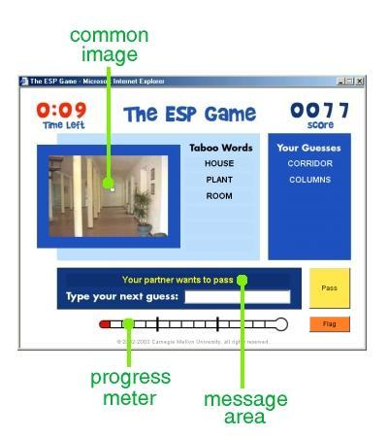
Crowdsourcing Knowledge

Slide 70
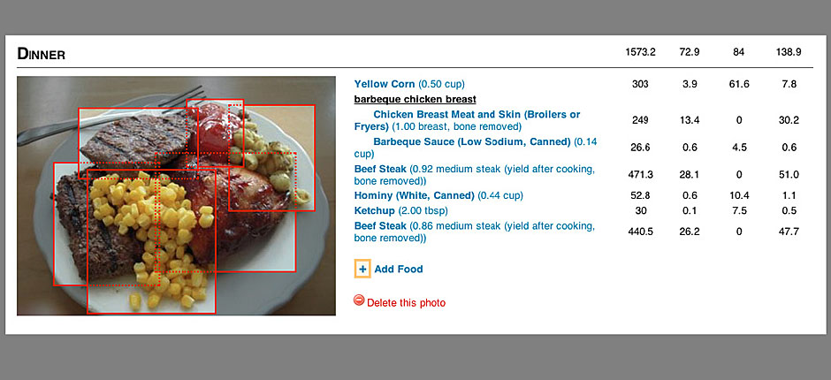
Crowdsourcing Knowledge

Slide 71
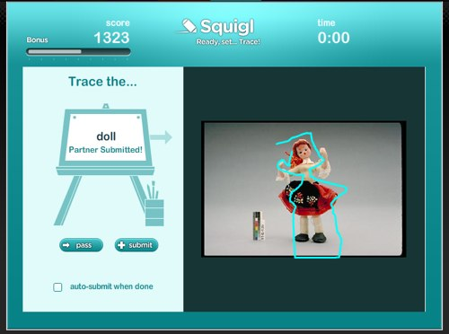
Crowdsourcing Knowledge

Slide 72
Crowdsourcing Knowledge
Why would someone help you!!!!
Turns out most crowdsourcing tools use one of three strategies:
Money (I’ll pay you to help me with this)
Philanthropy (Your work will help soooo many people!)
Fun (It’s a game! It’s “fun”!)

Slide 73
Some Prominent Expert Systems
Dendral
Dipmeter Advisor
Mycin
R1/Xcon
Notes:
Dendral analyse mass spectra
Dipmeter Advisor analysis of data gathered during oil exploration
Mycin diagnose infectious blood diseases and recommend antibiotics (by Standford University)
R1 (expert system)/XCon order processing

Slide 74
MYCIN
Developed in the 1970s at Stanford
Job was to diagnose certain blood infections (pretty specific task)
One of the first successful expert systems
Rule-Based, so very similar to example we saw
Written in LISP (Woooooooo…LISP!!!!)
Goal-directed system (uses backward chaining primarily)

Slide 75
MYCIN
Used backward chaining…but
As it is backward chaining, would ask the patient questions if it hit a variable that it needed an answer to.
Example: if chaining runs into “User feels dizzy” and doesn’t know, it would prompt user to answer
This would sometimes lead to user being asked MANY questions
Used heuristics to simplify the backward chaining search
Some paths ignored and not explored
Also would ask general questions to all patients to try to simplify the search process

Slide 76
MYCIN
Example Rule:
IF the infection is primary-bacteremia AND the site of the culture is one of the sterile sites AND the suspected portal of entry is the gastrointestinal tract THEN there is suggestive evidence (0.7) that infection is bacteroid.
*Note the probabilistic result (0.7). These probabilities were hardcoded. More recent advances calculate these on the fly (we’ll see this later)

Slide 77
SUMMARY: Expert Systems
Good for developing knowledge of domain experts in a particular field.
Advantages:
Can explain reasoning
One system shell can be used to develop system in many domains
Often very efficient
Can often deal with most “common” issues, freeing up human experts to deal with rare problems
Disadvantages:
Can be expensive and time-consuming to build (need domain experts, engineers, etc.)
Can be hard to maintain if knowledge is always changing (knowledge acquisition techniques help)
Not super general. Most systems solve a VERY specific task.

