Slide 1
CS4710: Artificial Intelligence Reasoning Under Uncertainty
Part 2: Hidden Markov Models, Bayesian Model Tracing, and a few other applications of uncertainty

Slide 2

Topics
Markov Chains
Markov Decision Processes
Partially observable Markov Decision Processes

Slide 3
Markov Chains

Slide 4

What is a Markov Chain?
A Markov chain is a special sort of belief network used to represent sequences of values, such as the sequence of states in a dynamic system or the sequence of words in a sentence.

Slide 5
What is a Markov Chain?
To define a Markov Chain, we define:
A set of states S
For each time step t >= 0
P(S_{t+1} | S_{t}) is probability you will move to some new state
P(S₀) specifies the initial state(s) of the system

Slide 6
The Markov Assumption
Markov Chains adhere to the Markov Assumption.
Namely:
For all t >= 0:
P(S_{t+1} | S₀, S₁,…,S_{t}) = P(S_{t+1} | S_{t})
i.e., The next state depends ONLY on the current state and not the path you took to get to the current state.

Slide 7
Advantages
Simple model that is easy to specify
Assumption of stationarity (probabilities don’t change as a function of t) is often natural. If probabilities do change, you can often incorporate this somehow.
Network can extend indefinitely.

Slide 8
Markov Chains Example: Chutes and Ladders ☺

Slide 9
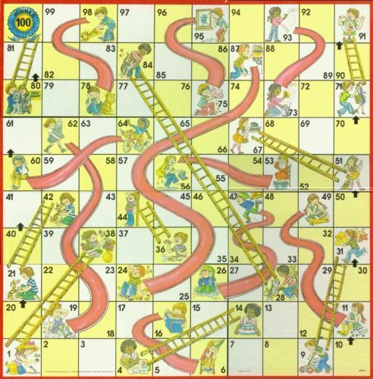

Slide 10
How the Game is Played
Chutes and Ladders is a board game where players spin a pointer to determine how they will advance
The board consists of 100 numbered squares
The objective is to land on square 100
The spin of the pointer determines how many squares the player will advance at his turn with equal probability of advancing from 1 to 6 squares

Slide 11
How the Game is Played
However, the board is filled with chutes, which move a player backward if landed on. There are also ladders, which advance a player.
Chutes have pictures of bad behavior which leads to disasters
Ladders have pictures of good behavior leading to rewards
Most of the chutes and ladders produce relatively small changes in position, but several produce large gains or losses

Slide 12
Markov Chains
Transition matrix
How we represent the chain
Probability vectors
How we represent likelihoods of being in various states over time
Absorbing vs. non-absorbing Markov chains
Steady-state matrices

Slide 13
Transition Matrix
Below, is the layout of the transition matrix for
Chutes and Ladders (101x101)
p0,0 p1,0 …………… p100,0
p0,1 p1,1 …………… p100,1
. . .
. . .
p0,100 p1, 100 ……………. p100,100

Slide 14
Three properties:
1) The probability of moving from state i to j is independent of what happened before moving to state j and how one got to state i (Markov assumption)
2) Sum of probabilities for each state must be one
3) X(t) = probability distribution vector of the probability of the system being in each of the states at time n

Slide 15
Probability Vector
The probability vector is a column vector in which the entries are nonnegative and add up to one
The entries can represent the probabilities of finding a system in each of the states
So, the starting X for chutes and ladders is:
X = [ 1.0 //100 percent chance we start in state 1
0.0
0.0
.
. ]

Slide 16
Two types of Markov Chains
1) Absorbing Markov Chains
• Can not get out of certain states
• Once a system enters an absorbing state, the system remains in that state from then on
2) Non-absorbing Markov Chains
• Can always get out of every state
What type is Chutes and Ladders?

Slide 17
Absorbing Markov Chains (Chutes and Ladders)
Two conditions must be met for a Markov Chain to be absorbing:
• Must have at least one state which cannot be left once it has been entered
• It must be possible, through a series of one or more moves, to reach at least one absorbing state from every non-absorbing state (given enough time, every subject will eventually be trapped in an absorbing state)

Slide 18
Common Question
A common question arising in Markov-chain models is, what is the long-term probability that the system will be in each state?
The vector containing these long-term probabilities is called the steady-state vector of the Markov chain

Slide 19
Steady-state matrix
The steady-state probabilities are average probabilities that the system will be in a certain state after a large number of transition periods
The convergence of the steady-state matrix is independent of the initial distribution
Long-term probabilities of being on certain squares

Slide 20
The Chutes and Ladders Transition Matrix

Slide 21
Techniques of Transition Matrix
How to do analytic computations
2D array of integers of size 101 by 101
Each array entry represents a move from one square to another
i.e. Pij represents the players move from position i to position j
A square with a ladder beginning in that square is considered a pseudo-state and has a 0 probability of landing on it
A square with a chute beginning in that square is considered a pseudo-state and also has a 0 probability of landing on it

Slide 22
Results of Transition Matrix
The matrix is way too large to show on this slide
Some example probabilities computed:
If a player is on square 97, the probability of staying on that square is 1/2 and the probability of moving to square 78 is 1/6

Slide 23
Techniques of Probability Vectors
How we could do the analytic computations
1D array of integers of size 101
Probability vectors Vn represent the probability of being on a certain square on move n
Vo = {1,0,…0} and means that the probability of being on square 0 is 1 or 100%
Vo * P = V1;
V1 * P = V2, etc.

Slide 24
Results of Transition Matrix
After 1000 moves, the probability vector reached a limit of {0,0,…1}
This means that after 1000 moves, the game is expected to be won!!!

Slide 25
Hidden Markov Model (HMM)

Slide 26
Hidden Markov Models
A hidden markov model is like a markov chain except that the underlying state the system is in is “hidden”
By “hidden” we mean that we don’t know what state the system is in at any one time
In Chutes and Ladders, we knew what state we were in (what space we are on) but the movements between states was random (rolling the dice)
I want you to know these exist, but we aren’t going to study them in this class

Slide 27
Markov Decision Processes (MDP)

Slide 28
Motivation
Agents:
Observe the world and react to what they see
Can make decisions about what actions to take given a situation
Need something that models:
States the agent or the world (or both) can be in
Actions available
How these actions affect the environment
Markov Chains do some of these things, but we need an extension to the model

Slide 29
Markov Decision Processes
A Markov Decision Process (MDP) is a model that contains:
A set of possible world states S
A set of possible actions A
A real valued reward function R(s,a)
A description T of each action’s effects in each state
We assume the Markov Property: The effects of an action taken in a state depend only on that state and not on the prior history.

Slide 30
Representing Actions
Depending on problem you are trying to solve, you may want to model:
Deterministic Actions:
T: (S x A) → S For each state and action, move to a new state (100%)
Stochastic Actions:
T: (S x A) → Prob(S) For each state and action, specify a prob distribution over next
states. Represented as P(s’ | s, a)

Slide 31
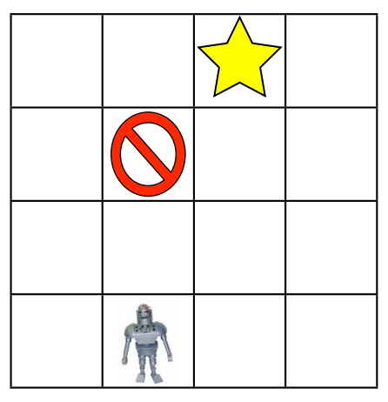
Example MDP: Robot
Robot needs to reach some goal and avoid special “traps”
E.g., stairs and such
Actions are to move up, down, left, right
Actions may fail or have surprising effects
There might be a wall in some location
We might not be certain where these walls are located

Slide 32
Example MDP: Robot
States: specify robot’s location
Actions: Move in one direction
Reward: 1 if at the goal, -1 if you hit a trap, 0 otherwise
Transitions: specified using probabilistic rules
E.g., the odds a space is a valid location (not a wall)

Slide 33
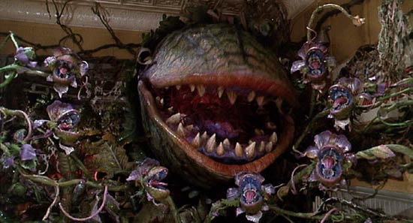
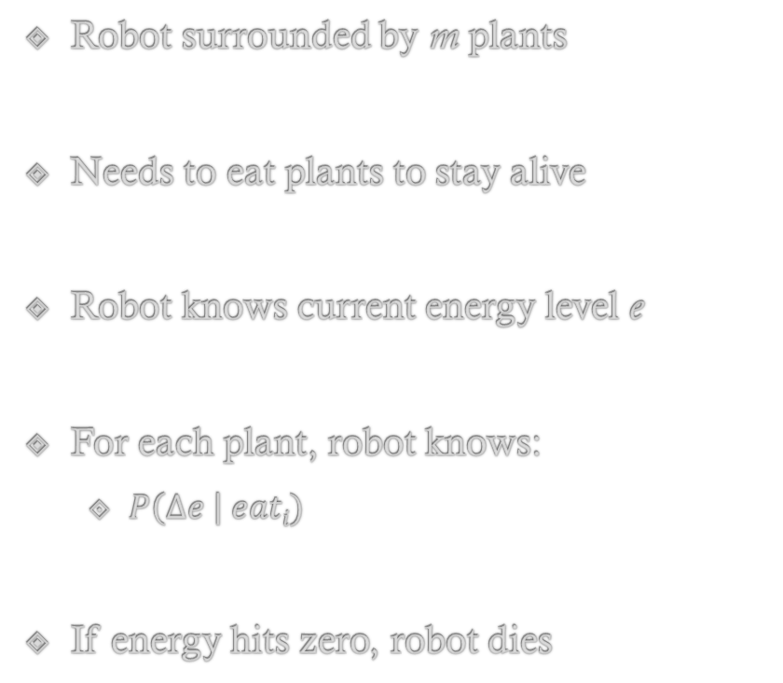
Another Example MDP: Plant Eating Robot
Robot surrounded by m plants
Needs to eat plants to stay alive
Robot knows current energy level e
For each plant, robot knows:
$P\left(∆e \right| eati)$
If energy hits zero, robot dies

Slide 34
Another Example MDP: Plant Eating Robot
States: Energy of robot
Actions: Choose to eat a plant
Reward
Total Energy

Slide 35
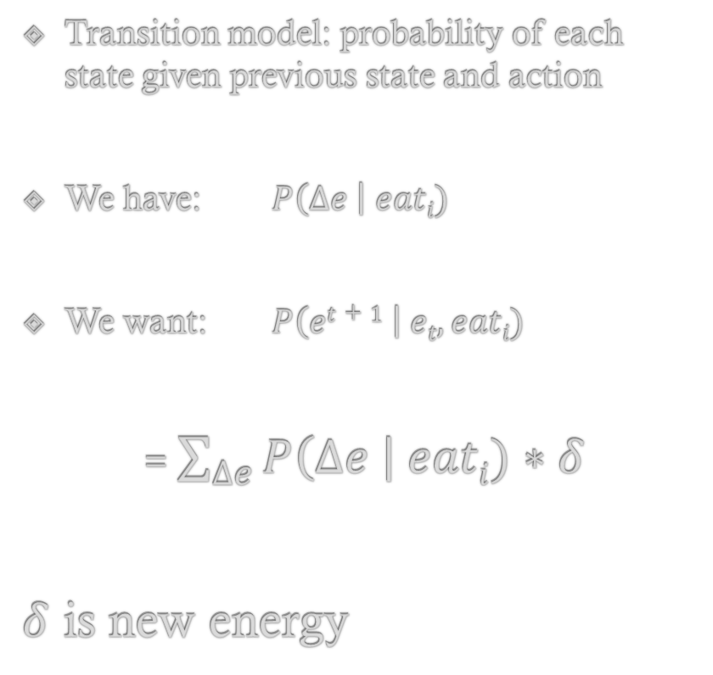
Another Example MDP: Plant Eating Robot
Transition model: probability of each state given previous state and action
We have: $P\left(∆e \right| eati)$
We want: $P\left(et+1 \right| et, eati)$
= $\sum_{∆e}{P\left(∆e \right| eati)∗δ}$
$δ$ is new energy

Slide 36
Solutions to MDPs
A “Solution” to an MDP is when the agent is taking the set of actions, in order, that optimize its behavior.
This “Solution” is called a policy because it governs how the agent will act in all situations.

Slide 37
Solutions to MDPs
A policy π is a mapping from S to A:
I.e, for each state, there is one action the agent always takes when in that state.
So, to follow a policy, the agent simply:
1. Determine current state s
2. Execute action π(s)
3. Go to step 1

Slide 38
Solutions to MDPs
So, to follow a policy, the agent simply:
1. Determine current state s
2. Execute action π(s)
3. Go to step 1
This assumes Full Observability, meaning the current state and new state are always fully known to the system (though we may not know, when performing action p_{i}(s) what state we will end up in, we do know that state once we are in it).

Slide 39
Evaluating an Optimal Policy Value Iteration

Slide 40
Reminder: Markov Decision Processes
A Markov Decision Process (MDP) is a model that contains:
A set of possible world states S
A set of possible actions A
A real valued reward function R(s,a)
A description T of each action’s effects in each state
Let’s calculate the optimal policy pi for this MDP!

Slide 41
Evaluating a Policy
How do we determine how good a policy π is?
For deterministic models, we could just sum the rewards (from r(s,a)) as the agent takes actions, but results might be infinite.
For stochastic actions, instead we use expected total reward, but this again typically yields infinite value.
So, how do we compare policies of infinite value?

Slide 42
MDPs: Objective Functions
Define an Objective Function
Maps infinite sequences of rewards to single real numbers
Options:
1. Set a finite horizon and total reward
2. Discounting to prefer earlier rewards
3. Average reward rate in the limit
#2 is most common

Slide 43
MDPs: Discounting Objective Functions
A reward n steps away is discounted by γ^{n}
γ is the discount rate (0 < γ < 1)
Models mortality: agent may die at any moment
models preference for short solutions
smoothed out version of limited horizon look ahead
We use a cumulative discounted reward as objective:
V(s) = r1 + γ*r2 + γ²*r3 + … = ??

Slide 44
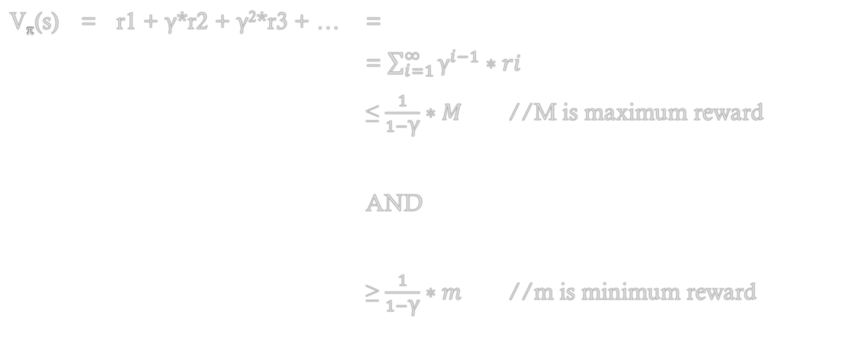
MDPs: Discounting Objective Functions
V_{π}(s) = r1 + γ*r2 + γ²*r3 + … =
= $\sum_{i=1}^{∞}{{\text{γ}}^{i−1}∗ri}$
≤ $\frac{1}{1−\text{γ}}∗M$ //M is maximum reward
AND
≥ $\frac{1}{1−\text{γ}}∗m$ //m is minimum reward

Slide 45
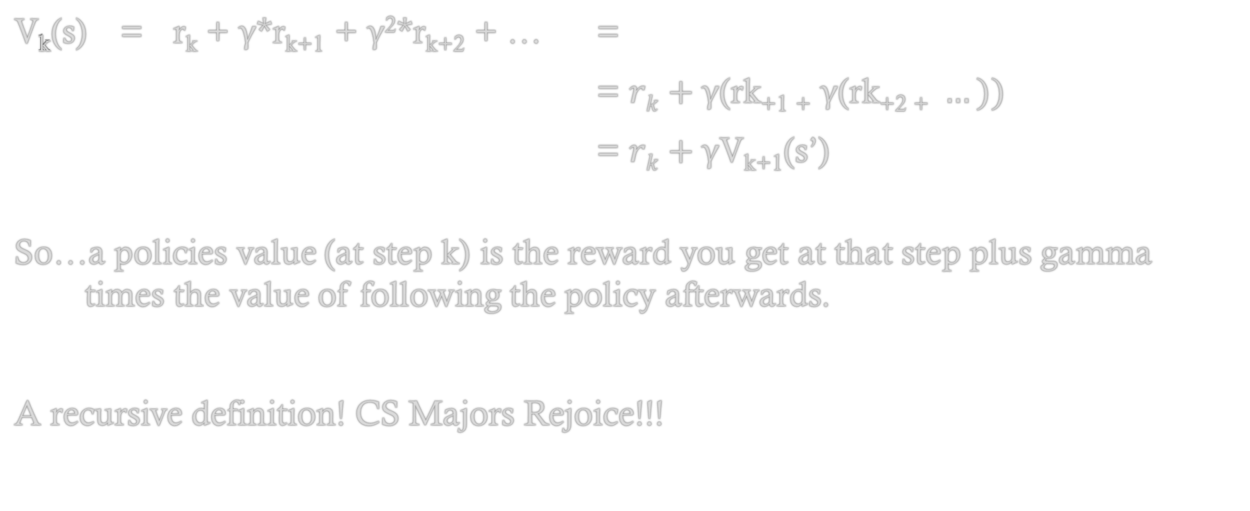
MDPs: More Importantly!
V_{k}(s) = r_{k} + γ*r_{k+1} + γ²*r_{k+2} + … =
= $rk+\text{γ}\text{(}\text{rk}\text{+1 +} \text{γ}\text{(}\text{rk}\text{+2 +} …))$
= $rk+\text{γ}\text{V}\text{k}\text{+1}$(s’)
So…a policies value (at step k) is the reward you get at that step plus gamma times the value of following the policy afterwards.
A recursive definition! CS Majors Rejoice!!!

Slide 46
MDPs: Value Functions
A value function V_{π} : S → R represents the expected objective value obtained following policy π from each state in S
Value functions partially order the policies
A policy is optimal if there is not other policy that has a higher value function starting at ANY state

Slide 47


Value of a Policy
So…let’s finally flesh out our definition of a policy’s value

Slide 48



Value of a Policy
…and an optimal policy analogously (the * means that decision is optimal)

Slide 49
Value Iteration
Value Iteration is an algorithm that takes an MDP and calculates an optimal policy.
It starts at the end, in the sense that it defines k > 0 be the optimal policy over the last ‘k’ steps of an agent’s processing.
*Notice there isn’t really an end, this is just so we can iterate and converge to some optimal policy.
Base Case: Let V₀ be an arbitrary value function (notice this is stored for each state)

Slide 50
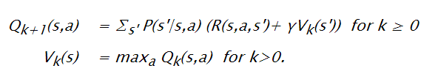
Value Iteration
Recursive Case: For increasing values of k, compute:

Slide 51
Partially Observable Markov Decision Processes (POMDP)
*This section courtesy of: cs.brown.edu/research/ai/pomdp/tutorial

Slide 52
POMDP
Markov decision processes are fully observable
i.e., we always know what state we are in at any time
Some of the transitions were probabilistic, but after we took an action we always could observe what state we are in
Partially Observable MDPs are the same except the agent is not sure what state it is in at any given time

Slide 53
POMDP: Definition
A Partially Observable Markov Decision Process is defined by the following:
S Set of states of the world
A Set of actions the agent can take
O Set of possible observations agent can make
P(S₀) Probability distribution of the start state
P(S’ | S, A) Prob. of moving to state S’ if in S and take action A
R(S, A, S’) Reward if start in S, take action A, move to S’
P(O | S) Probability of observing O given agent in state S

Slide 54

POMDP: Definition
Because we do not know what state we are in, we must “guess” or have some “belief” in what state we are in.
Below is the belief space for a two state POMDP. Our belief in our state can fall anywhere in between. We want our belief to be near the edges!

Slide 55
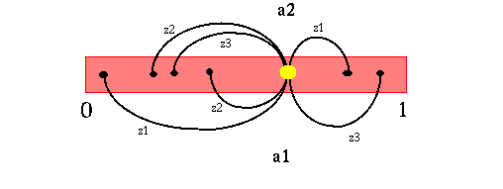
POMDP: Belief Space
As we take actions, our belief in our state changes. One goal of the POMDP is to update the belief in the current state at every step. This is not hard, as we can use the probabilities based on observations to guess the state.
Visually, this might look like below: Jumping around the belief state when taking actions

Slide 56
POMDP: Belief Space
This Belief Space is markovian, the next belief I will have in my state depends only on my current belief…and this is starting to look like an MDP!

Slide 57
POMDP: Belief Space
So: let’s solve POMDPs by:
Converting into an equivalent MDP (belief states = states of and MDP)
Use value iteration as before to find the optimal policy
Problem: Belief space is still continuous, so can’t represent with an array like before!

Slide 58
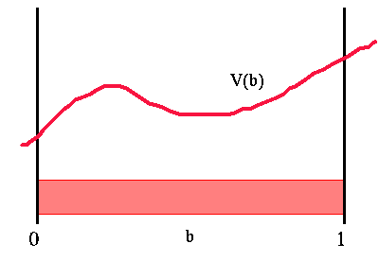
POMDP: Problem!
This algorithm has some issues. The belief space is continuous, not discreet!
With MDPs, we had a value function that was just a number
Now, we have value functions continuous
over the given belief space, see right →
How can we represent V(b)??

Slide 59
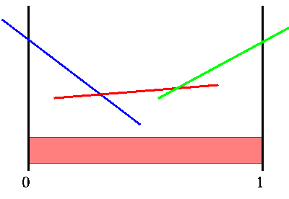
POMDP: Insight!
It turns out that for finite horizon problems, the value function of a POMDP can be represented as a piecewise linear and convex function.
Or, as a set of line segments like shown
Why? Let’s hold off on that for a moment.
for now, just believe me ☺
Thus, for value iteration, only need to store these
finite lines in memory

Slide 60
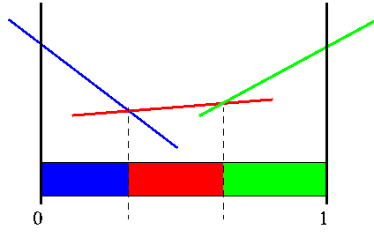
POMDP: Insight!
So, to solve for a policy, we want to use the same algorithm (value iteration)
Problem 1: Value function is continuous!
Solved, because function is piecewise linear convex
Problem 2: To find a states new value (while
iterating), we need to loop over all next states, but
this is infinite!
Sigh…just need to fix problem 2 now

Slide 61
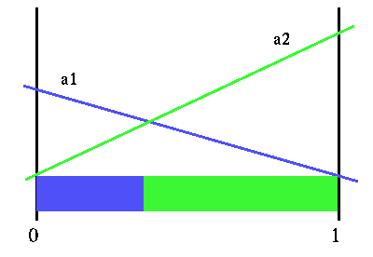
POMDP: Example!
Let’s use a simple example to try to understand this. Assume we only take 1 action:
a1 and a2 are two actions we can take
Where they intersect 0 and 1 are the rewards from the POMDP
The lines are interpolated between the two
Where they cross, it shouldn’t really matter which action you take (in theory)

Slide 62
POMDP: Example!
This works if we are only taking one action, but what if we are taking two? Or three? Or ‘n’?
Let’s start with two, we will show this in three stages:
1. Compute value of belief state of given action and observation
2. Compute value of belief state given only an action
3. Compute actual value of belief state

Slide 63
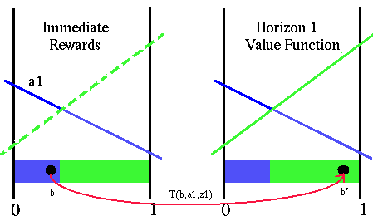
POMDP
1. Compute value of belief state of given action and observation
If the next observation (z1) is fixed, what is the best set of two actions (value)?
Easy, just do a1 then a2 (see pic at right)
T(b,a1,z1) returns the new belief state if in belief state b currently, take action a1, and then observe z1

Slide 64
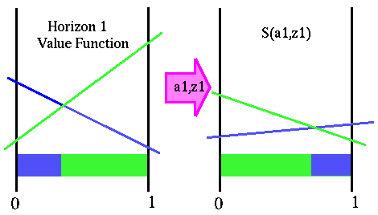
POMDP
1. Compute value of belief state of given action and observation
To simplify this, we want to compute S(a1,z1), which is the value of all beliefs, given you’ve already taken a1 and are now observing z1
So, S(a1,z1) tells you the value of the horizon 1 function but as a function of your current belief b (no need to transform b into b’)
So, for some belief b we get S(a1,z1) = (r(a1,b) + T(b,a1,z1)*r(ai,b’)) P(x) //probability this whole situation happens

Slide 65
POMDP
1. Compute value of belief state of given action and observation
Not clear how to do this transformation! But for now, just try to understand the intuition!

Slide 66
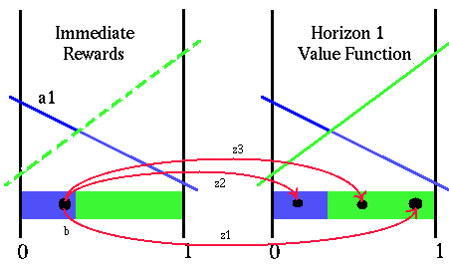
POMDP
2. Compute value of belief state given only an action
When we get rid of the constant observation z1, we now have many new observations that could occur. Need to account for all possible next observations
So, do the same thing, but weight each by probability of the next observation

Slide 67
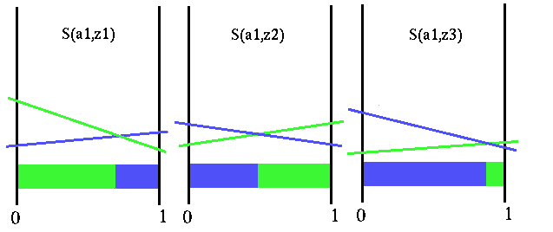
POMDP
2. Compute value of belief state given only an action
So, we want to calculate at S(a1,z) function over all possible observations z

Slide 68
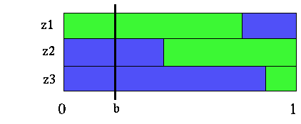
POMDP
2. Compute value of belief state given only an action
In practice, we would take whichever action is best after making next observation (z1,z2,or z3)
However, the expected value of this state, given b, is just the sum of the three + horizon1(a1,b)
Why no weights? The probabilistic weights are actually built into each S() function

Slide 69
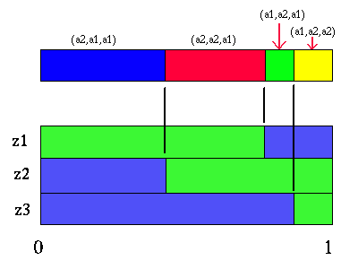
POMDP
2. Compute value of belief state given only an action
Only four distinct “future strategies”

Slide 70
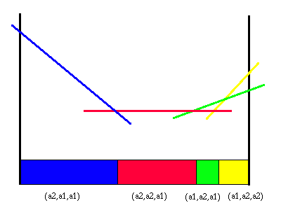
POMDP
2. Compute value of belief state given only an action
Only four distinct “future strategies”
So, we know how to solve our problem
Given belief state b
This function to the right tells us the value we should get after taking a1 and one other action.
So it is the general value of being in that belief state given that we plan to take two actions (a1 and one other)

Slide 71
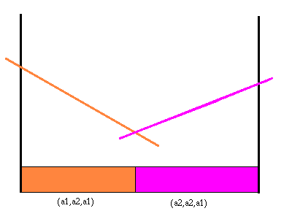
POMDP
2. Compute value of belief state given only an action
We only did this for a single first action a1
We need to repeat this process for other actions
So a2 in this example
Let’s suppose it looks like this →

Slide 72
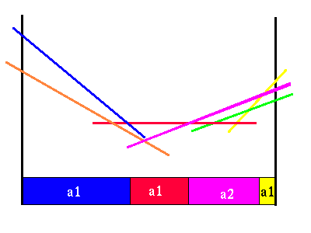
POMDP
3. Compute actual value of belief state
We simply overlay the belief segments for the two actions on top of one another →

Slide 73
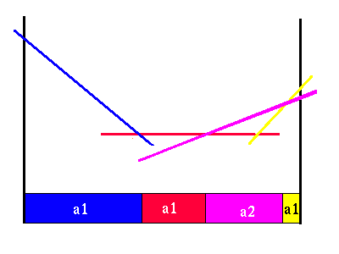
POMDP
3. Compute actual value of belief state
We simply overlay the belief segments for the two actions on top of one another →
…and remove lines that are occluded
*Remind you of anything? Cough Cough cs4102 written 3 lines problem!!!

Slide 74
POMDP: Summary!
What do we do now?
We can repeat the WHOLE process again. This will yield the horizon 3 value function.
Notice that horizon n+1 value function may actually have less line segments that horizon n function.
Keep iterating as many times as possible to look as far ahead as possible.

Slide 75
Conclusions

Slide 76
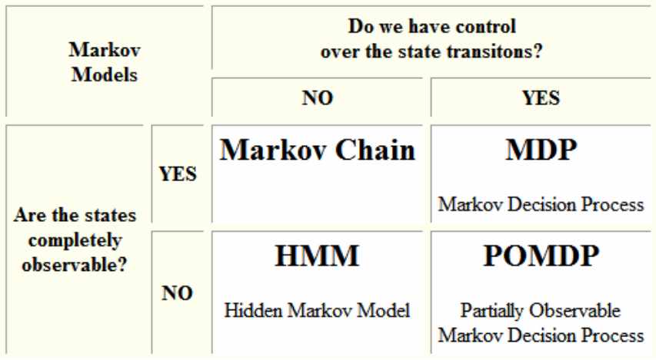
Summary

