Slide 1
CS4710: Artificial Intelligence Reasoning Under Uncertainty
Part 3: Example application of a hidden markov model called Bayesian Model Tracing
*material from: Brett Van De Sande. “Properties of the Bayesian Knowledge Tracing Model”. Journal of Educational Data Mining, Volume 5, No 2, August 2013

Slide 2
Special Topic: Bayesian Knowledge Tracing

Slide 3
What is the key goal of BKT?
A concrete example of using an uncertainty model to do something useful
Suppose we are building an education system that teaches math to elementary or middle school students
We want to measure how well a student knows a specific skill/knowledge component at a specific time
So we know whether to give them more practice (individualized learning)
So we know what topic to move them onto next (individualized progression of topics)
Etc…

Slide 4
What is the key goal of BKT?
Why not just give a student a bunch of problems and calculate NumCorrect / NumQuestions
Some serious problems with this:
If student gets many problems wrong early, difficult to “dig out of the hole”
Doesn’t take into account:
Students might know a skill but make a mistake
Students might not know a skill but guess correctly
Doesn’t model a student’s knowledge changing over time
i.e., later correct answers should be weighted more because more likely students has learned skill through practice

Slide 5
First: skills should be tightly defined
The goal is not to measure overall skill for a broadly-defined construct
Such as arithmetic
But to measure a specific skill or knowledge component
Such as addition of two-digit numbers where no carrying is needed
Generally more specific is better, but don’t want to get TOO specific
E.g., ability to add 144 and 126

Slide 6
What is the typical use of BKT?
Assess a student’s knowledge of a skill
Note that this idea would extend to other types of problems too!
Based on a sequence of items that are dichotomously scored
E.g. the student can get a score of 0 or 1 on each item (right or wrong)
Only true for some domains (math, etc.)
Where each item corresponds to a single skill
Where the student can learn on each item, due to help, feedback, scaffolding, etc.
i.e., a human or system provides hints, gives a short lesson, etc.

Slide 7
Key assumptions
Each item must involve a single latent trait or skill
Each skill has four parameters
From these parameters, and the pattern of successes and failures the student has had on each relevant skill so far, we can compute latent knowledge P(Ln) and the probability P(CORR) that the learner will get the item correct

Slide 8
Key Assumptions
Two-state learning model
Each skill is either learned or unlearned
In problem-solving, the student can learn a skill at each opportunity to apply the skill
A student does not forget a skill, once he or she knows it

Slide 9
Model Performance Assumptions
If the student knows a skill, there is still some chance the student will slip and make a mistake.
If the student does not know a skill, there is still some chance the student will guess correctly.

Slide 10
Corbett and Anderson’s Model
Two Learning Parameters
p(L₀) Probability the skill is already known before the first opportunity to use the skill in problem solving.
p(T) Probability the skill will be learned at each opportunity to use the skill.
Two Performance Parameters
p(G) Probability the student will guess correctly if the skill is not known.
p(S) Probability the student will slip (make a mistake) if the skill is known.
Not learned
p(T)
Learned
p(L₀)
p(G)
1-p(S)
correct
correct

Slide 11


Solving the Hidden Markov Model
We can define the following probabilities that we are interested in:
Probability the skill is learned at the jth step
Probability the student gets the jth problem correct

Slide 12
Solving the Hidden Markov Model
Goal: We want to solve for P(C_{j}), but only in terms of the variables from the model
So only other probabilities in formula can be P(S), P(G), P(L₀), and P(T)
Probability the skill is learned at the jth step
Probability the student gets the jth problem correct

Slide 13

Solving the Hidden Markov Model
Previous equation re-written in different form

Slide 14

Solving the Hidden Markov Model
Previous equation re-written in different form
By solving the previous recursion relation (subst. method)

Slide 15
Solving the Hidden Markov Model
Previous equation re-written in different form
By solving the previous recursion relation (subst. method)
Substituting the previous equation into the P(C_{j}) equation
From previous slide

Slide 16



Solving the Hidden Markov Model
Our final solution is:

Slide 17
Solving the Hidden Markov Model
Our final solution is:
Strengths:
This is an EXACT solution to the hidden markov model we looked at.
Theoretically, can plug in j and know how likely it is a student will get a problem correct.
*Seems kind of weird doesn’t it?
Weakness:
I need to know P(L₀), P(G), and P(S) to use this, but how do I get these values? One way is to fit the model to student data to find values that guess performance well.
Is very retroactive (need a student to do work before knowing the correct parameters to the model)
Several different parameter values will lead to the exact same model (Identifiability Problem)

Slide 18
Solving the Hidden Markov Model
Our final solution is:
How is this used in practice:
A student works on some problems. Data is collected.
Data is used to fit the model parameters above
Model is used to figure out how much practice (or more practice) student needs on a given topic

Slide 19
Another Approach: Knowledge Tracing Algorithm

Slide 20
Knowledge Tracing Algorithm
Whenever the student has an opportunity to use a skill, the probability that the student knows the skill is updated using formulas derived from Bayes’ Theorem.
Same model as before (reminder on next slide).
Able to calculate probabilities of interest in real time (while a student is working)

Slide 21
Corbett and Anderson’s Model
Two Learning Parameters
p(L₀) Probability the skill is already known before the first opportunity to use the skill in problem solving.
p(T) Probability the skill will be learned at each opportunity to use the skill.
Two Performance Parameters
p(G) Probability the student will guess correctly if the skill is not known.
p(S) Probability the student will slip (make a mistake) if the skill is known.
Not learned
p(T)
Learned
p(L₀)
p(G)
1-p(S)
correct
correct

Slide 22
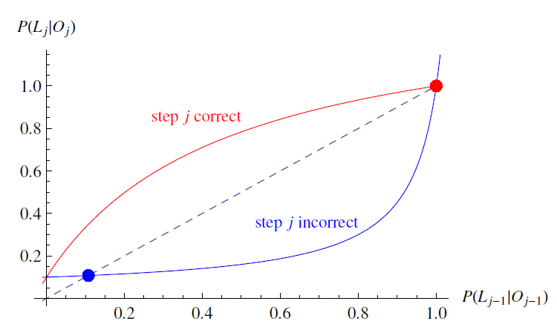
Overview
Goal:
To predict P(L_{j}) for a student in real-time.
To do this, we want to calculate P(L_{j} | O_{j})
*The probability a student has learned a skill given the most recent problem they’ve solved
O_{j} is whether or not student got the jth problem correct or not

Slide 23
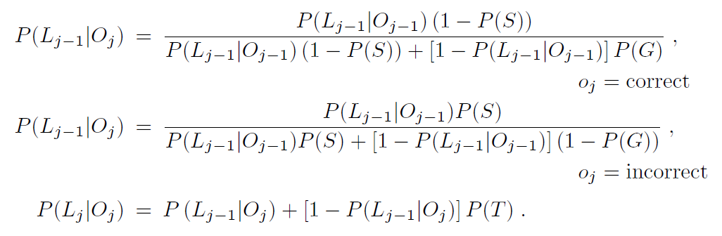
Formulas

Slide 24
Knowledge Tracing
How do we know if a knowledge tracing model is any good?
Our primary goal is to predict knowledge
But knowledge is a latent trait
So we instead check our knowledge predictions by checking how well the model predicts performance

Slide 25
Fit Methods
Goal: To pick the best values for P(S), P(G), P(L0), and P(T) that best predict student performance in practice
Algorithms:
Hill-Climbing
Hill-Climbing (Randomized Restart)
Simulated Annealing (YAY!)
Genetic
*This is a local search problem! So all local search techniques apply!

Slide 26
Fit Methods
Goal: To pick the best values for P(S), P(G), P(L0), and P(T) that best predict student performance in practice
Objective Function: How well the model predicts given student performance (data set already in hand)
Generating Neighbors: Many choices, but tweak the four parameters above a bit.
You should be comfortable with implementing local search algorithms if you were asked to

Slide 27
Model Degeneracy

Slide 28
Conceptual Idea Behind Knowledge Tracing
Knowing a skill generally leads to correct performance
Correct performance implies that a student knows the relevant skill
Hence, by looking at whether a student’s performance is correct, we can infer whether they know the skill

Slide 29
Essentially
A knowledge model is degenerate when it violates this idea
When knowing a skill leads to worse performance
When getting a skill wrong means you know it

Slide 30
Theoretical Degeneracy (Baker, Corbett, & Aleven, 2008)
P(S) > 0.5
A student who knows a skill is more likely to get a wrong answer than a correct answer
P(G) > 0.5
A student who does not know a skill is more likely to get a correct answer than a wrong answer

Slide 31
Empirical Degeneracy (Baker, Corbett, & Aleven, 2008)
Actual behavior by a model that violates the link between knowledge and performance

Slide 32
Empirical Degeneracy: Test 1 (Concrete Version)
If a student’s first 3 actions in the tutor are correct
The model’s estimated probability that the student knows the skill
Should be higher than before these 3 actions.

Slide 33
Examples
P(L₀)= 0.2
Elmo gets his first ten actions right
P(L₁₀)= 0.42
Elmo gets his next 300 actions right
P(L₃₁₀)= 0.42
Elmo’s school quits using the tutor
P(L₀)= 0.2
Maria gets her first three actions right
P(L₃)= 0.1

Slide 34
Model Degeneracy
What about this alternate definition of model degeneracy:
P(G)+P(S) > 1.0 Always leads to a degenerative model
Why might this definition make sense?

Slide 35
Model Degeneracy
So, to prevent this problem, we simply add at least one of these additional constraints to our model’s fit:
P(G) < 0.5 AND P(S) < 0.5
P(G)+P(S) < 1.0
Why might this definition make sense?

