Slide 1
CS4710: Artificial Intelligence Course Introduction
What is this course about? How much homework is there? How hard will I have to work? Will I pass if I don’t do the homework? Other important questions!

Slide 2

Course Info:
Tu Th @ 11:00-12:15
On Zoom!
Live and in-person!
Instructor:
Dr. Mark Floryan
Office: Rice 203

Slide 3
Course Staff:
Graduate:
Ryan Kann (rak3me@virginia.edu)
Undergraduate
Helen Shi (hs2fw@virginia.edu)
Sabrina Baldassare (sjb4sy@virginia.edu)
Tanay Bapat (tb6xr@virginia.edu)
Vivian Chen (sc9by@virginia.edu)
Danielle Zevitz (dez8dc@virginia.edu)

Slide 4
Pre-requisites
Absolutely Required:
CS2150 (Prog. and Data Rep.)
CS2102 (Discrete Math)
Helpful, but not (technically) required:
CS4102 (Algorithms)
Probability
We’ll review some of this when necessary
Statistics
Not much, but a little stat is helpful

Slide 5

I Expect You to Know
Graphs
Comfortable implementing a graph
Adj. List or Adj. Matrix
If you aren’t comfortable with graphs, review them NOW!
At some point, we will do a VERY short review of this
Basic Discrete Math Material
Propositional Logic
Basic logic and inference

Slide 6
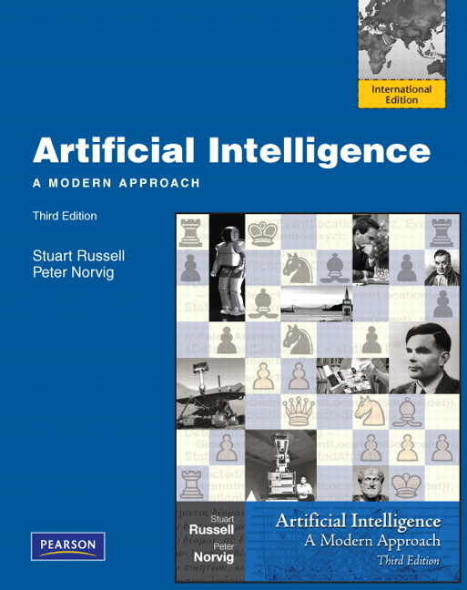
Textbook (Required)
Artificial Intelligence: A Modern Approach
Third Edition
Stuart Russel & Peter Norvig
ISBN: 978-0136042594
We will be following the book loosely
So you can probably survive without it, but I recommend having it.

Slide 7
Topics (As of right now)
Introduction to AI
Knowledge Representation
Expert Systems
Search
Reasoning Under Uncertainty
Multi-Agent Systems
Machine Learning
Course is meant to be an overview of AI, so won’t go completely into any one topic.

Slide 8

Modules
Course is split into 9 modules
What is AI?
Expert Systems
Classic Search
Local Search
Game Playing
Bayesian Networks
Markov Models
Multi-agent systems
Machine Learning

Slide 9
Quizzes
Some modules have a quiz
Some modules have homework
A couple have both.
5 quizzes total, these are 24 hour take home problems on associated module
We will look at the schedule in a moment

Slide 10

Homework: The Meat of the Course
6 of these
one per module (only 6 of 9 modules have a homework)
Mostly Programming problems
Problems will be well-defined, but many solutions possible
For each you will:
Turn in your code
Usually some kind of write-up regarding your solution

Slide 11
Homework: The Meat of the Course
Recommendations:
Start Early!! These HWs generally are not of the “just implement something” form.
You will need to:
Implement an algorithm
Test it, see where it does well and fails
Tweak it and see how performance changes
Test on MANY different types of inputs
Analyze the differences
Write an analytical paper about it

Slide 12
Homework Groups
Homeworks must be done individually, but you can collaborate with friends to discuss high level problems, solutions, etc.

Slide 13
Homeworks:
HW 0: Is AI Possible? (Report)
HW 1: Automatic Theorem Prover
HW 2: Pathfinding (with a probabilistic twist!)
HW 3: Ticket To Ride AI
HW 4: Negotiation
HW 5: Machine Learning

Slide 14
Homework: Late Policy
Deadlines are extremely flexible in this course.
Let’s look at the course schedule!!

Slide 15

Grading
Let’s look at the grading scheme on the course website!!
Not too crazy, but warrants an explanation.

Slide 16
Ok…I think that is all
You have an assigned reading tonight:
“Computer Science as Empirical Inquiry: Symbols and Search”
-Allen Newell and Herbert Simon
This is due tomorrow. You must have read this, I will check somehow…hmmmmmm.

