Slide 1

Mental Fitness Tracker
Ashish Kumar Dwivedi
(Artificial Intelligence Intern, Edunet, under IBM SkillsBuild Program)

Slide 2

Mental Fitness Tracker
The Mental Fitness Tracker Regression Model is an advanced data-driven approach aimed at analyzing and predicting mental health trends across different countries over time. The model utilizes a dataset containing information about various mental health disorders and their prevalence, along with data on mental fitness indicators. By employing regression analysis, the project aims to identify factors that contribute to mental health issues and assess the relationship between mental fitness and mental disorders on a global scale.

Slide 3
Agenda
The project aims to develop a Mental Fitness Tracker Regression Model to analyse mental health trends globally. The agenda includes data preprocessing, exploratory data analysis, feature engineering, regression model building, and model evaluation. The model will identify factors influencing mental fitness, predict mental fitness levels based on mental health and lifestyle data, and provide insights for targeted mental health interventions and awareness campaigns.

Slide 4
Project Overview
We have two datasets in this project. Our task is to merge them using `df.merge` and obtain the final dataset. After that, we will check for null values, drop the "code" column, and rename the columns. The current column names are too lengthy; hence, we will shorten them to ('Country', 'Year', 'Schizophrenia', 'Bipolar', 'Eating', 'Anxiety', 'Drugs', 'Depression', 'Alcohol', 'Mental_fitness'). Following the Exploratory Data Analysis (EDA), we will proceed with the final model building using LinearRegression. To achieve this, we will split the dataframe into an 80-20 ratio for training and testing the model.

Slide 5
Who are the end users of this project?
Public Health Authorities: Government health departments and agencies can utilize the insights to develop mental health policies, targeted interventions, and resource allocation.
Healthcare Professionals: Psychiatrists, psychologists, and mental health practitioners can benefit from understanding the factors affecting mental fitness to design personalized treatment plans.
Non-profit Organizations: Mental health advocacy groups and NGOs can use the findings to raise awareness, create campaigns, and support communities in need.
Researchers and Academics: Scholars studying mental health and related fields can use the model's outcomes as a foundation for further research.
General Public: The model's insights may be disseminated through public health campaigns, online platforms, or mobile applications to increase awareness and promote mental well-being among the general population.

Slide 6
Its value proposition
Comprehensive Mental Health Analysis: The model provides a comprehensive analysis of mental health trends and factors influencing mental fitness on a global scale.
Evidence-Based Decision Making: Policy-makers and healthcare professionals can make informed decisions based on the data-driven insights from the model, leading to more effective mental health interventions.
Targeted Interventions: The model helps in identifying specific high-risk factors for mental health disorders, enabling targeted interventions and awareness campaigns.
Efficiency and Accuracy: The regression model offers accurate predictions of mental fitness levels, helping healthcare professionals design personalized treatment plans.
Cost-Effectiveness: By understanding the key factors impacting mental health, resources can be allocated more efficiently, potentially leading to cost savings in the long run.
Research Foundation: The model's findings can serve as a foundation for further research in the field of mental health and related studies.

Slide 7
Customization
As part of customizing the model, firstly, I converted the entire dataset into a normal distribution. After conducting some analysis, I discovered that the "Country" column was not contributing significantly to the model's performance. Its presence was causing bias and reducing the overall accuracy. Consequently, I decided to remove the "Country" column from the dataset. As a result, my model achieved an impressive accuracy of 1.

Slide 8
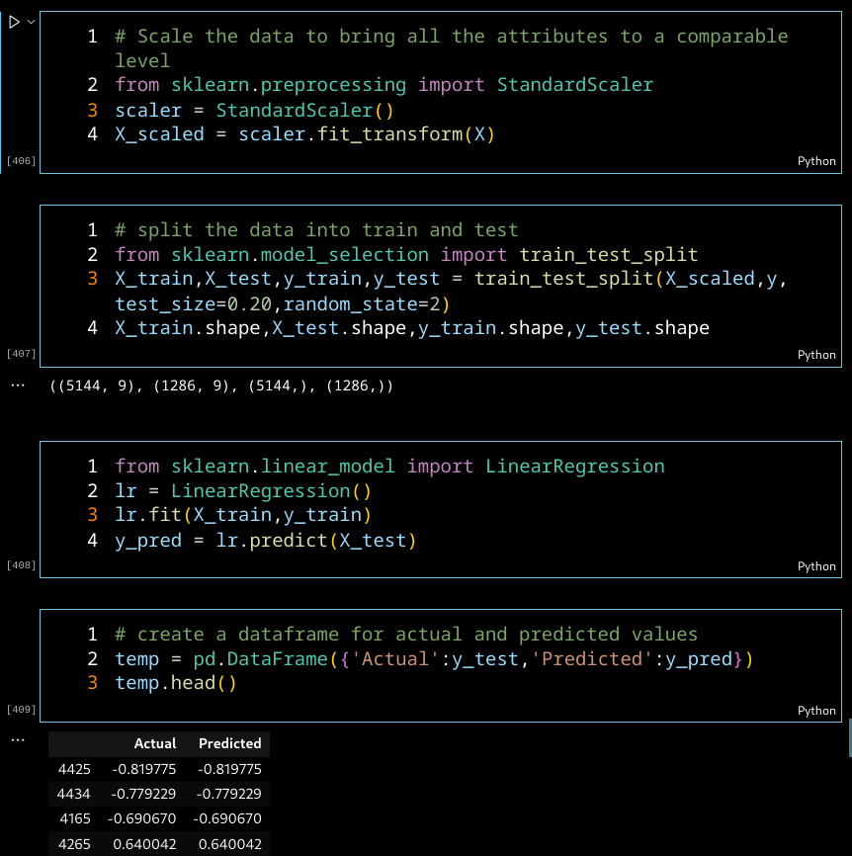
Modelling
After performing all the necessary EDA(like removing null values, removing columns of no use, removing outliers, normalizing the data) we defined dependent and independent variable (i.e. X=df.drop('Mental_fitness',axis=1) y=df['Mental_fitness']) and then splited the data in to 80-20 ratio for training and testing and then we called Linear regression model to train it on our dataset

Slide 9
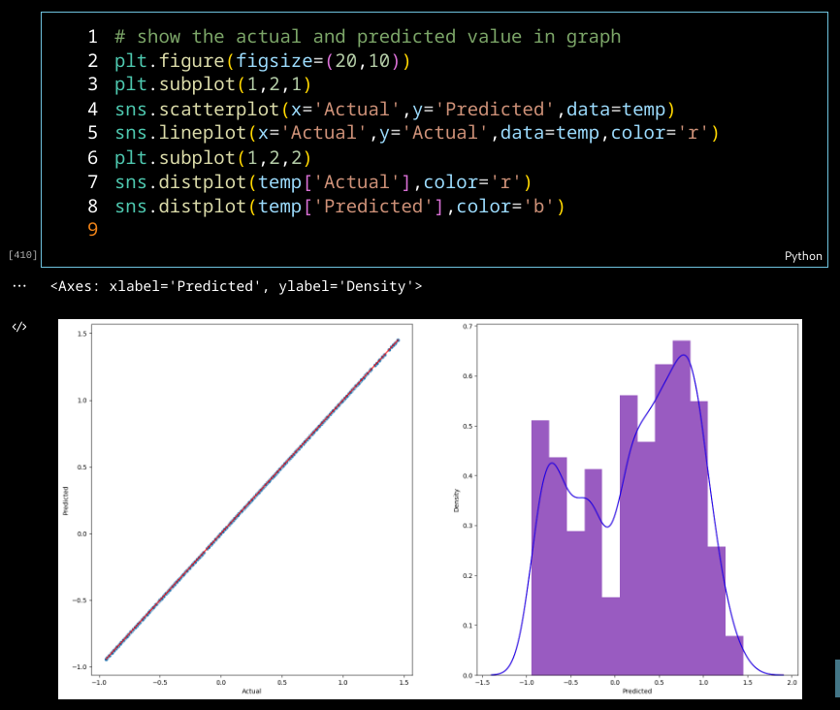
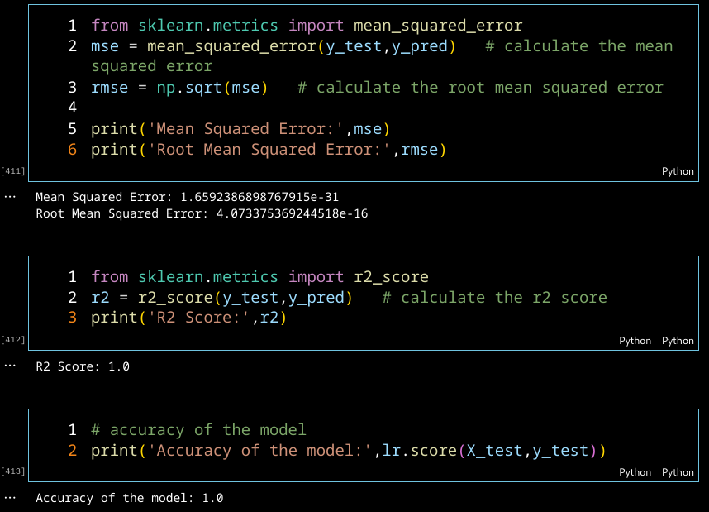
Results
After training our model we got the accuracy of 1

Slide 10

Links
GitHub Repo
IBM SkillBuild Video
DataSet

