Slide 1
Product Design #1 (ATMAA Accounting Software)
Atmanirbhar Business Consultancy LLP
By Adokshaj Bhandarkar

Slide 2
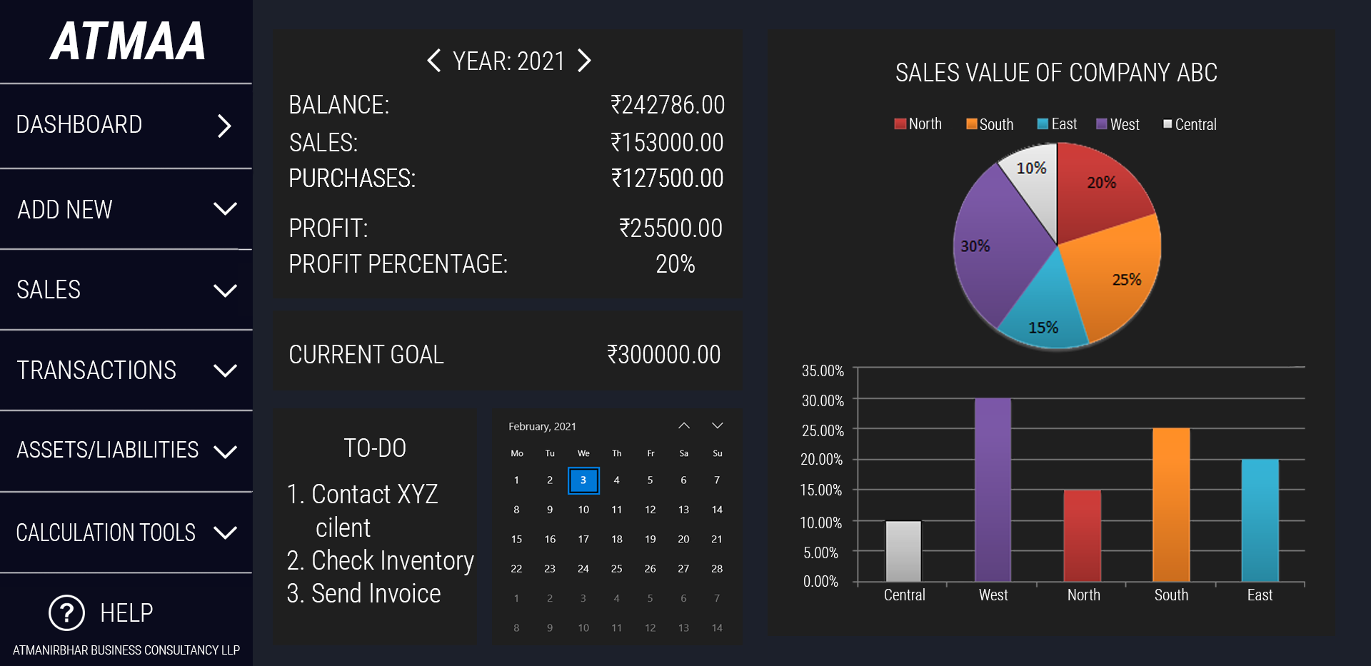
OPENING SCREEN OF THE SOFTWARE
_ X

Slide 3
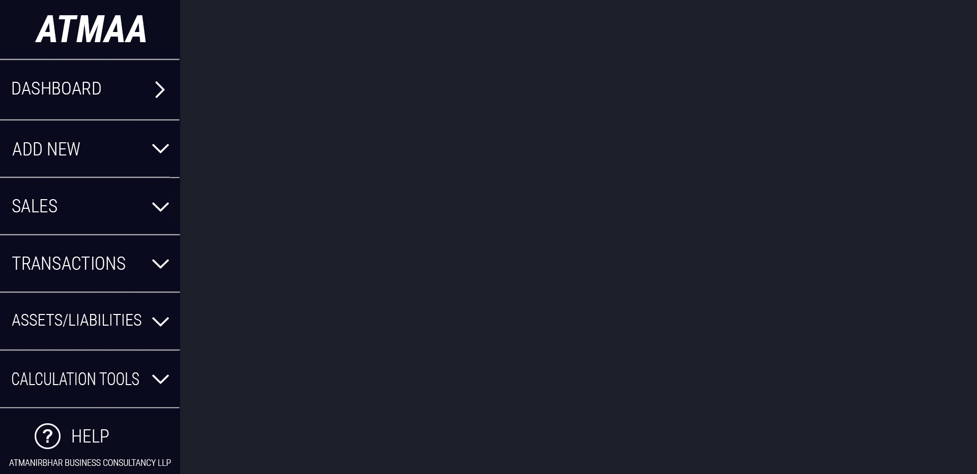

ABOUT THE ‘SIDE MENU’
_ X
1. DASHBOARD: Important information visible in one go.
2. ADD NEW: Add a new company/individual for tracking.
3. SALES: Profits and Losses (detailed) information.
4. TRANSACTIONS: History of transactions. (Cash, Online,Credit)
5. ASSETS/LIABILITIES: Assets and Liabilities owned by the
company/individual.
6. CALCULATION TOOLS: GST, Profit and Loss, Interest
calculators.
7. HELP: Documentation of the software for reference and
learning purposes.
SIDE MENU

Slide 4
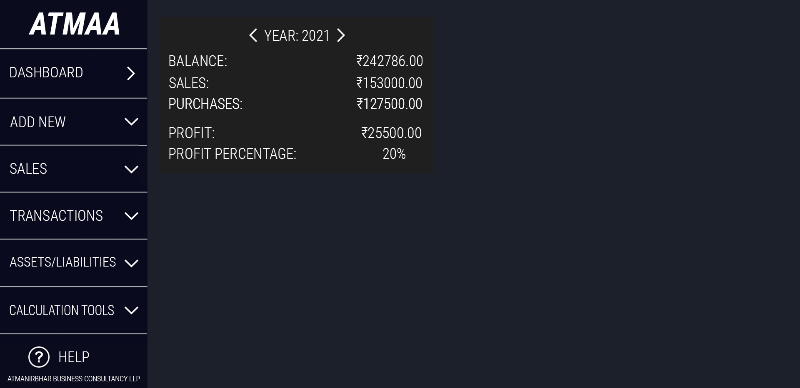
ABOUT ‘EXPENSES AND GAINS’ SECTION
_ X
Shows year-wise expenses and gains.
(Summary only; Year-wise/Month-wise/Week-wise options decided by the user)

Slide 5
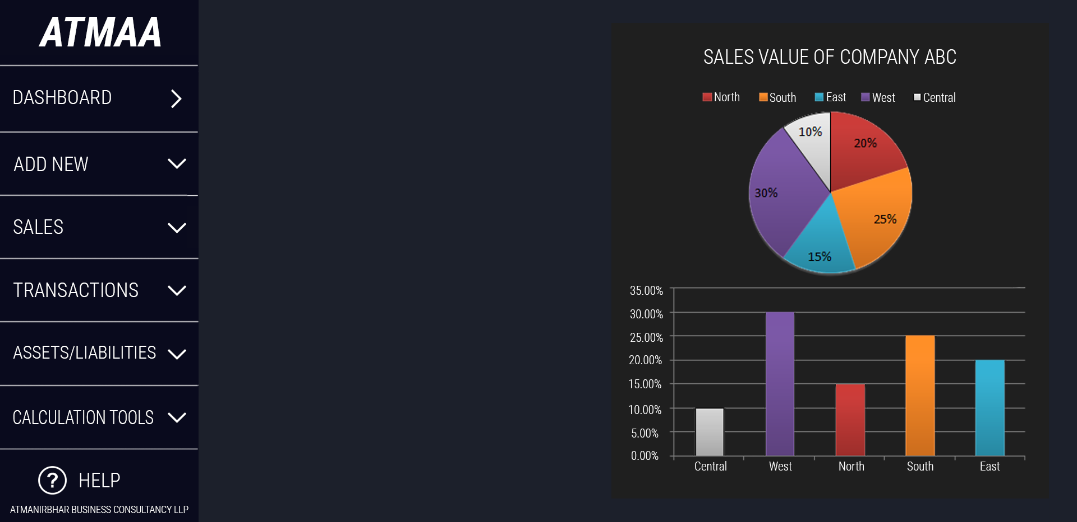
ABOUT ‘GRAPHS’ SECTION
_ X
Graphs make it possible to get more information in less amount of time.
These graphs show the sales of the company ‘ABC’ in different regions. (Categories can be changed according to the user’s wish.)

Slide 6
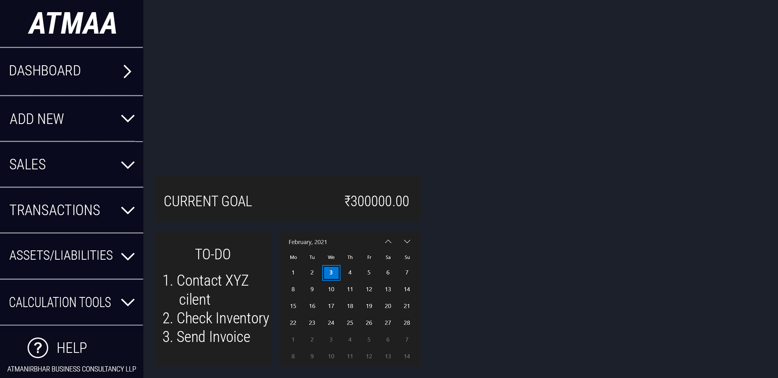
ABOUT ‘MISC.’ SECTION
_ X
Graphs make it possible to get more information in less amount of time.
These graphs show the sales of the company ‘ABC’ in different regions. (Categories can be changed according to the user’s wish.)
‘Misc.’ section shows:
the current goal of the company/individual.
simple to-do list.
calendar.

