Slide 1
Product Plan
2021 – PRASHANT SINGH AND ADOKSHAJ BHANDARKAR

Slide 2
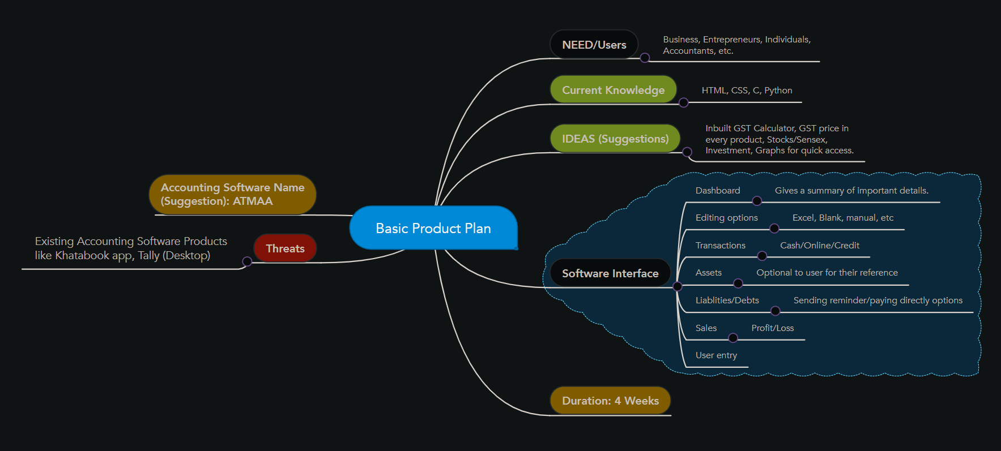
MINDMAP

Slide 3
ATMAA – A personalized accounting software
The name of the accounting software should be ATMAA.
Why? - The 'soul' of every successful business is organized information. A personalized accounting software is advantageous in our case, hence the name.
Project Company : Atmanirbhar Business Consultancy LLP
Duration of the internship (Time available) : 4 Weeks

Slide 4
Who can benefit the most from ATMAA? (Need/Users)
Small Businesses
Entrepreneurs
Accountants
Budding Creators

Slide 5
Threats
Existing Accounting Software Products like Khatabook app, Tally (Desktop).
Why a threat? -
1) Successfully established software products.
2) Frequently Updated.
3) Features they offer.

Slide 6
General Ideas and Suggestions
Dashboard (Summary)
Inbuilt GST Calculator
GST price in every product
Stocks/Sensex
Investment
Graphs for quick information.

Slide 7
Current Knowledge
HTML – Responsible for giving structure to a webpage.
CSS - Responsible for the way a webpage looks.
C - Multipurpose programming language.
Python – Multipurpose programming language.

Slide 8
Software Interface
Dashboard – Gives a summary of important details.
Editing Options - Excel, Blank Page for Data Entry, Manual, etc.
Transactions - Cash, Online, Credit.
Assests – Optional to the user for their reference.
Liabilities/Debts - Sending reminder/paying directly options.
Sales – Profits and Losses incurred.
Options to enter user/organization information.

