Slide 1

Syvis
A visual code editor for Lively
Software Architecture Group
Prof. Dr. Robert Hirschfeld
Web Based Development Environments 2017-2018

Slide 2
Demo
Add.js - Same function, several ways to format it
Gotchas.js - Hard to spot bugs
Primitives.js - Responsive layout and emojis
Loops.js - Custom syntax style and pretty objects
Gotchas.js - Fix the bugs
Large.js - Demonstrate good performance

Slide 3
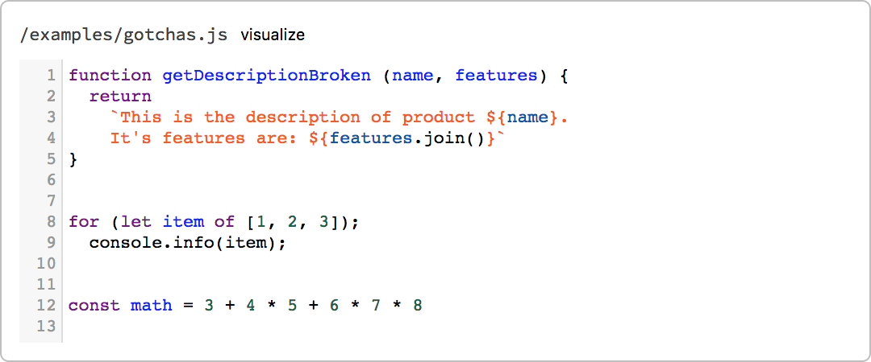
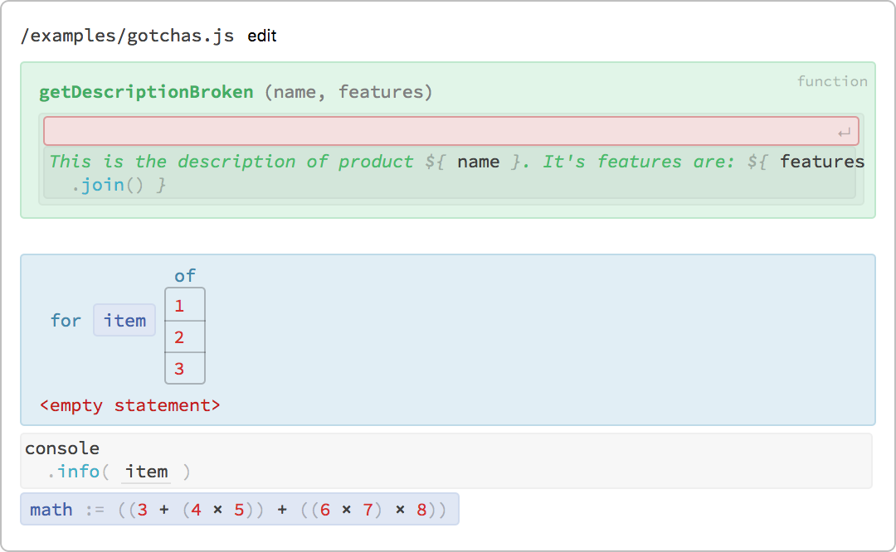

Slide 4
The Problem
Plain text can be hard to comprehend
=> Formatting & syntax highlighting try to mitigate this problem
Formatting is decided by the author and not the reader
=> Code is less comprehensible in unfamiliar formatting which leads to
decreased development speed and higher error rates
Semantically equivalent code can be written in vastly different textual representations
=> Makes it hard to reason about code

Slide 5
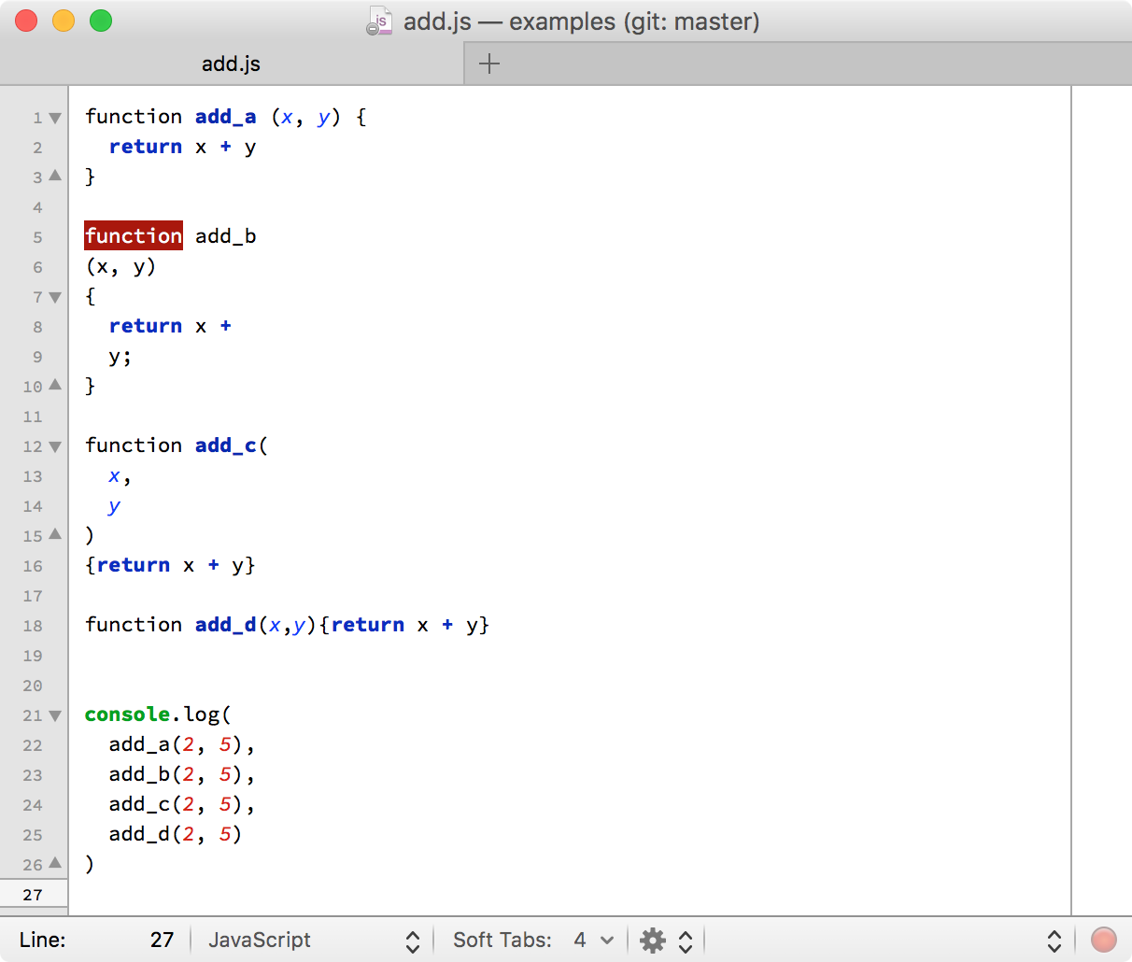
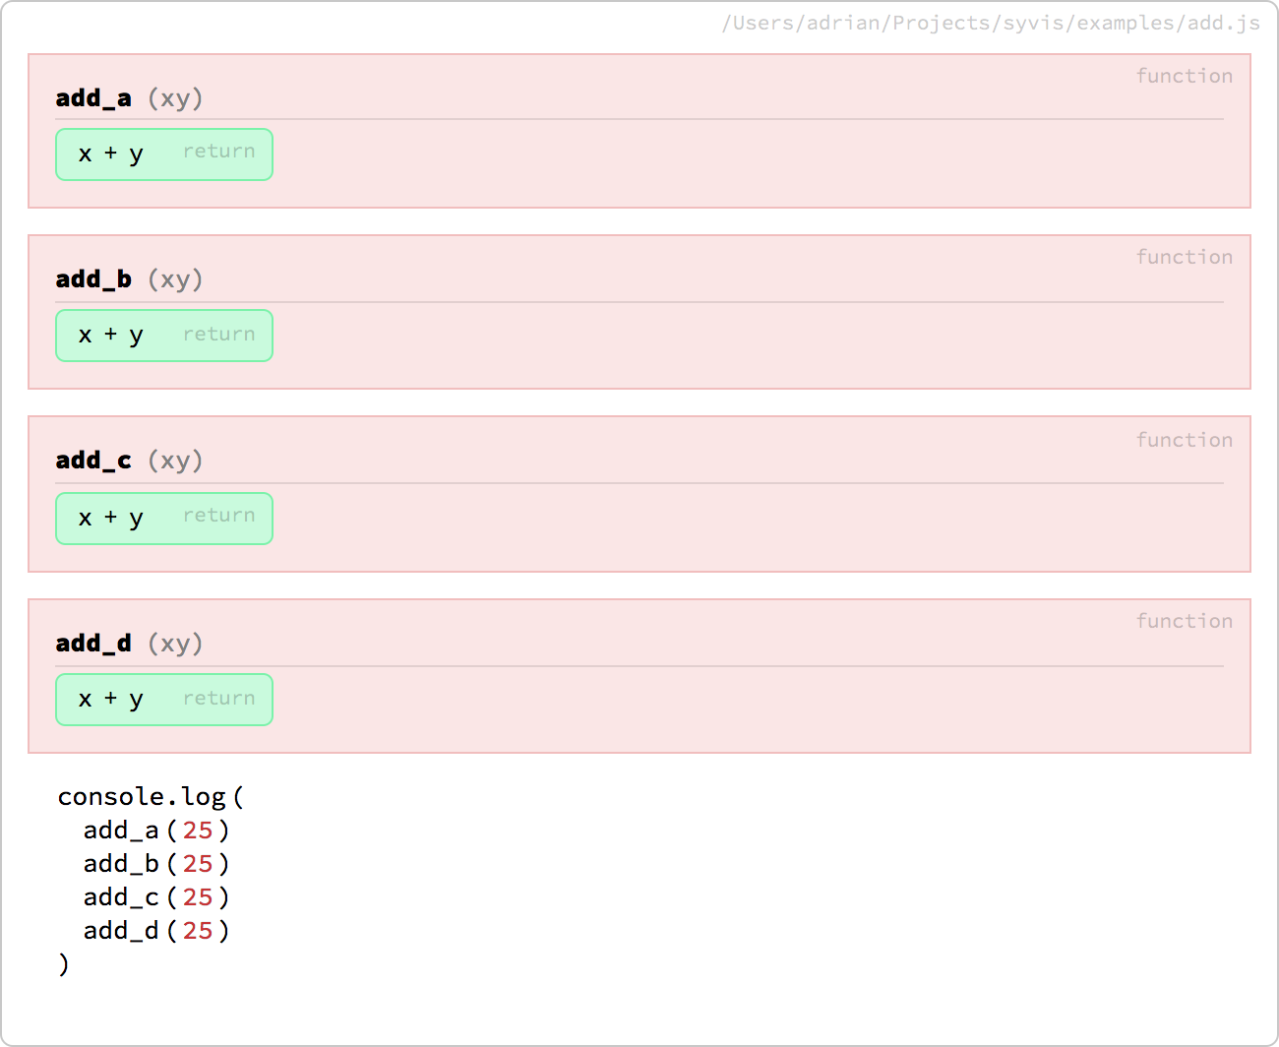
Instead: Syntax Visualization

Slide 6
Architecture
let value = 6 * 7
let value = 42
Initial
Code
New Code
Syvis
Serialize
['div', {id: '…
<div id="…
Transform to virtual DOM
Render in document
Transform to AST
"type": "VariableDeclarator",
"id": {
"type": "Identifier",
"name": "value"
},
Patch the AST
(original formatting is lost)
-let value = 6 * 7
+let value = 42
Didn't work
It worked
Try to patch original code
Edit code

Slide 7
Challenges
Rendering is complex
  ~120 commits just to get it working
  64 node visualizers and still counting
  (Almost) unlimited edge cases
Developer needs to get used to it
Tooling needs to be built

Slide 8
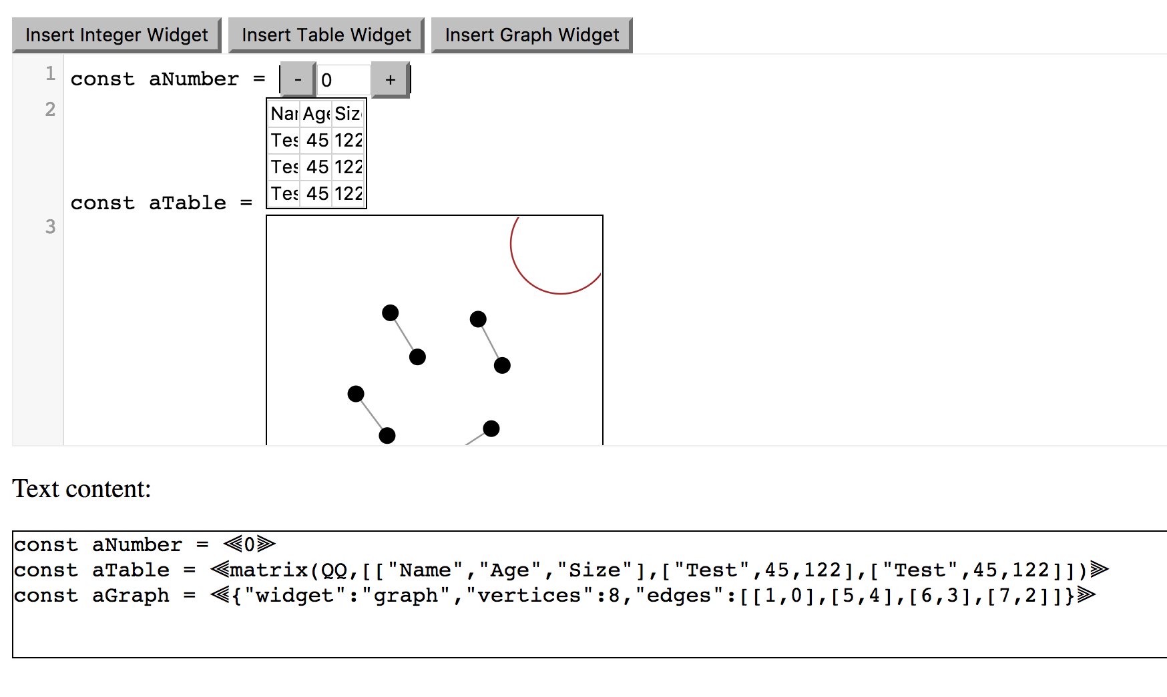
Future Work
Better editing
Several Themes + Selector
Different input elements
for different data types
  Slider
  Calendar widget
Drag and drop reordering
Multi language support with integrated cross compilation
AST all the way
Multi language rendering (Math formulas, Latex, Markdown)

Slide 10
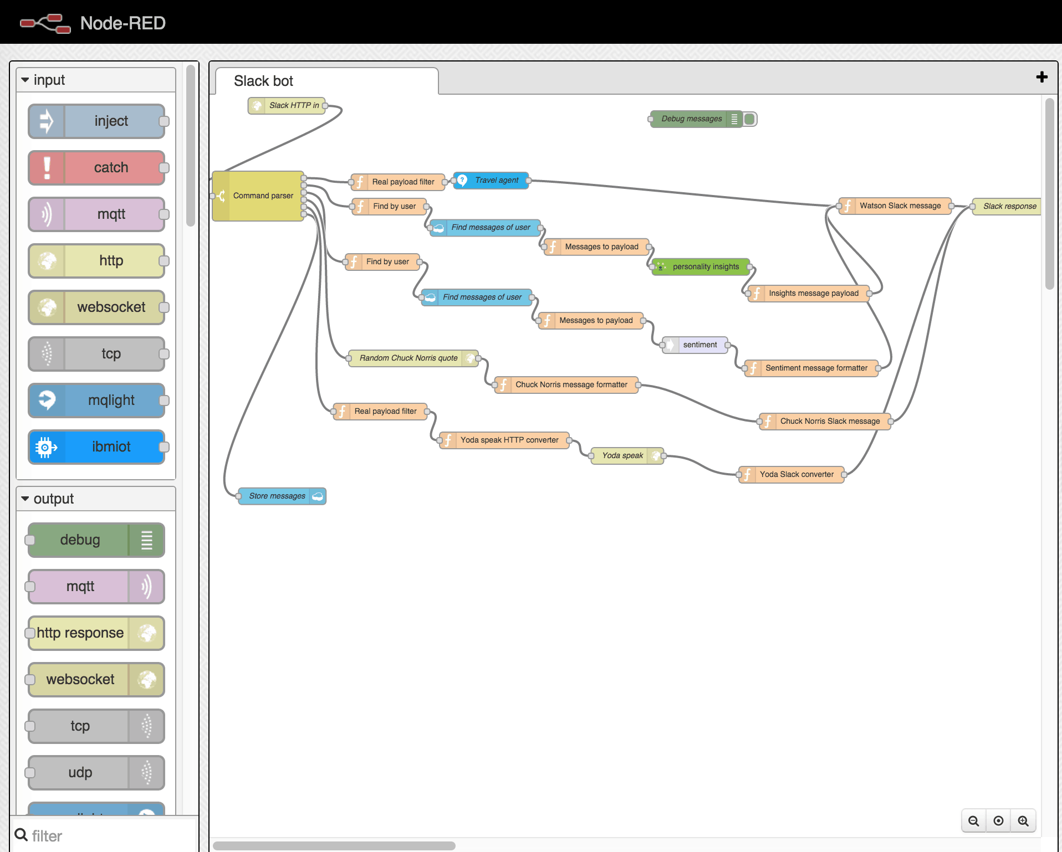
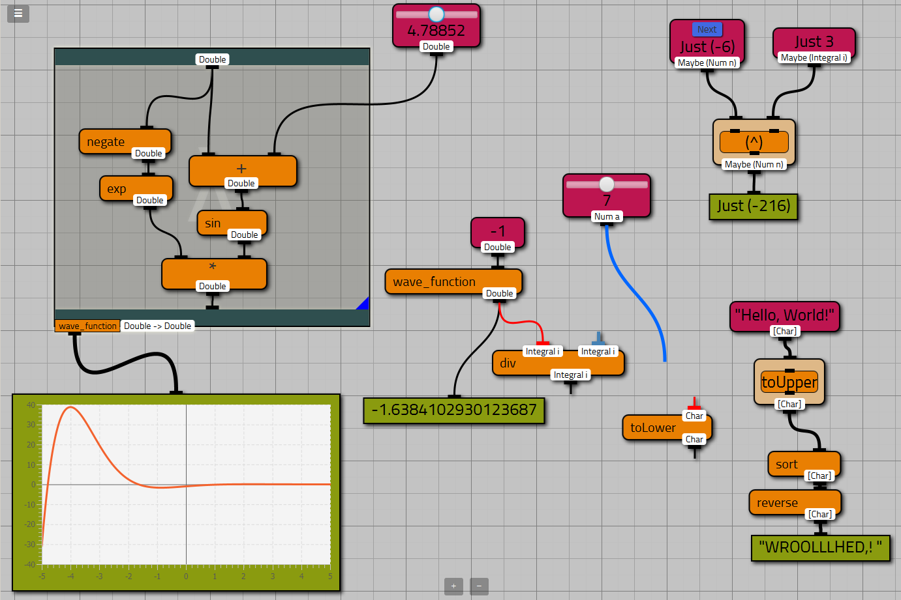
Probably Not Ideal: Flow Graphs
Still hard to read
Still unlimited different representations

Slide 11
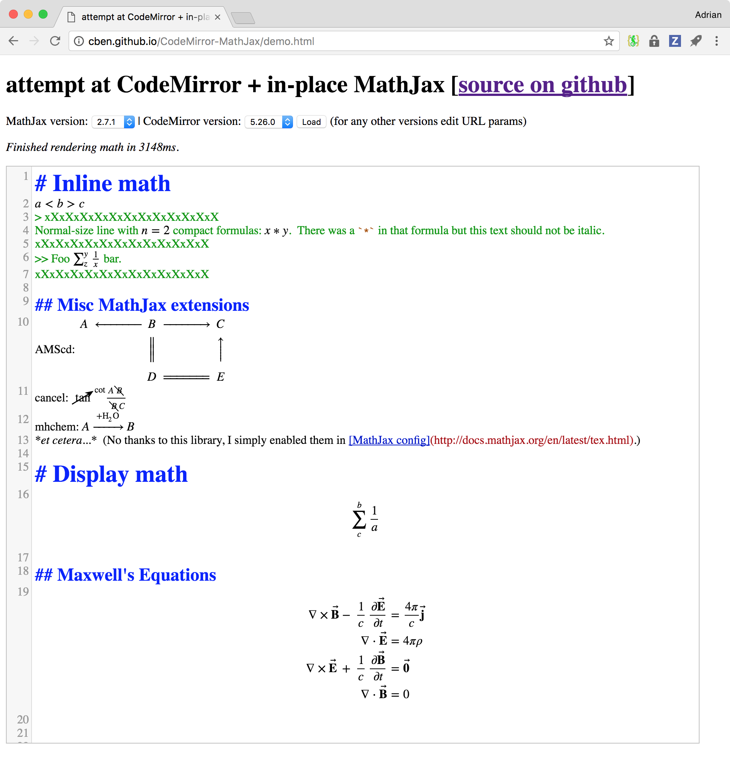
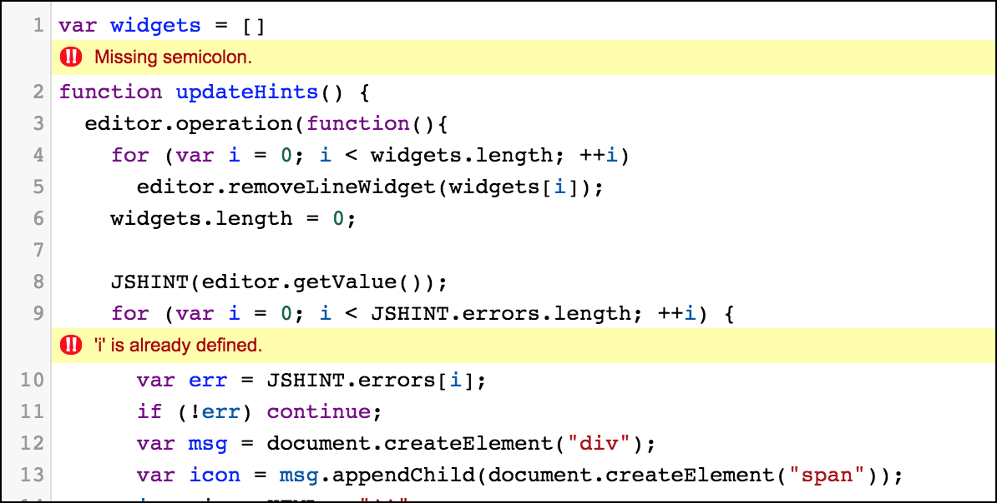
Inline Widgets

Slide 12
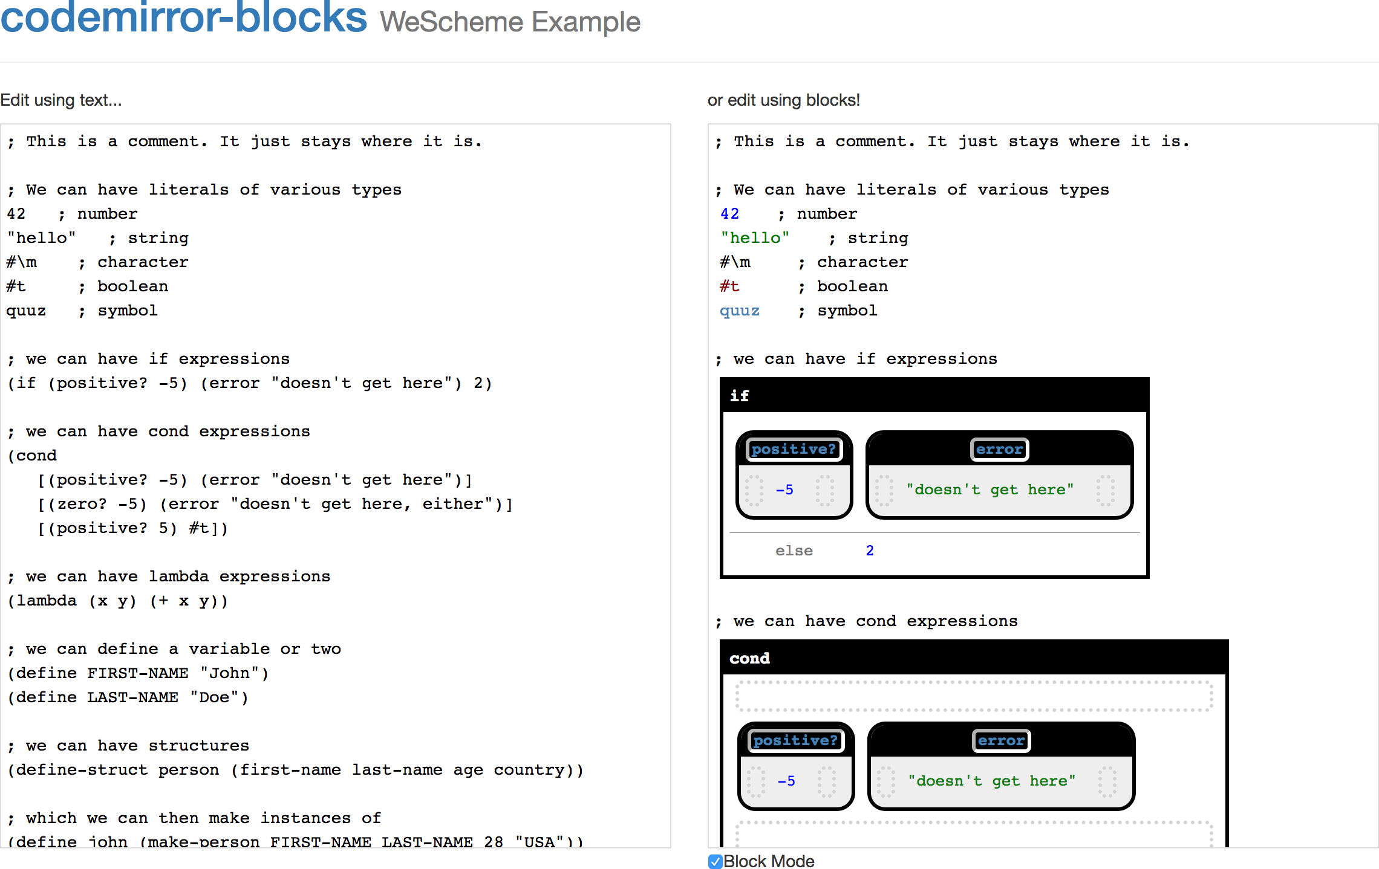

Slide 13
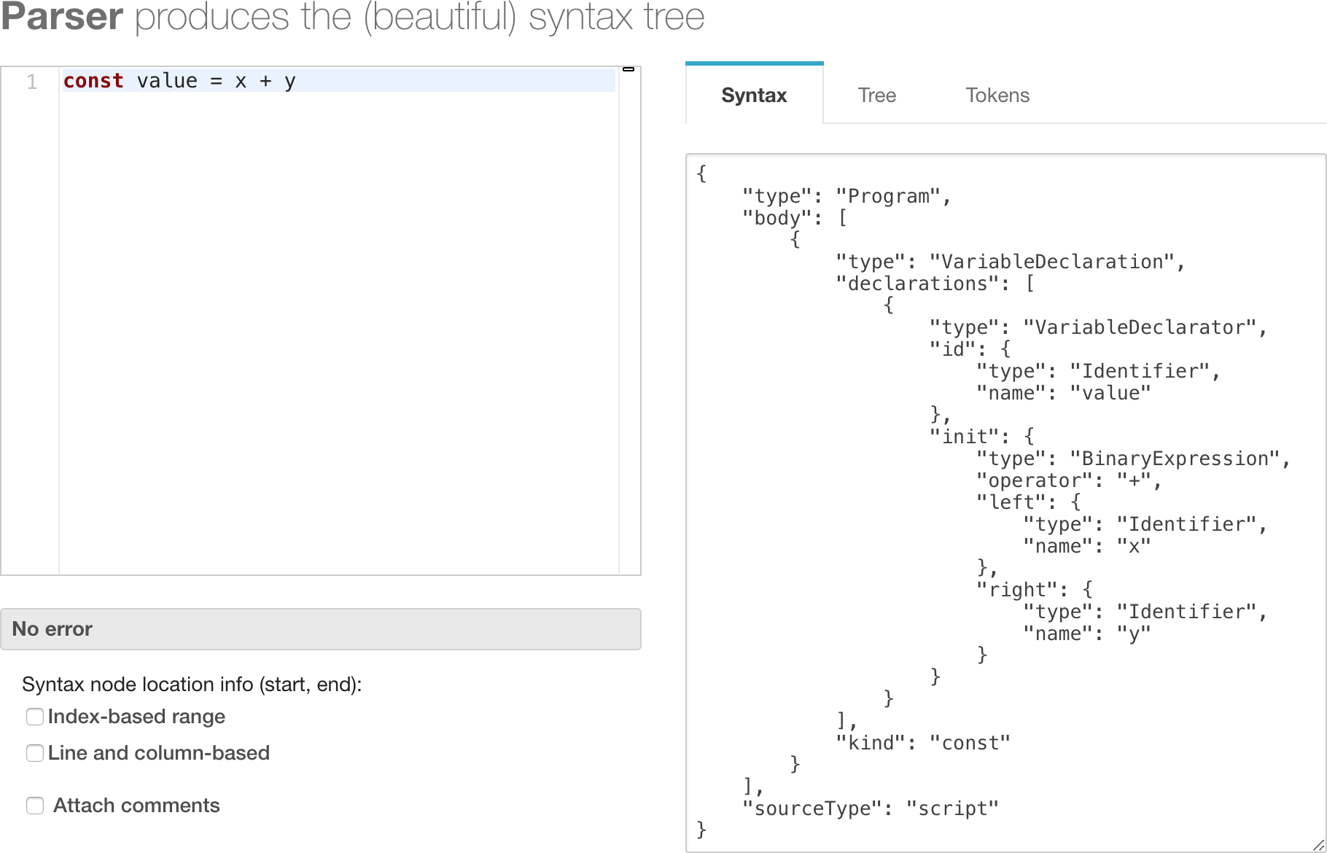
Use AST (not the Code)

Slide 14
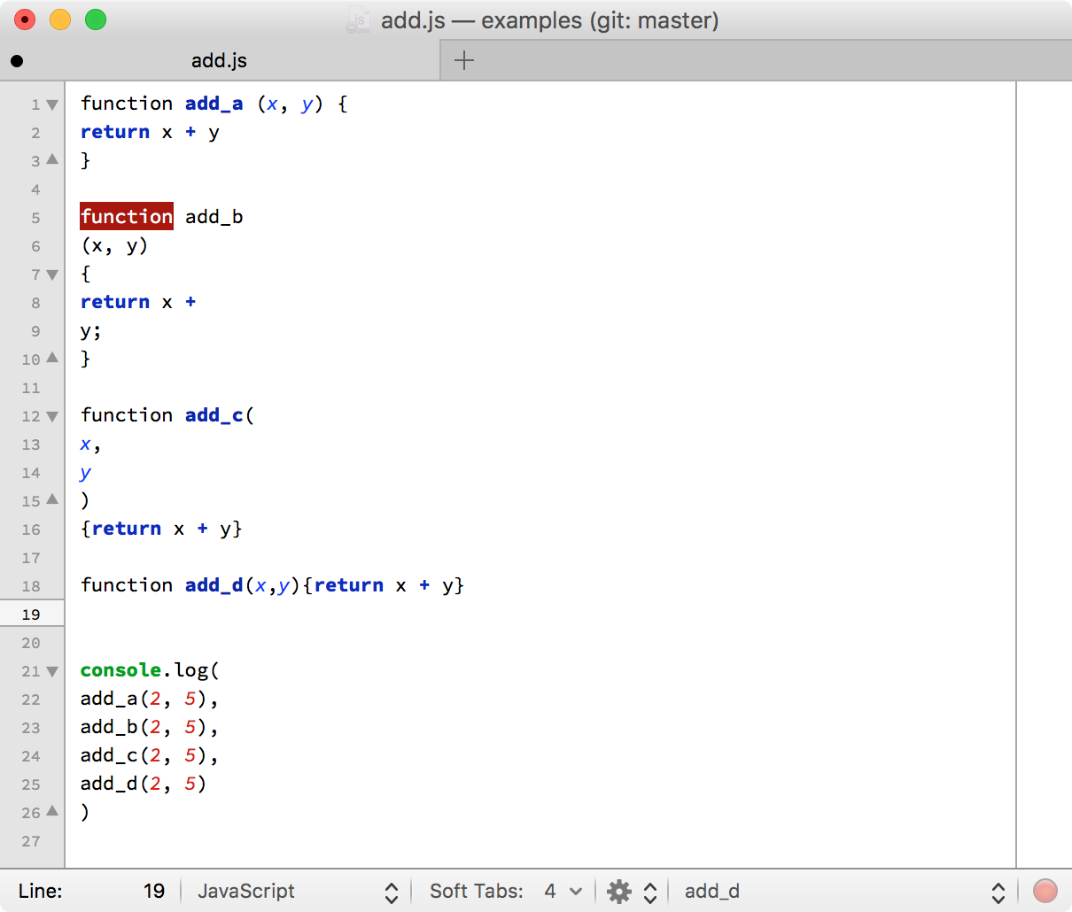
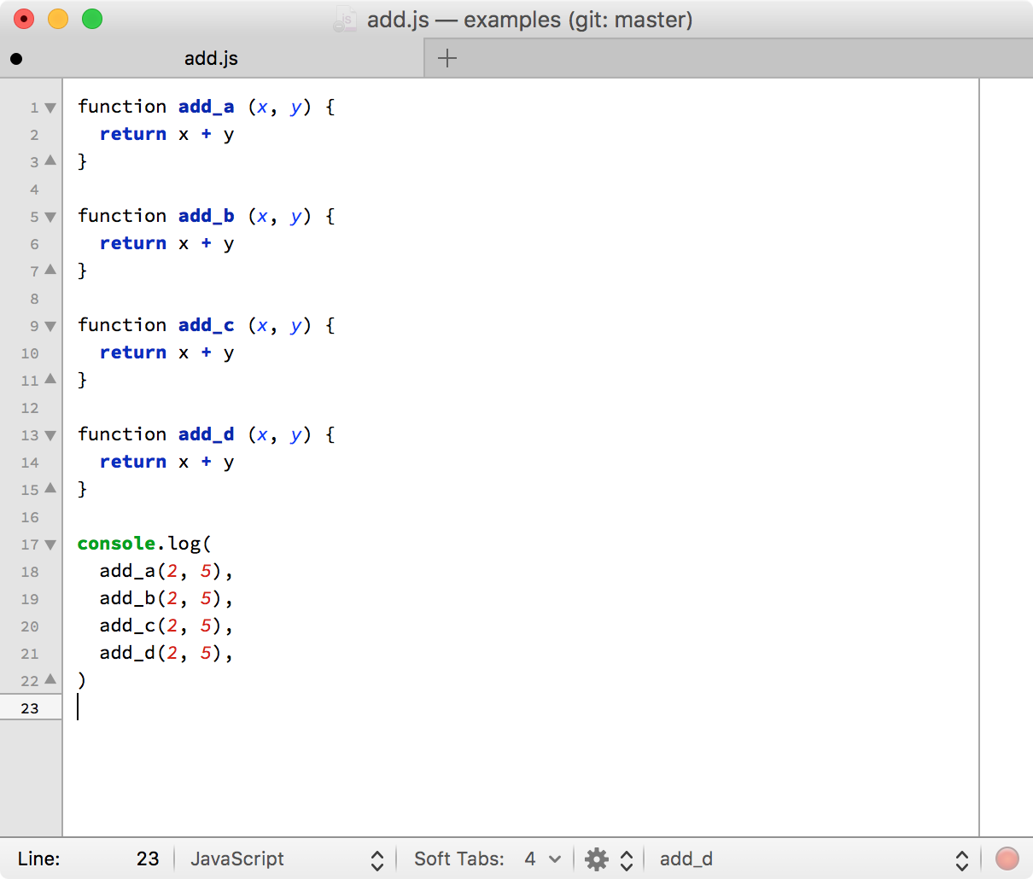
Formatting Should be a User Setting

