Slide 1
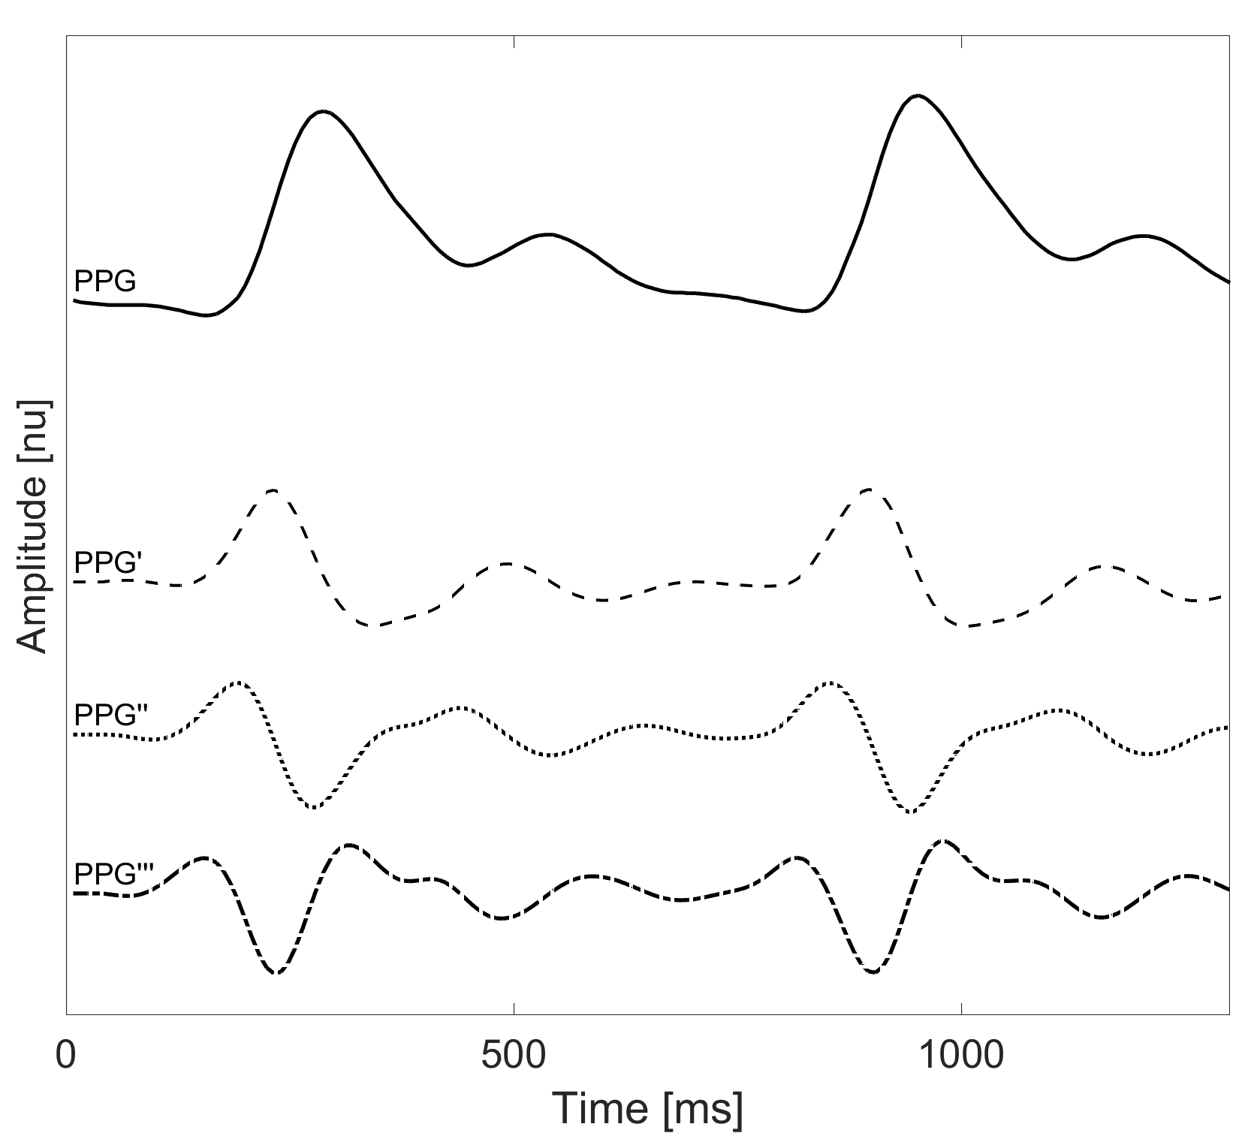
sp
Peak-to-Peak Interval (T_{pp})
sp
Diastolic Width
at 50% (T_{dw50})
Time Delay (∆T)
Systolic Peak Amplitude (A_{sp})
Systolic Width
at 50% (T_{sw50})
dp
dn
on
off
Pulse Interval (T_{pi})
Systolic Time (T_{sys})
Diastolic Time (T_{dia})
Diastolic Peak Time (T_{dp})
Systolic Peak Time (T_{sp})
u
w
v
a
e
c
d
f
b
p₁
p₂

