Slide 1
Biodiversity Analysis — Slide Deck
Portfolio Project (Codecademy)
Data: species_info.csv + observations.csv
Auto-generated deck

Slide 2
Data Overview
species_info.csv: 5,824 rows | columns: category, scientific_name, common_names, conservation_status, is_protected
observations.csv: 23,296 rows | columns: scientific_name, park_name, observations
Unique species: 5,541 | Parks: 4

Slide 3
Significance: Category vs Protection
Chi-squared test (category × is_protected):
χ² = 469.511, df = 6, p = 3.096e-98
Result: Significant at α = 0.05

Slide 4
Recommendations
Prioritize categories with higher protected share:
- Mammal: 17.0% protected
- Bird: 15.4% protected
- Amphibian: 8.9% protected
- Fish: 8.7% protected
- Reptile: 6.4% protected
- Nonvascular Plant: 1.5% protected
- Vascular Plant: 1.1% protected
Report both absolute counts and shares at park level.

Slide 5
Foot-and-Mouth Disease — Sample Size
Fill in after sample-size step in notebook:
• Define hypotheses and MDE
• Choose α and target power
• Run power analysis for proportions (n per group)
• State assumptions and final n

Slide 6
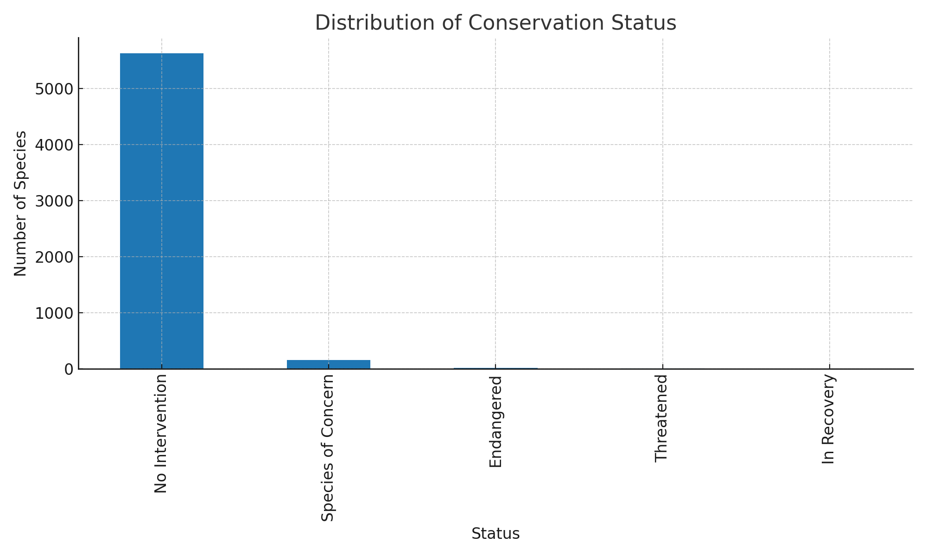
Distribution of Conservation Status

Slide 7
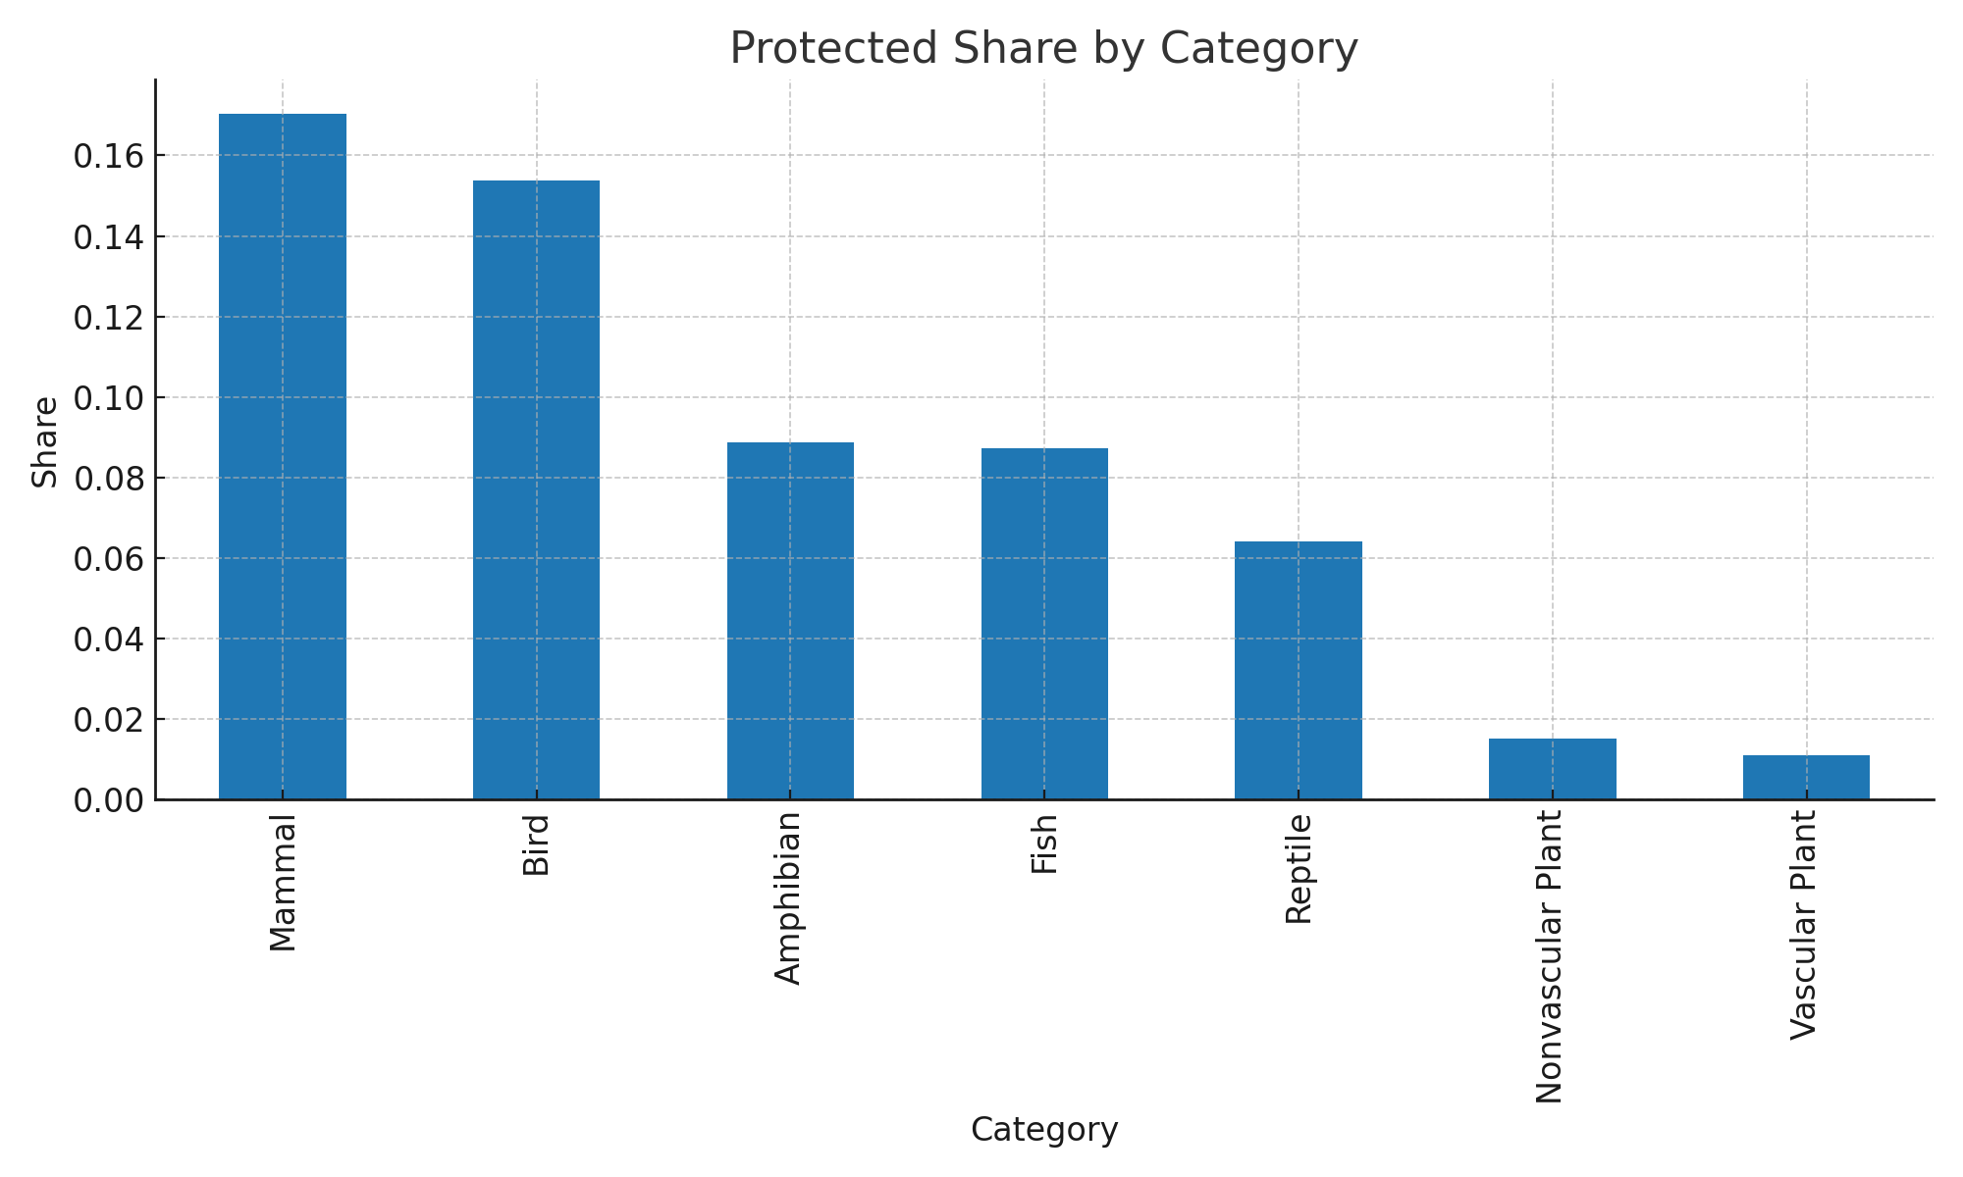
Protected Share by Category

Slide 8
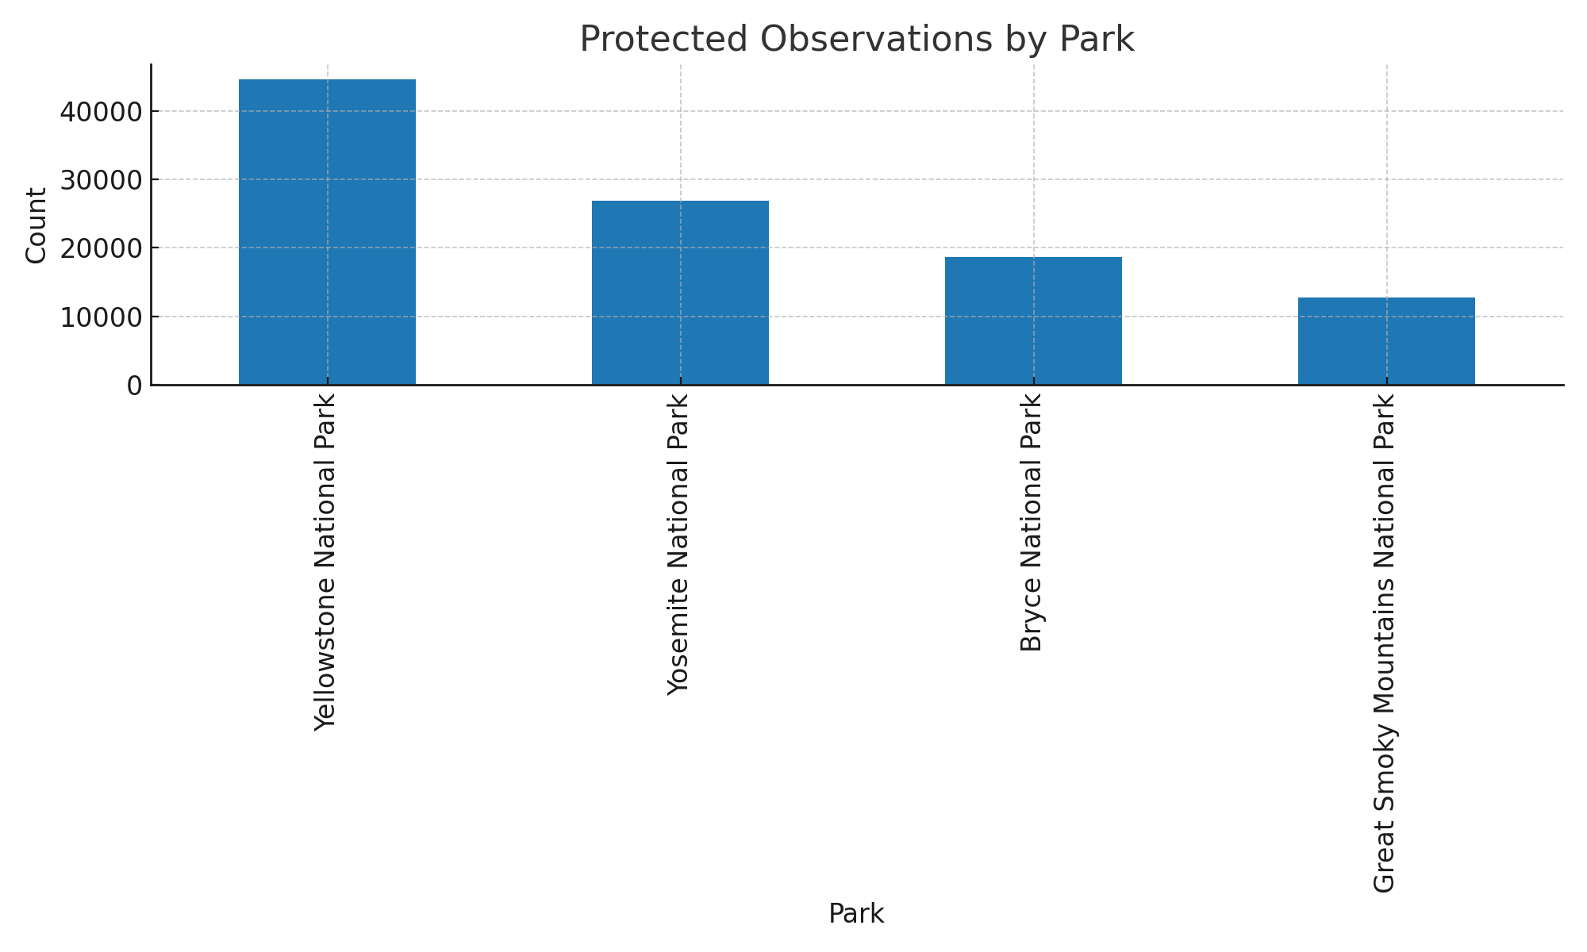
Protected Observations by Park

