Slide 1

The Smoothie Solution
By Amanda Doyle

Slide 2
Project Description
Overall Description

Slide 3
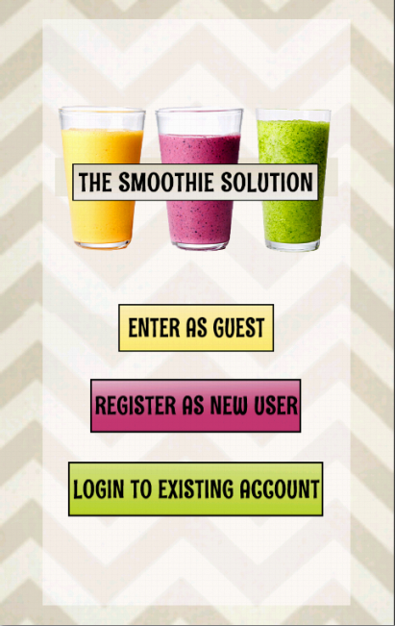
Project Description
User Interface

Slide 4
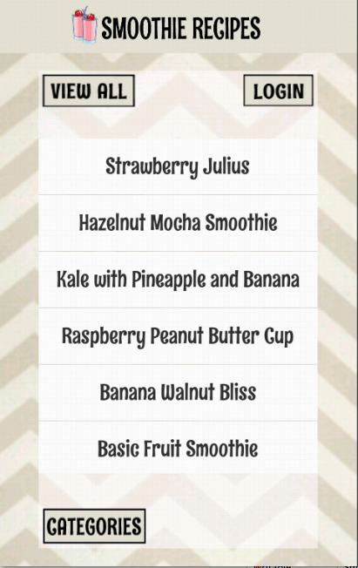
Project Description
Basic Functionality

Slide 5
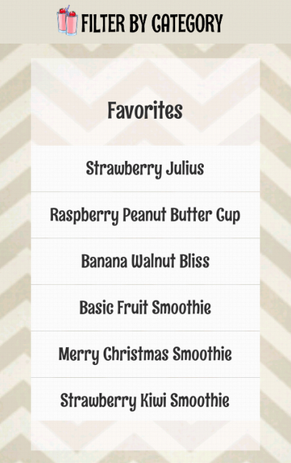
Project Description
Extra Functionality

Slide 6
Motivation
Everyday Application

Slide 7
Motivation
Ease of Accessibility

Slide 8
Motivation
Popular Target Market

Slide 9
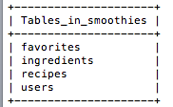
Motivation
Database Opportunity

Slide 10
Technology
AsyncTask

Slide 11
Technology
MySQL

Slide 12
Technology
PHP

Slide 13
Technology
JSON

Slide 14
Technology
Built-in Android Libraries

Slide 15
Implementation Details
Design Elements

Slide 16
Implementation Details
Server Communication

Slide 17
Implementation Details
Response Handling

Slide 18
External Concepts
Database Implementation

Slide 19

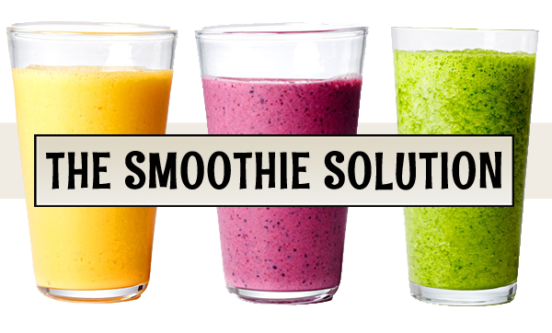


External Concepts
Extra Design Elements

Slide 20
Conclusion

