Slide 1

Project Proposal JAAM studios presents JAAM Casino BLACKJACK GOAT 2.1

Slide 2
About Us
Developers
Jonah Hoffman (jh258312@my.stchas.edu)
- background in JavaScript and frontend development.
Austin Steiniger (as263003@my.stchas.edu)
- background in Python and backend development.
Project Managers
Alix David (ad124058@my.stchas.edu)
- experience in real world Project Management
Matt Wright (mw212610@my.stchas.edu)
- experience in Python and C++ languages

Slide 3
Introduction
Welcome to the Goat of chance games…
Blackjack GOAT 2.1
Where there is excitement in every card!
- JAAM studios aims to make the next greatest Blackjack web game! Sit back, relax, and let the sound of the cards hitting the felt relax you after a long week.
- With tons of features to keep the game interesting and implementation of using your very own Google account, you will be able to save your progress and rack up chips endlessly. No need to worry about the stress and risk of real-life casino gambling, enjoy your time and stay with us on Blackjack Goat 2.1.
Our Mission is to provide the user with relaxing entertainment without the risk of real-life gambling!

Slide 4
How to Play
Objective:
Players draw cards to reach a total of 21 or closest to it before going bust (over 21) .
- Card Values:
-Number cards: worth the listed numeric value
-Face cards: worth 10
-Aces: worth 1 or 11
Beat the bank:
21 (or blackjack) as your starting hole cards pays 3 to 2
2X Bet If you beat the banks draw without reaching 21
Exceeding 21 = bust and loss of all chips that were bet

Slide 5
Features
Changing deck themes (card backs, possible implementation of felt color)
Change the number of decks in play (2, 4, or even 6 decks in play!)
Your own avatar photo and display name
Google account implementation saves your chip stack!
Wide variety of bet amounts to keep the game interesting (1,5,10,20,50,100 bet amounts!) potentially more coming
Playable on PC web browser or phone/tablet web browser
All your favorite blackjack rules (1.5x pay on Blackjacks, splitting pairs, AND double down!)

Slide 6
Future Implementation…
Out of chips? Work on Casino Cleaning Crew to earn more so you can head back to the tables..
Have a gambling problem that you can't seem to shake? We have rehab roleplay to keep you off the casino floor!
MORE to come!

Slide 7
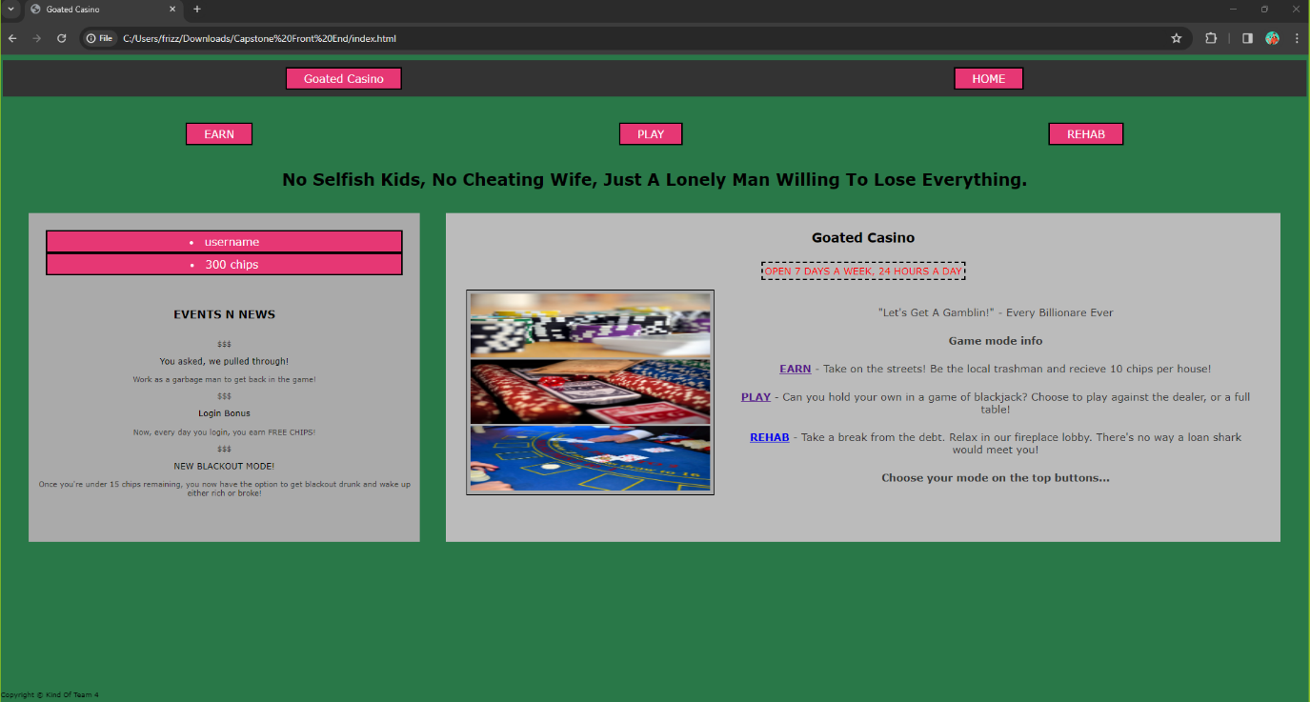
Front End Development
HTML
CSS
JavaScript

Slide 8
Back End Development
Django Framework
- This will be our web framework to help us set up our backend
- Utilization of Django will also help us implement our Google API’s
- This is an open-source framework that is used in many popular applications today such as Instagram, Spotify, and Dropbox
Python 3.21
- Python will be the language we use for all backend development as Django is built on it

Slide 9
Development and Testing
Internal testing:
- We aim to debug all our code internally and get our program to a running state in which we can move on to group testing.
Focus group testing:
- At this point in the process we aim to have small groups of individuals we know personally test our application and provide feedback on its functionality.
Beta testing:
- The next step in the process will be releasing a beta test to a limited public audience to provide further feedback on the functionality of our game.
Final testing:
- After completing final edits and all three prior phases have been considered a success. Our final phase of testing would consist of an open beta that anyone could participate in.

Slide 10
Budget and Finance
- Projected budget: $350,000.00
- $50,000 Per week of Development
- 160 work hours per week
- 4 development members each working 40 hours per week

Slide 11
Week # | Monday | Tuesday | Wednesday | Thursday | Friday
Week 1 | Begin Development | Front End Develop | Front End Develop | Front End Edits | Front End Edits
Week 2 | Finalize Front End | Finalize Front End | Back End Planning | Back End Develop | Back End Develop
Week 3 | Back End Develop | Back End Develop | Back End Develop | Back End Testing | Back End Testing
Week 4 | Client/Server Integration | Client/Server Integration | Client/Server Integration | Internal Testing | Internal Testing
Week 5 | Deploy Focus Group Testing | Deploy Focus Group Testing | Focus Group Test Edits | Focus Group Test Edits | Focus Group Test Edits
Week 6 | Deploy Closed Beta Testing | Deploy Closed Beta Testing | Closed Beta Test Edits | Closed Beta Test Edits | Closed Beta Test Edits
Week 7 | Deploy Open Beta | Open Beta Review | Open Beta Review | Open Beta Review | Final Deployment
Proposed Scheduling

Slide 12
Thank You Shareholders!
We look forward to staying connected through our ongoing development process.

