Slide 1
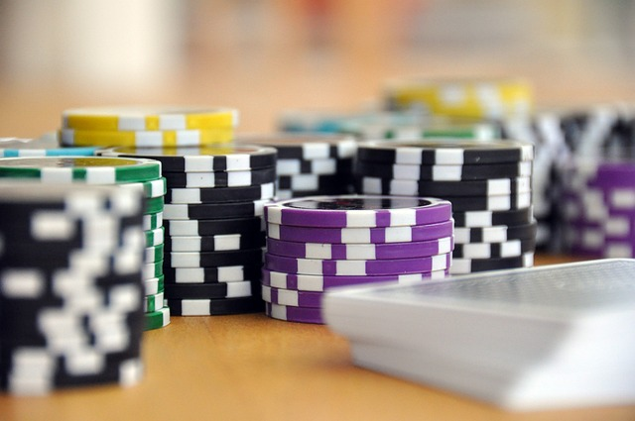
Project PHASE 3 Report JAAMN studios presents… JAAMN Casino BLACKJACK GOAT Phase 3

Slide 2
Backend Development Process..
We have not achieved as much backend development progress as we would have hoped at this point.
We have been learning as we go throughout the process and will share what we have planned and developed at this point.
We would like to apologize to our stakeholders for not adhering to the timeline as tightly as expected but we are making slow progress through our backend as we learn the process.

Slide 3
Out of order research…
We first delved into research on getting our Google account login API setup properly.
We then discovered none of that was going to matter until we had our website hosted.
Research on hosting our site then began.
We landed on hosting our website through Github.io through our team member Alix.

Slide 4
Github.io does not support backend development
We then discovered that github.io was not going to allow us to run any sort of back-end code or database
So, what we end up having currently is a functional connected front end that isn’t currently setup to any back-end database
What this means is we currently have no login functionality, or any sort of account information stored everything runs locally

Slide 5
Web Framework Research…
This leads us back to needing some sort of framework that will support our frontend whilst also allowing us to build a database that supports our login and account creation functionality.
None of our team members have any background in backend development or web frameworks so research on this is still on going…
We do however have SQL written and plans for our database once a framework is setup.
We also have hope that once our framework is setup our account creation and login functionality will be available. This will allow us then to store chip stack, profile customization, etc.

Slide 6
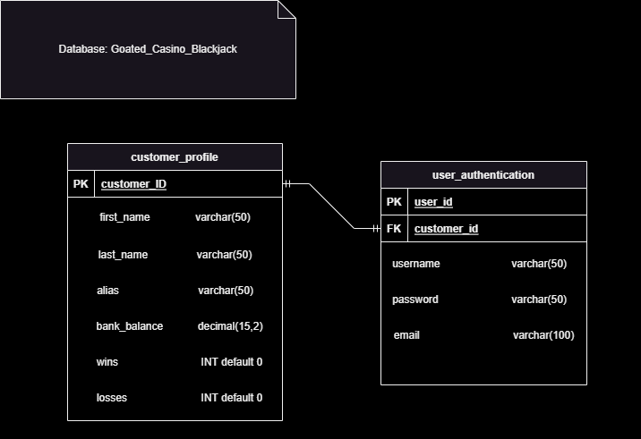
Entity Relationship Diagram

Slide 7
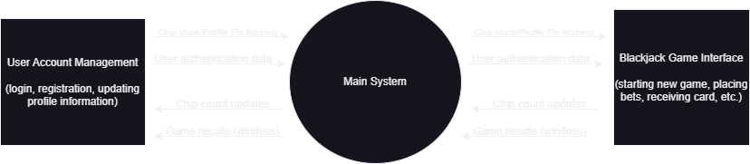
Data Flow Diagram: Level 0

Slide 8
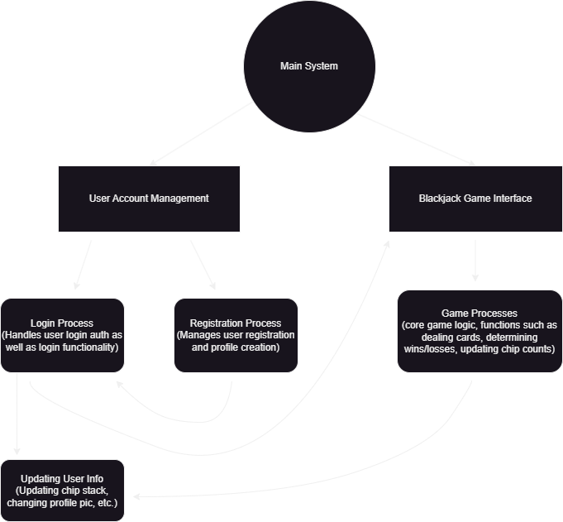
Data Flow Diagram: Level 1

Slide 9
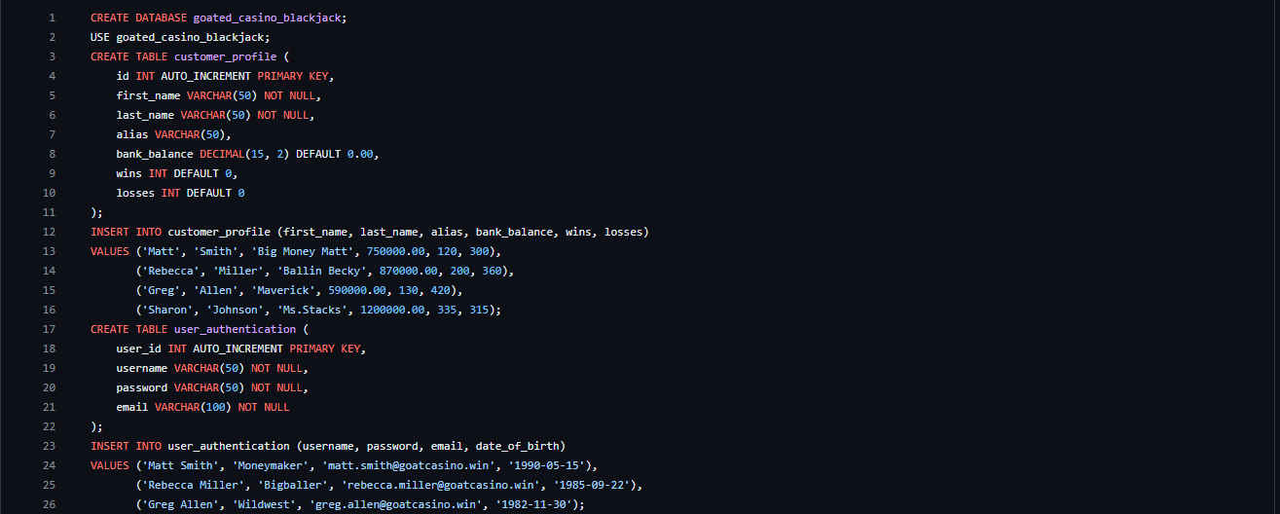
SQL Script (Intellectual Property!)

Slide 10
Blackjack Goat 2.0 Live demo up to this point…

Slide 11
Thanks Again Shareholders!
We look forward to seeing you in the Final Phase to show our finished product!

