Slide 1
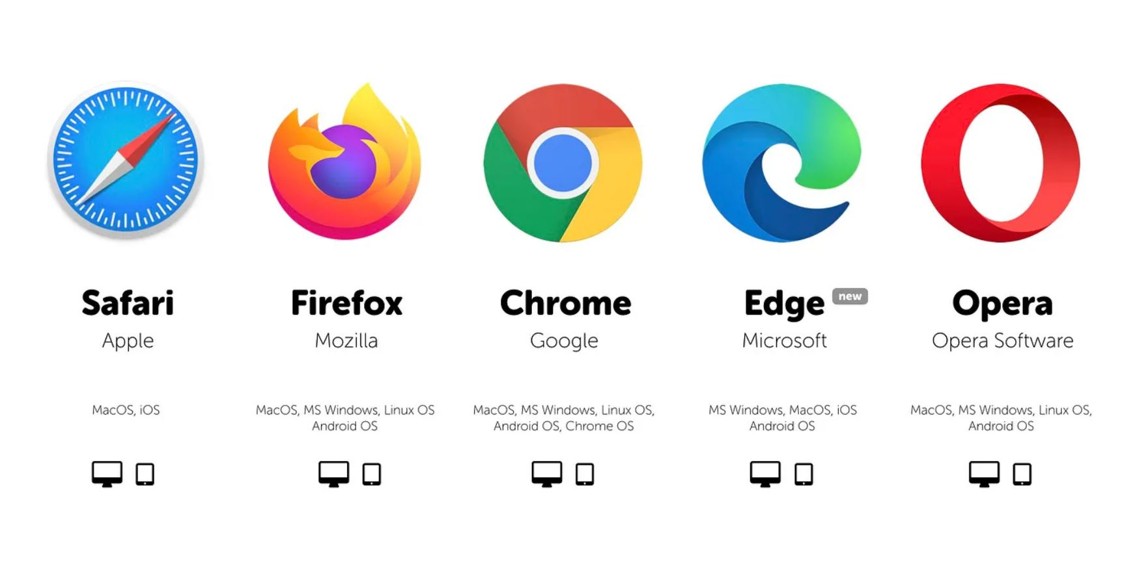
For the hardware it will just require a computer with a search engine: We used Google for this presentation.

Slide 2
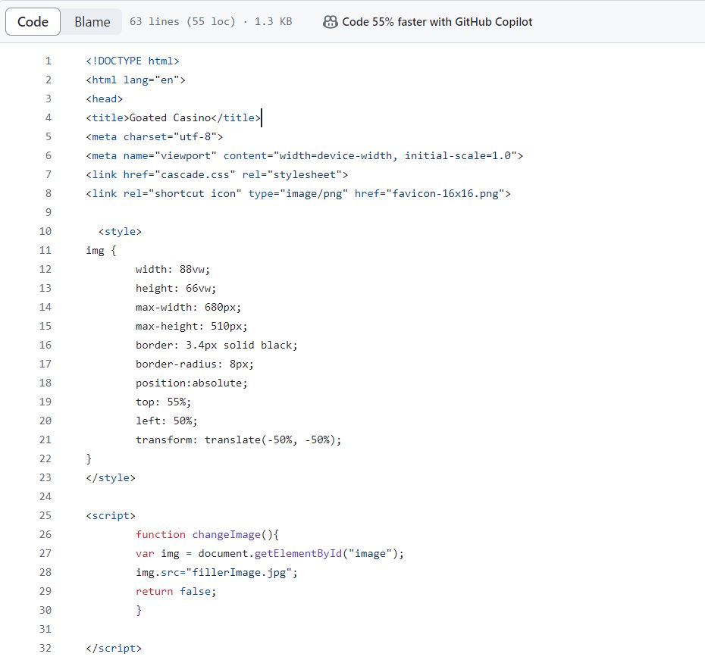
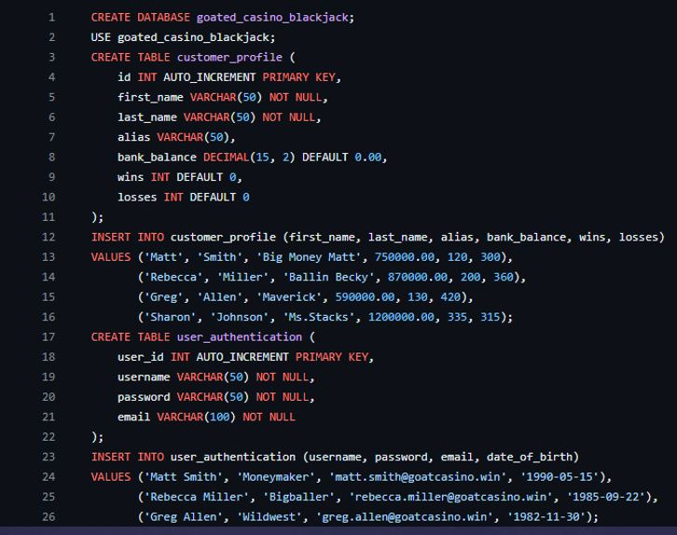
Software used was a blend of HTML, CSS, JavaScript:
Additional we used SQL for the database that will help store all our info for next time we log in and out:

