Slide 1
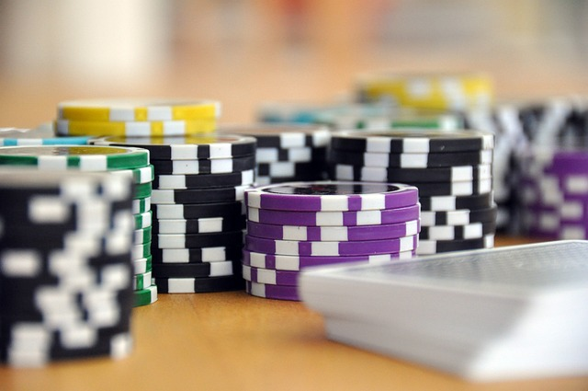
Project PHASE 3 Report JAAMN studios presents… JAAMN Casino BLACKJACK GOAT Phase 4

Slide 2
Recap Up to This Point…
Nearly finished implementation of Front End
Solid foundation to build on our JavaScript focused Blackjack gameplay
Two more modes with front end completed waiting for polishing
Stuck on implementation of a back end or ‘server side’, further work and research needed to finish off our blackjack web game

Slide 3
Where We Are Now…
After many hours of research and planning/collaborating, we began to find success in the Django Web Framework
Some steps had to be redone such as importing all our static html, CSS, static assets, etc.
Once we had all pages linked, we began to finally implement our back end using Django’s models for SQLite.
Research into post and get http requests and JSON data also ensued to get a working login system as well as chip count functionality.

Slide 4
What We Were Able to Implement…
Ultimately, we were able to successfully create an account creation and login system using some simple fields.
This account system saves your chip count data throughout your login session and is used through our ‘Play’ and ‘Earn’ gameplay.
We were able to implement all the usual blackjack betting rules and betting types such as Double down, 3 to 2 pay for blackjack, and push rules.
Some UI changes throughout the website to show your account on pages where it’s needed as well as some simple UI changes on the blackjack game itself.
We were able to implement some trash ‘Earn’ gameplay to get chips back if you happen to get down to 0 or want a break from blackjack gameplay.
We were also able to implement ‘Rehab’ as a place to get away from the blackjack tables and relax if you feel like you are losing to many chips…

Slide 5
What We Could Not Implement in time…
There were a few items that had to be cut due to time constraints
‘Rehab’ does not feature any sort of way to spend chips for cosmetics
Profile pictures were not added
Google account functionality is not yet currently available

Slide 6
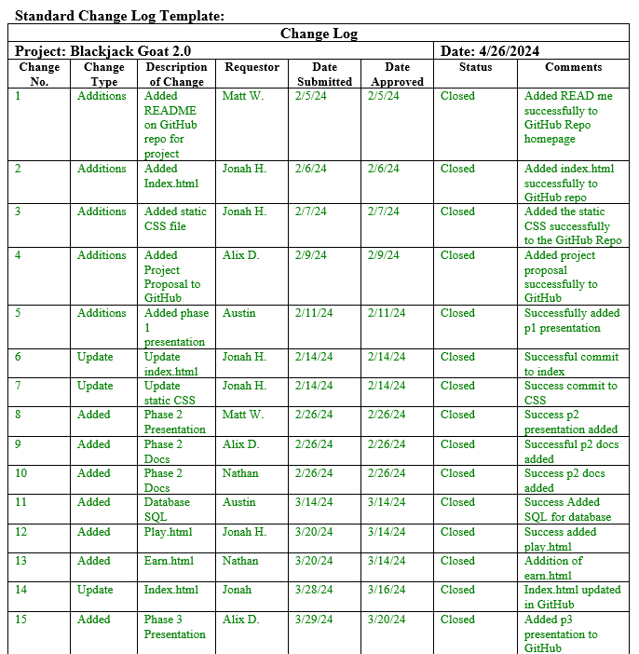
Example of our Change Log:

Slide 7
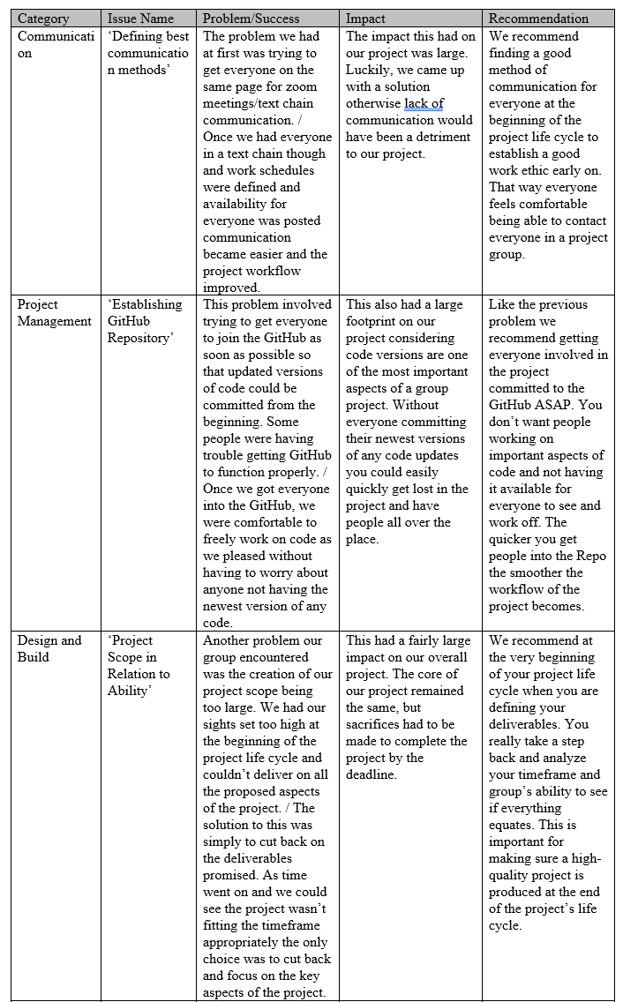
Example of our Lessons Learned:

Slide 8
Achievements…
Overall, as a group JAMMN studios is proud of what we’ve been able to accomplish.
Our group was faced with many challenges, and we were able to overcome them to create a successful functioning web game.
We grew as a team throughout the process, and we all have been able to increase our skills as developers / project managers.
We are still beginners in the grand scheme of the development world. However, we feel as though what we were able to create reflects our best efforts as our abilities currently stand.
We stand by our work and thank everyone for following us along on this project’s journey.
We hope you enjoy our final product as much as we do…

Slide 9
Blackjack Goat 2.0 Final Live Demo

Slide 10
Thanks Again Shareholders!
We thank you for joining us throughout this whole process and look forward to showing you our final video!

