Slide 1
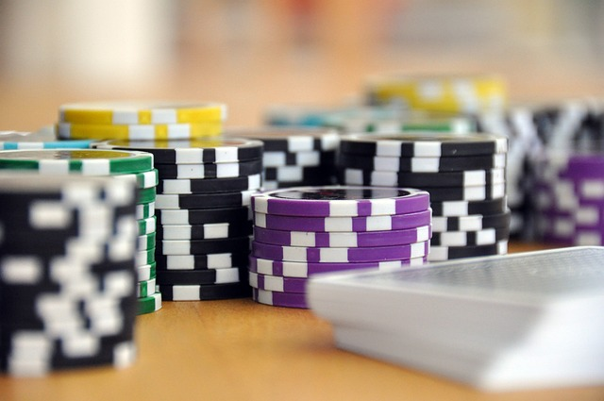
Project Proposal JAAM studios presents JAAM Casino BLACKJACK GOAT 2.1

Slide 2
About Us
Developers
Jonah Hoffman (jh258312@my.stchas.edu)
- background in JavaScript and frontend development.
Austin Steiniger (as263003@my.stchas.edu)
- background in Python and backend development.
Project Managers
Alix David (ad124058@my.stchas.edu)
- experience in real world Project Management
Matt Wright (mw212610@my.stchas.edu)
- experience in Python and C++ languages

Slide 3
Introduction
Welcome to the Goat of chance games…
Blackjack GOAT 2.1
Where there is excitement in every card!
- JAAM studios aims to make the next greatest Blackjack web game! Sit back, relax, and let the sound of the cards hitting the felt relax you after a long week.
- With tons of features to keep the game interesting and implementation of using your very own Google account, you will be able to save your progress and rack up chips endlessly. No need to worry about the stress and risk of real-life casino gambling, enjoy your time and stay with us on Blackjack Goat 2.1.
Our Mission is to provide the user with relaxing entertainment without the risk of real-life gambling!

Slide 4
How to Play
Objective:
Players draw cards to reach a total of 21 or closest to it before going bust (over 21) .
- Card Values:
-Number cards: worth the listed numeric value
-Face cards: worth 10
-Aces: worth 1 or 11
Beat the bank:
21 (or blackjack) as your starting hole cards pays 3 to 2
2X Bet If you beat the banks draw without reaching 21
Exceeding 21 = bust and loss of all chips that were bet

Slide 5
Features
Changing deck themes (card backs, possible implementation of felt color)
Change the number of decks in play (2, 4, or even 6 decks in play!)
Your own avatar photo and display name
Google account implementation saves your chip stack!
Wide variety of bet amounts to keep the game interesting (1,5,10,20,50,100 bet amounts!) potentially more coming
Playable on PC web browser or phone/tablet web browser
All your favorite blackjack rules (1.5x pay on Blackjacks, splitting pairs, AND double down!)

Slide 6
Future Implementation
Out of chips? Work on Casino Cleaning Crew to earn more so you can head back to the tables..
Have a gambling problem that you can't seem to shake? We have rehab roleplay to keep you off the casino floor!
MORE to come!

Slide 7
Front End Development
HTML
Site Shell
JavaScript:
GUI : user input

Slide 8
Back End Development
Django Framework
Python 3.21

Slide 9
Development and Testing
-Internal testing
-Focus group testing
-Beta Test
-Final test

Slide 10
Budget and Finance
- Projected budget: $350,000.00
- $50,000 Per week of Development
- 160 work hours per week
- 4 development members each working 40 hours per week

Slide 11
Schedule
Week # | Monday | Tuesday | Wednesday | Thursday | Friday
Week 1 Feb 12th to 16 | Begin Development
Week 2 | Back End Development
Week3
Week4
Week5 | Begin Front End Development
Week6
Week7 | Complete Final edit and testing |  | Deliver Final Product

Slide 12
Thank You Shareholders!
We look forward to staying connected through our ongoing development process

