Slide 1
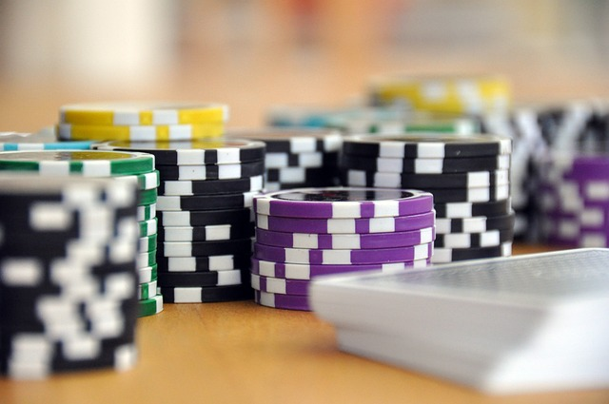
Project Proposal JAAM studios presents JAAM Casino BLACK JACK GOAT 2.1

Slide 2
Introduction
Welcome to the Goat of chance games.
Black Jack GOAT 2.1 !!!
Where there is excitement in every card!
Project Description:
JAAM studios aims to make the next greatest Blackjack web game! Sit back, relax, and let the sound of the cards hitting the felt relax you after a long week! With tons of features to keep the game interesting and implementation of using your very own Google account, you will be able to save your progress and rack up chips endlessly. No need to worry about the stress and risk of real life casino gambling, enjoy your time and stay with us on Black Jack Goat 2.1.

Slide 3
How to Play
Objective:
Players draw cards to reach a total of 21 or closest to it before going busts (over 21) .
- Card Values
-Number cards: worth the listed numeric value
-Face cards: worth 10
-Aces: worth 1 or 11
Beat the bank
21 = 3X bet
2X Bet If you beat the banks draw without reaching 21
Exceeding 21 = bust

Slide 4
Features
Changing deck themes
Change the amount of decks in play (2, 4, or even 6 decks in play!)
Your own avatar photo and in game name
Google account implementation saves your chip stack!
Wide variety of bet amounts to keep the game interesting (1,5,10,20,50,100 bet amounts!) potentially more coming
Playable on PC web browser or phone/tablet web browser
All of your favorite blackjack rules (1.5x pay on Blackjacks, splitting pairs, AND double down!)

Slide 5
Future Implementation
Out of chips? Work on Casino Cleaning Crew to earn more so you can head back to the tables..
Have a gambling problem that you can't seem to shake.. we have rehab roleplay to keep you off the casino floor!
******* And MORE updates to come!!

Slide 6
Front End Development
HTML
Site Shell
Javascript:
GUI : user input

Slide 7
Back End Develpment
Django Framework
Python 3.21

Slide 8
Development and Testing
Internal testing
Focus group testing
Beta Test
Final test

Slide 9
Budget and Finance
Projected budget 350,000.00
50,000 Per week of Development
160 work hours per week

Slide 10
Schedule
Week # | Monday | Tuesday | Wednesday | Thursday | Friday
Week 1 Feb 12th to 16 | Begin Development
Week 2 | Back End Development
Week3
Week4
Week5 | Begin Front End Development
Week6
Week7 | Complete Final edit and testing |  | Deliver Final Product

Slide 11
Contrbuters
Developers:
Jonah Hoffman (jh258312@my.stchas.edu)
Austin Steiniger (as263003@my.stchas.edu)
Manager / Developers:
Alix David (ad124058@my.stchas.edu)
Matt Wright (mw212610@my.stchas.edu)

Slide 12
10 minute presentation, 10 slides stored in the github repository, technology planned to be used to implement the system, project proposal, statement of work, planned future work

