Slide 1
HIGH PERFORMANCE COMPUTING · BCSE414L · MINI-PROJECT REVIEW 2
ParallelRoute
Island-Model Genetic Algorithms for the Travelling Salesman Problem: an HPC Re-Audit
Aditya Sahu · 23BCE0873
Platform: Intel Core i5-10210U, 4 physical cores / 8 SMT threads, 1.6 GHz, 6 MB L3, 15 W TDP
1

Slide 2
CONTEXT
What changed since Review 1
Platform. Review 1 was measured on an Apple M3. Review 2 measures on the Intel i5-10210U that Review 1 itself named as its target platform but never actually used.
Scale. 1,600+ measured configurations across ten experiments (E1-E10), every one validated: the returned tour must be a permutation of 0..n-1 and its reported length must match an independent recomputation.
Outcome. Zero validation failures. Two Review-1 headline numbers turn out to be measurement artefacts, not parallelism. This deck reports the corrected numbers alongside why the originals were wrong.
Same code base, same GA, new machine, new protocol.
Every number that follows was measured on the i5, is reproducible from results/FINDINGS.md, and is never re-rounded or extrapolated.
2

Slide 3
ABSTRACT
Headline results
3.93x
7 / 7
7.8-13.2x
0
Speedup at 8 SMT threads (islands fixed at 8, 2-opt off)
TSPLIB instances solved to the proven optimum, 0.00% gap
Candidate-list 2-opt speedup on the local-search step
Configurations in which DTAM meaningfully beats fixed migration
The headline is the method, not a single number.
Correcting two measurement flaws changed the scaling story; a mechanistic diagnostic (donor availability 0.3-0.6%) explains why the project's adaptive migration policy does not beat the textbook baseline, rather than merely reporting that it does not. Three standard HPC micro-optimisations (cache padding, allocation removal, RNG localisation) produced no measurable gain; the real gain came from a bitset diversity metric and candidate-list 2-opt.
3

Slide 4
METHODOLOGY
The shared GA core
Representation. Permutation tour; full precomputed Euclidean distance matrix.
Selection. Tournament selection.
Crossover. Order Crossover (OX).
Mutation. Inversion mutation.
Survival. Elitism.
Local search. Bounded 2-opt, first-improvement, optionally with a candidate list and don't-look bits (Review 2's optimisation).
Validation. validate_tour(): permutation check + independent length recomputation, run on every measured configuration.
One core, three engines.
Serial, fixed-migration island (P1), and DTAM (P2) all call the same GA operators, so differences between them are due to parallel structure and migration policy, not different algorithms.
4

Slide 5
METHODOLOGY
The three engines and the fairness protocol
Mode
What it is
Role
serial
One panmictic population of size P on one core
Baseline
island-fixed (P1)
I islands of P/I; ring neighbour's best-K over own worst-K, every fixed interval
Naive parallel
island-dtam (P2)
Same engine; migrates only when diversity collapses, pulls from the most different island
Adaptive parallel
Fairness protocol.
Speedup is measured with 2-opt off, where work per generation is fixed and identical across engines. --islands decouples island count from thread count, so I is held constant while T is swept. Because each island owns an RNG stream keyed by its own id, every thread count produces a bit-identical search trajectory - verified, not assumed - leaving wall-clock as the only variable. Quality is measured separately under an equal wall-clock budget.
5

Slide 6
METHODOLOGY
DTAM, in four steps
1. Measure diversity. Mean edge-set distance between the island's population and its own best tour; low value means the island has converged.
2. Publish a signature. The island's best tour, readable by peer islands.
3. Flag stagnation. If diversity < tau.
4. Pull migrants. A stagnating island imports the best K individuals from the non-stagnating island whose signature is most different from its own (falling back to the most distant island overall if every peer is stagnating), overwriting its own worst K.
Three design shifts against P1.
Fixed schedule -> diversity-triggered. Fixed ring neighbour -> runtime-selected distant source. Push -> pull. All three are evaluated later against the stock DTAM result, not just asserted.
6

Slide 7
METHODOLOGY
The OpenMP structure
#pragma omp parallel num_threads(T)
loop over epochs:
[omp for over islands] evolve E generations, publish state
---- implicit barrier: every publish visible before any read ----
[omp for over islands] migrate (read peers' slots, write own)
---- implicit barrier ----
[omp single] global best, logging, termination check
No locks needed. Each thread touches only its own island's data during evolution; barriers order publish-before-read and migrate-before-next-epoch.
--islands decouples decomposition from thread count. Holding island count fixed and sweeping threads produces a bit-identical search trajectory at every thread count - verified, not assumed - so wall-clock is the only variable.
7

Slide 8
MEASUREMENT FLAWS
Flaw 1: “equal work” was not equal work
The problem. 2-opt is first-improvement local search: its cost depends on how good the tour already is. Two runs performing the same number of fitness evaluations do not perform the same amount of work.
The measurement. Correlation between tour length and wall-clock at fixed thread count: +0.15 to +0.31, with a 6-8% time spread and 4.8% length spread. The effect is real and in the predicted direction, though modest.
The fix. Speedup is measured with 2-opt off, where work per generation is fixed; quality is measured separately under an equal wall-clock budget.
Why it matters.
Under the original protocol, island-dtam at 2 threads finished in 7.68 s while island-fixed at 2 threads took 14.79 s - a 1.9x gap between two engines doing nominally identical work, driven by tour quality, not by parallelism.
8

Slide 9
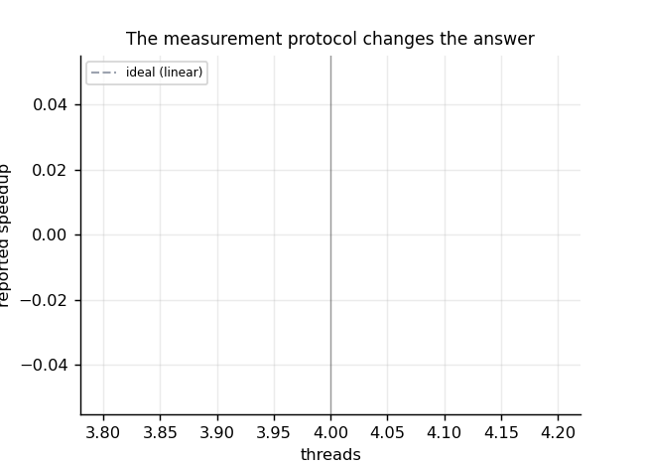
MEASUREMENT FLAWS
Flaw 2: speedup conflated parallelism with a cache effect
The problem. The frozen engine hard-wires one island per thread, so island_pop = P/T. Raising T adds parallelism and shrinks the per-thread working set at the same time.
The numbers. 240 individuals x 500 ints ~ 480 KB overflows L2. 30 individuals ~ 60 KB fits comfortably.
The fix. --islands decouples island count from thread count; every thread count now produces a bit-identical search trajectory.
Figure: i5_protocol_effect.png - wall-clock under the original entangled protocol versus the decoupled --islands protocol.
9

Slide 10
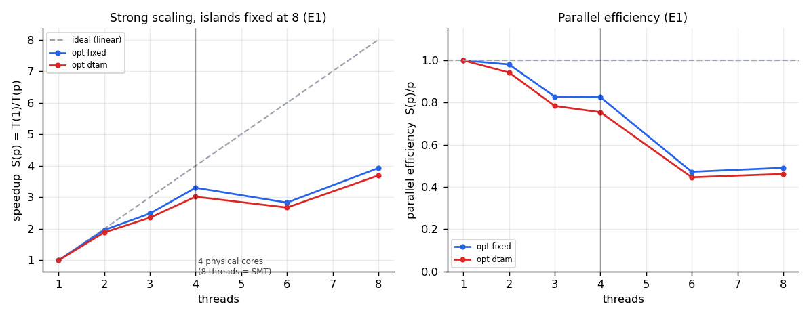
RESULTS
Strong scaling (E1): islands fixed at 8
T
time (s)
speedup
eff.
K-F
1
4.240
1.00x
1.00
—
2
2.162
1.96x
0.98
0.020
3
1.706
2.49x
0.83
0.104
4
1.284
3.30x
0.83
0.070
6
1.498
2.83x
0.47
0.224
8
1.080
3.93x
0.49
0.148
Why p = 6 is slower than p = 4 - and it is not noise.
Islands are distributed with schedule(static); an epoch costs ceil(I/p) island-units. With I = 8, both p = 6 and p = 4 cost 2 units, and p = 6 additionally contends for 4 physical cores. Amdahl fit: serial fraction f = 0.155, implying a ceiling of 6.47x. The i5 scales considerably better than the M3 (3.93x vs ~2.5x), confirming Review 1's speculation that homogeneous cores scale more evenly than the M3's performance/efficiency core split.
10

Slide 11
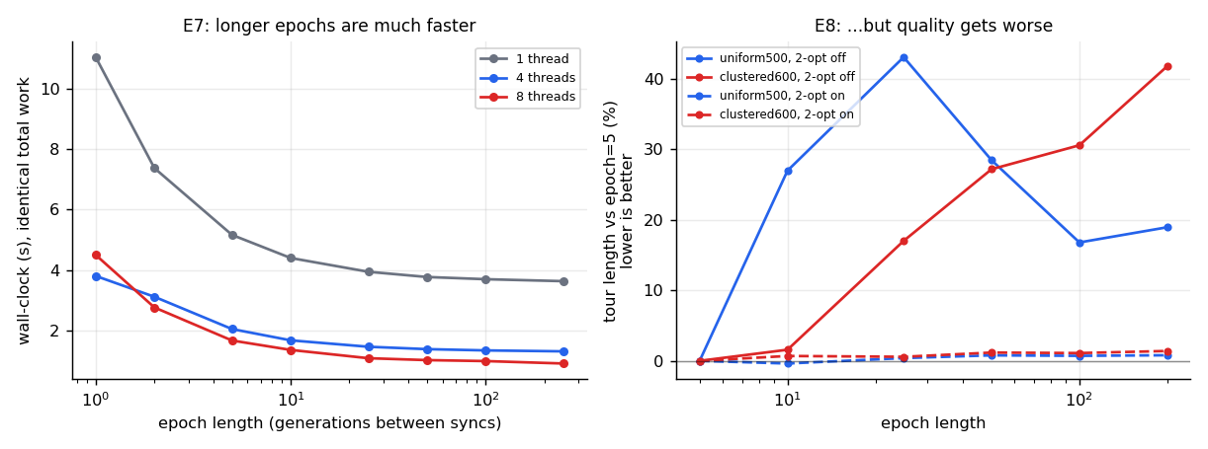
RESULTS
Where the time actually goes (E7 / E8)
E7. At p=1 there are no barriers at all, yet time still falls 3x as epoch length grows 1 -> 250. The dominant cost is per-epoch serial bookkeeping, not synchronisation.
E8. But longer epochs complete more generations and still produce worse tours: uniform-500 goes 23949 -> 30402 -> ... as epoch length grows; clustered-600 is +42% worse at epoch 200 vs epoch 5.
The default epoch length stays at 10.
Migration is load-bearing: E7 alone would have justified raising the epoch length; measuring quality shows it is a Pareto trade. A speed number without a quality number is not a result.
11

Slide 12
RESULTS
What the engineering bought
Change
Effect
Verdict
Cache-line padding (false sharing)
0.92-0.99x
No gain
Eliminating per-generation heap allocation
included above
No gain
Moving RNG to thread-local storage
0.92-0.99x
No gain
Bitset edge-set diversity metric
~6x on the metric; 1.11-1.16x end-to-end
Real gain
Candidate-list 2-opt + don't-look bits
7.8-13.2x on local search; 10-14x more generations
Largest gain
Three textbook HPC optimisations did nothing here.
Cache padding, allocation removal and RNG localisation all measured 0.92-0.99x - slightly slower. Their theoretical cost is real but negligible against ~15,000 operations of useful work per shared write. Guessing at bottlenecks by pattern-matching does not pay; the epoch-length experiment is what located the real one.
12

Slide 13
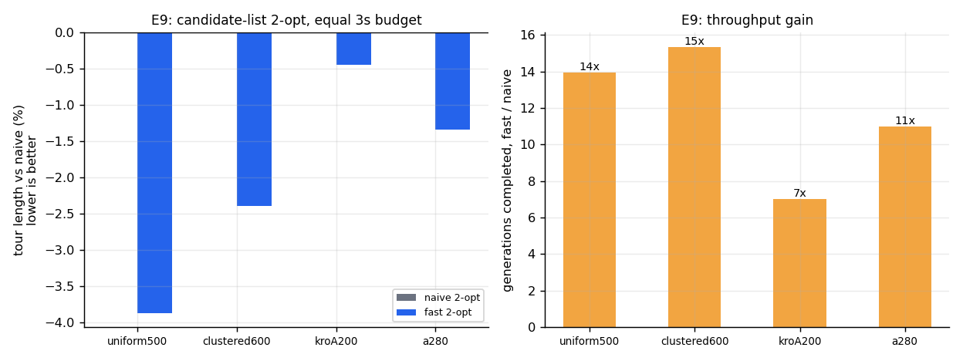
RESULTS
Candidate-list 2-opt (E9)
instance/mode
change
p
uniform500 fixed
-3.9%
0.0020
uniform500 dtam
-3.5%
0.0020
clustered600 fixed
-2.4%
0.0020
clustered600 dtam
-2.4%
0.0020
kroA200 fixed
-0.4%
0.0020
a280 fixed
-1.3%
0.0078
Faster and better.
Don't-look-bit exhaustion converges further than the reference's fixed pass cap. p = 0.0020 is the smallest value attainable with n = 10 paired samples. k = 8 chosen from a sweep (k = 5 loses 9.1% quality).
13

Slide 14
RESULTS
Correctness: seven TSPLIB instances at 0.00% gap
Instance
Published optimum
Result
Gap
berlin52
7542
7542
0.00%
eil51
426
426
0.00%
st70
675
675
0.00%
kroA100
21282
21282
0.00%
ch150
6528
6528
0.00%
kroA200
29368
29368
0.00%
a280
2579
2579
0.00%
All seven reach the proven optimum within a 3-second budget using candidate-list 2-opt.
Before that optimisation, kroA200 stalled at 29491, a280 at 2602 and eil51 at 427. Review 1 reported gaps only against the Beardwood-Halton-Hammersley estimate for random points - an asymptotic approximation, not an optimum.
14

Slide 15
RESULTS
Does the island model actually help? It depends on local search
Landscape
2-opt
Serial
Island-fixed
Island-DTAM
Parallel vs serial
clustered-600
off
27297.2
7100.1
7695.7
-74.0%
uniform-500
off
67353.2
21046.2
21274.7
-68.8%
clustered-600
on
5361.5
5320.9
5331.8
-0.8%
uniform-500
on
17714.9
17280.9
17205.6
-2.5%
Without local search the island engines find 68-74% shorter tours. With it, 0.8-2.5%.
2-opt does most of the optimisation and keeps even the serial GA competitive per generation. Review 1 quoted the 60-67% figure without stating that it holds only with local search disabled. A number reported without its operating conditions is not a result: this is the same methodological point as the epoch-length trade-off.
Equal 4 s budget, 12 seeds, median tour length. On TSPLIB with local search all three engines are indistinguishable, because all of them reach the published optimum.
15

Slide 16
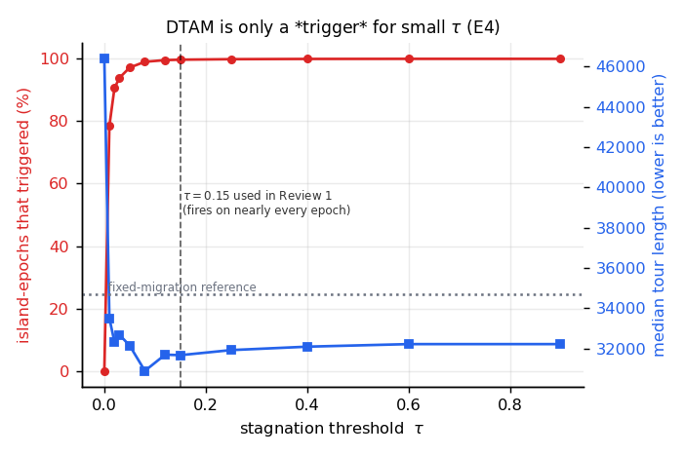
THE DTAM RESULT
Part 1: diversity collapses
generation
10
130
250
370
610
730
1090
1450
diversity
0.224
0.032
0.039
0.012
0.010
0.006
0.005
0.004
Whole run. min 0.0029, max 0.2236, mean 0.0181. Islands collapse to near-clones within ~100 generations.
tau = 0.15 fires on 99.7% of island-epochs. It sits far above the metric's entire operating range. Only tau = 0 stops migration, and that is far worse (46382 vs ~31000).
Figure: i5_tau_sweep.png - trigger rate vs tau, 100% down to 78.55% across the sweep.
16

Slide 17
THE DTAM RESULT
Part 2: donor availability 0.3-0.6%
The key diagnostic of the project.
New instrumentation counts how often DTAM finds a genuinely non-stagnating donor, versus falling through to its “most distant island overall” fallback. Across the 10-seed factorial, stock DTAM finds a healthy donor on only 0.3-0.6% of migrations.
The mechanism is almost never exercised as designed. On more than 99% of migrations the distant-source-pull mechanism - the project's actual contribution - does not fire as intended, because every island has collapsed simultaneously and there is no healthy donor to pull from.
Why this matters more than a null result. It identifies why DTAM does not beat fixed migration: the cause is premature convergence, not a flaw in the migration policy itself.
17

Slide 18
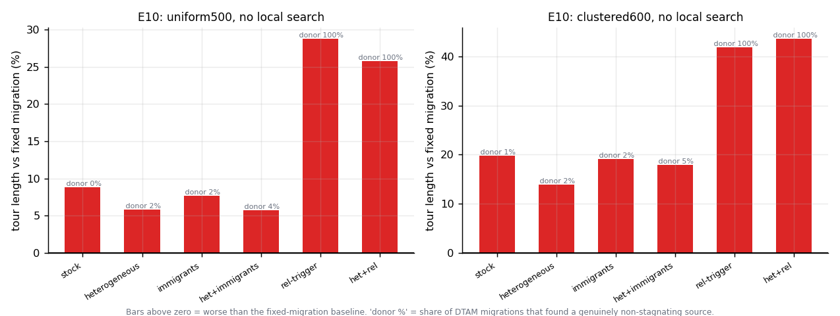
THE DTAM RESULT
Part 3: the E10 rescue factorial
Heterogeneous island parameters help. The only mechanism that consistently improves on stock DTAM (-2.8% uniform, -4.9% clustered); triples donor availability, but does not close the gap to fixed migration.
The relative trigger works exactly as designed - and that makes it worse. Discrimination is restored (99.8% -> ~31% firing, donor availability -> 100%), and quality drops 18-20%, because migration is the dominant source of genetic material once islands collapse.
DTAM's core premise is wrong for this problem.
The right policy here is to migrate constantly, demonstrated mechanistically rather than asserted.
18

Slide 19
NOVELTY
Novelty, honestly stated
1. A specific policy design. The combination of a stagnation trigger with distant-source pull selection chosen at runtime is self-implemented. Incremental, and presented as such.
2. An HPC-framed evaluation that changed the answer. Reporting speedup, efficiency, Karp-Flatt and Amdahl alongside quality exposed two Review-1 headline numbers as measurement artefacts and located the real bottleneck.
3. A cost-versus-quality framing the literature does not contain. No surveyed adaptive-migration paper measures the runtime cost of an adaptive migration decision. “8.6% better per generation, 8.4% worse per second” is exactly the trade-off that framing hides.
4. A mechanistically diagnosed negative result. Donor-availability instrumentation shows the proposed mechanism fires as designed on under 1% of migrations - a more useful finding than a null result, because it identifies why.
What this does not claim.
No configuration was found in which DTAM meaningfully beats fixed migration.
19

Slide 20
CONCLUSION
Conclusion and future work
Conclusion. On the stated target hardware, the shared GA core scales to 3.93x at 8 SMT threads once measurement flaws are removed; candidate-list 2-opt is the largest engineering gain and solves all seven TSPLIB instances to proven optimum; DTAM does not beat fixed migration, and the reason - donor availability under 1% - is now demonstrated rather than guessed at.
Future work. Test heterogeneous island parameters at other spreads. Sweep tau on more than one instance family. Increase E1 seed count for the equal-work DTAM comparison beyond 3 pairs. Extend beyond Euclidean TSP and beyond one GA operator set to see whether the migrate-constantly finding generalises.
Known limitations, stated plainly.
Euclidean TSP only, one machine, one GA operator set. Results at 6 and 8 threads use SMT, where efficiency past 4 physical cores is expected to fall.
20

