Slide 1
Process Management in Linux
CS344 OS Lab 2021
Aditya Trivedi
190101005

Slide 2
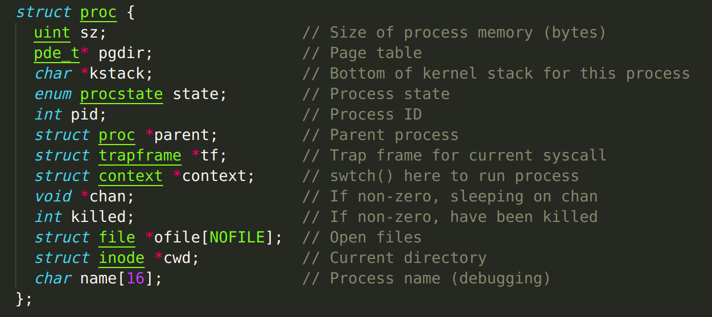
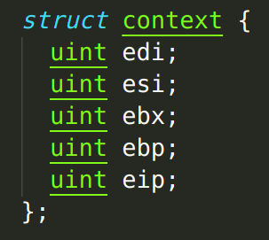
Process Representation -xv6

Slide 3
Process Representation -Linux
In Linux each process is represented by a task_struct data structure.
task vector - array of pointers to every task_struct in system.
source code https://github.com/torvalds/linux/blob/master/include/linux/sched.h
To summarise, it has the following subfields :
State
Scheduling Information
Identifiers
Inter-Process Communication
Links
Times and Timers
File system
Virtual memory
Processor Specific Context

Slide 4
What is Process Management ?
Creation
Scheduling
Switching & Communication
Termination

Slide 5
Comparison - Creation
Similar in both
fork() used to create new processes.
allocates new memory for the child
copies the parents content into it.
Linux avoids naive copying by using copy-on-write
Additionally, Linux has support for kernel-level threading.

Slide 6
Comparison - Switching & IPC
Both use a process table
maintain the context using a stack or process control block.
advanced in Linux.
IPC :
xv6 uses the simplest primitive possible, pipes, i.e., unidirectional flows.
Linux has advanced techniques such as shared memory, queues for messages, etc.

Slide 7
Comparison - Scheduling
xv6 - naive scheduling algorithm - similar to round-robin.
Linux - advanced algorithm called CFS. This will be explained further ahead.

Slide 8
Comparison - Termination
Both the OSes use the exit() system call
Furthermore, terms such as orphan, zombie, etc mean the same in both contexts.

Slide 9
Process Management in xv6
Initiating : userinit()
Creating processes : fork(), exec()
Termination: exit(), kill(), wait()
Switching & syncing: sleep(), wakeup()

Slide 10
Process Management in Linux
The term "tasks" is used – represent both processes & threads
Linux Threads are processes sharing address space (Kernel Threads)
Light weight compared to traditional processes, why ?
VM mappings, file descriptors – not copied
No longer describe the process

Slide 11
Processes vs Threads
Process – heavyweight
Process context switching is expensive - kernel has to
save old registers
load current registers, memory maps, and other resources
Thread – lightweight
Process can do more than one unit of work concurrently by creating one or more threads.

Slide 12
Processes vs Threads
Thread shares the same address space of the process.
Therefore, spawning new thread cheap compared to starting a new process.
Switching faster due to shared address space with the process
Internally
the thread has only a stack in the memory
share the heap with the parent process.

Slide 13
Missing Feature #1 Threads
Implementation of Threads
Multi thread processes
Add support for kernel-level threading
single user-level process – can have concurrency
Any synchronization method will also be needed as multiple threads will now be working with shared data of 1 process

Slide 14
Overview
Add new structures :
1
Thread
Spinlock (basic Mutex mechanism)
Add system calls for threads:
2
Create_thread()
Assoc_thread()
Add system calls for Mutex:
3
Create_mutex()
Lock_mutex()
UnLock_mutex()
**These will use clone() and join() system calls

Slide 15
Flow
thread_create creates a new user stack, and supplies it to the clone() function.
There is a struct of threadTable array that stores all the threads we create.
As the join() begins, the threads are removed from the array.

Slide 16
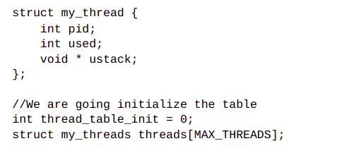
threads.h

Slide 17
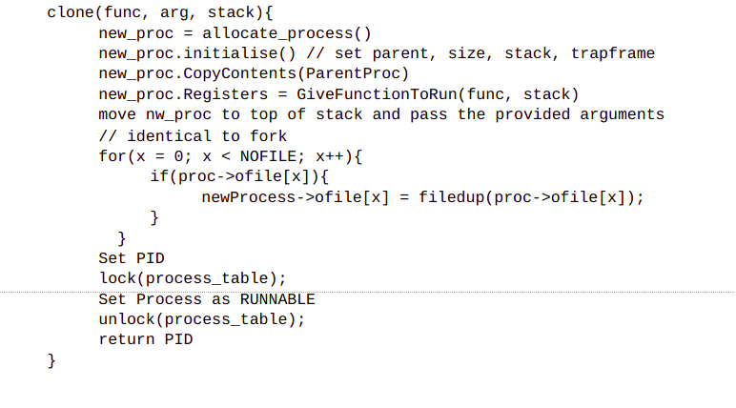
clone() // in proc.c
Directs the thread to point to the user stack
receive the func to the appropriate register and pass the arguments of that func as well.
sets the state of that thread's PID to RUNNABLE while using the acquire() and release() lock functions.

Slide 18
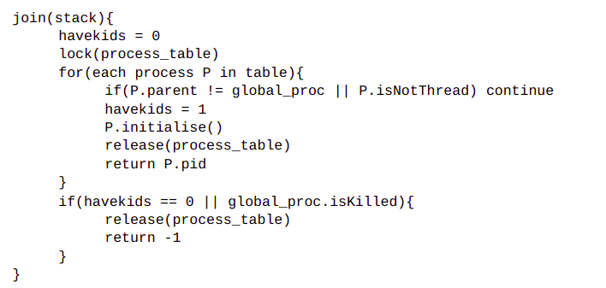
join() // in proc.c ~ wait
It is similar to wait(), additionally, it makes sure that the thread will release itself and kill the process.

Slide 19
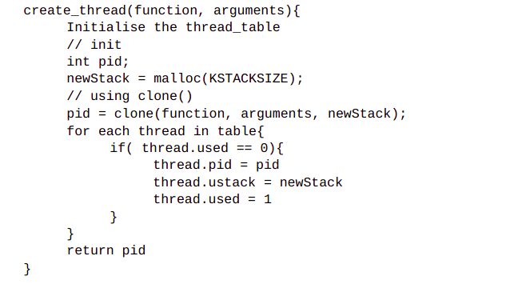
create_thread()

Slide 20
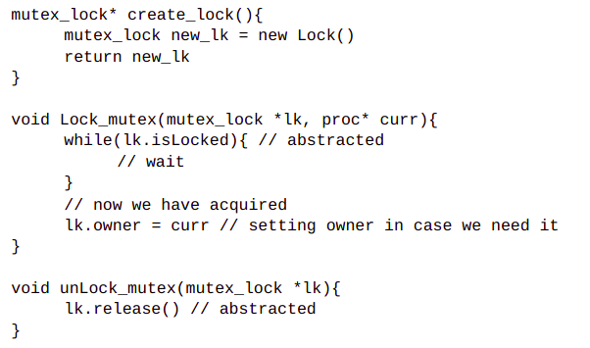
For Mutex
Add the struct definition in types.h and declaration in defs.h
Pseudocodes :

Slide 21
Missing Feature #2
In vanilla xv6 there are no scheduling algorithms. While in linux there exists a rich history of schedulers :
1.2 - circular queues & round-robin
2.2 - scheduling classes and policies
2.4 - O(N) scheduler based on time epochs
2.6 - O(1) scheduler based on runnable queues – active, expired
more scalable
metrics to determine whether tasks were I/O-bound or processor-bound.
large mass of code needed to calculate heuristics
2.6.21 - patch from Con Kolivas - Rotating Staircase Deadline Scheduler (RSDL)
incorporated fairness with bounded latency

Slide 22
Missing Feature #2 : Completely Fair Scheduler
The goal is to ensure a balance of processor time, among all competing processes
This "balance" is determined by a virtual runtime :
amount of time a task has been permitted access
Smaller runtime <=> HIgher the need for processor
"Sleeper fairness" : tasks currently not runnable -> receive their share whenever needed

Slide 23
Working of CFS
So whenever we call scheduler :
Find out process with least vruntime
if cached in pointer, get in O(1)
else, use get_least_vruntime_node(), in O(logP)
If this is the process we are currently running, no switch needed
Else swapin this new process
If current process is still pending, aka, runnable, swap it out and insert it back into the tree. This again takes only O(logP) time.
O(logP) because of self balancing Red Black Tree

Slide 24
Overview
Add
1
Red-Black Tree structure
virtual_runtime variable to each process
"NICE" priority to each process
Add system calls for :
2
Setting "NICE" values for each process
Adding a new process to RB Tree
Updating virtual_runtime
Determining process with minimum runtime
Decay mechanism of NICE values
3
Sanity Test

Slide 25
Reminder
In a previous assignment we implemented a scheduler by modifying :
scheduler() function in proc.c
proc struct in proc.h
set_priority() function in proc.c
Makefile
We also added a yield() system call by modifying :
syscall.h
syscall.c
user.h
usys.S

Slide 26
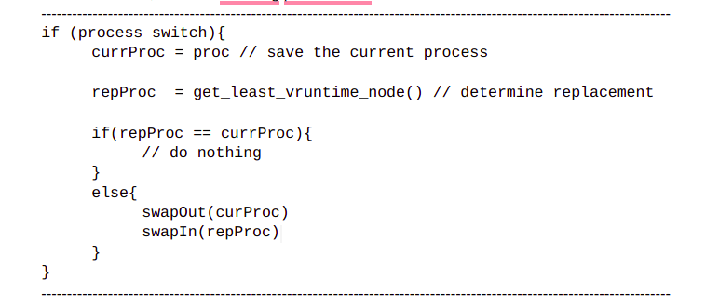
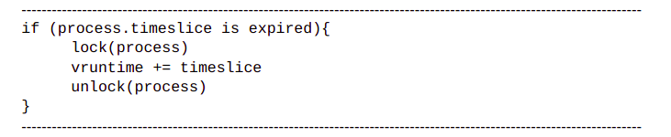
scheduler() pseudocode

Slide 27
References
https://www.cse.iitb.ac.in/~mythili/os/notes/old-xv6/xv6-process.pdf
https://www.cs.columbia.edu/~junfeng/13fa-w4118/lectures/l07-proc-xv6.pdf
https://developer.ibm.com/tutorials/l-completely-fair-scheduler/
https://pdos.csail.mit.edu/6.828/2020/xv6/book-riscv-rev1.pdf
https://www.baeldung.com/linux/process-vs-thread
http://www.science.unitn.it/~fiorella/guidelinux/tlk/node45.html

Slide 28
Thank You

