Slide 1
Line instantwin

Slide 2
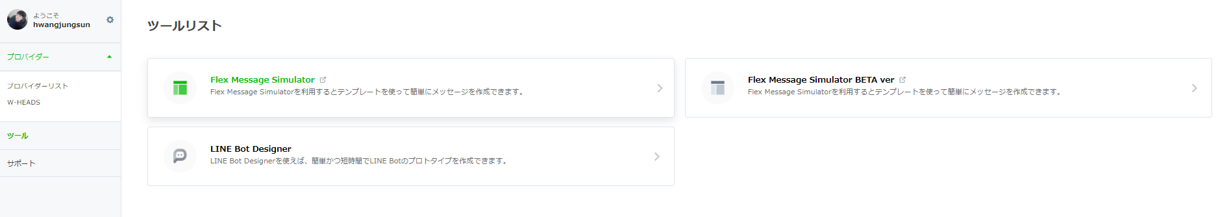
LineMessageApi

Slide 3
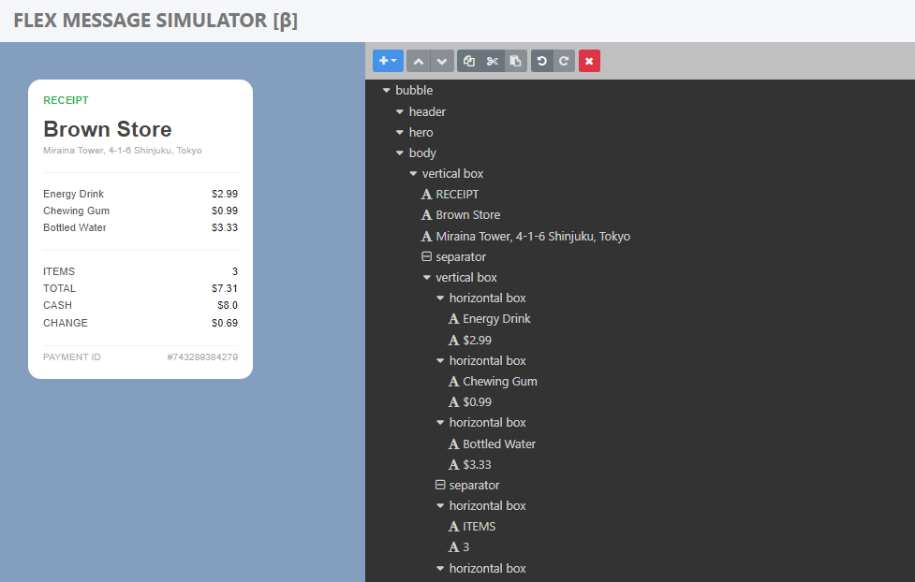
LineMessageApi

Slide 4
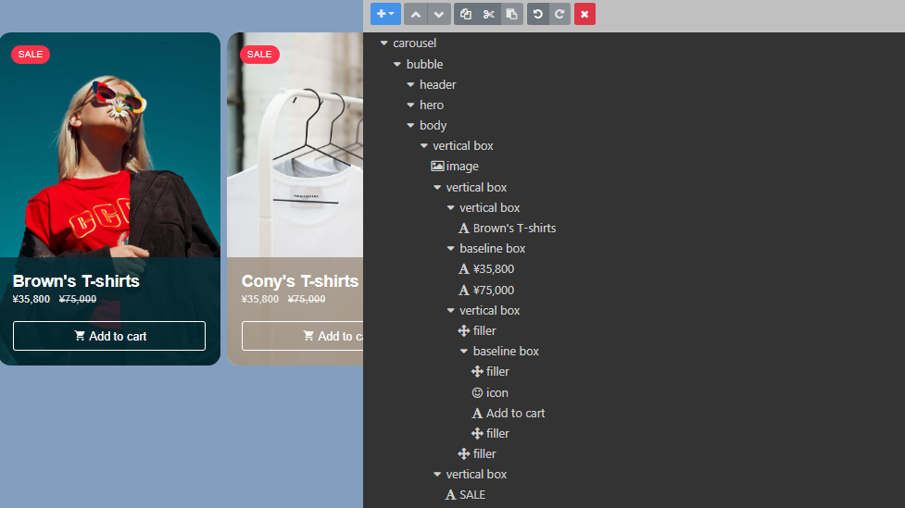
LineMessageApi

Slide 5
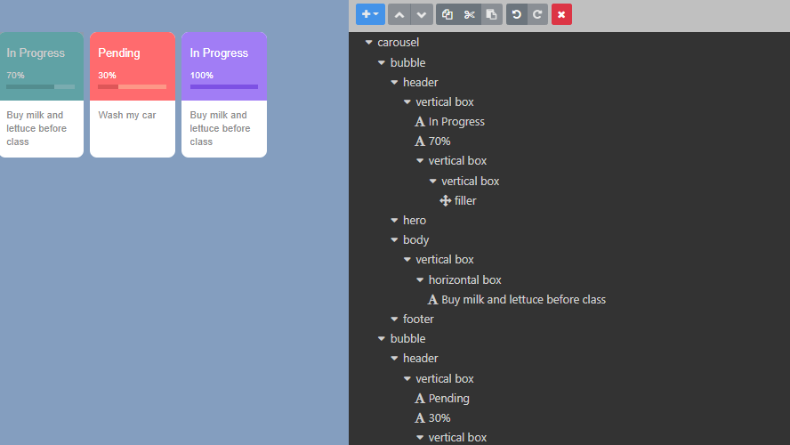
LineMessageApi

Slide 6
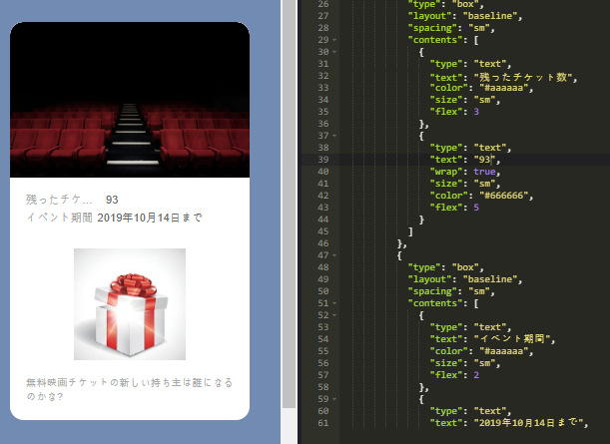
LineMessageApi

Slide 7
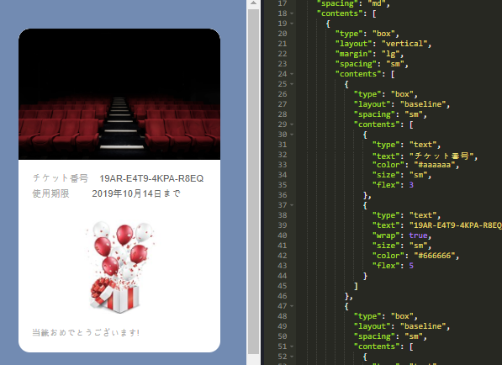
LineMessageApi

Slide 8
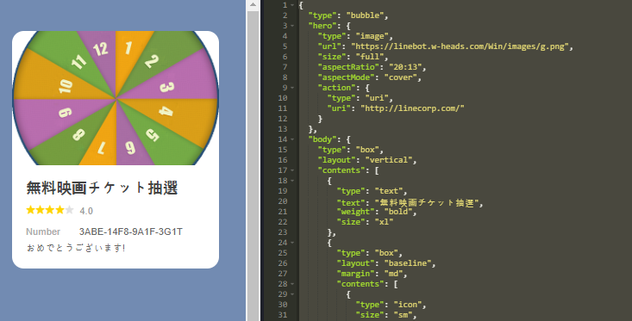
LineMessageApi

Slide 9
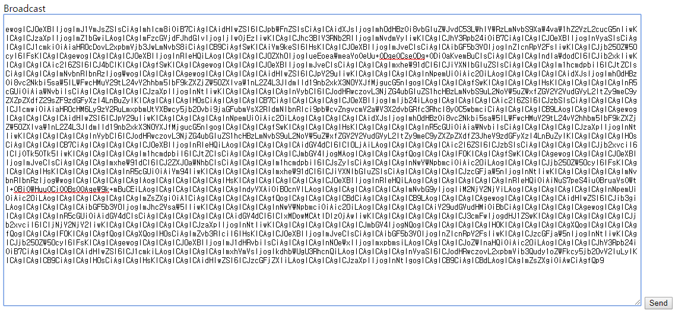
LineMessageApi - GameStart

Slide 10
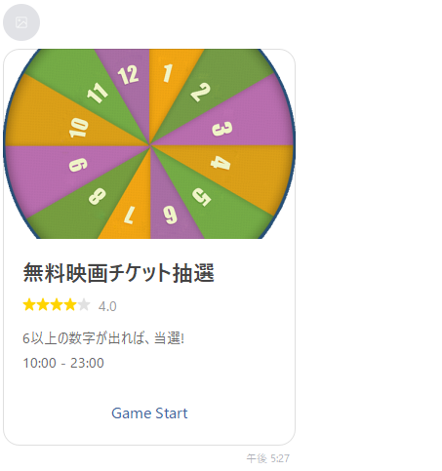
LineMessageApi - GameStart
Click!

Slide 11
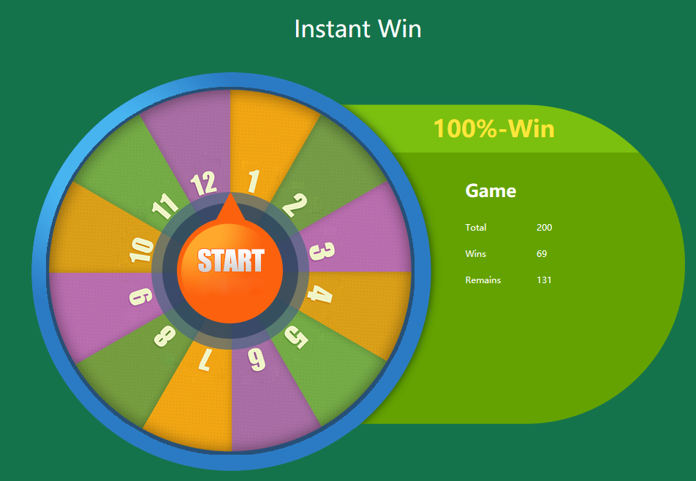
LineMessageApi - GameStart
Click!

Slide 12
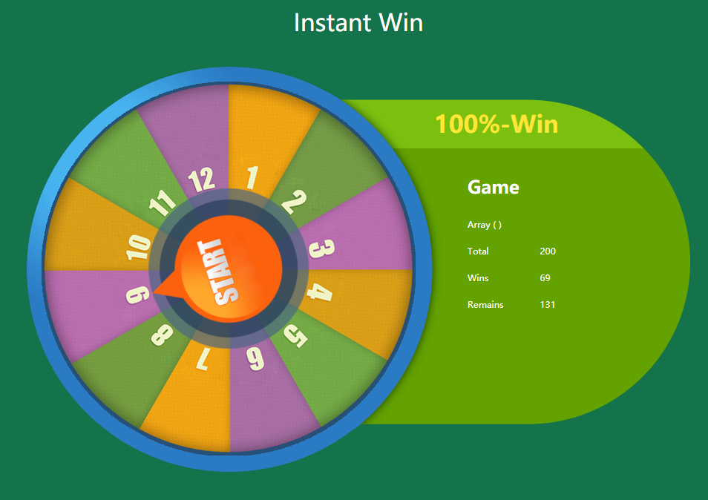
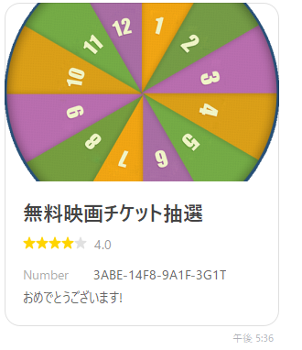
LineMessageApi - GameStart

Slide 13
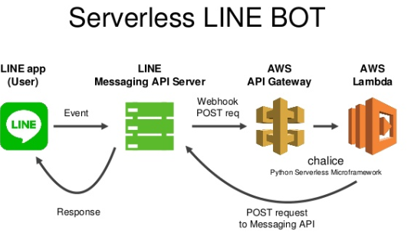
LineBOTServer

