Slide 1
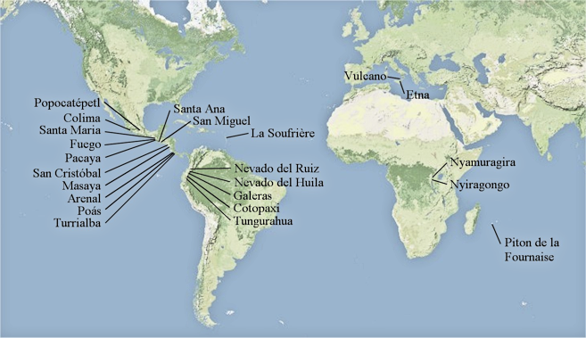

Slide 2
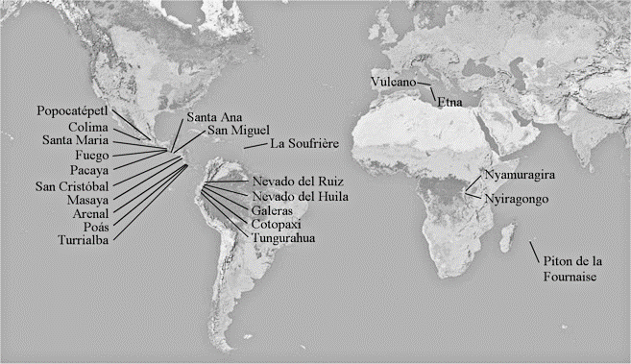
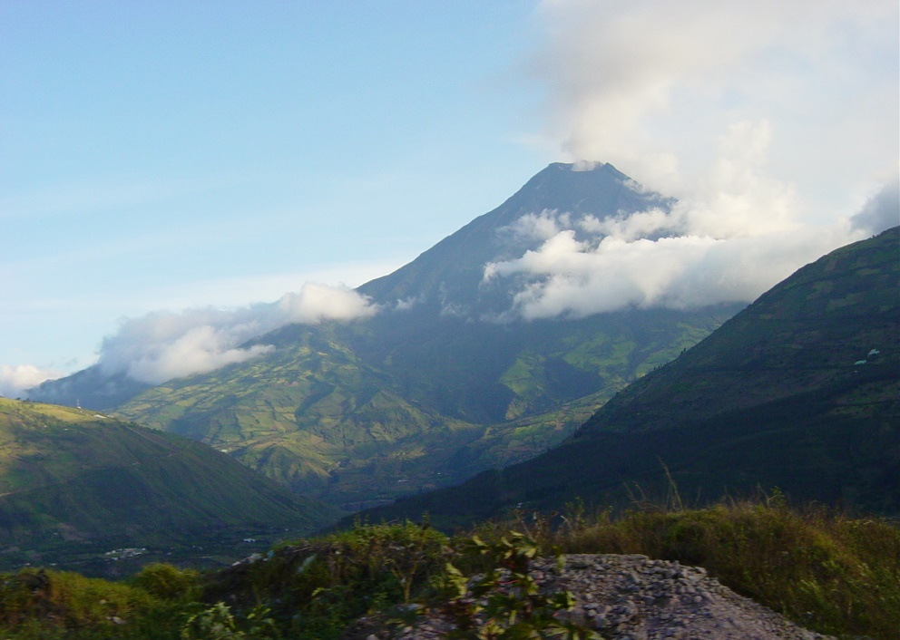

Slide 4
Vulcano
NOVAC Instrument

Slide 5
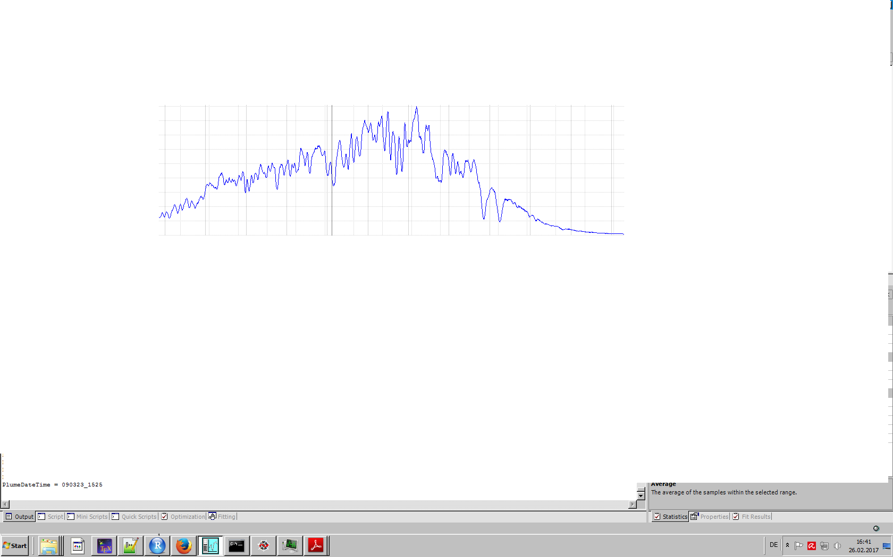
Meassurement Spectrum
intensity
wave length

Slide 6
Meassurement Spectrum
Intensity
300
350
400
Wavelength
[nm]

Slide 7
Meassurement Spectrum
Intensity
300
350
400
Wavelength
[nm]
Reference Spectrum
Intensity
300
350
400
Wavelength
[nm]

Slide 8
Meassurement Spectrum
Spectra Qutotient
Intensity
2
300
350
400
Wavelength
[nm]
=
Intensity ratio
Reference Spectrum
1.5
Intensity
1
300
350
400
300
350
400
Wavelength
[nm]
Wavelength
[nm]

Slide 9
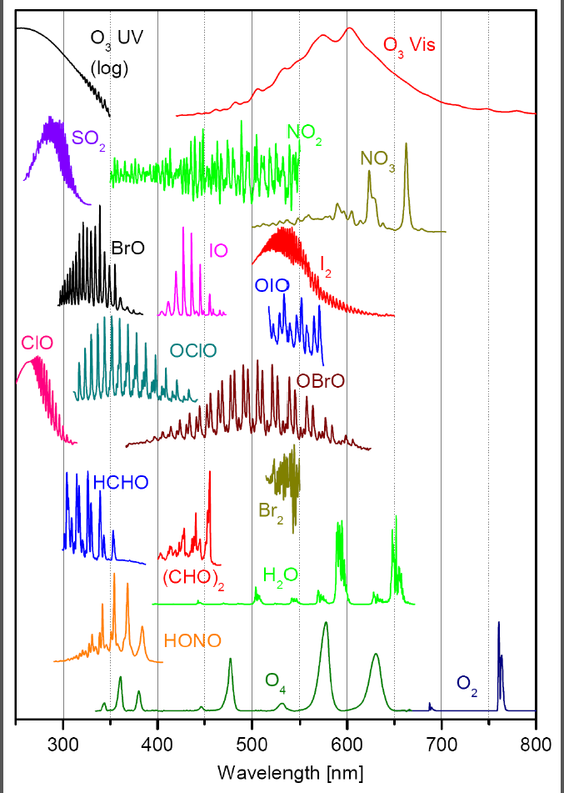
BrO
Meassurement Spectrum
Spectra Qutotient
Intensity
2
300
350
400
Wavelength
[nm]
=
Intensity ratio
Reference Spectrum
1.5
Intensity
1
300
350
400
300
350
400
Wavelength
[nm]
Wavelength
[nm]

Slide 10
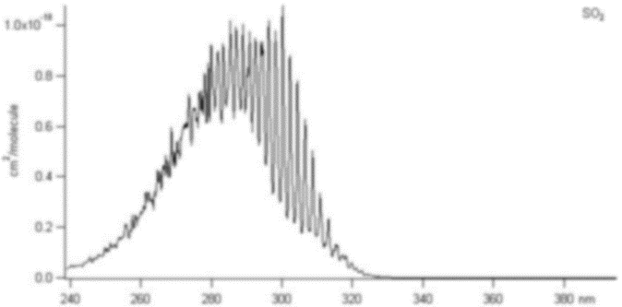
SO₂
Meassurement Spectrum
Spectra Qutotient
Intensity
2
300
350
400
Wavelength
[nm]
=
Intensity ratio
Reference Spectrum
1.5
Intensity
1
300
350
400
300
350
400
Wavelength
[nm]
Wavelength
[nm]

Slide 11
Get Pre Reference Spectrum

Slide 12
Get Pre Reference Spectrum

Slide 13
Get Pre Reference Spectrum
Get SO₂ Meassurement Spectra
intensity
wave length

Slide 14
Get Pre Reference Spectrum
Get SO₂ Meassurement Spectra
Meassure SO2 difference
intensity
wave length
column
density SO₂
elevation angle
-90°
0°
90°

Slide 15
column
density SO₂
elevation angle
-90°
0°
90°

Slide 16
column
density SO₂
elevation angle
-90°
0°
90°

Slide 17
column
density SO₂
elevation angle
-90°
0°
90°

Slide 18
column
density SO₂
elevation angle
-90°
0°
90°

Slide 19
column
density SO₂
elevation angle
-90°
0°
90°

Slide 20
column
density SO₂
elevation angle
-90°
0°
90°

Slide 21
column
density SO₂
elevation angle
-90°
0°
90°

Slide 22
column
density SO₂
elevation angle
-90°
0°
90°

Slide 23
column
density SO₂
elevation angle
-90°
0°
90°

Slide 24
Plume Spectra
Reference Spectra
column
density SO₂
MeasuredSO₂
elevation angle
-90°
0°
90°

Slide 25
Plume Spectra
Reference Spectra
column
density SO₂
MeasuredSO₂
elevation angle
-90°
0°
90°

Slide 26
Measured at t₁
Measured at t₂
MeasuredSO₂
column
density SO₂
elevation angle
-90°
0°
90°
column
density SO₂
MeasuredSO₂
elevation angle
-90°
0°
90°

Slide 27
Measured at t₁
Measured at t₂
MeasuredSO₂
column
density SO₂
elevation angle
-90°
0°
90°
column
density SO₂
MeasuredSO₂
elevation angle
-90°
0°
90°

