Slide 1
Final Project Report
Chinese Word Segmentation
Team name: Destiny

Slide 2
Our Features
Succinct
Small
Speed
Smart
User First

Slide 3
Task Allocation
Li Jianda: User Interface
Chen Zhen: Algorithm and Implementation
Liu Baichen: Lexicon
Yuan Quanning: Rules and Test

Slide 4
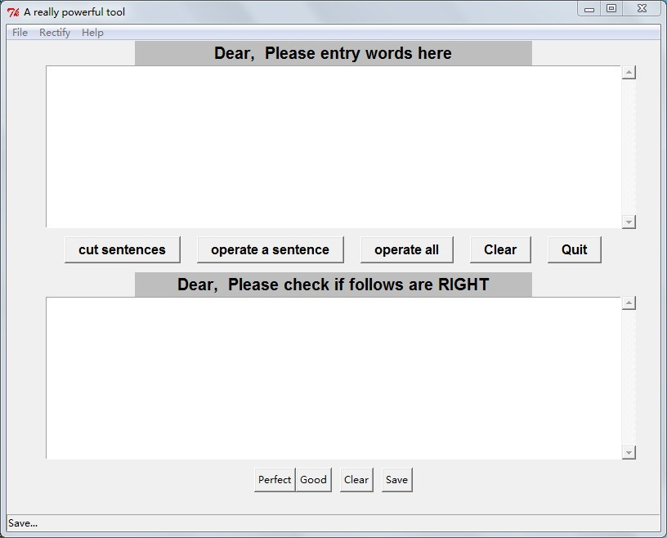
User Interface

Slide 5
Algorithm
Sentence Segment
Deal with space
Deal with number
Word Segment
Deal with name
Deal with punctuation

Slide 6
Algorithm
Sentence Segment
There are some punctuation in the passage. Some can be symbol of the end of a sentence while some can not. Some are special so that we need use some condition to judge it.

Slide 7
Algorithm
；。？！
For these punctuation, if they are not followed by ”and ’, they are the end of a sentence. Otherwise, the ”and ’will be the symbol.

Slide 8


Algorithm
，：
These two punctuation are special because they can be used in number representation.
世博网12月27日消息：
12:30
要大力弘扬上海世博会精神，
123,456,789

Slide 9
Algorithm
Word Segment
We have three procedures:
1. cut a sentence into small pieces
2. cut each piece into words
3. combine the names

Slide 10
Algorithm
The first step:
Also, we use some symbols to judge:
Spaces
Numbers
English words
Pause marks

Slide 11
Algorithm
Spaces
If we detected a space, we will ask users whether the program should neglect the space.
Take “世 界” as an example
If neglect the space, it will be “世界|”
If not, it will be “世|界|”

Slide 12
Algorithm
Numbers and English words
If the program meet a number or a English letter, it will take it with the following numbers and English letters together.
Including the punctuation like “3.14”,“www.sjtu.edu.cn”

Slide 13
Algorithm
Pause marks
We notice that the pause marks are often used in the passages so we decide to use it as a symbol to cut the sentence and we believe this can improve the performance.
中共中央总书记、国家主席、中央军委主席
中共中央总书记|、|国家主席|、|中央军委主席|

Slide 14
Algorithm
The second step
For each small piece, we use RMM algorithm to do the word segmentation.
Consider both the performance and the words in lexicon, finally we decide to set the maximum match length to 7.

Slide 15
Algorithm
The third step
In this step, we mainly focus on the name problem.
Idea: I notice that commonly Chinese people’s last name is not a word and the first name must exist.
Based on this idea: I design the name algorithm.

Slide 16
Algorithm
First, we need a blacklist. All the things in it cannot be a part of name.
Such as “啊么吗”and punctuation, number
Then, we need a whitelist. Some last names can be a word such as “建国”,“计划”. These things will be in the whitelist.

Slide 17
Algorithm
Now let’s start!
We scan the segmentation result. If the word is in the first name list, the name algorithm will start.
If the following one or two word is single letter and not in the blacklist, we take them as a name and combine.
If the following word is two letters word and in the whitelist, it is also a name.

Slide 18
Lexicon
Delete the letter, number, punctuations.
infile = open("城市.txt", "r")
xs = infile.readlines()
infile.close()
b=""
for i in xs:
for letter in i:
if letter not in "0123456789qwertyuiopasdfghjklzxcvbnmQWERTYUIOPASDFGHJKLZXCVBNM!\"#$%&?)*+(,-'./:;<=>?@[\\]^_}~.,?":
b=b+letter
x=b.split()
m=" ".join(x)

Slide 19
Lexicon
Print the text one expression one line.
a=""
for i in m:
if i ==" ":
a=a+"\n"
else:
a=a+i
myfile=open("1111.txt","w")
myfile.write(a)
myfile.close()

Slide 20
Lexicon
Delete the single character
infile = open("abc.txt", "r")
a=""
while True:
theline = infile.readline()
if len(theline)==2:
a+=str(theline)
if len(theline)==0:
break
myfile=open("abc.txt","w")
myfile.write(a)
myfile.close
infile.close

Slide 21
Lexicon
Three main parts:
Universal dictionary
Place dictionary
Name dictionary

Slide 22
Lexicon
Idioms and common sayings
邯郸学步
不管三七二十一
狗拿耗子多管闲事

Slide 23
Rules and Test
def slide(old_word,direction,length,s):
if old_word in s:
if direction=="left":
length=-length
new_word=""
for word in old_word:
if word!="|":
new_word+=word
n=old_word.find("|")
if 0<n+length<len(new_word):
new_word=new_word[:n+length]+"|"+new_word[n+length:]
s=s.replace(old_word,new_word)
else:
return s
return s

Slide 24


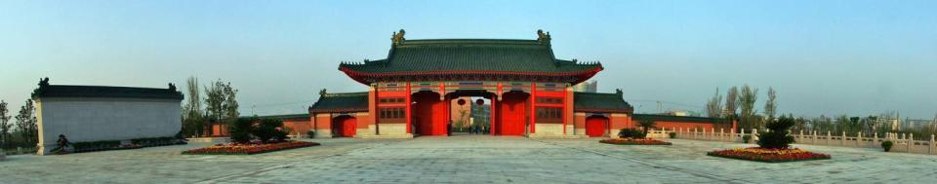


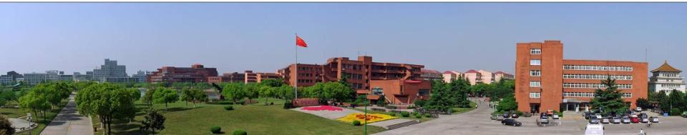

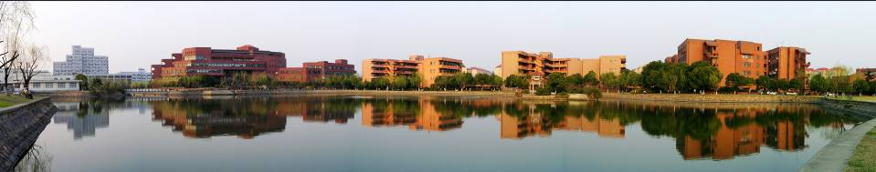

Thank you for watching
Team member: 陈桢、李健达、袁全宁、刘柏辰

