Slide 1
Health Check App
Group Members:
Aleksa Doda
Lawrence Buljanovic
Pieter Rudovic
Professor:
Domagoj Tolic
SWEN - SW Des Principles and Patterns

Slide 2
Back-End Pattern Concerns
MVC – Model View Controller
Composite Pattern
Abstraction

Slide 3
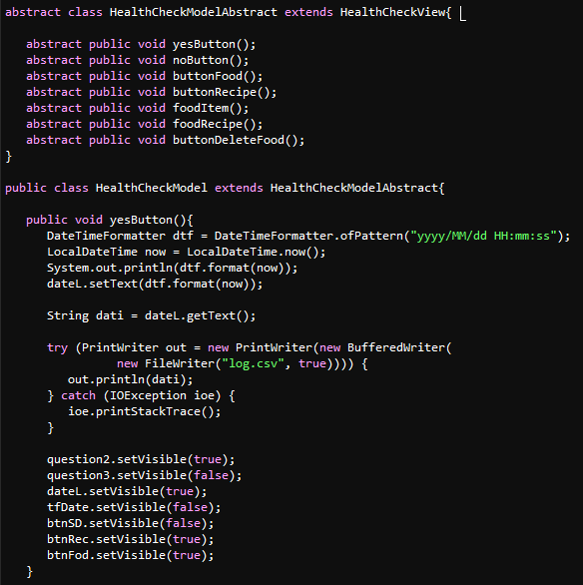
MVC – Model View Controller
Model: Buttons with their functionalities. Saving, adding, deleting, and more! Example:

Slide 4
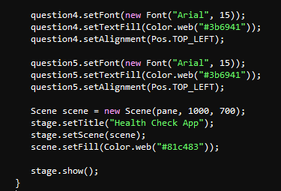
MVC – Model View Controller
View: GUI, and design.

Slide 5
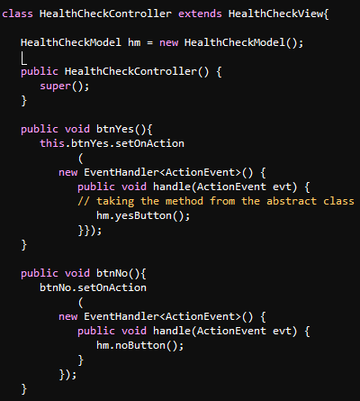
MVC – Model View Controller
Controller: It has all the event handlers with the appropriate methods.

Slide 6
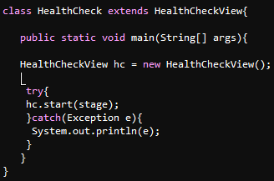
HealthCheck.java
Connecting all together:

Slide 7
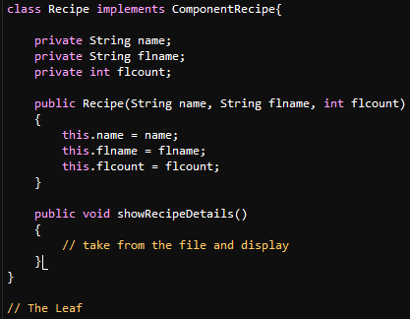
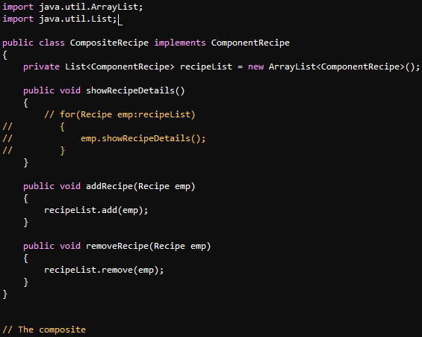
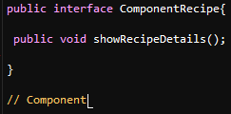
Composite Pattern

Slide 8
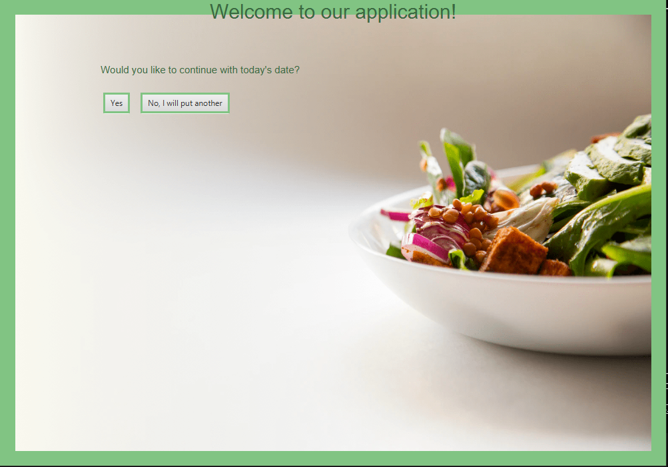
Front-end

Slide 9
Thank you for your attention!
New Version will be out soon!
For more information:
ad8593@g.rit.edu
lab8761@rit.edu
pr4215@rit.edu

