Slide 1


SMART INDIA HACKATHON 2026
THERMOSHELTER
Problem Statement ID – SIH26051 Problem Statement Title – Software Based Model Development for Design of Area Specific Shelter for Thermal Comfort Maintenance Theme – Agriculture, FoodTech & Rural Development PS Category – Software Department-DRDO/IDEX

Slide 2
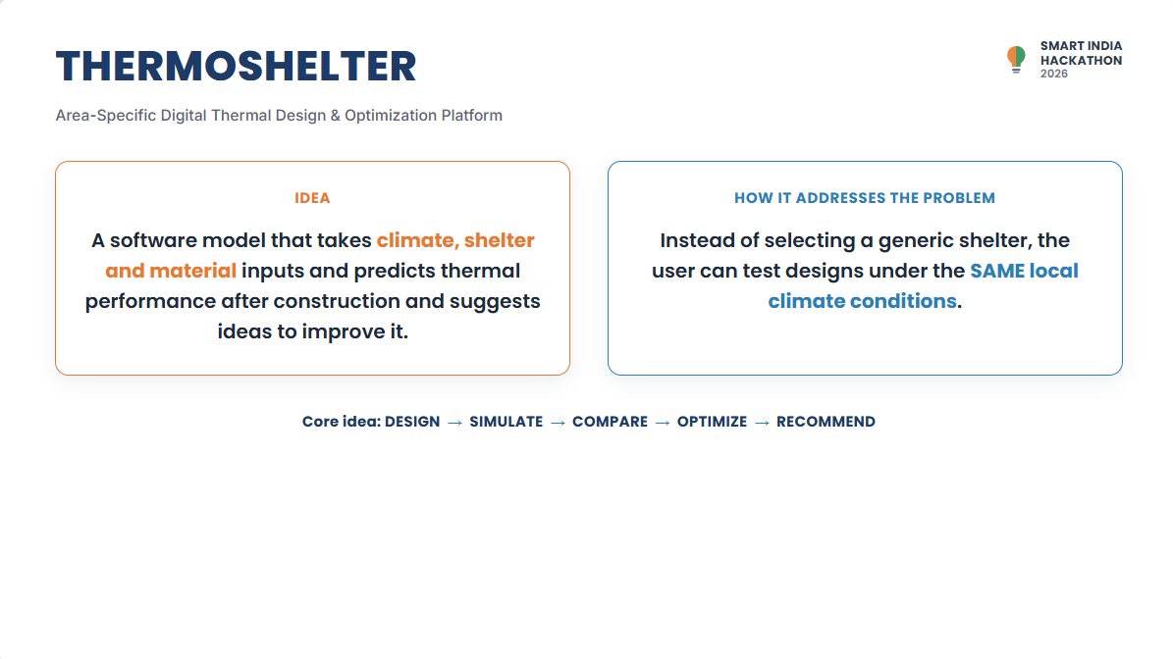


THERMOSHELTER
Area-Specific Digital Thermal Design & Optimization Platform
IDEA
HOW IT ADDRESSES THE PROBLEM
A software model that takes climate, shelter and material inputs and predicts thermal performance after construction and suggests ideas to improve it .
Instead of selecting a generic shelter, the user can test designs under the SAME local climate conditions.
Core idea: DESIGN → SIMULATE → COMPARE → OPTIMIZE → RECOMMEND

Slide 3
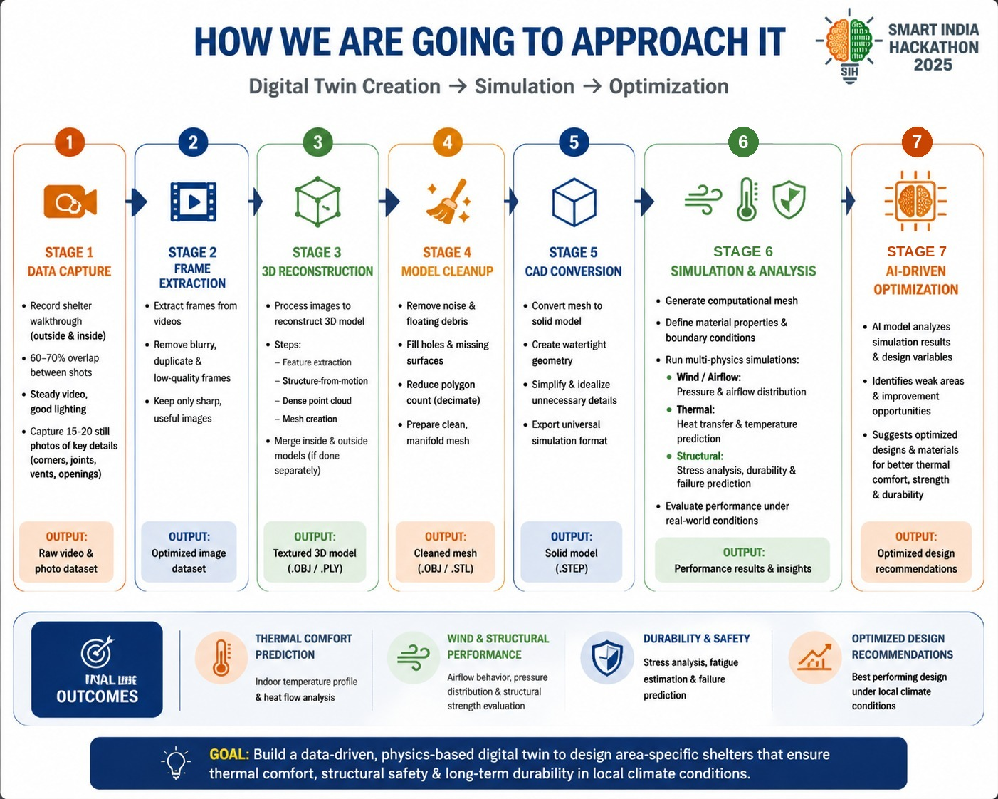
TECHNICAL APPROACH
A physics-based thermal model wrapped in a simple user interface
CLIMATE DATA
→
SHELTER + MATERIALS
→
THERMAL MODEL
→
PARAMETRIC RUNS
→
RANKED DESIGN
THERMAL MODEL / CALCULATIONS
TECHNOLOGIES & IMPLEMENTATION
Solar gain
Qsolar = G × A × α × η
Frontend
React / web dashboard for user inputs and result visualization
Envelope heat transfer
Q = U × A × ΔT
Backend
Python + FastAPI; NumPy / SciPy for numerical calculations
Transient energy balance
Energy stored + gains − losses → Tinside(t)
Validation
ANSYS thermal model and/or measured sensor data
Data
Weather API / local sensors + material-property database
Also considers: conduction • convection • openings / infiltration • thermal mass
Output
Temperature profile + solar energy + heat flow + design score

Slide 4

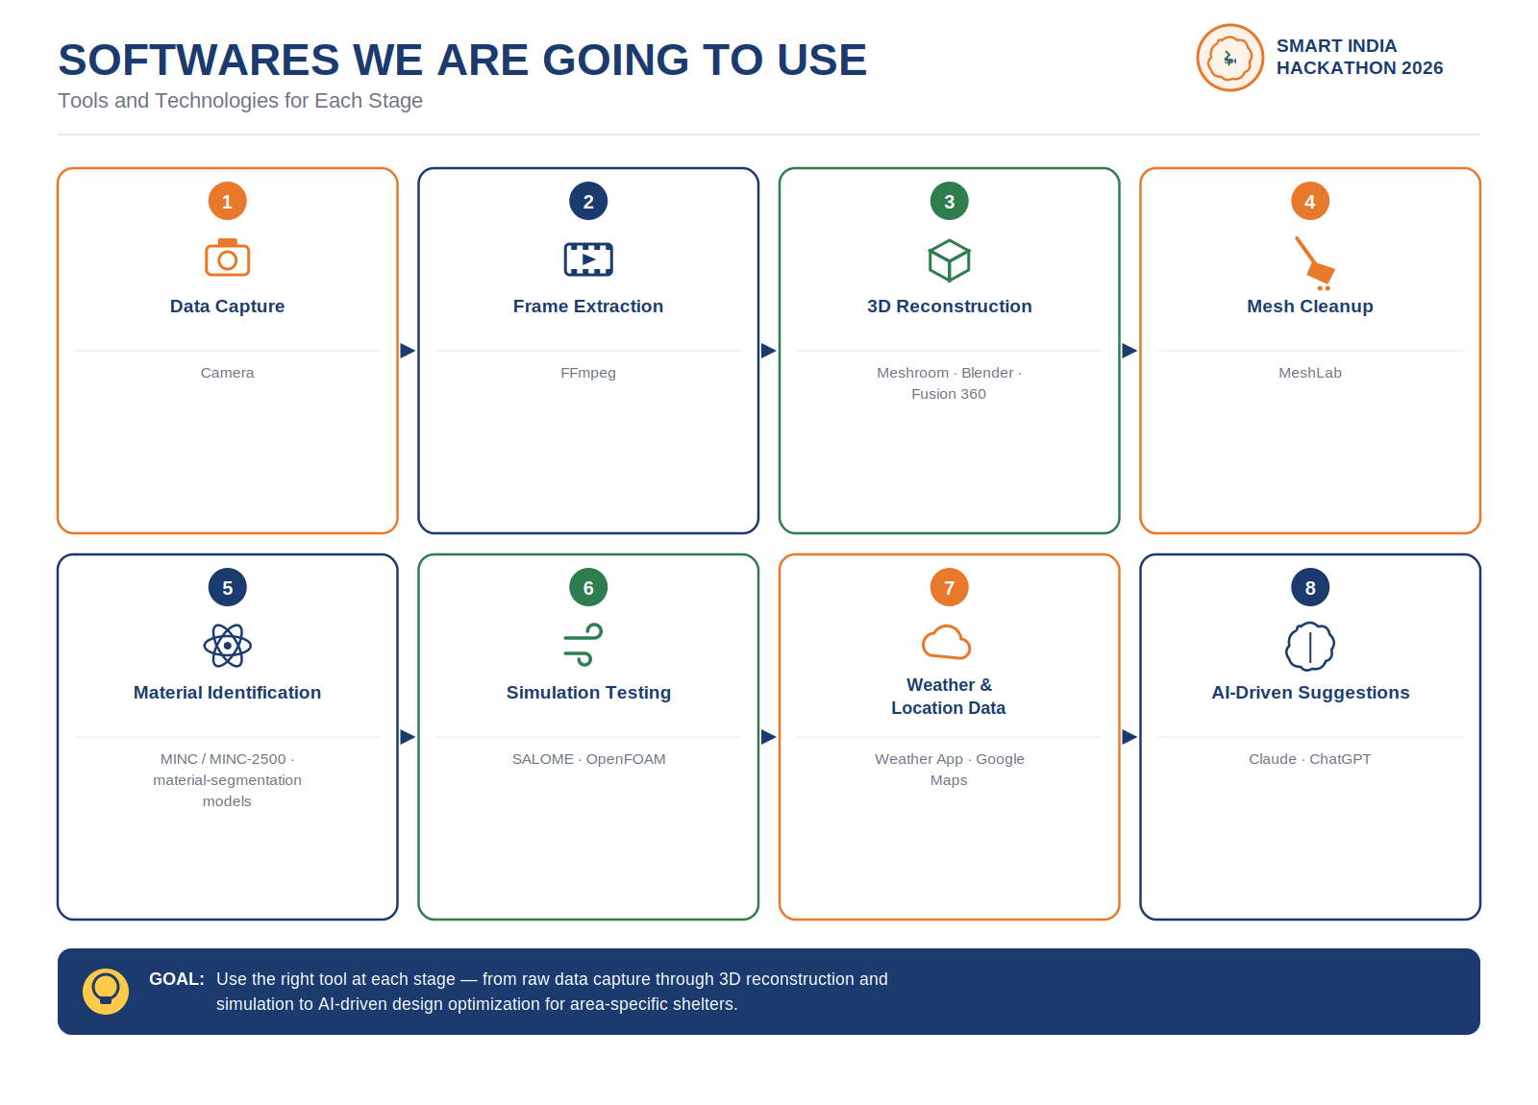
Softwares we are gonna use .
1)capturing video-camera 2)video-2d frames-Ffmpeg 3)constructing the 3d modell-Meshroom,blender,Fusion360,etc 4)Mesh Cleanup(filling holes )-Meshlab 4)Identifying type of material-MINC / MINC-2500 kyotovision-public/multimodal-material-segmentation, beric7/material_segmentation etc. 5)Testing the modell-SALOME, OpenFOAM 6)weather conditions and geographical location data-weather app,Google maps, 7)Suggesting Improvements- AI softwares like Claud,Chat gpt etc

Slide 5
FEASIBILITY, VIABILITY & IMPACT
Can it be built, who it’s for, and the value it creates
01
FEASIBILITY & VIABILITY
Built on established physics and proven open-source tools (Python/FastAPI, NumPy/SciPy, OpenFOAM/SALOME); runs as a lightweight web tool usable by planners and field engineers with no specialised training.
02
TARGET AUDIENCE
Armed forces personnel at remote, high-altitude posts; campers and outdoor/expedition groups; and everyday rural households — anyone who needs a shelter built for their exact local climate.
03
KEY CHALLENGES & RISKS
Requirement of pipeline structure that connects all the softwares and runs automatically to give results.
04
MITIGATION STRATEGIES
Phased validation benchmarked against ANSYS, an open user-editable material database, and calibration against real Ladakh weather-station data before scaling up.
05
SOCIAL & ECONOMIC IMPACT
Safer, more comfortable shelters that reduce cold-related health risks; cuts construction cost via optimised upfront design and lowers long-term heating/energy costs.
06
ENVIRONMENTAL IMPACT
Reduces energy consumption and fuel use for heating, and cuts material waste by right-sizing insulation and design to the local climate.
Overall: technically feasible with existing tools, serves army posts, campers and rural households alike, and directly cuts cost, risk and environmental footprint.

Slide 6
RESEARCH AND REFERENCES
Problem-statement requirements and technical basis for the proposed model
01
SMART INDIA HACKATHON 2026 — SIH26051
Problem statement: Software Based Model Development for Design of Area Specific Shelter for Thermal Comfort Maintenance; Organization: DRDO.
02
SIH26051 — REQUIRED MODEL OUTPUTS
Internal shelter temperature, solar thermal energy generated, and heat-flow calculations for a defined period.
03
SIH26051 — DESIGN VARIABLES
User-defined atmospheric conditions, shelter dimensions/shape, orientation, wall/roof materials, insulation, openings, thermal mass / PCM and composite materials.
04
SIH26051 — LADAKH CONTEXT
Problem statement highlights high solar irradiance, long sunshine duration and severe temperature variation as the design opportunity.
05
PROPOSED TECHNICAL BASIS
Parametric thermal simulation, material-property modelling, energy-balance calculations and automated design comparison; validation recommended using ANSYS and/or measured data.
Reference: Official SIH problem statement / SIH portal • Technical equations shown are proposed modelling choices, not official prescribed equations.

