Slide 1




Alexa, in you, I trust!
Fairness and Interpretability Issues in E-commerce Search
through Smart Speakers
Abhisek Dash, Abhijnan Chakraborty, Saptarshi Ghosh,
Animesh Mukherjee, Krishna P. Gummadi

Slide 2
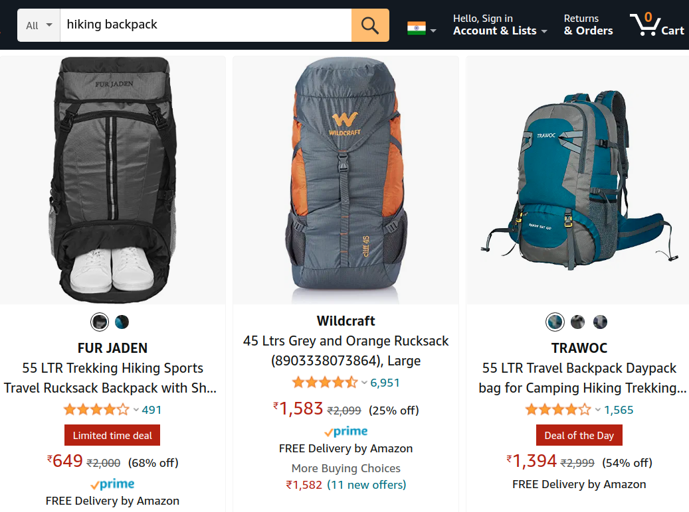
Traditional e-commerce search
Customers enter query strings
A ranked list of products appear
Decreasing order of relevance
Metadata of the products shown
Customers have multiple options to choose from

Slide 3
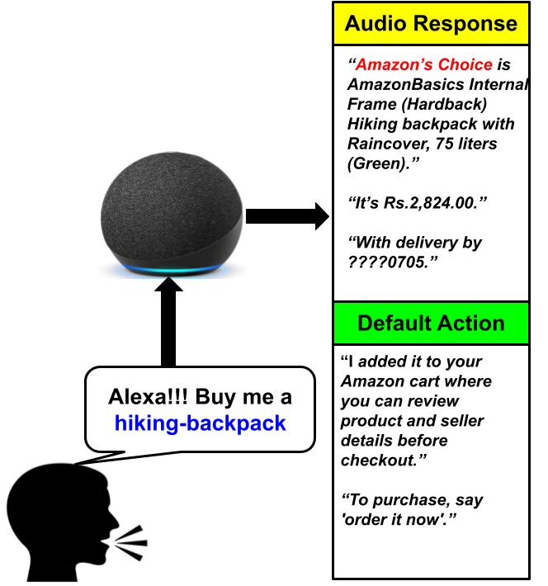
E-commerce search through Smart Speakers
Smart speakers are powered by voice assistants (VAs)
Customers utter a query string
The details of a single product is told
Audio response with a brief explanation
Default action of adding the product to cart
https://mindstreammediagroup.com/introduction-smart-speakers-voice-search-brand-advertisers/

Slide 4
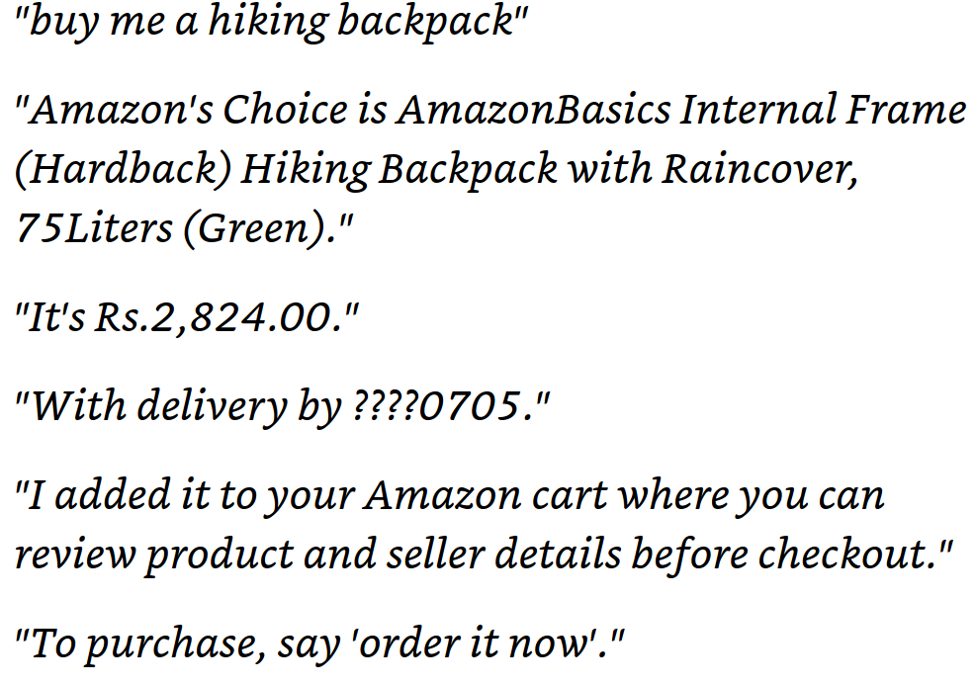
Audio responses from Alexa

Slide 5
Audio responses from Alexa
Query string

Slide 6
Audio responses from Alexa
Query string
Product details

Slide 7
Audio responses from Alexa
Query string
Brief explanation
Product details

Slide 8
Audio responses from Alexa
Query string
Brief explanation
Product details
Default action

Slide 9
E-commerce search through Smart Speakers
Smart speakers are powered by voice assistants (VAs)
Customers utter a query string
The details of a single product is told
Audio response with a brief explanation
Default action of adding the product to cart
Unlike traditional product search, customers do not have many options to choose from.
https://mindstreammediagroup.com/introduction-smart-speakers-voice-search-brand-advertisers/

Slide 10
In this paper
RQ 1: How do customers interpret the explanations given in the audio response by the VA?
RQ 2: How fair is the default action by the VA?

Slide 11
Why are these questions important?

Slide 12
Gap in explanation and Interpretation of customers

Slide 13

Gap in explanation and Interpretation of customers
Alexa buy me a backpack
A top result is P …
Aah!!! Nice! It must be very good as Alexa said it is the top result on Amazon.

Slide 14
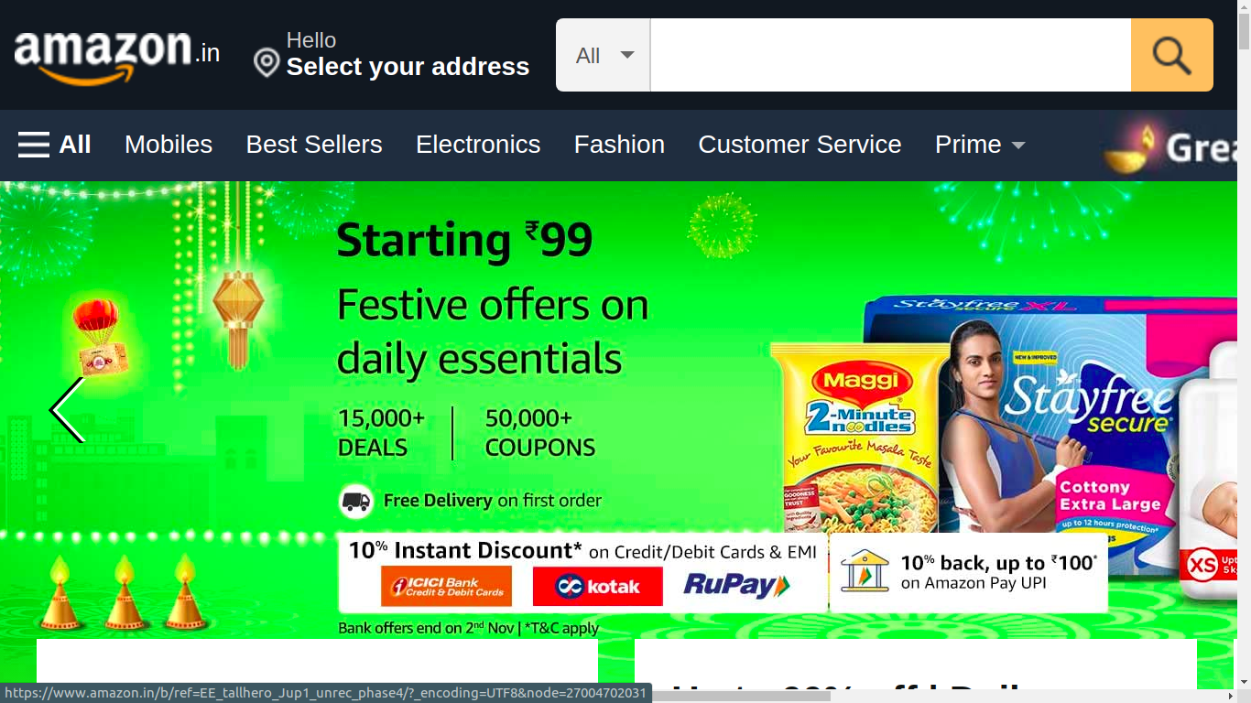
Gap in explanation and Interpretation of customers
Alexa buy me a backpack
backpack
A top result is P …
Aah!!! Nice! It must be very good as Alexa said it is the top result on Amazon.
But, P is not even in the first SERP on Amazon. How did Alexa say it is `a top result’?

Slide 15
Fairness in the default action by VA
VA selects one specific product as part of its default action
Customers have a tendency to take the path of less effort.
Default option often comes as an endorsement from the choice architect.
Hence, likelihood of choosing / purchasing the default option is generally high.
Thaler, Richard H., and Cass R. Sunstein. "Nudge: Improving decisions about health, wealth, and happiness."

Slide 16
Fairness in the default action by VA
VA selects one specific product as part of its default action
Customers have a tendency to take the path of less effort.
Default option often comes as an endorsement from the choice architect.
Hence, likelihood of choosing / purchasing the default option is generally high.
Non-selection of the most relevant product as the default choice
may deny its producers sales and revenue opportunities
may mislead customers to (possibly) less relevant products

Slide 17
Research questions
RQ 1: How do customers interpret the explanations given in the audio response by the VA?
RQ 2: How fair is the default action by the VA?

Slide 18
Challenges in understanding customers interpretation
These explanations have several semantics and nuances attached
Customers are more conversant with traditional mediums e.g., Desktop e-commerce search.
https://tinuiti.com/wp-content/uploads/2020/03/2020_Amazon_Shopper_Survey_02.pdf

Slide 19
Challenges in understanding customers interpretation
These explanations have several semantics and nuances attached
Customers are more conversant with traditional mediums e.g., Desktop e-commerce search.
One way is to contrast the customers’ interpretation of the explanations with observations on desktop search.
https://tinuiti.com/wp-content/uploads/2020/03/2020_Amazon_Shopper_Survey_02.pdf

Slide 20
Challenges in understanding customers interpretation
These explanations have several semantics and nuances attached
Customers are more conversant with traditional mediums e.g., Desktop e-commerce search.
One way is to contrast the customers’ interpretation of the explanations with observations on desktop search.
How to design an effective data collection framework for such analysis?
https://tinuiti.com/wp-content/uploads/2020/03/2020_Amazon_Shopper_Survey_02.pdf

Slide 21
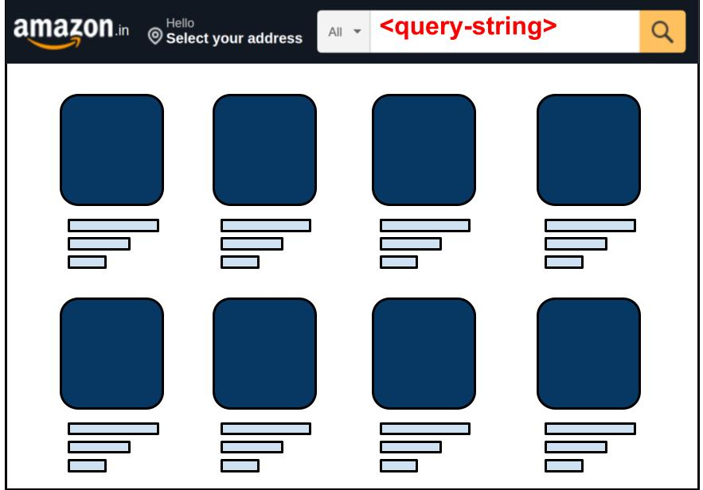
Data collection for a meaningful comparison
Audio Response
--------------
--------------
Default Action
Google text to speech
--------------
--------------
Product details
Query String
Product details

Slide 22
Data collection for a meaningful comparison
Audio Response
--------------
--------------
Query string
Default Action
Google text to speech
--------------
--------------
Product details
Query String
Product details

Slide 23
Data collection for a meaningful comparison
Audio Response
--------------
--------------
Query string
gTTS to generate audio command
Default Action
Google text to speech
--------------
--------------
Product details
Query String
Product details

Slide 24
Data collection for a meaningful comparison
Audio Response
--------------
--------------
Query string
gTTS to generate audio command
At the same time search on Alexa and desktop
Default Action
Google text to speech
--------------
--------------
Product details
Query String
Product details

Slide 25
Data collection for a meaningful comparison
Audio Response
--------------
--------------
Query string
gTTS to generate audio command
At the same time search on Alexa and desktop
Get the audio response and desktop SERP
Default Action
Google text to speech
--------------
--------------
Product details
Query String
Product details

Slide 26
Data collection for a meaningful comparison
Audio Response
--------------
--------------
Query string
gTTS to generate audio command
At the same time search on Alexa and desktop
Get the audio response and desktop SERP
Collect the product details
Default Action
Google text to speech
--------------
--------------
Product details
Query String
Product details

Slide 27
Some statistics of the dataset collected
We collected data for 1000 query strings on Amazon.
The queries cover 10 popular product categories on Amazon.
We also collected 14 temporal snapshots for top-100 queries on Amazon.

Slide 28
Some statistics of the dataset collected
We collected data for 1000 query strings on Amazon.
The queries cover 10 popular product categories on Amazon.
We also collected 14 temporal snapshots for top-100 queries on Amazon.
For access to dataset, please refer to the form at this link: https://forms.gle/aEG2n84Ay82QkVD19

Slide 29
Most prevalent explanations
66% queries out of 1000

Slide 30
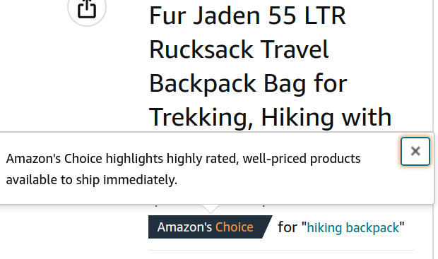
Most prevalent explanations
Amazon’s choice highlights highly rated, well-priced products available to ship immediately.
66% queries out of 1000

Slide 31
User survey for understanding interpretation
We conducted a survey among 100 participants.
Most of them are conversant with Amazon platform.

Slide 32
User survey for understanding interpretation
We conducted a survey among 100 participants.
Most of them are conversant with Amazon platform.
We asked them different questions pertaining to
What do customers interpret by `highly rated’ (or `well priced’) products?
Where do customers expect Amazon’s Choice products to appear?
How likely are you to buy the product which is explained as “Amazon’s Choice”?

Slide 33
What do customers interpret by `highly rated’ product?
According to 59% respondents, a product with avg. rating greater than 4.0 out of 5.0 can be considered highly rated.

Slide 34
What do customers interpret by `highly rated’ product?
According to 59% respondents, a product with avg. rating greater than 4.0 out of 5.0 can be considered highly rated.
In all the 662 queries, the product selected with Amazon’s choice explanation has an average rating greater than 4.0.

Slide 35
What do customers interpret by `well priced’ product?
61% respondents consider a product with price among the least 5 prices among all the products shown in SERP to be well priced.

Slide 36
What do customers interpret by `well priced’ product?
61% respondents consider a product with price among the least 5 prices among all the products shown in SERP to be well priced.
In merely 23% cases, product added to cart adhered to the most common interpretation as mentioned above.

Slide 37
Where do customers expect Amazon’s Choice products to appear?
54% respondents expect them to appear in top-5 positions; while 30% respondents expect them to appear as the top search result.

Slide 38
Where do customers expect Amazon’s Choice products to appear?
54% respondents expect them to appear in top-5 positions; while 30% respondents expect them to appear as the top search result.
In 74% cases, Amazon’s Choice product appeared in the top-5 positions.

Slide 39
Where do customers expect Amazon’s Choice products to appear?
54% respondents expect them to appear in top-5 positions; while 30% respondents expect them to appear as the top search result.
In 74% cases, Amazon’s Choice product appeared in the top-5 positions.
The contribution from position 1 is merely 39%.
Worse, nearly 8% of the times, it does not even appear in the first SERP.

Slide 40


Major takeaways from the survey
Explanation type | Statement | Interpretation | Match
Amazon’s Choice | Highly rated | Avg. user rating ≥ 4.0 | (100%) (00%)
 | Well priced | Least-5 price | (23%) (77%)
 | Expected position | Top-5 in SERP | (74%) (26%)
A top result | Expected position | Top result (position 1) | (19%) (81%)

Slide 41
Major takeaways from the survey
Respondents’ interpretations of the VA’s explanation do not align with observations from desktop search results in majority of the cases.
Explanation type | Statement | Interpretation | Match
Amazon’s Choice | Highly rated | Avg. user rating ≥ 4.0 | (100%) (00%)
 | Well priced | Least-5 price | (23%) (77%)
 | Expected position | Top-5 in SERP | (74%) (26%)
A top result | Expected position | Top result (position 1) | (19%) (81%)

Slide 42
Major takeaways from the survey
Respondents’ interpretations of the VA’s explanation do not align with observations from desktop search results in majority of the cases.
Additionally, 56% customers answered that they are likely or very likely to purchase products with such explanations.
Explanation type | Statement | Interpretation | Match
Amazon’s Choice | Highly rated | Avg. user rating ≥ 4.0 | (100%) (00%)
 | Well priced | Least-5 price | (23%) (77%)
 | Expected position | Top-5 in SERP | (74%) (26%)
A top result | Expected position | Top result (position 1) | (19%) (81%)

Slide 43
Research questions
RQ 1: How do customers interpret the explanations given in the audio response by the VA?
RQ 2: How fair is the default action by the VA?

Slide 44
(Un)Fairness toward producers
Exposure due to Alexa:
1 if product is added to cart, 0 otherwise
Exposure due to ranked results of desktop search
Can be evaluated using any standard attention distribution mechanism
We assume attention / exposure are distributed geometrically
Exposure bias is the difference between the two exposures
Ideally, Exposure bias ≃ 0.
Notes:
First we tried to quantify the unfairness toward producers / sellers. We compared the exposure that a product will get due to different mediums of interaction and the difference between the two is defined as the exposure bias.

Slide 45
Observation
In 68% of all 1000 queries, exposure bias is non-zero →most relevant product according to desktop search was not added to cart by Alexa.

Slide 46
Observation
In 68% of all 1000 queries, exposure bias is non-zero →most relevant product according to desktop search was not added to cart by Alexa.
Less relevant products were added to cart; thus, depriving producers of more relevant products an opportunity to potential sales and revenue.

Slide 47
(Un)Fairness toward customers
Is the product added to cart by Alexa also preferred by customers?
We conducted a user survey among the same 100 respondents
We showed the customers:
Product that was added to cart by Alexa
Product that appeared as the top result in the corresponding desktop search
Which of the following two products would you prefer to buy?

Slide 48
Observation
For 22 out of the 30 queries (73.3%), the majority preference of respondents did not match with the products selected by Alexa.
Out of the 1000 evaluations, we find that in 73.2% cases, respondents preferred the top desktop search result to the product selected by Alexa.

Slide 49
Observation
For 22 out of the 30 queries (73.3%), the majority preference of respondents and products selected by Alexa did not match.
Out of the 1000 evaluations, we find that in 73.2% cases, respondents preferred top of desktop search result to product selected by Alexa.
These observations further underpin the potential unfairness and customer dissatisfaction concerns due to default product selection of Alexa.

Slide 50
Conclusion
There exists significant gap in customers’ interpretation of Alexa’s explanations and observation in traditional desktop search.
The default product selection of Alexa has potential unfairness concerns for both customers and producers / sellers.
Since customers cede complete autonomy to smart speakers (and the VAs therein), VAs should be more responsible during such interactions.

Slide 51
Acknowledgements
ERC Advanced Grant
TCS Research Fellowship
CNeRG Lab, IIT Kharagpur

Slide 52

Thank You
For dataset please fill up: https://forms.gle/PQdTghzynxQiuw4h6
@adash0193
Notes:
Thank you!!!

