Slide 1
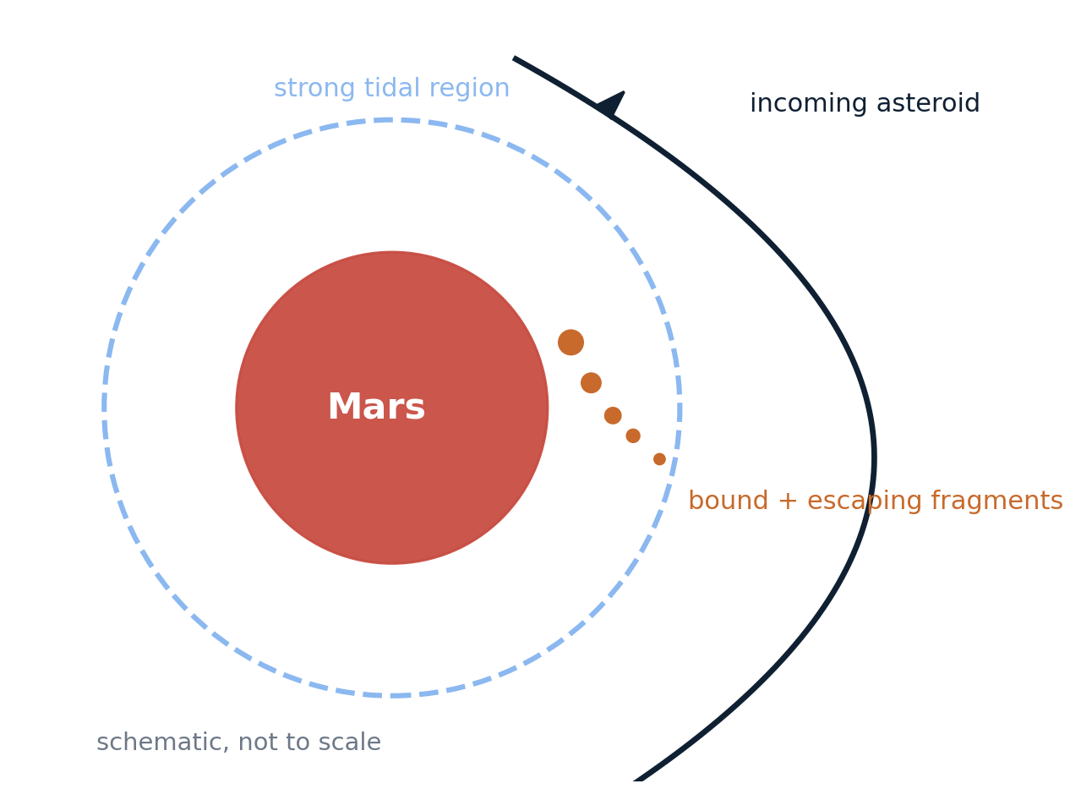
Mars Tidal Encounters: Physics First
IRP refactor | 10 slides | August 11, 2026
Main question: when do close asteroid flybys leave Mars-bound debris?
This version leads with SPH-supported physical findings. ML is used only as an in-domain screening layer.
1

Slide 2
Four Results
Physics findings first. Screening logic second.
1. Closer and slower encounters retain more bound mass.
2. Mass, velocity, and periapsis interact rather than acting independently.
3. Spin can strongly change BMF in some matched regimes.
4. The surrogate is trusted only where local SPH support exists.
Archive used here: 279 unique physical SPH runs after removing repeated FoF rows.
2

Slide 3
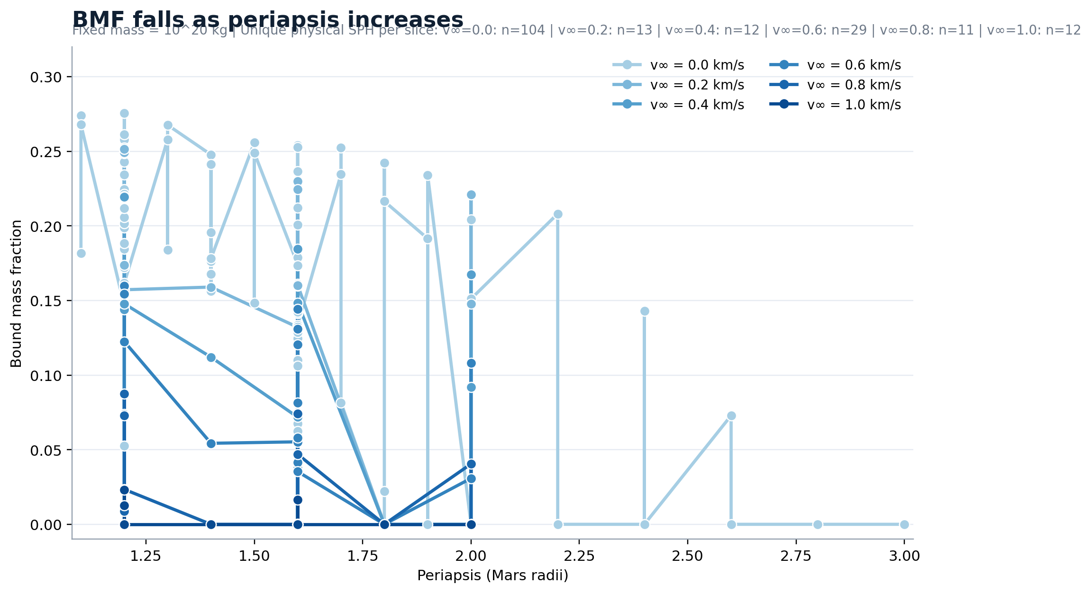
Closer passes keep more bound mass
Controlled SPH slice: fixed mass, multiple velocities.
3

Slide 4
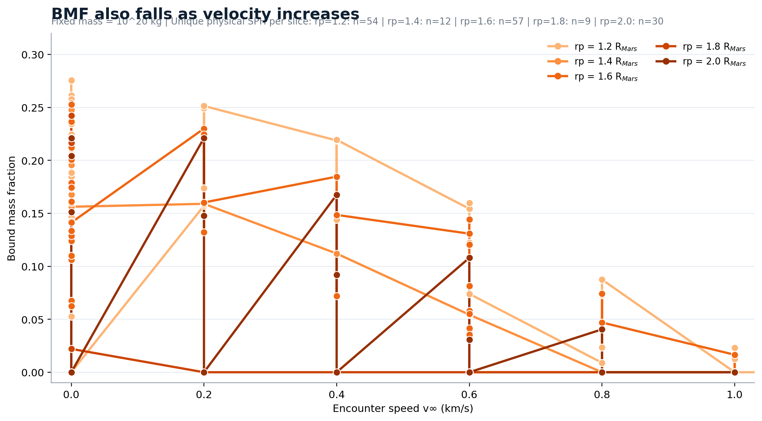
Faster flybys suppress retention
Controlled SPH slice: fixed mass, multiple periapses.
4

Slide 5
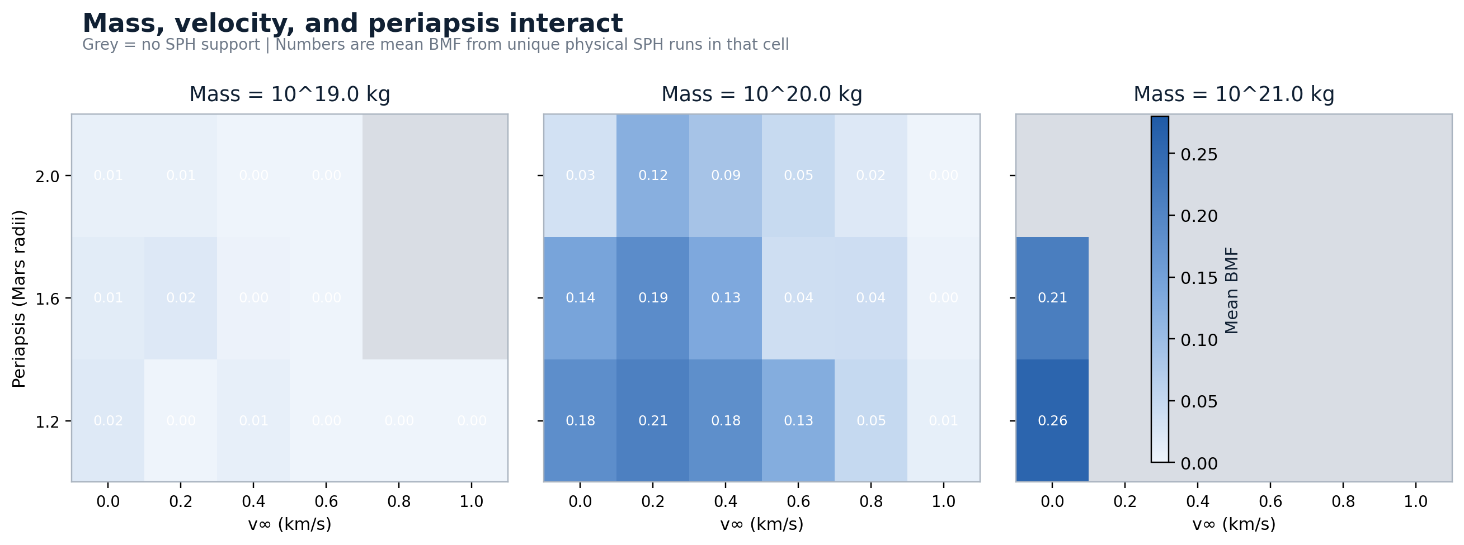
The three-way interaction matters
Actual SPH means only. Grey cells were never simulated.
5

Slide 6
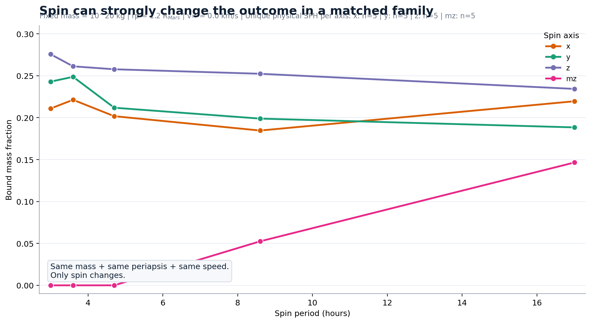
Spin can flip the outcome
Matched family: same mass, same periapsis, same speed.
6

Slide 7
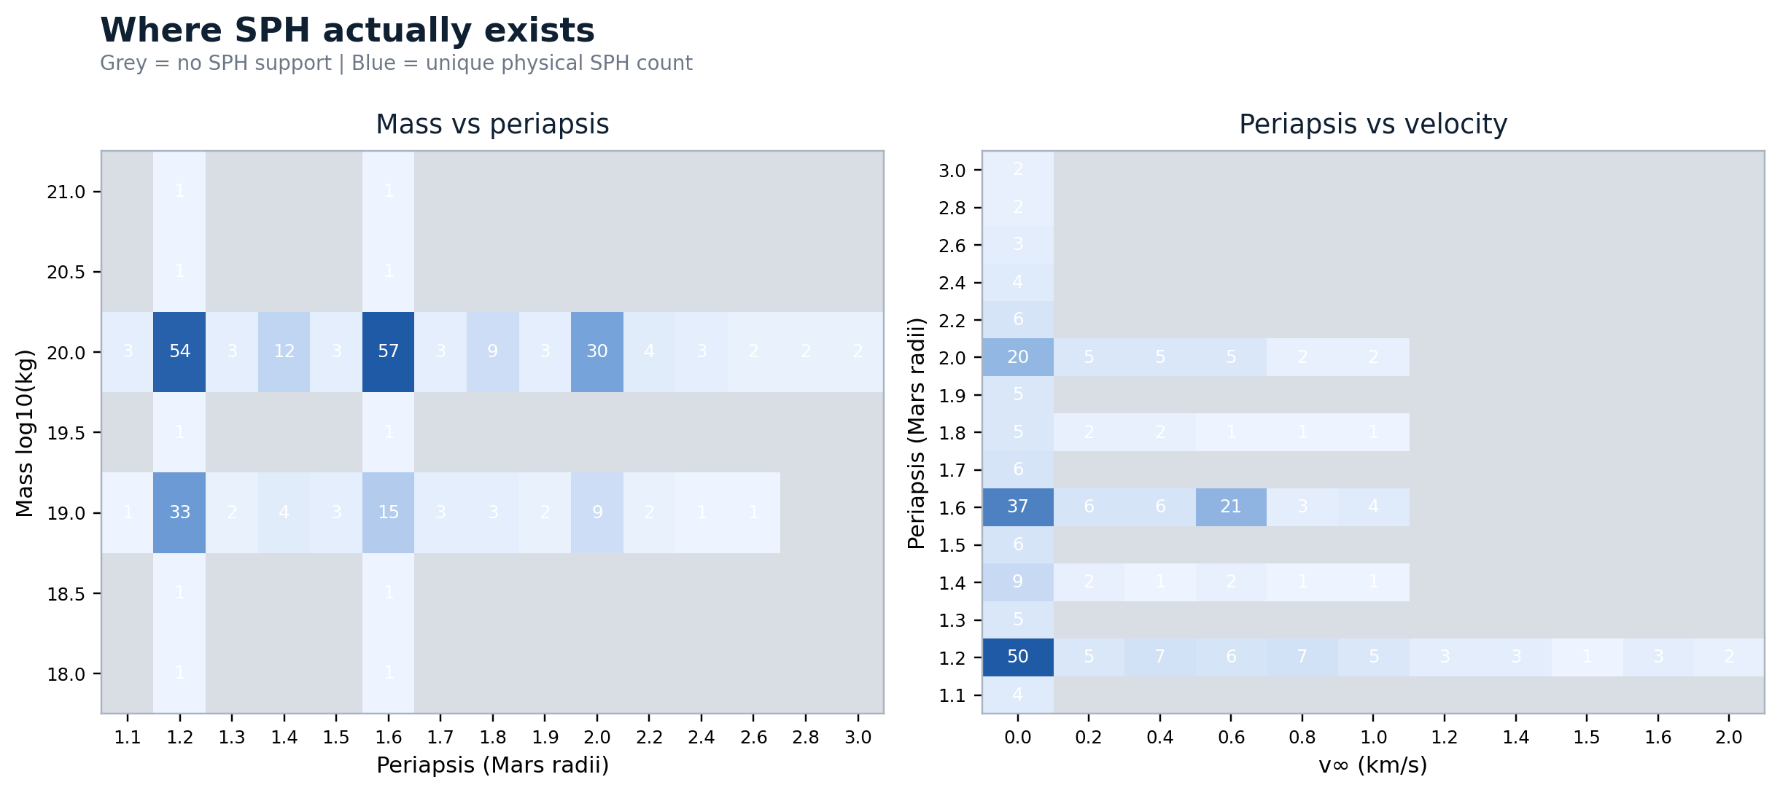
Trust depends on local SPH support
Blue = unique physical SPH count. Grey = no support.
7

Slide 8
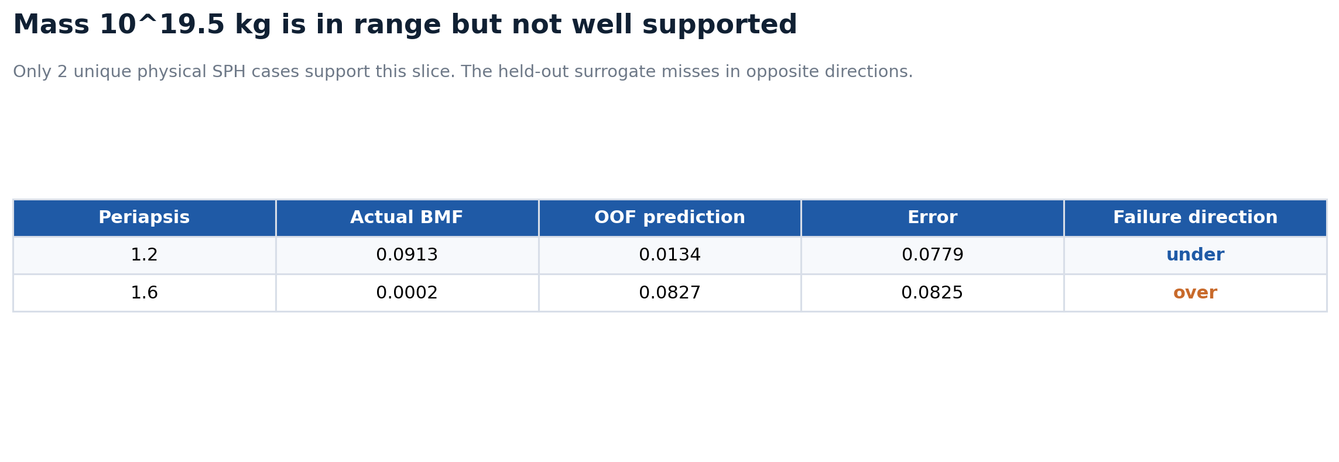
A concrete failure case
Mass 10^19.5 kg looks in-range globally but fails locally.
8

Slide 9
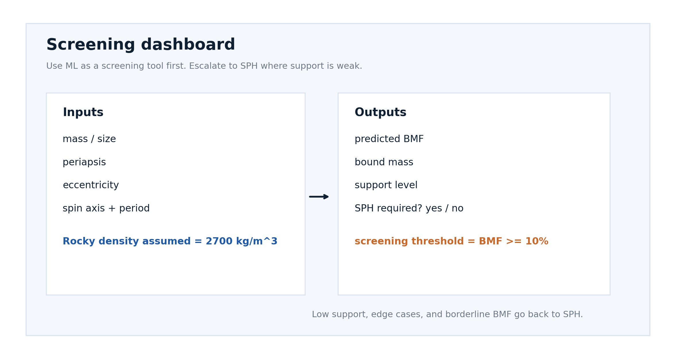
How the screening tool should be presented
Inputs, outputs, and wording aligned to the physics-first story.
9

Slide 10
Takeaways
What should carry into the spoken summary.
Closer and slower flybys are the clearest route to higher BMF.
Mass lifts retention, but only together with favourable periapsis and velocity.
Spin is not a small correction everywhere; some matched SPH families change sharply with spin.
Use ML for screening, not replacement. Sparse or weakly supported regions still need SPH.
Immediate SPH priority: fill the sparse mass 10^19.5 kg region and other grey cells before widening surrogate claims.
10

