Slide 1


Americans with Disabilities Act (ADA)
History of Disability Rights & Legislation
ADA Participation Action Research Consortium (PARC)
Participation Equity Navigator Training
Notes:
Hello and welcome to the Americans with Disabilities Act - History of Disability Rights & Legislation. A presentation within module 1-Unit 2: ADA Basics of the ADA PARC Participation Equity Navigator Training. Please note that there is an accessible PDF and Rich Text Format handout of this presentation available in Brightspace within module 1, unit 2 of this training course.
Moving onto slide 2

Slide 2
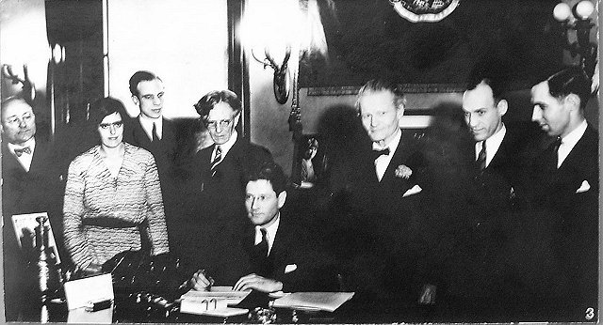


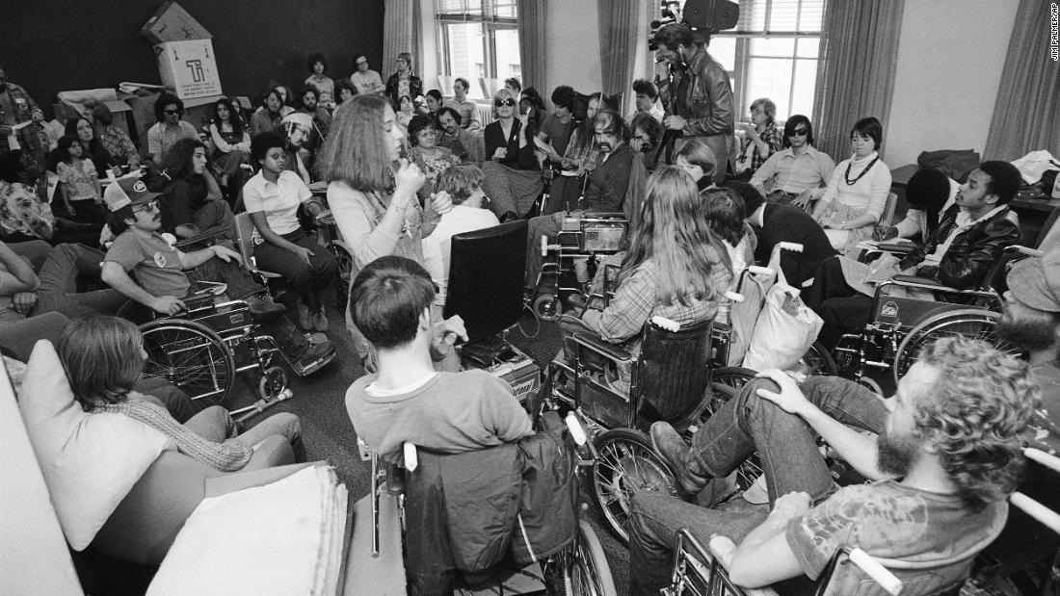
Disability Rights & Legislation
In 1917, the Smith-Hughes Act established the federal-state program in vocational education, as well as created a Federal Board of Vocational Education with the authority and responsibility for vocational rehabilitation of disabled veterans
In 1962, Ed Roberts (who used a wheelchair) finally gained admission to the University of California after winning a lawsuit
In 1973, the Rehabilitation Act was passed, prohibiting disability discrimination in federal programs and services
The longest “sit-in” ever conducted at a US federal building was in 1977 when people were protesting the US Secretary of Dept. of Health, Education & Welfare’s refusal to sign into law regulations to enforce the Rehabilitation Act
Notes:
In 1917, The Smith-Hughes Act made federal monies available to states on a matching basis for vocational education programs. It established the Federal Board for Vocational Education, which later administered the veteran and civilian vocational rehabilitation programs otherwise known as Voc. Rehab. or VR. The goal is to help those with disabilities return to work and become economically independent. Participants may receive diagnosis, an individualized rehabilitation program, counseling and guidance, training, job placement, and services to support job retention
Displayed on this slide is a photo of the signing of the Smith-Hughes Act.
Double Click
The University of California refused to admit Ed Roberts (who used a wheelchair) as a student despite the fact that he was fully qualified. Maintaining that this refusal was “for his own good,” college admission officials maintained that it would not be safe for Mr. Roberts to attend college. In 1962, Ed, who founded the independent living movement, finally gained admission to the college after winning the lawsuit he filed.
Displayed on this slide is a photo of Ed Roberts next to a University campus
Double Click
In 1973, the Rehabilitation Act was passed, prohibiting disability discrimination in federal programs and services. This legislation was important because it laid the groundwork for the ADA.
Displayed on this slide is a photo of People with Disabilities protesting for the passing of the Rehabilitation Act
Double Click
Although the Rehabilitation Act was passed in 1973, the US Secretary of Health, Education and Welfare refused to sign the regulations for the Rehabilitation Act. This was important because, without regulations, this law was not enforceable. There were many “504-Sit ins” all over the country, but the San Francisco sit-in lasted 26 days and at any time, there were between 1 and 200 people with disabilities and allies occupying the building.
Displayed on this slide is a photo of a group of people with disabilities in 1977 participating in the sit-in protesting against the refusal to sign into law regulations to enforce the Rehabilitation Act
Moving onto slide 3

Slide 3
Rehabilitation Act
Section 501: Prohibits federal agencies from discriminating against qualified individuals with disabilities, using the same standards as Title I of the ADA
Section 503: Prohibits federal contractors and subcontractors from discriminating in employment against individuals with disabilities
Section 504: States that “no qualified individual with a disability in the United States shall be excluded from, denied the benefits of, or be subjected to discrimination under” any program or activity that either receives Federal financial assistance or is conducted by any Executive agency or the United States Postal Service
Section 508: Requires Federal electronic and information technology to be accessible to people with disabilities (employees and members of the public)
Notes:
Let’s break down the Rehabilitation Act
Click
Section 501: Prohibits federal agencies from discriminating against qualified individuals with disabilities, using the same standards as Title I employment of the ADA. It requires federal agencies to take affirmative action in the hiring, placing, and advancing of individuals with disabilities. Section 501 is enforced by a federal agency’s Equal Employment Opportunity Office.
Click
Section 503: Prohibits federal contractors and subcontractors from discriminating in employment against individuals with disabilities. It requires employers to take affirmative action to recruit, hire, promote, and retain these individuals. Section 503 is enforced by the Office of Federal Contract Compliance Programs within the U.S. Department of Labor.
Click
Section 504: States that “no qualified individual with a disability in the United States shall be excluded from, denied the benefits of, or be subjected to discrimination under” any program or activity that either receives Federal financial assistance or is conducted by any Executive agency or the United States Postal Service. Requirements common to these regulations include reasonable accommodation for employees with disabilities, program access, effective communication with people who have hearing or vision disabilities, and new construction and alterations built with accessibility in mind. Individuals can contact the U.S. Department of Justice for information on what appropriate federal agency to contact regarding the enforcement of Section 504.
Click
Section 508: Requires Federal electronic and information technology to be accessible to people with disabilities, including employees and members of the public. It establishes requirements for electronic and information technology developed, maintained, procured, or used by the Federal government. For more information on section 508, Individuals can contact the U.S. General Services Administration, Office of Enterprise Planning and Governance
Moving onto slide 4

Slide 4

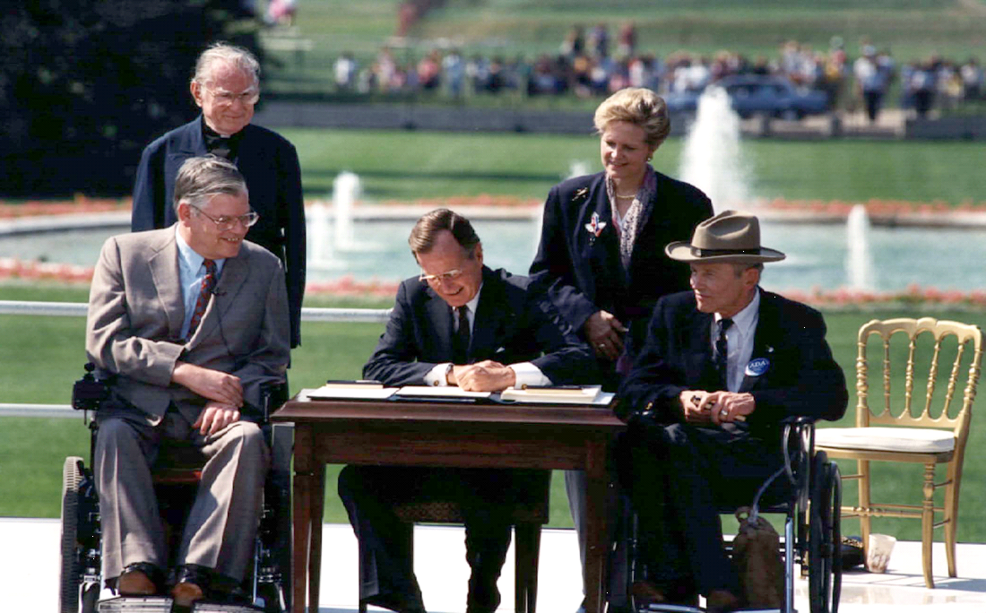
Passage of the ADA
March 12, 1990, Capitol Crawl: protest to demand the passage of the Americans with Disabilities Act (ADA)
July 26, 1990: ADA signed into law
Notes:
On March 12, 1990, more than 1000 disability activists went to Washington to protest the US Congress stalling the passage of the Americans with Disabilities Act prohibiting discrimination of people with disabilities. When the group reached the capitol steps, they pulled themselves out of their wheelchairs and began to crawl up the steps to dramatically protest the lack of access for people with disabilities.
Displayed on this slide is a photo of two young woman crawling up the US capitol steps with photographers in front of them taking pictures.
Double Click
Six months later, following the bill’s remarkably swift passage through the House, President George H. W. Bush signed the ADA into law on July 26, 1990.
Displayed on this slide is a photo of President George Bush signing the ADA into law
Moving onto slide 5

Slide 5

Legislative Timeline
1965 – Voting Rights Act
1968 – Architectural Barriers Act (ABA)
1973 – Rehabilitation Act
1975 – Individuals with Disabilities in Education Act (IDEA)
1976 – Higher Education Act Amendment (to include students with disabilities)
1980 – Civil Rights of Institutionalized Persons Act (CRIPA)
1984 – Voting Accessibility for Elderly and Handicapped Act
1986 – Air Carrier Access Act
1988 – Fair Housing Amendments Act
1990 – Americans with Disabilities Act (ADA)
1996 –Telecommunications Act
2008 – ADA Amendments Act (broadened the definition of disability)
2010 – 21st Century Communications and Video Accessibility Act
Notes:
On this slide is a legislative timeline of some civil rights laws providing protections to Americans with disabilities. Many of these laws provide protections that the ADA does not cover. Let's take a look at some of them.
CLICK
The Voting Rights Act was passed in 1965 and established the right for voters who are blind or have other disabilities to receive assistance from a person of their choice. It also prohibits making the right to vote contingent on a citizen's ability to read or write, attaining a specific level of education or passing an interpretation test.
CLICK
Architectural Barriers Act of 1968 requires access to facilities designed, built, altered, or leased with federal funds or by federal agencies. It ensures accessibility in the built environment for people with disabilities through the Act’s accessibility standards.
CLICK
The Individuals with Disabilities Education Act of 1975 or IDEA requires public schools to make available to all eligible children with disabilities a free appropriate public education in the least restrictive environment appropriate to their individual needs. IDEA requires public school systems to develop appropriate Individualized Education Programs (IEPs) for each child.
CLICK
The Air Carrier Access Act of 1986 prohibits discrimination on the basis of disability in air travel. The Department of Transportation, or DOT, has a rule defining the rights of passengers and the obligations of airlines under this law. This rule applies to all flights of U.S. airlines and to flights to or from the United States by foreign airlines. DOT’s rule addresses prohibited discriminatory practices; for example, airlines may not require a person with a disability to travel with another person, except in certain limited circumstances. The rule also addresses the accessibility of aircraft and other services and accommodations required by airlines.
CLICK
The Fair Housing Act, as amended in 1988, prohibits housing discrimination on the basis of race, color, religion, sex, disability, familial status, and national origin. The Fair Housing Act requires owners of housing facilities to make reasonable exceptions in their policies and operations to afford people with disabilities equal housing opportunities. It also requires landlords to allow tenants with disabilities to make reasonable access-related modifications to their private living space, as well as to common-use spaces. The Act further requires that new multifamily housing with four or more units be designed and built to allow access for persons with disabilities by following the Fair Housing Act design and construction requirements. This law is enforced by the US Department of Housing and Urban Development, otherwise known as HUD.
CLICK
In 2008, the ADA was further strengthened with the passage of ADA Amendments Act in response to several Supreme Court decisions that weakened the law by placing narrow restrictions on who could be given the protections of the law. When Congress passed the ADA Amendments Act, they made it clear that the original intent of the ADA was to provide broad coverage, that determining if a person has a disability as defined by the ADA should be straightforward forward, and that covered entities are to spend more time focusing on the removal of disability-related barriers.
CLICK
Additionally, it is important to note that the 21st Century Communications and Video Accessibility Act Of 2010 updates federal communications law to increase the access of persons with disabilities to modern communications. This Act makes sure that accessibility laws enacted in the 1980s and 1990s are brought up to date with 21st-century technologies, including new digital, broadband, and mobile innovations.
Moving onto our final slide, slide 6

Slide 6
Conclusion
To learn more about the concepts reviewed during this training, check out the ADA resources provided within this unit
If you have questions about the ADA, call your regional ADA Center at 800-949-4232
The next step is to view the Americans with Disabilities Act (ADA) –Overview of the ADA
Notes:
To learn more about the concepts reviewed during this training, check out the ADA resources provided in this unit within Brightspace.
CLICK
If you have questions about the ADA, call your regional ADA Center at 800-949-4232
CLICK
This concludes the Americans with Disabilities Act- History of Disability Rights and Legislation presentation.
The next step is to view the Americans with Disabilities Act–Overview of the ADA
Thank you

