Slide 1


Americans with Disabilities Act (ADA)
ADA Requirements
ADA Participation Action Research Consortium (PARC)
Participation Equity Navigator Training
Notes:
Hello and welcome to the Americans with Disabilities Act –ADA Requirements, a presentation within module 1-Unit 2: ADA Basics of the ADA PARC Participation Equity Navigator Training. Please note that there is an accessible PDF and Rich Text Format handout of this presentation available in Brightspace within module 1, unit 2 of this training course.
Moving onto slide 2

Slide 2
2010 ADA Standards
The original ADA Accessibility Guidelines (ADAAG) were published in 1991 and amended in 2010
  The 2010 ADA Accessible Standards are the current version and went into effect on March 15, 2012
      Applies to new construction, alterations and additions (built environment)
“Safe Harbor” not “Grandfathered”
  New technical requirements for elements that were not addressed in the 1991 Standards are not eligible for “safe harbor”
      Examples: Play areas, fishing piers, golf facilities, saunas, etc.
Maintenance of accessible features (operable working condition)
  Examples: platform lifts unlocked, a route remains accessible and not blocked by obstacles such as furniture, etc.
Notes:
Entities covered under the ADA must follow the 2010 ADA Accessible Standards for physical accessibility in new construction, alterations, and additions.
CLICK
Elements that have not been altered in existing facilities on or after March 15, 2012,and that comply with the corresponding technical and scoping specifications for those elements in the 1991 Standards are not required to be modified in order to comply with the requirements set forth in the 2010 Standards.
This is called Safe harbor.
New technical requirements for elements that were not addressed in the 1991 Standards are not eligible for “safe harbor” such as Play areas, fishing piers, golf facilities, saunas, etc.
“Grandfather provisions” are often found in local building codes but do not exempt businesses and state and local governments from their obligations under the ADA.
CLICK
Covered entities must maintain in working order equipment and features of facilities that are required to provide ready access to individuals with disabilities.
Required accessible routes must remain accessible and not blocked by obstacles such as furniture, filing cabinets, or potted plants.
For example: Using an accessible route for storage of supplies would also be a violation if it made the route inaccessible.
An isolated instance of placement of an object on an accessible route, however, would not be a violation, if the object is promptly removed.
Similarly, accessible doors must be unlocked when the public entity is open for business.
Mechanical failures in equipment, such as elevators or automatic doors, will occur from time to time.
The obligation to ensure that facilities are readily accessible to and usable by individuals with disabilities would be violated, if repairs are not made promptly or if improper or inadequate maintenance causes repeated and persistent failures.
Moving onto slide 3

Slide 3

Digital Accessibility Legal Framework
  ADA applies to digital spaces (websites and online services) that covered entities (state & local governments and businesses) offer to the public
  State & Local Governments must follow Web and Mobile App Accessibility Requirements
  In 1996, the DOJ said covered entities under the ADA are required to provide effective communication, regardless of whether they generally communicate through print media, audio media, or computerized media such as the internet
Notes:
The ADA also applies to digital spaces such as websites and online services that state & local governments and businesses offer to the public
CLICK
State & Local Governments must follow new Web and Mobile App Accessibility Requirements to ensure digital platforms are accessible. Some businesses choose to follow these new requirements to ensure their websites and online services are accessible but are not obligated to do so.
CLICK
In a 1996 letter from the Department of Justice in response to Senator Tom Harkin question about the accessibility of web pages on the internet, said covered entities under the ADA are required to provide effective communication, regardless of whether they generally communicate through print media, audio media, or computerized media such as the internet.
Moving onto slide 4

Slide 4
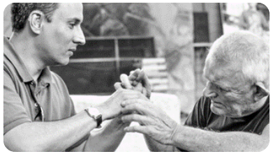

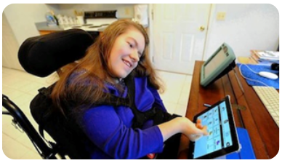
Effective Communication Requirements
Covered entities must provide auxiliary aids and services when needed to communicate effectively with people who have communication disabilities at no extra cost
  State and local governments required to give primary consideration
  Businesses encouraged to consult with the individual
Effective communication is when a person with a vision, hearing, or speech disability can communicate with, receive information from, and convey information to the covered entity
Applies to communicating with not only the person who is receiving the covered entity’s goods or services but also with that person’s parent, spouse, or companion in appropriate circumstances
Notes:
Covered entities must provide auxiliary aids and services when needed to communicate effectively with people who have communication disabilities at no extra cost.
CLICK
Effective communication is when a person with a vision, hearing, or speech disability can communicate with, receive information from, and convey information to the covered entity
For example, providing a sign language interpreter or real-time captioning for individuals who are deaf or have hearing loss. Or providing a large print or accessible electronic copy of a document for individuals with low vision or blindness.
Displayed on this slide are photos of tactile signing, two people signing, and a person using a communication pad.
The communication must be provided in a manner that enables people with disabilities to participate in or benefit from the service or program on an equal basis with others, unless to do so would result in a fundamental alteration to the program or in undue financial or administrative burden
CLICK
This requirement also applies to communicating with not only the person who is receiving the covered entity’s goods or services but as well as with that person’s parent, spouse, or companion in appropriate circumstances.
People with disabilities need to be given the opportunity to request the auxiliary aid or service of their choice.
CLICK
State and Local Governments must honor that choice unless it can demonstrate that another equally effective means of communication is available or that the aid requested would result in a fundamental alteration or an undue.
CLICK
Businesses are encouraged to honor the individual with disability’s choice, but effective communication must be the end result.
Keep in mind the individual with a disability is in the best position to determine what type of aid or service will be effective.
Moving onto slide 5

Slide 5
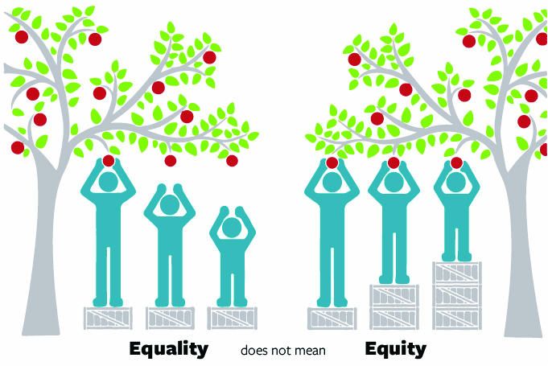
Reasonable Modification
Modification or adjustment to the environment or the way things are usually done (policy, practice, or procedure)
Purpose is not to provide an advantage but to make a person with a disability opportunity and access to the activities, programs, goods, and services equal to someone without a disability
Covered entities are not required to provide the requested or “preferred” modification if they can provide an alternative that would be reasonable and effective
Does NOT include:
  Providing personal services
  Tolerating or excusing violent or abusive behaviors
Notes:
State and local governments and businesses have formal and informal policies, practices, and procedures that keep them running smoothly.
However, sometimes, these policies or procedures can inadvertently make it difficult or impossible for a customer with a disability to access goods and services.
That is why the ADA requires covered entities to make “reasonable modifications” to their usual ways of doing things when serving people with disabilities.
CLICK
The purpose is not to provide an advantage but to make a person with a disability’s opportunity and access to the activities, programs, goods, and services equal to someone without a disability.
CLICK
This is also demonstrated by the equality vs. equity image described in the 5 titles of the ADA presentation when we discussed employment accommodations.
There are no “cookie cutter” approaches, and most modifications involve only minor adjustments in policies or practices.
For example, a daycare center that has two scheduled snack times must modify this policy to allow a child with diabetes to bring food for an extra snack if necessary.
A clothing store must modify a policy of permitting only one person at a time in a dressing room for a person with a disability who is shopping with a companion and needs the companion’s assistance to try on clothes.
Other examples of Reasonable Modifications include:
Permitting a service animal in a place where animals are typically not allowed, such as a cafeteria or a courtroom.
Or granting a zoning variance to allow a ramp to be built inside a setback.
CLICK
Covered entities are not required to provide the requested or “preferred” modification if they can provide an alternative that would be reasonable and effective.
A modification may be appropriate under some circumstances but not others.
For example, a transcription service for a student with hearing loss may be appropriate in a lecture where the communication is generally one-sided. If a student needs to participate in class discussions, a sign language interpreter may be more appropriate.
Not all modifications will be the same for the same limitation/disability
Disability manifests itself differently in different people, and individuals have their own coping mechanisms and responses to the limitations that they may experience
Some conditions can be episodic in nature and require different responses at different times
CLICK
Reasonable modification does NOT include:
Tolerating or excusing violent or abusive behaviors or providing personal services such as toileting, feeding, clothing and medication management, etc.
“Personal services” do not include minor assistance provided to individuals with disabilities such as retrieving items from shelves, providing curb service or home delivery, removing the cover from a customer's straw, a cook in a restaurant cutting up food into smaller pieces, or a bank teller filling out a deposit slip
If a public accommodation, such as a hospital or nursing home, customarily provides its clients with what might otherwise be considered services of a personal nature, it must provide the same services for individuals with disabilities.
Moving onto slide 6

Slide 6

Modification Scenario
A city ordinance states homeowners must remove snow from their sidewalks within 48 hours. A resident with a disability that inhibits their ability to shovel snow requests the city provide snow removal service as a reasonable modification.
  Is the city obligated to provide this?
    NO. The ADA does not require a city government to provide snow removal service for the private driveways of residents with disabilities if the city does not provide such service for residents without disabilities.
Notes:
Let’s take a look at a modification scenario
A city ordinance states homeowners must remove snow from their sidewalks within 48 hours. A resident with a disability that inhibits their ability to shovel snow requests the city provide snow removal service as a reasonable modification.
Is the city obligated to provide this?
CLICK
NO. The ADA does not require a city government to provide snow removal service for the private driveways of residents with disabilities if the city does not provide such service for residents without disabilities.
Moving on to slide 7

Slide 7
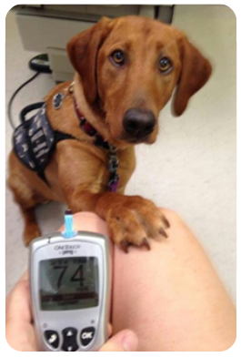


Service Animal Under the ADA
A service animal is defined as a dog that has been individually trained to do work or perform tasks for an individual with a disability
  Must modify policies to permit miniature horses where reasonable
Service animals must have a harness, leash, or other tether unless these devices interfere with the service animal’s work or the person’s disability prevents use of these devices
Two specific exceptions for when service animals can be excluded:
    The animal is out of control and the individual does not take effective action to control it; or
    The animal is not housebroken
Notes:
Covered entities must allow service animals to go to most places where the public can go.
A service animal is defined as a dog of any breed or size that has been individually trained to do work or perform tasks for an individual with a disability.
Displayed on this slide is a photo of a service dog alerting a person of their blood sugar levels
The ADA doesn’t require service animals to be professionally trained. People with disabilities have the right to train a dog themselves and are not required to use a professional service dog training program.
Covered entities must also modify policies to permit miniature horses as a service animal where reasonable.
CLICK
The ADA requires that service animals be under the control of the handler at all times.
In most instances, the handler will be the individual with a disability or a third party who accompanies the individual with a disability.
In primary school and in similar settings, the school or similar entity may need to provide some assistance to enable a particular student to handle their service animal.
The service animal must be harnessed, leashed, or tethered while in public places unless these devices interfere with the service animal’s work or the person’s disability prevents the use of these devices.
In that case, the person must use voice, signal, or other effective means to maintain control of the animal.
For example, a person who uses a wheelchair may use a long, retractable leash to allow their service animal to pick up or retrieve items. The person may not allow the dog to wander away from them and must maintain control of the dog, even if it is retrieving an item at a distance from them.
Or, a returning veteran who has Post Traumatic Stress Disorder and has great difficulty entering unfamiliar spaces may have a dog that is trained to enter a space, check to see that no threats are there, and come back and signal that it is safe to enter.
TRIPLE CLICK
Covered entities can ask someone to remove their service animal if:
The dog is out of control, and the person cannot get the dog under control.
Or the dog is not housebroken.
The entity must still allow the person with a disability to participate in the goods and services without the excluded service animal and may need to provide reasonable modifications in the absence of the person’s service animal
Moving onto slide 8

Slide 8

Service Animals: What Can Be Asked?
In situations where it is not obvious that the dog is a service animal, covered entity staff may ask only two specific questions:
Is the dog a service animal required because of a disability?
What work or task has the dog been trained to perform?
Entities cannot ask these questions if the disability and trained work or task are obvious
Staff are NOT allowed to request any documentation for the dog, require that the dog demonstrate its task, or inquire about the nature of the person's disability
Notes:
In situations where it is not obvious that the dog is a service animal-covered entity staff may ask only two specific questions:
CLICK
Is the dog a service animal required because of a disability?
This is a yes or no response.
If a person says yes to this first question, then a covered entity can follow up by asking:
CLICK
What work or task has the dog been trained to perform?
For example, my service animal alerts me to oncoming attacks so that I may take precautionary measures to manage the attack
CLICK
Entities cannot ask these questions if the disability and trained work or task are obvious
CLICK
Staff are not allowed to request any documentation for the service animal, require that the service animal demonstrate its task, or inquire about the nature of the person's disability.
Service animals are not required to be certified or go through a professional training program, wear a vest or other ID that indicates they’re a service dog
People with disabilities are not required to register their trained service animals, provide training documentation, carry a special ID card or certificate, disclose their disability, or provide medical documentation of their disability
Moving onto to the final slide, slide 9

Slide 9

Conclusion
To learn more about the concepts reviewed during this training, check out the ADA resources provided within this unit
If you have questions about the ADA, call your regional ADA Center at 800-949-4232
To complete Module 1 - Unit 2: ADA Basics, complete the ADA Titles Quiz
Notes:
To learn more about the concepts reviewed during this training, check out the ADA resources provided in this unit within Brightspace.
CLICK
If you have questions about the ADA, call your regional ADA Center at 800-949-4232
CLICK
This concludes the Americans with Disabilities Act - ADA Requirements
To complete Module 1 - Unit 2: ADA Basics, please complete the ADA Titles Quiz

