Slide 1


Module 3:
Unit 2:How to Make Sense of Data
ADA Participation Action Research Consortium (PARC)
Participation Equity Navigator Training

Slide 2

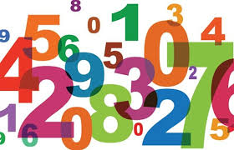
What We’ll Learn?
What’s the difference between numbers and percentages, and when do we use each?

Slide 3
Numbers vs. Percentages
• Numbers = exact counts (e.g., 500 people with disabilities have jobs).
• Percentages = comparisons (e.g., 20% of people with disabilities have jobs).

Slide 4
Why Use Percentages First, Then Numbers
Using percentages first helps to compare cities and states, especially when the populations of cities or states are very different in size. You can follow up with numbers to give exact data.
Use numbers to show the exact number of people in your city or state

Slide 5

Activity part: Try it yourself!
Go to the ADA-PARC Website.
1. Look at the data for two different states or cities.
2. Find the number of people with disabilities who are employed in your state.
3. Then look at the percentage of people with disabilities employed in your state.
Compare your state with another state.

Slide 6
Example: Illinois vs. Mississippi
Using percentages is essential when comparing cities or states of different sizes.
Based on the ADA-PARC Data:
• Illinois: 1,482,931 people have disabilities = 11.8%
• Mississippi: 500,688 people have disabilities = 17.4%

Slide 7

A Quick Note: Keep in Mind
📊 Percentages first → show the bigger picture, compare fairly
🔢 Numbers second → give local detail
🤝 Together → tell a clear and strong story

