Slide 1


Module 3:
How to Make Sense of Data
ADA Participation Action Research Consortium (PARC)
Participation Equity Navigator Training

Slide 2
Training Outline
Understanding Data on Disability
Making Sense of Numbers vs Percentage
Limitations of National Data
Making Sense of Scorecard

Slide 3
Limitations of National Data

Slide 4
Why National Data Has Limitations
Big surveys (like the American Community Survey) tell us how people are doing across the whole country.
But sometimes, this “big picture” hides the small details of local communities

Slide 5
Problems with National Data:
Small groups get lost: If only a few people from a small-town answer, the results may not be right.
Averages hide differences: National numbers can cover up how life is different in cities vs. rural areas.
Example:
People with disabilities in a big city may face different problems than those in a small rural town, but national data may not show this.

Slide 6
What Does NA Mean and Why It Appears
Sometimes data is marked NA, which means the information is missing.
Why Data Can Be NA:
Too few answers: Not enough people responded to give good results.
Different ways of asking: Some places collect data in different ways, so we can’t compare them.

Slide 7
Limitations in Small-Region Data
When we look at smaller places (like towns or neighborhoods), there are fewer people answering the survey.
Fewer answers = results are less exact.
Sometimes the survey will just say NA (not available) because there weren’t enough answers.

Slide 8
Limitations in Small-Region Data (Cont..)
Example:
A small rural town may not show data about disability services, because too few people answered.
Be Careful!
Numbers from small towns might not tell the whole story.
Talking with people in the community can help us understand what’s missing.

Slide 9
Differences in Definitions and Reporting
Different surveys don’t always agree on what “disability” means.
For Example:
The American Community Survey (ACS) looks at 6 types of disability (like trouble seeing, hearing, walking, or remembering).
Other surveys use different rules. This makes the numbers hard to compare

Slide 10
Differences in Definitions and Reporting (Cont.)
Some Groups Get Missed:
Mental health (psychiatric) disabilities: People may not share because of stigma.
Intellectual and developmental disabilities (IDD): Big surveys often don’t ask the right questions.
Cultural differences: Some people don’t call themselves “disabled,” even if they have health challenge.

Slide 11
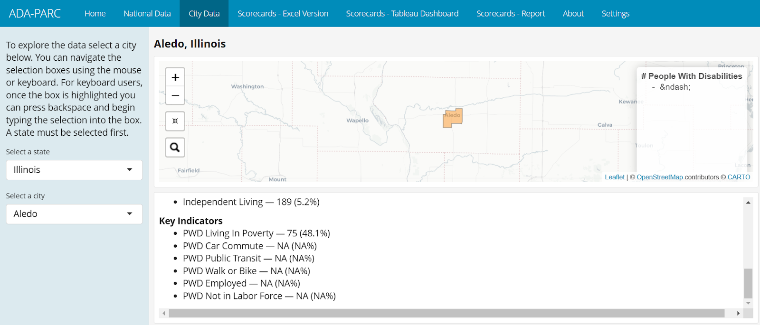
Look at your state and your city. Do you find any item(s) that is NA in your city or any other city in your state?
What does NA mean?

Slide 12
Challenges in Reporting Disparities
Some survey questions are hard to understand.
For example, if a question says “lack of access to transportation”, people might get confused.
This can cause mistakes in the data

Slide 13
Best Practices for Using Data with Limitations
Look at the big picture: Don’t make big claims from small numbers.
Check for missing data: Remember NA means “we don’t know,” not “zero.”
Compare carefully: Numbers may not always mean the same thing across surveys.
Add local voices: Talk to people in the community to fill in missing details.
Be honest: Share both the strengths and the limits of the data.

Slide 14
Supplementary Resources
National Institute of Mental Health (NIMH)
Hearing Loss Association of America (HLAA)
National Federation of the Blind (NFB)
National Council on Independent Living (NCIL

Slide 15
Important Note
When comparing data between states or cities, always use percentages first. Percentages show the proportion of affected people, regardless of population size, preventing misleading comparisons.
Percentages for clarity and then use raw numbers for specific details.

Slide 16
Activity
Look up data for your state or city
ADAPARC.ORG
Find one item marked NA or with a number that seems low or unusual.
Reflect: Why might this be missing or different?
Too few answers?
Different definitions?
Write down one way you could fill this gap — for example, by adding community voices, stories, or local surveys.

