Slide 1


Module 3:
How to Make Sense of Data
ADA Participation Action Research Consortium (PARC)
Participation Equity Navigator Training

Slide 2
Training Outline
Understanding Data on Disability
Making Sense of Numbers vs Percentage
Limitations of National Data
Making Sense of Scorecard

Slide 3
Making Sense of Scorecard

Slide 4
What does the scorecard mean? (0 to 100)
The scorecard shows how people with disabilities are doing in different parts of life.
It uses data from the 2023 Census, collected through the American Community Survey (ACS).
The scorecard makes numbers easier to see and compare, like a report card for a community.
It helps us spot where things are going well and where changes are needed

Slide 5
What does the scorecard mean? (0 to 100)
The scorecard uses a scale from 0 to 100.
50 = average (the middle, right in line with most states).
0 = much worse than average (a state is doing poorly compared to others).
100 = much better than average (a state is doing great compared to others)

Slide 6
What does the scorecard mean? (0 to 100)
Scores are shown in two ways:
A 0–100 score
  100 = much better than most states
  0 = much worse than most states
Quartiles (Q1–Q4)
  Q1 = worst scores (poor opportunity for people with disabilities)
  Q2 = below average
  Q3 = above average
  Q4 = best scores (great opportunity for people with disabilities)

Slide 7
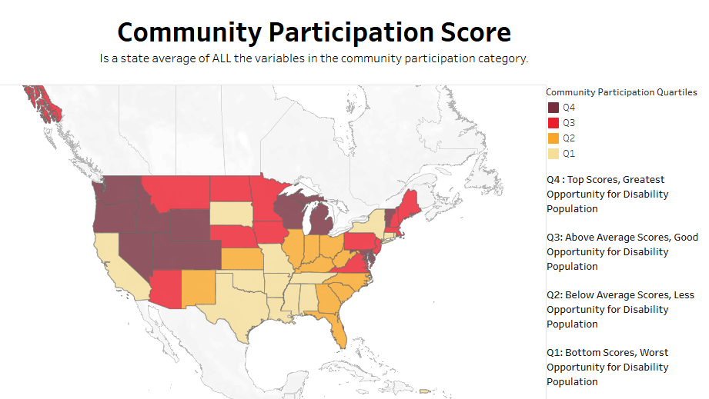
Let’s look at one example

Slide 8
What does the scorecard mean? (0 to 100)
The Community Participation Score shows how well each state supports people with disabilities in everyday community life. It combines many measures into one average score for each state.
States are grouped into four quartiles, shown by color:
Q4 (dark red): Highest scores, meaning the best opportunities for people with disabilities. Example states: Minnesota, Oregon, Washington.
Q3 (red): Above average opportunities. Example states: New York, Pennsylvania, Colorado.
Q2 (orange): Below average opportunities. Example states: Florida, Texas, Kentucky.
Q1 (yellow): Lowest scores, meaning the least opportunities for people with disabilities. Example states: Alabama, Mississippi, and Louisiana.
This scorecard helps us compare states, see where participation is strong, and notice where more support is needed.

Slide 9
Scorecards are helpful because…
Scorecards give each state a grade or score.
They combine many numbers into one simple score.
Example: A score for community participation shows which states are doing best, and which states have more challenges.

Slide 10
Activity
Explore Your State’s Scorecard
Go to the ADA-PARC Scorecard site
ADAPARC.ORG
Look up your state’s scores.
Write down: One area where your state is doing well (Q3 or Q4).
One area where your state is struggling (Q1 or Q2).
Does this match what I see in my community? Why or why not?

