Slide 1
Bird classification by sound using Case-Based Reasoning
Alex Anis, Johan Söderlind Åström, Daniel Hedlund, Anna Enbom
March of 2014 - Västerås
Notes:
Alex

Slide 2
Introduction
Function of bird vocalization
Bird vocalization has lots of information
Unique song patterns for communication
The goal is to classify a bird by using a very short audio recording of its singing
Notes:
Alex

Slide 3
Method
Audio files of bird songs
Feature extraction
CBR for classification
K-neighbour approach
Five different similarity functions
Notes:
Alex

Slide 4
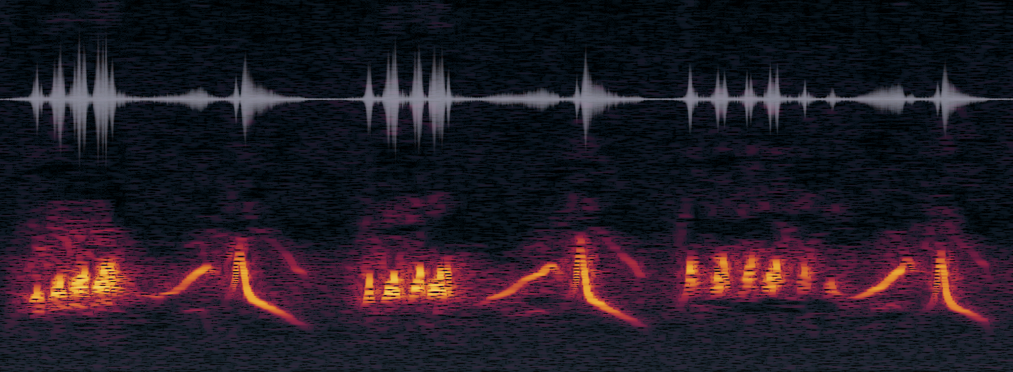
Spectrogram
Visual representation of the spectrum of frequencies in a sound or other signal as they vary with time

Slide 5
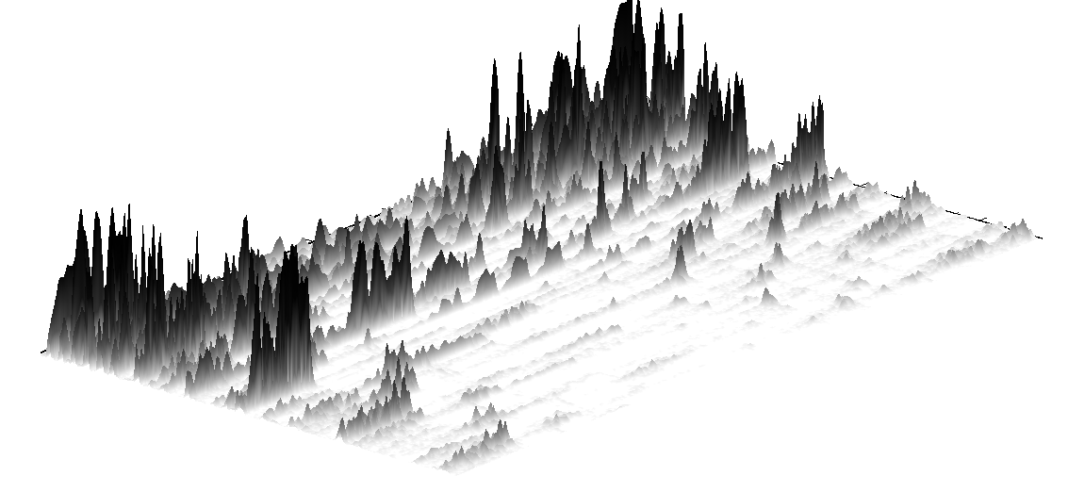
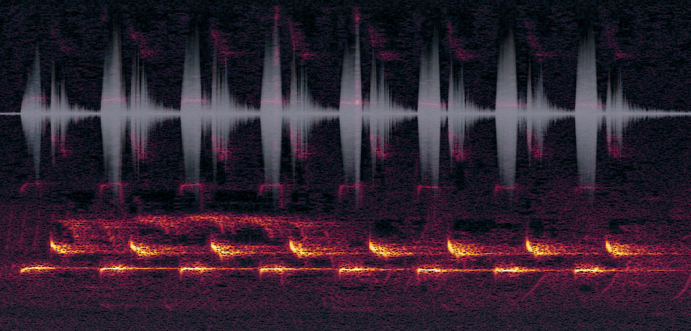
Spectrogram

Slide 6
Periodigram

Slide 7

Case-Based reasoning
Euclidian formula: ${(a−b)}^{2}$
Manhattan: $|a−b|$
Canberra: $\frac{a−b }{\left|a\right|+|b|}$
Tan: $tan⁡(|a−b|)$
Tanh: $tanh⁡(a−b)$
Notes:
Alex

Slide 8
Results and future work
The current database containes cases for 5 different birds
Blåhake, Bofink, Grönsångare, Gök, Koltrast, Näktergal, Rödhake, Talgoxe
Total number of cases: n
The CBR system can classify with n% accuracy
Gain accuracy by using more appropriate features
Test for classification of other animals such as whales when the accuracy is gained.
Song pattern recognition
Notes:
Its probably better with latin bird names instaead of swedish

Slide 9
Birds classification by sound using Case-Based Reasoning
Alex Anis, Johan Söderlind Åström, Daniel Hedlund
March of 2014 - Västerås
Notes:
Alex

