Slide 1
Bird classification by sound using Case-Based Reasoning
Alex Anis , Anna Enbom, Daniel Hedlund , Johan Söderlind Åström
March of 2014 - Västerås
Notes:
Anna

Slide 2
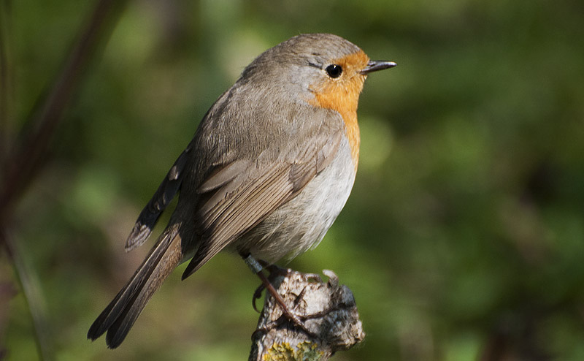
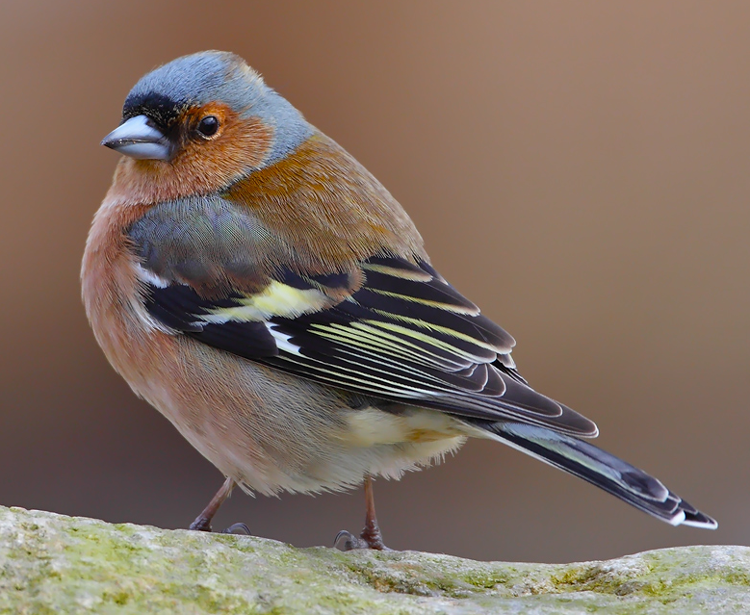
Introduction
Function of bird vocalization
Bird vocalization has lots of information
Unique song patterns for communication
The goal is to classify a bird by using a very short audio recording of its singing
Notes:
Anna

Slide 3
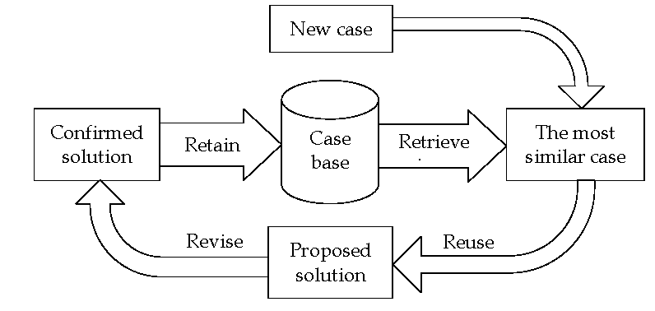
Method
Audio files of bird songs[1]
Feature extraction
CBR for classification
K-neighbour approach
Five different similarity functions
[1]: http://www.fågelsång.se/
Notes:
Anna/Daniel

Slide 4
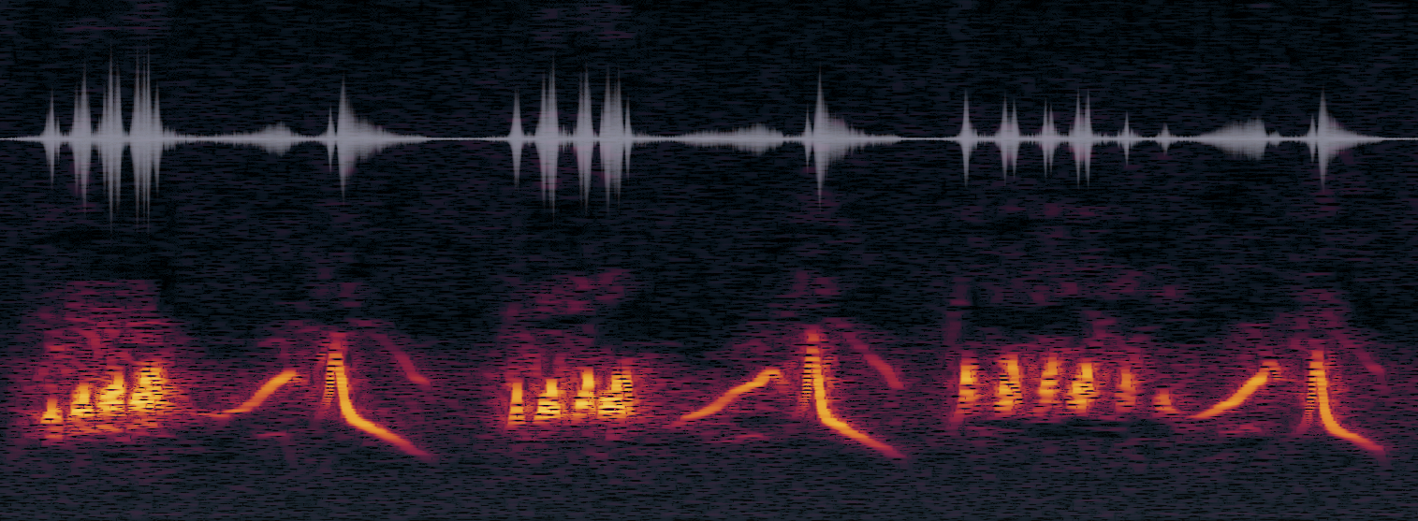
Spectrogram
Visual representation of the spectrum of frequencies in a sound or other signal as they vary with time.
can be used to identify spoken words phonetically, and to analyse the various calls of animals.
Hard to extract features
Notes:
Daniel

Slide 5
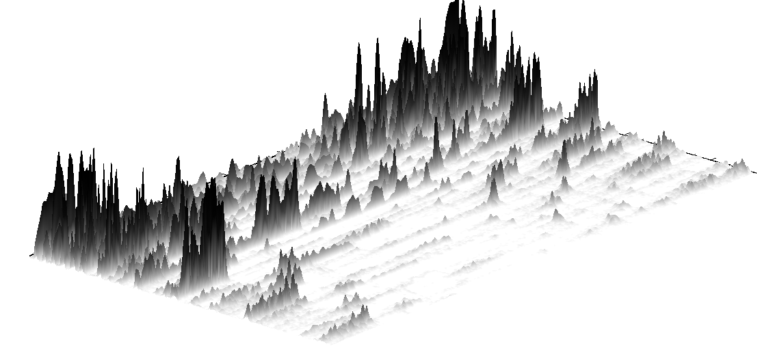
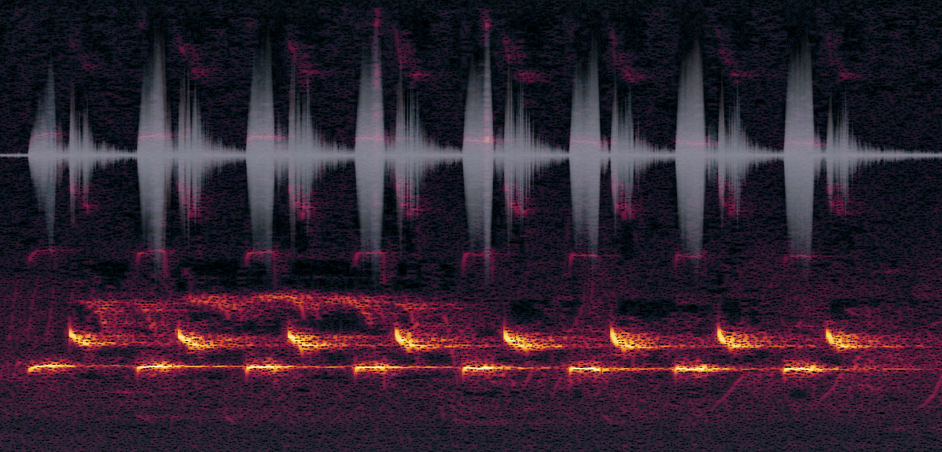
Spectrogram
Notes:
Daniel

Slide 6
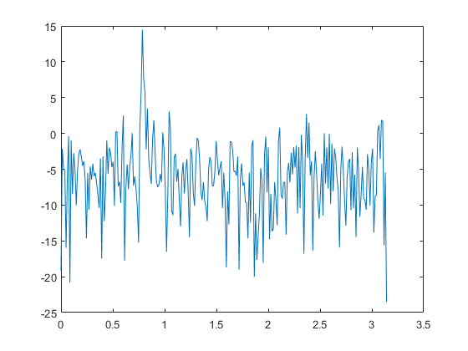
Periodogram
Estimate the power spectral density of a signal from a sequence of time samples of the signal.
Spectral density characterizes the frequency content of the signal.
Can detect any periodicities in the data, by observing peaks at the frequencies corresponding to these periodicities.
Decompose a complex signal into simpler parts
Notes:
One purpose of estimating the spectral density is to detect any periodicities in the data, by observing peaks at the frequencies corresponding to these periodicities.

Slide 7
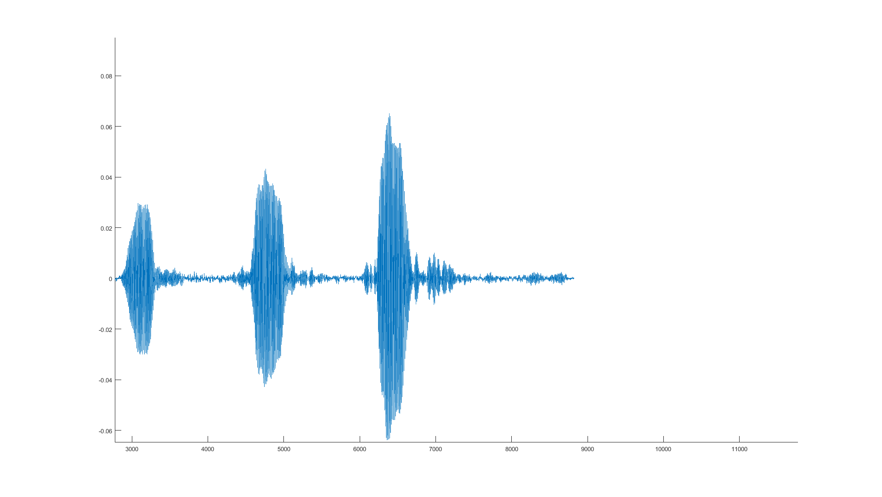
Audio signal

Slide 8
Frame scanning the signal

Slide 9
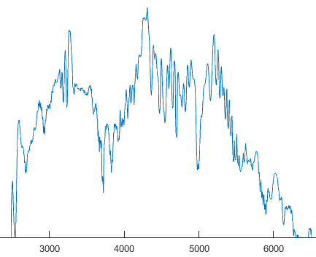
FFT of the frame

Slide 10
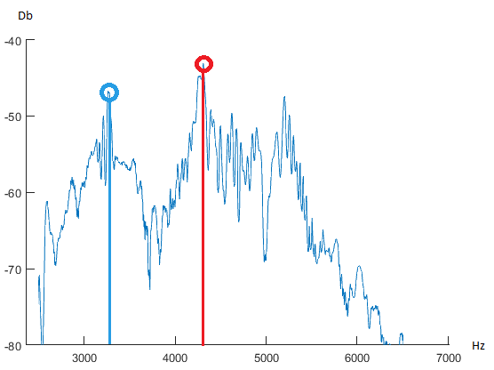
Find peaks

Slide 11
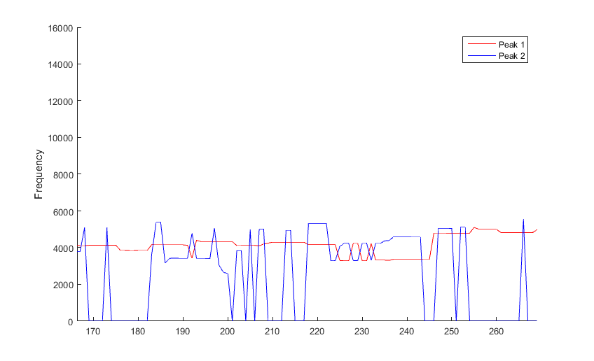
Peaks over time

Slide 12
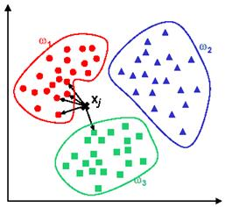
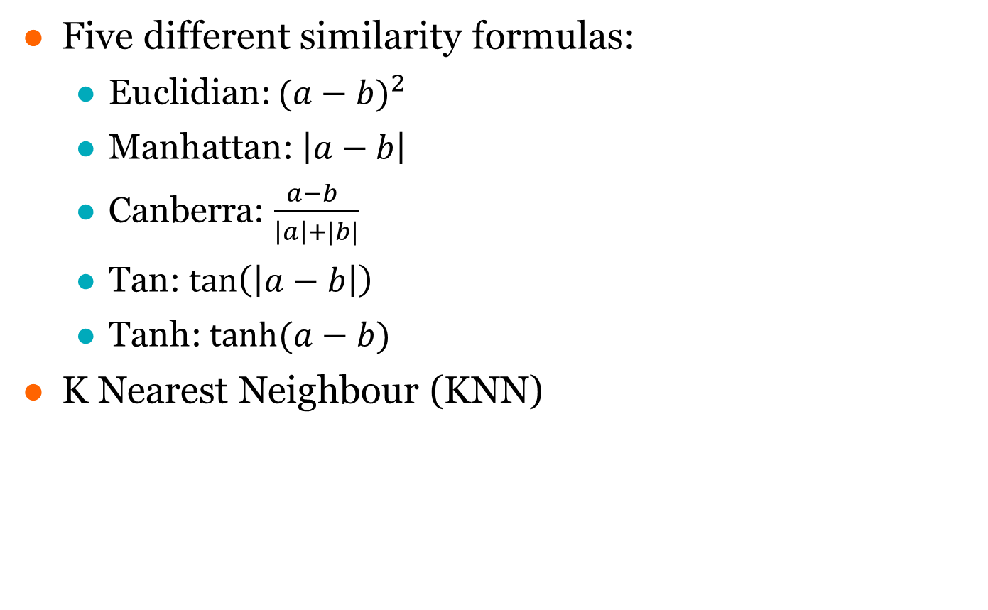
Case-Based reasoning
Five different similarity formulas:
Euclidian: ${(a−b)}^{2}$
Manhattan: $\left|a−b\right|$
Canberra: $\frac{a−b }{\left|a\right|+|b|}$
Tan: $\tan\left(\left|a−b\right|\right)$
Tanh: $tanh⁡(a−b)$
K Nearest Neighbour (KNN)
Notes:
Alex

Slide 13
Results and future work
The current database containes cases for 8 different birds
Blåhake, Bofink, Grönsångare, Gök, Koltrast, Näktergal, Rödhake, Talgoxe
Total number of cases: arbitrary depending on the HDD
The CBR system can classify with 100% accuracy.
Gain accuracy by using more appropriate features
Test for classification of other animals such as whales when the accuracy is gained.
Song pattern recognition
Notes:
Its probably better with latin bird names instaead of swedish

Slide 15
Bird classification by sound using Case-Based Reasoning
Alex Anis , Anna Enbom, Daniel Hedlund , Johan Söderlind Åström
March of 2014 - Västerås
Notes:
Anna

