Slide 1
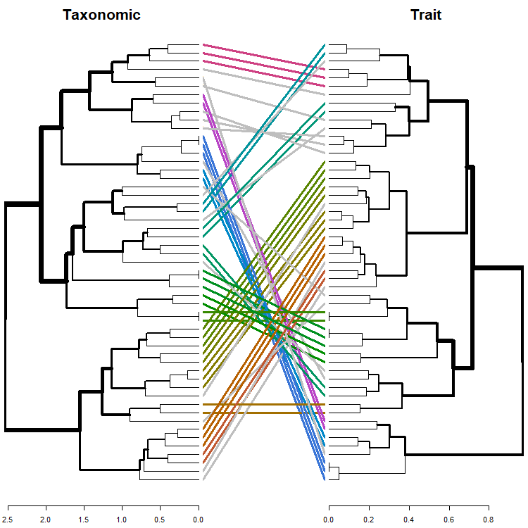
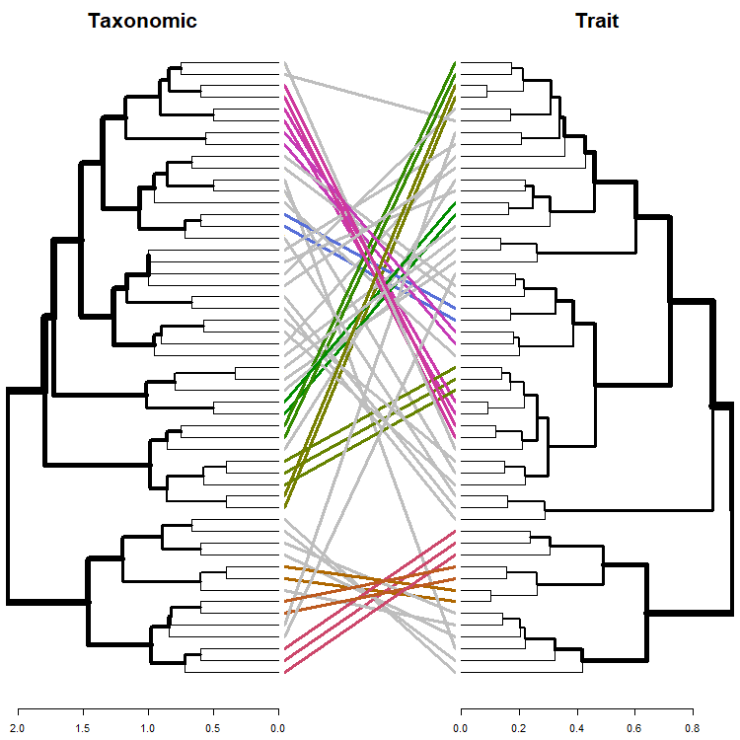
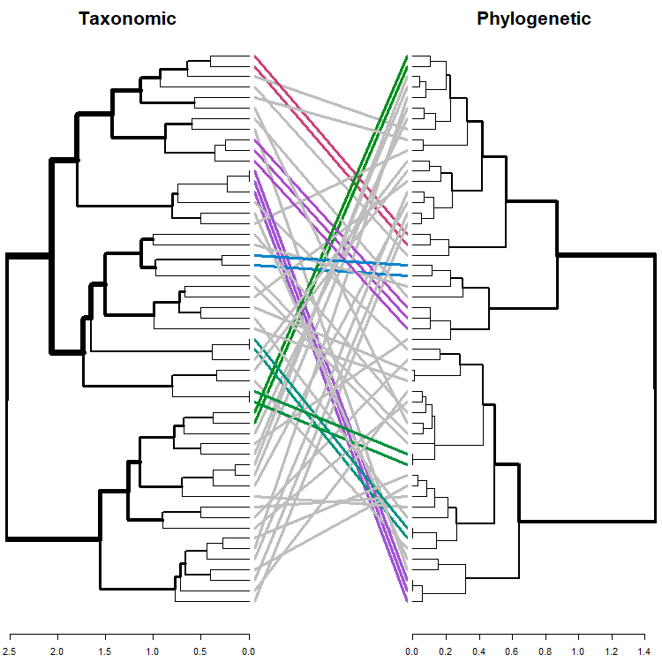
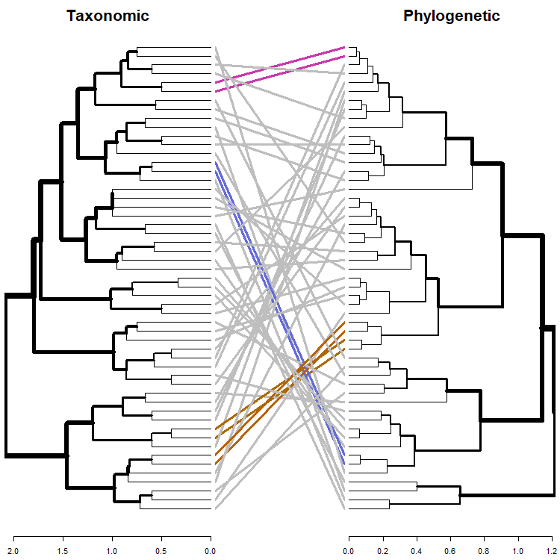
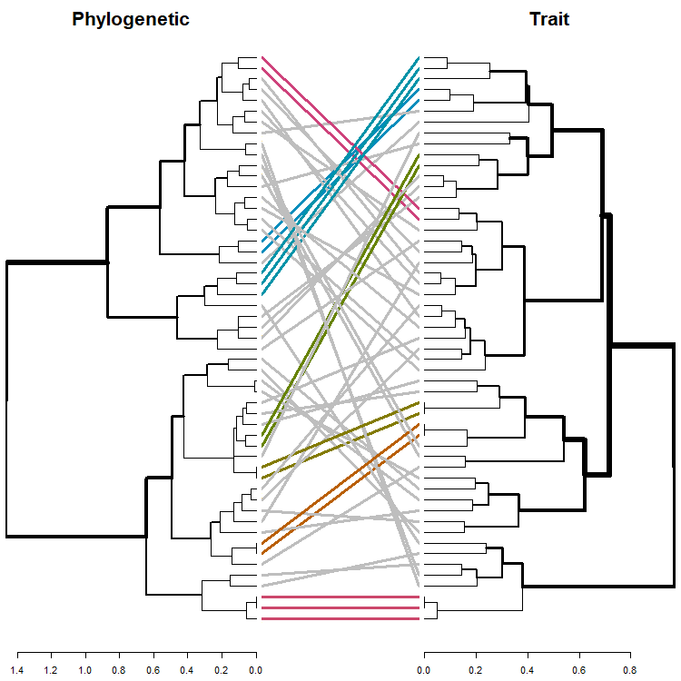
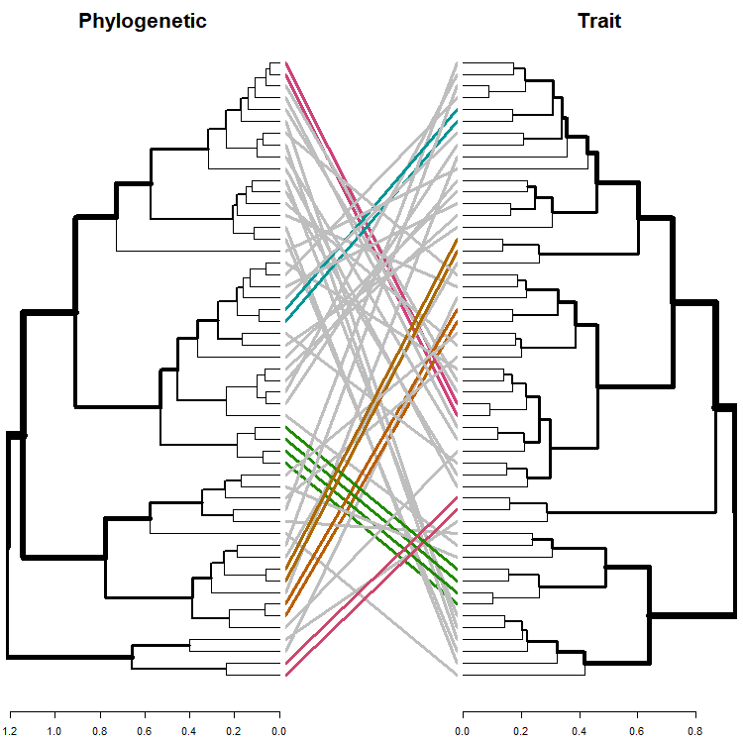
Historical Broad
Cont. Native + Introduced
BGI= 0.28
P = 0
BGI= 0.59
P = 0
BGI= 0.07
P = 0.03
BGI=-0.06
P = 1
BGI= 0.22
P = 0
BGI=-0.14
P = 0.03

Slide 2
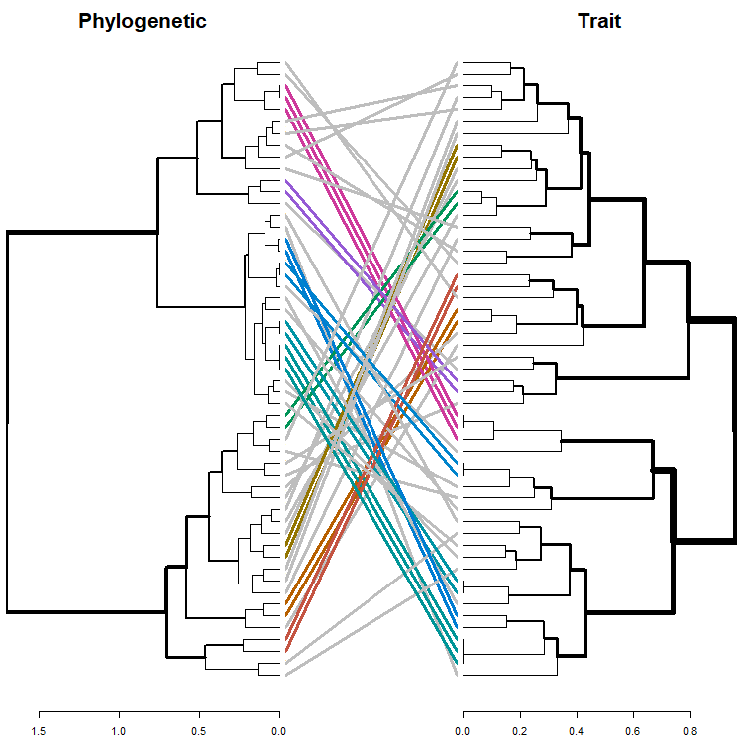
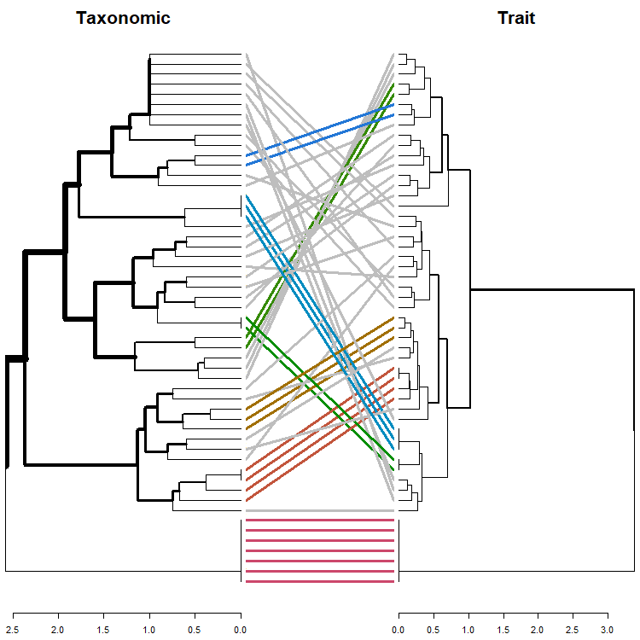
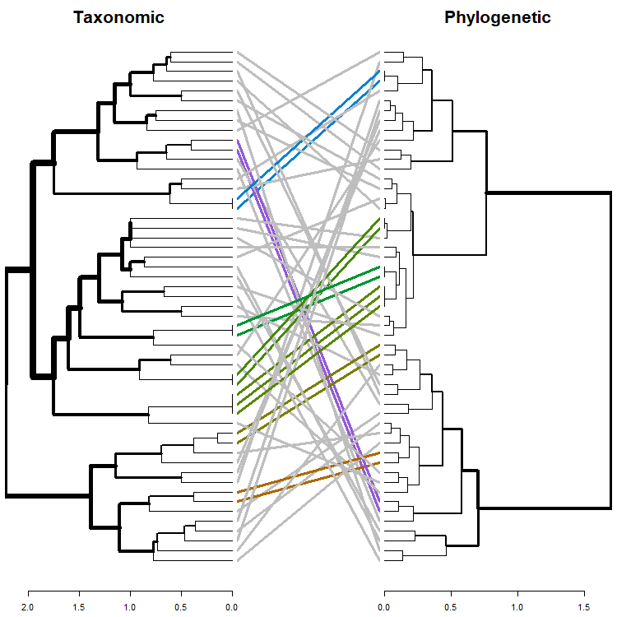
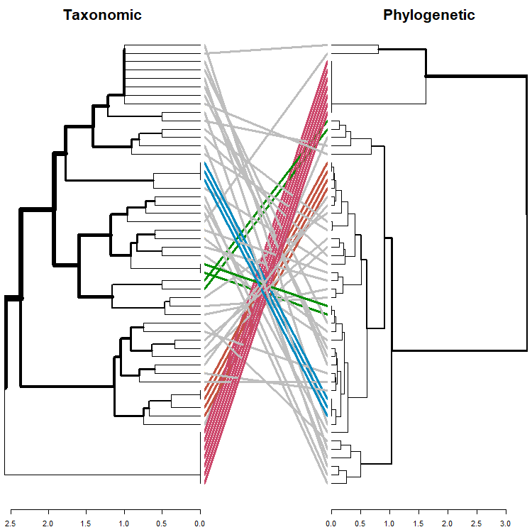
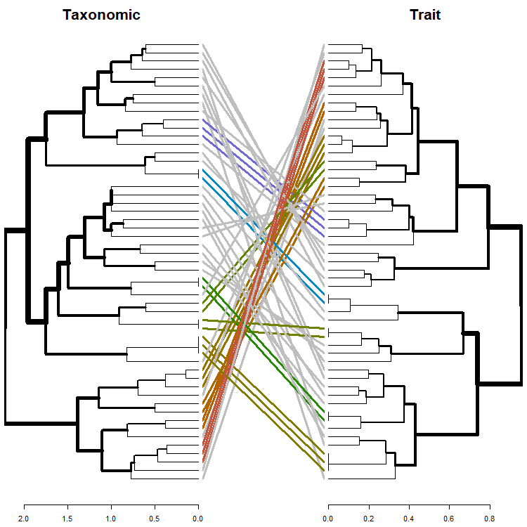
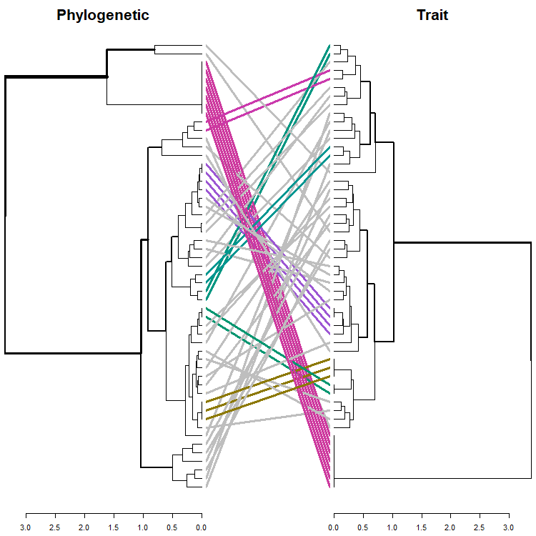
Historical Conservative
Cont. Native
BGI= 0.28
P = 0
BGI= 0.69
P = 0
BGI= 0.14
P = 0.01
BGI=-0.53
P = 0
BGI= 0.39
P = 0
BGI=-0.59
P = 0

Slide 3
 | Period | BGI | P
Tax-Trait | HC | 0.29 | 0
Tax-Trait | HB | 0.47 | 0
Tax-Trait | CN | 0.92 | 0
Tax-Trait | C | 0.90 | 0
Tax-Phylo | HC | 0.19 | 0
Tax-Phylo | HB | 0.12 | 0
Tax-Phylo | CN | 0.89 | 0
Tax-Phylo | C | 0.75 | 0
Trait-Phylo | HC | 0.29 | 0
Trait-Phylo | HB | 0.24 | 0
Trait-Phylo | CN | 0.91 | 0
Trait-Phylo | C | 0.79 | 0

